Slide 1
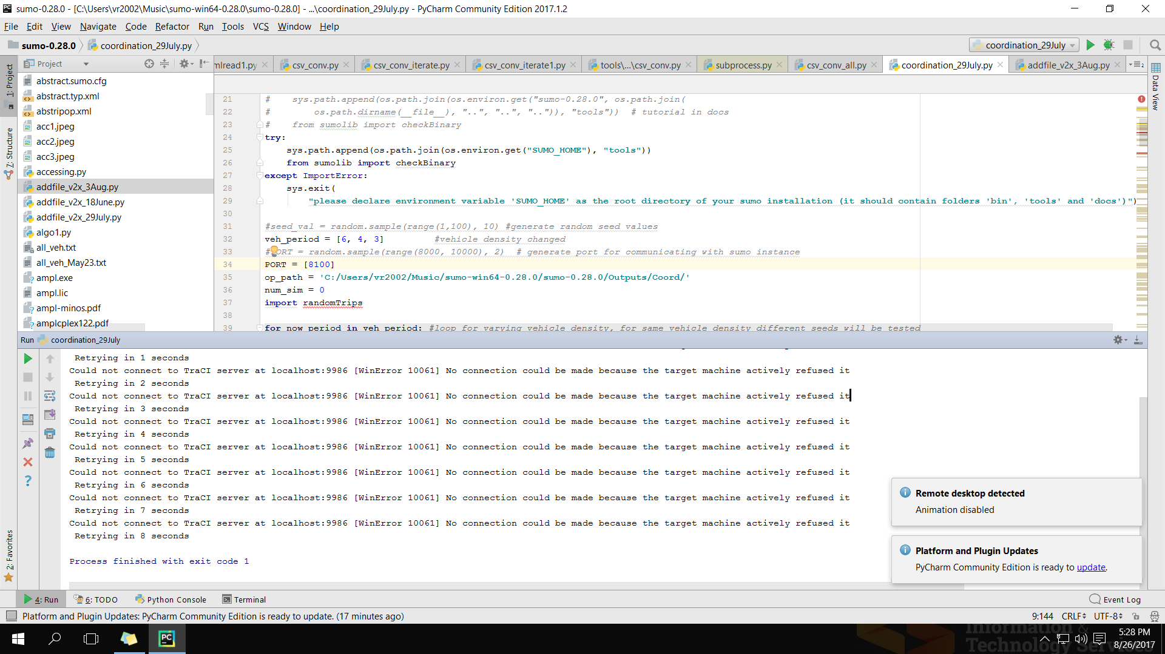
Log: Could not connect to TraCI server at localhost:8200 [WinError 10061] No connection could be made because the target machine actively refused it. - I am currently remotely accessing the machine used for running the simulation and I tried different ports. - I do not get this error when I run simulation over same port from a similar but different program. Kindly suggest how I may fix this. Thanks.

