Slide 1
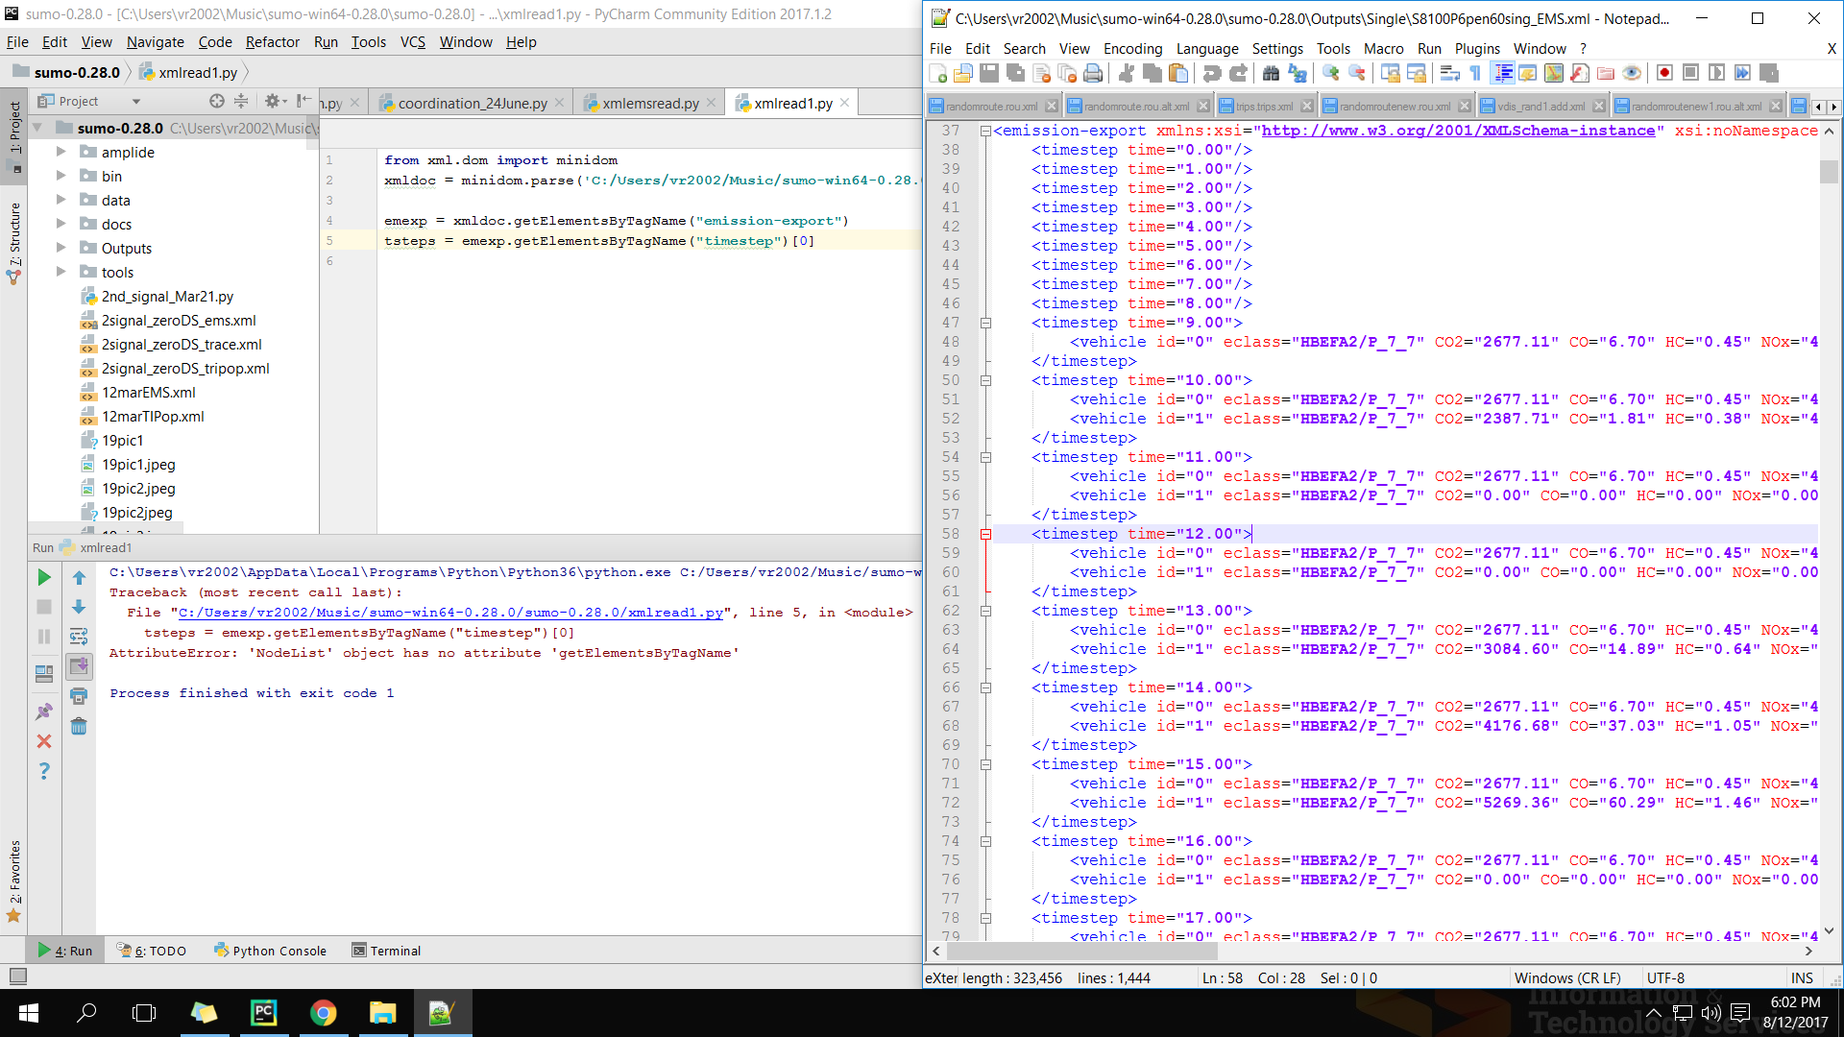
XML Parsing
I have to analyze over 300 XML files. The xml2csy.py can’t be used to call multiple files at time as per our previous communication. I am thinking to create a Python script to parse all the XML files and generate summary. Kindly suggest how I may proceed. Thanks.
Is the error because of structure of the XML file?
Commands I found online for XML Parsing
Error

Slide 2
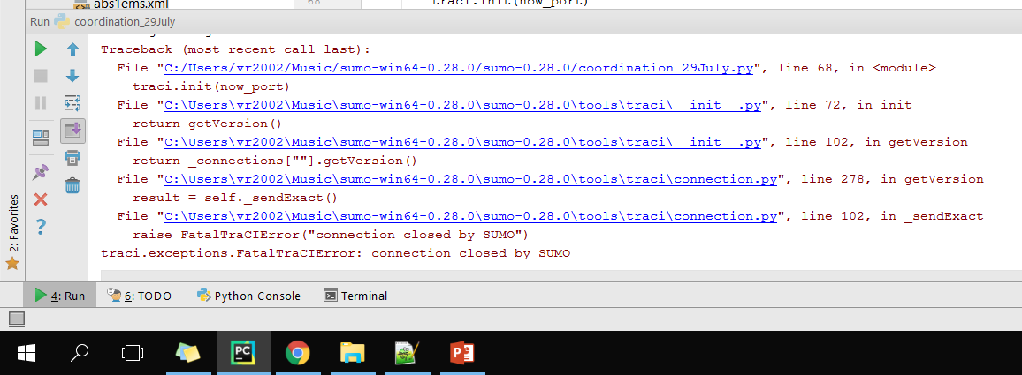
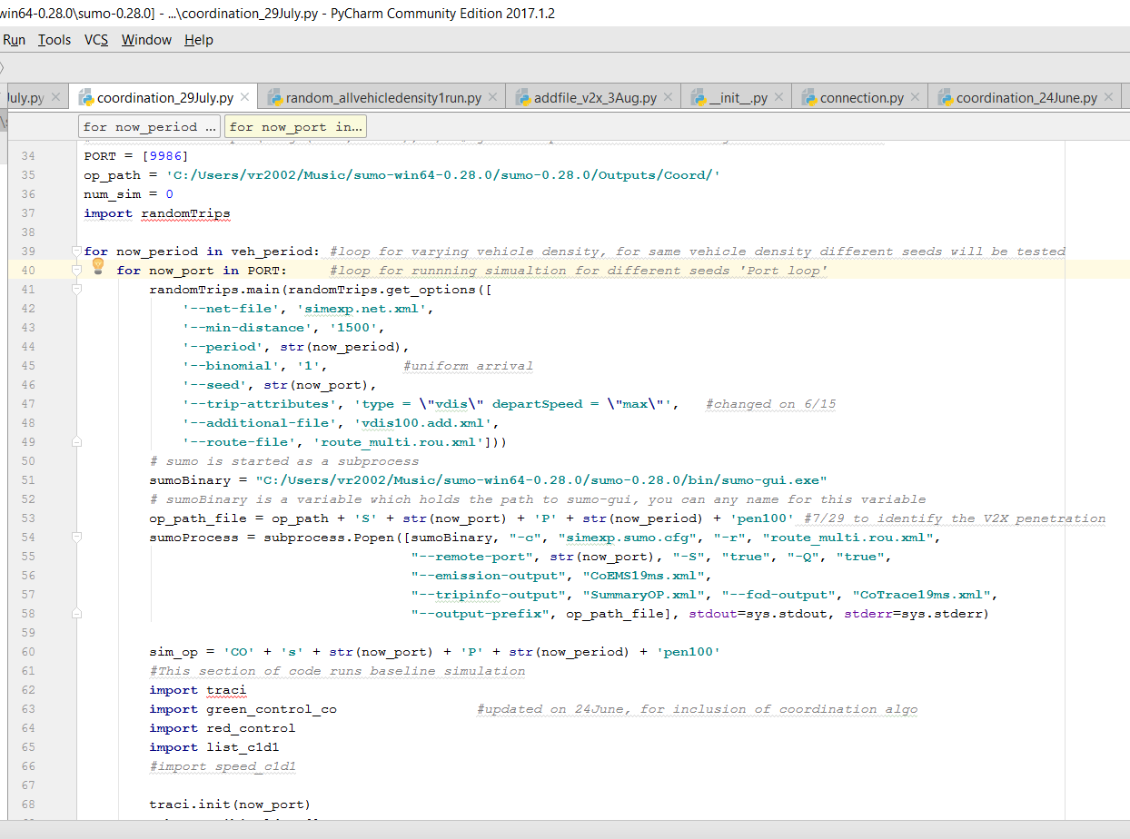
Connection error
4
1
I have another piece of code which is calling multiple simulation one at a time exactly the same way and it’s working fine. Kindly suggest what I might be doing wrong. Thanks.
2
3

