Slide 1
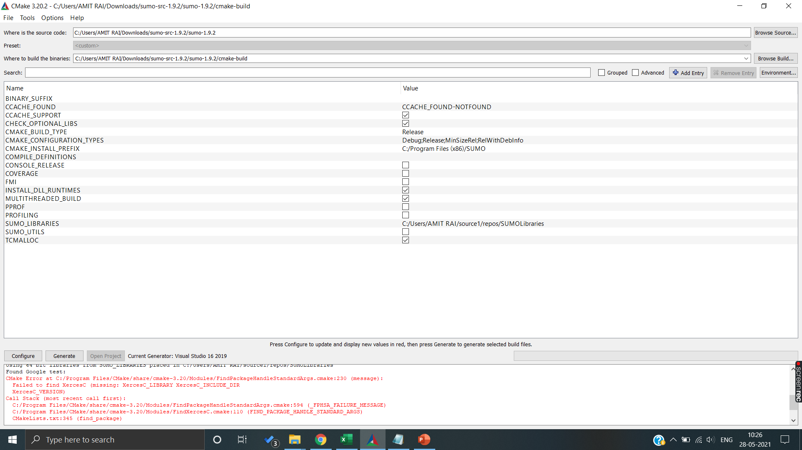
ERROR
I am trying out the manual configuration with the help of CMAKE GUI and getting following error

Slide 2
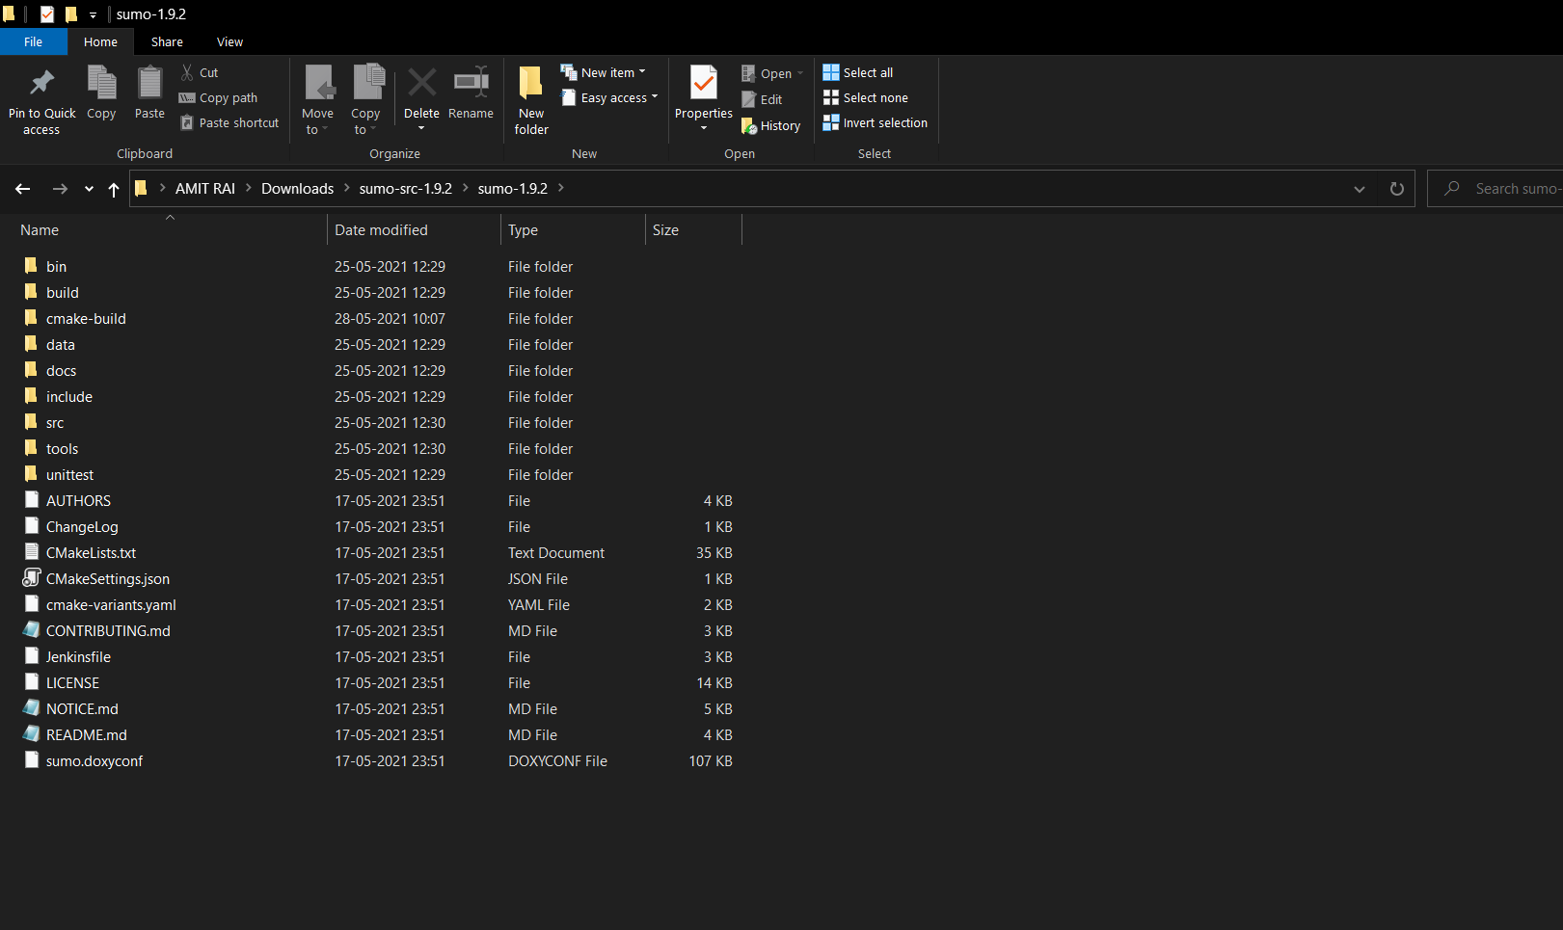
Steps followed
1. Download The sumo src code and extracted the zip file in downloads folder

Slide 3
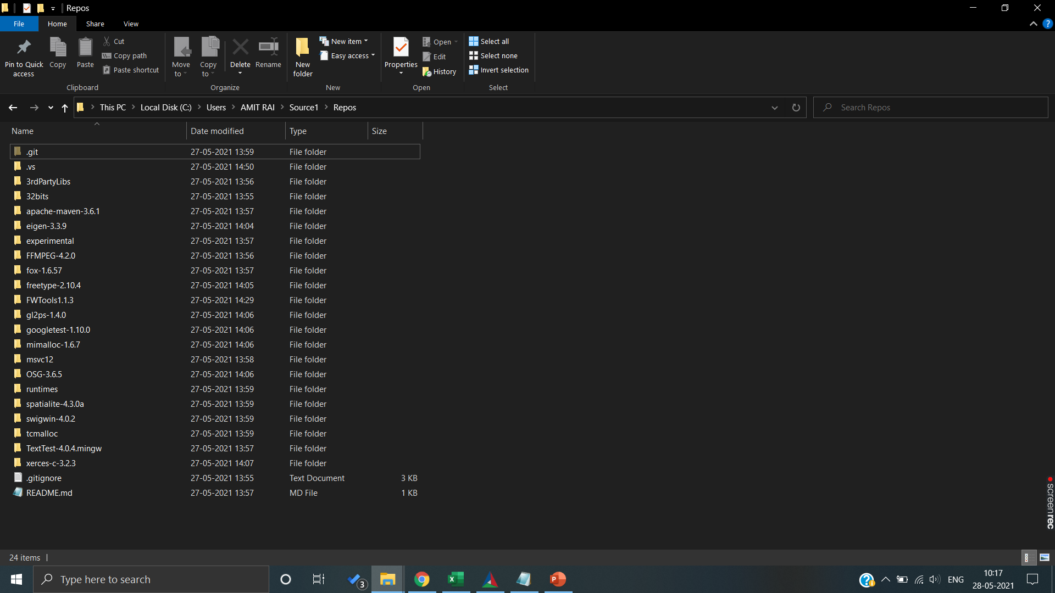
Steps followed
2 Cloned Sumo-Library in C:\Users\AMIT RAI\Source1\Repos location

Slide 4
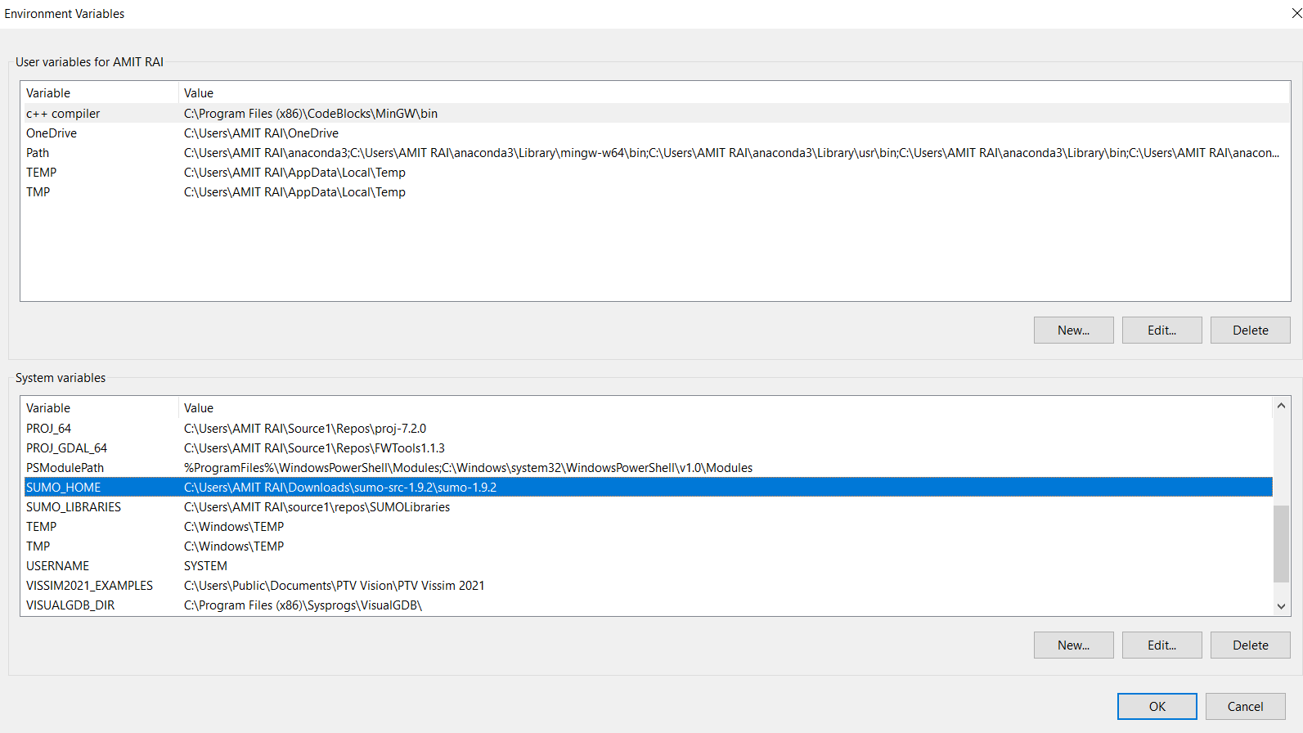
Steps followed
3. Setting SUMO_HOME in path :

Slide 5
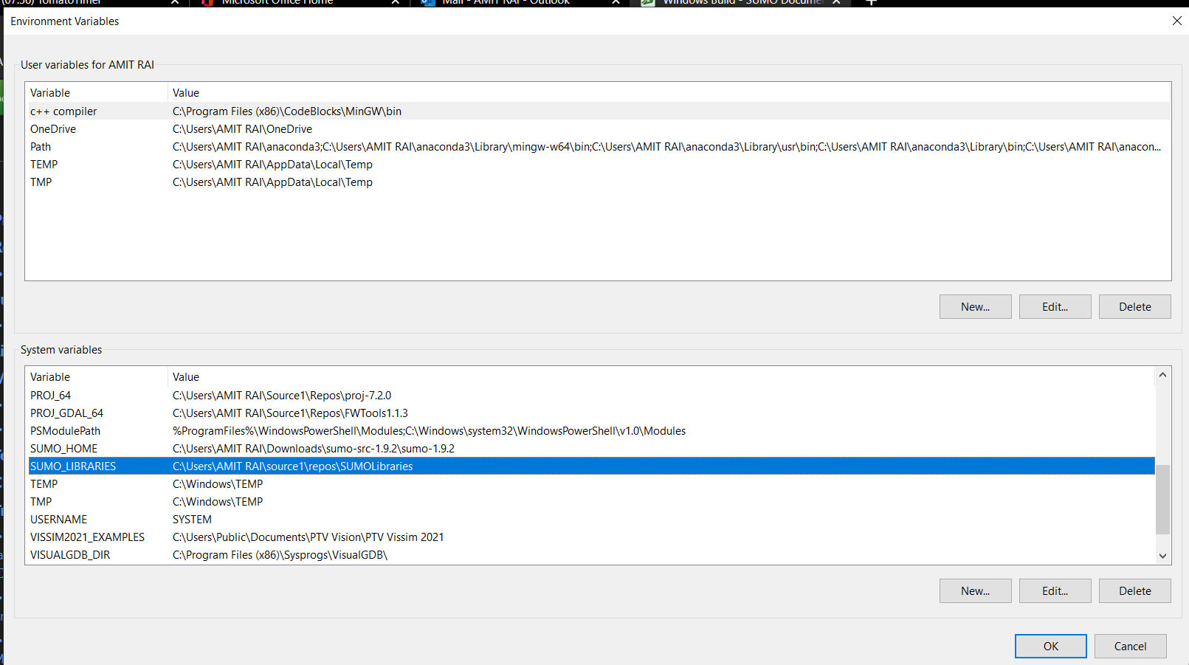
Steps followed
4. Setting SUMO_LIBRARIES as environment variable:

Slide 6
Steps followed
5. Manual configuration through CMAKE GUI:

