Slide 1
SOA Symposium
Intro
Eclipse CON Europe 2012

Slide 2
Agenda
Intro (Adrian Mos) 10’
Models as Operational Documentation & SOA Use Case (Marc Dutoo) 30’
Talend and EasySOA : from registry to execution and back again (Cédric Carbone, Marc Dutoo) 30’
Towards Multi Platform Enterprise Processes (Marc Dutoo) 25’
Break 15’
DSL integration in BPMS/SOA through Mangrove (Adrian Mos) 30’
Stardust – an Eclipse Platform for BPM, SOA and Document Processing (Marc Gille) 60’
PANEL DISCUSSION

Slide 3
Eclipse SOA
Goal: one-stop destination in Eclipse for SOA/BPM
Editors and runtimes that cover the entire lifecycle of BPM and SOA projects
http://eclipse.org/soa/

Slide 4
Stardust News
Full-blown, mature, production-proven BPM suite
Entire source code contributed to Eclipse
Covers interactive workflow, document processing and service integration
Fully integrated in Eclipse (e.g. modeling, refactoring, debugging, integrated runtime)
Connectivity/potential for collaboration exists to/with other SOA (and more) project, e.g. BPMN2 Metamodel, BPMN 2 Modeler, Nuxeo, ORION

Slide 5
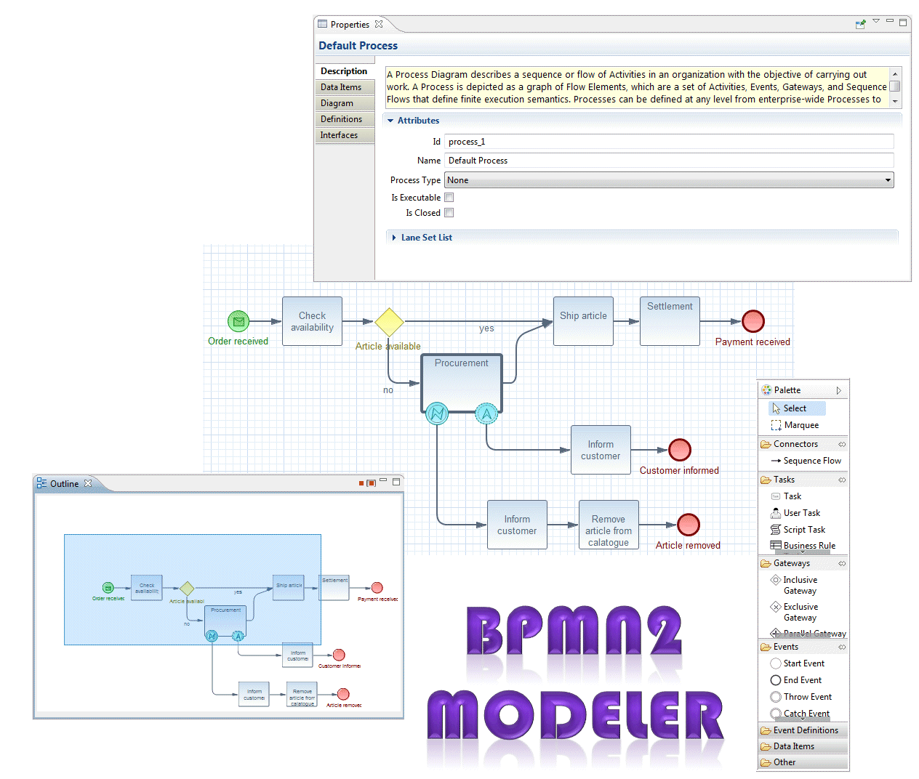
Project Lead: Bob Brodt bbrodt@redhat.com

Slide 6
Compatibility and Dependencies
Incubation Project
  current version 0.1.0 with service release planned in near future
BPMN 2.0 Spec Compliant
Graphiti versions 0.8.2 & 0.9.0
EMF
Supports Eclipse 3.6 through 4.2
Uses MDT BPMN2 meta model

Slide 7
Enjoy the Symposium! ☺

