Slide 1
Workflow and Integration Open Bar
Adrian Mos (Xerox), Bob Brodt (Redhat), Oliver Kopp (Uni Stuttgart), Marc Gille (SunGard)
EclipseCon
San Francisco
3/17/2014 9-12 am

Slide 2
Goal
Discuss and demo the activities of the projects under the „SOA umbrella“
Gather requirements
Identify areas of collaboration

Slide 3
Stardust

Slide 4
Stardust
Industry-proven, mature Business Process Management Suite Infinity Process Platform under Eclipse Public License
  Workflow
  System Integration
  Document Management
More than 1.600 production deployments worldwide
  > 10,000 users (Commerzbank, former Dresdner Bank)
  > 1,000,000 processes/day (CSS Insurance, SWIFT)
  > 300,000 documents/day (VAR Japan)
  Benchmarks exist with > 10,000 processes per second.
Largest BPMS in the industry (2.5M LOC, 726 person years)
  Bonitasoft (2M LOC, 589 person years)
  jBPM (738k LOC, 200 person years)

Slide 5

Ecosystem
Eclipse Community
SunGard
Contribution
Resources
Contribution
Consumption via
Eclipse Public License (EPL)
Infinity Process Platform
Update on important fixes
or enhancements
Stardust
Maintenance
Periodic update e.g. on
Eclipse Releases
Consumption via
SunGard-proprietary
commercial license
SunGard Customers

Slide 6
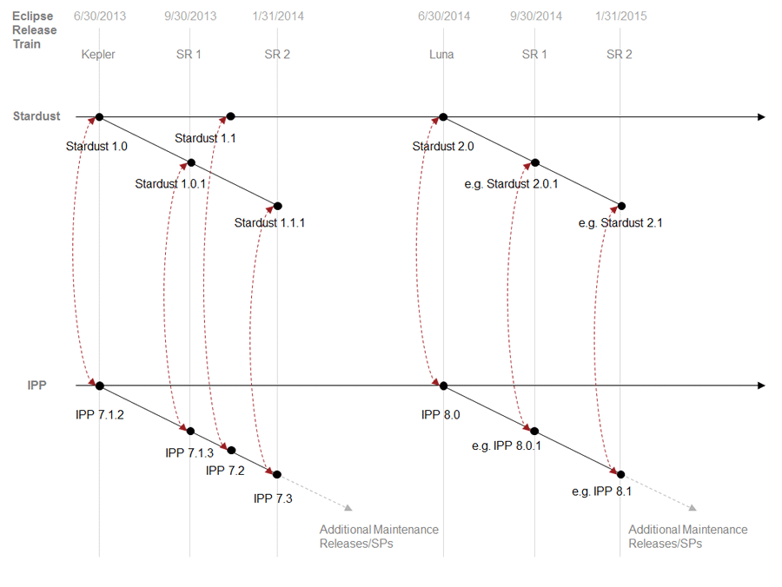
Stardust/IPP Synchronization

Slide 7
Current Activities
Targeting Browser/Cloud wherever possible
  Commercial offering for Hosting (Managed Services)
  Free for Non-profit
Integration capabilities
  Complex data structures
  Connectors (Camel, possibly with UI wrappers)
  UI Mashup
Some topology
  Multi-instance pattern
  Non-exclusive OR
Mobile
Reporting

Slide 8
Browser-Modeler Architecture
„Bob‘s Editor“ over the next 1.5 years.
Stardust Eclipse Modeler
Stardust Browser Modeler
XPDL
Marshaller/
Unmarshaller
BPMN
Marshaller/
Unmarshaller
Stardust
Runtime
XPDL
BPMN

