Slide 1
Mangrove

Slide 2
Mangrove Reminder
Bridge: Integrates design and runtime artefacts created or used in Eclipse SOA
Common metamodel (Mangrove Core) and transformation plugins enable partial transport of essential information between tools
Mangrove Core contains elements related to processes as well as SOA services
More details: http://eclipse.org/mangrove/

Slide 3
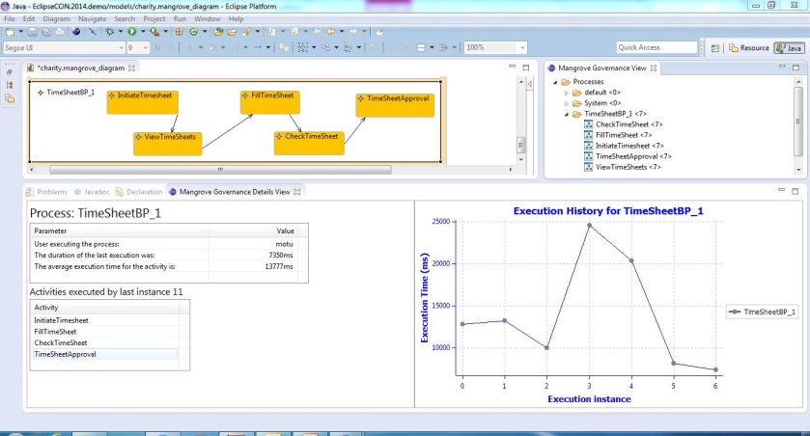
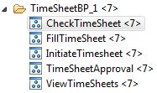
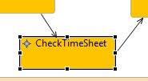
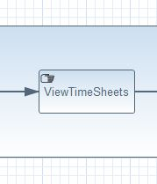
New in Mangrove: Monitoring
Client Side
Agent
Abstract Server-Side
Agent
Stardust Environment
Stardust BPMS
Agent

Slide 4
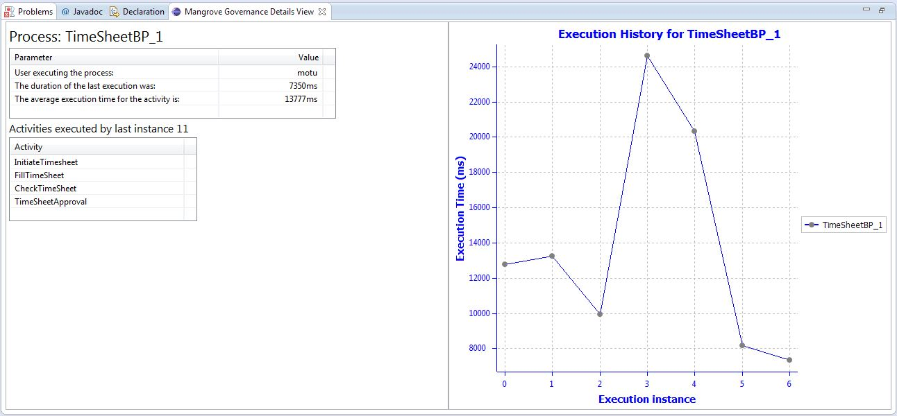
Monitoring Process View

Slide 5
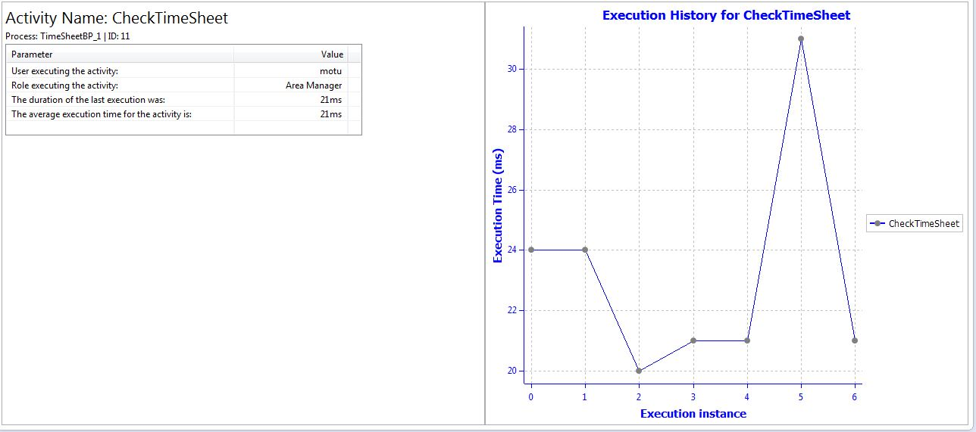
Monitoring Activity View

