Slide 1
SOA Symposium
Adrian Mos (Xerox), Bob Brodt (Redhat), Marc Dutoo (OpenWide), Marc Gille (SunGard)
EclipseCon
Boston
3/25/2013 9-12 am

Slide 2
Goal
Show how Process Modeling with BPMN supports a holistic approach from business to implementation
Demonstrate the role of BPM in a SOA
Introduce the Eclipse SOA Project and its subprojects and their current state of development

Slide 3
Overview/Agenda
Short Introduction of presenters and their project [20‘]
Overview end-to-end use case [10‘]
Project demos along the end-to-end use case [20‘/project]
  Break after 2nd project
Deeper dive into the projects (functionality architecture, status, roadmap, community) [30‘/project]
  Break after 2nd project
Panel Q & A (no limit – but move to the bar if others will be claiming the room …)

Slide 4
Presenters and their Projects

Slide 5
Adrian Mos/Mangrove
Research Scientist, Xerox Research Europe
SOA Project PMC Member
Project Lead for Mangrove
adrian.mos@xerox.com

Slide 6
Bob Brodt/BPMN2 Modeler
Software Engr., Red Hat, Inc.
Eclipse Project Lead for BPMN2 Modeler & BPEL Designer

Slide 7
Marc Dutoo/EasySOA
Head of R&D Dept. at Open Wide, where he leads the EasySOA Registry & Tools Open Source solution
Eclipse SOA PMC member
co-leads Eclipse SOA's Java Workflow Tooling
Email: marc.dutoo AT openwide DOT org

Slide 8
Marc Gille/Stardust (Eclipse Process Manager)
CARNOT AG
  Founded in 2000 („Workflow and EAI for J2EE“)
  Acquired by SunGard in November 2006
  All key players still on board – and are Stardust committers
Rebranded CARNOT Process Engine as Infinity Process Platform (IPP).
Production deployments e.g. with
  > 10,000 users (Commerzbank, former Dresdner Bank)
  > 1,000,000 processes/day (CSS Insurance, SWIFT)
  > 300,000 documents/day (VAR Japan)
Ranked #2 in Vision in Gartner MQ for BPMS in 2007
All code submitted into Eclipse Stardust in 2012
With ~3M lines of code one of the largest code contributions
Full-blown Business Process Management Suite under EPL
Project Release planned with Kepler – M6 has been build
Marc Gille
  Founder of CARNOT AG
  Project Lead Stardust
  SVP Product Management Infinity at SunGard
  marc.gille@sungard.com

Slide 9
Use Case

Slide 10
Federal Charity Platform
The Federal Charity institution of Neverland provides an Internet platform for charity organizations to distribute their benefits to those in need.
Charity institutions can register and describe their rules for accepting beneficiaries.
Beneficiaries can apply for benefits such as vacation funding.

Slide 11
Processes, Events and Activities
Charity Organization Registration and Approval
  Data Entry
  Address Verification
  Review
  Approval/Rejection
Vacation Request
  Data Entry
  Address Verification
  Dispatching to Charity Organization
  Review
  Approval/Rejection

Slide 12
Participants
Platform Operators from the roof organization running/operating the system
Administrators of the charity organizations
Applicants would only be implicit participants kicking of workflows via a little portal and receiving notifications

Slide 13
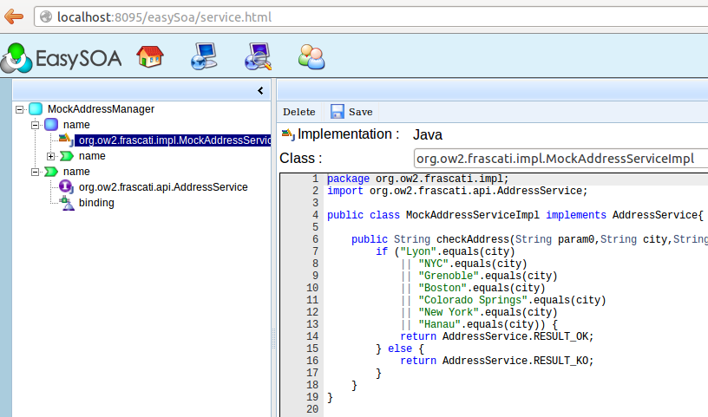
Services
Address Validation
  Specifications managed in EasySOA, implementation prototyped in OW2 FraSCAti Studio
Plus: Simplistic HTML5 web portal for
  Charity organization registration (kicking off first process)
  Application for vacation funding (kicking off second process)
  Code available via http://git.eclipse.org/c/stardust/org.eclipse.stardust.examples.git/

Slide 14
Data Model
XSD
  Charity Organization (Structure)
  Vacation Funding Request (Structure)
  Beneficiary (Structure)
  Address (Structure)
  Country (Structure)
Used across tools (BPM, WS)

Slide 15
Demoes

Slide 16
Mangrove

Slide 17
Mangrove Reminder
Bridge: Integrates design and runtime artefacts created or used in Eclipse SOA
Common metamodel (Mangrove Core) and transformation plugins enable partial transport of essential information between tools
Mangrove Core contains elements related to processes as well as SOA services
More details: http://eclipse.org/mangrove/

Slide 18
Current Transformations
BPMN 1 → Mangrove Core
Mangrove Core → BPMN2
Mangrove Core → BPEL
SCA ←→ Mangrove Core
Mangrove Core → JBI

Slide 19
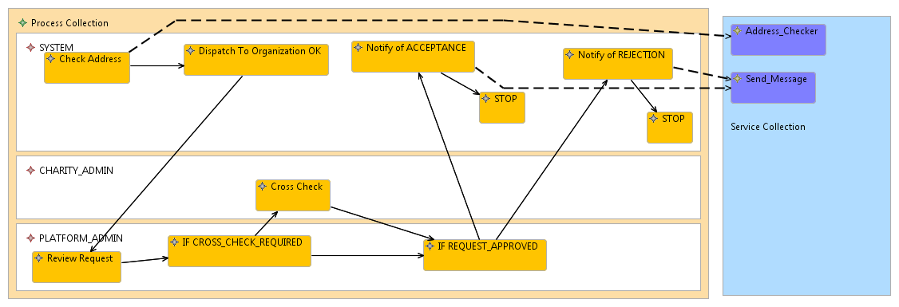
Mangrove Viewer / Editor

Slide 20
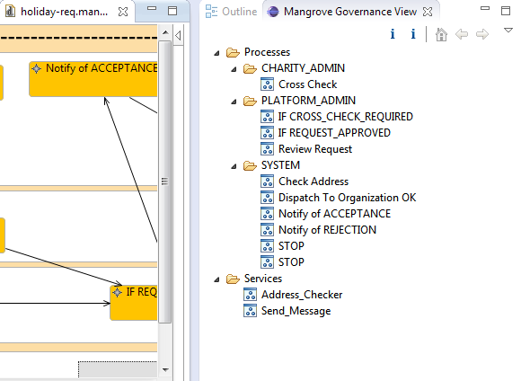
In the Works: Governance View

Slide 21
Potential Use: Bring DSLs in SOA/BPM World
Generic languages not always sufficient
Different processes or sub-processes better defined by domain experts
DSL-based processes should be able to benefit from SOA connections
BPMN can be used as glue and as interface to BPMS
What PDF is for the portable exchange of documents, BPMN could be for the portable exchange of DSL-based processes

Slide 22
DSL Integration in Eclipse SOA

Slide 23
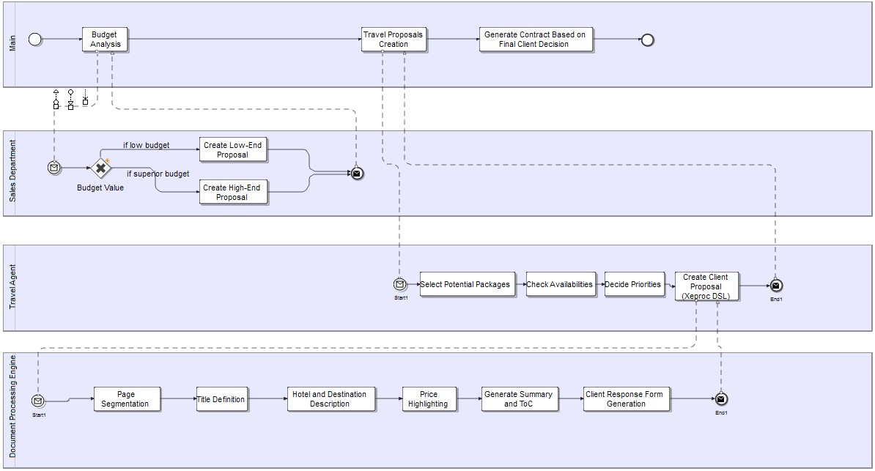
Scenario #1
DSL

Slide 24
Scenario #2
DSL

Slide 25
Scenario #3
DSL 1
DSL 2

Slide 26
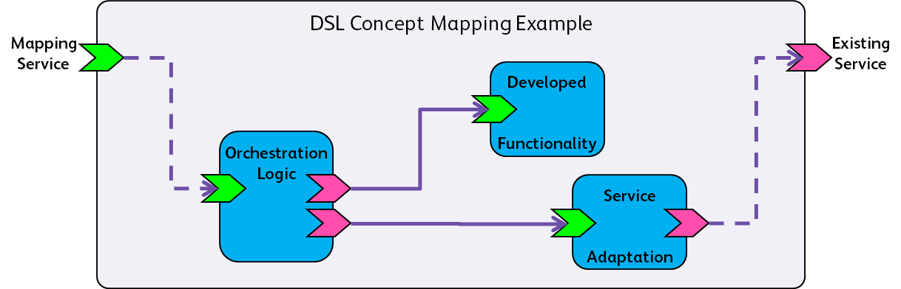

Scenario #4
DSL 1
SOA / BPMS

Slide 27
BPMN2 Modeler

Slide 28
BPMN2 Modeler - Architecture
Still in Incubation, current version is 0.2.4
Graphiti
  Supports Graphiti versions 8.0.2 (Eclipse Helios 3.6.2) and 10.0.1 (Eclipse Juno 4.2)
Eclipse BPMN2 EMF model, version 0.7.0
EMF, version 2.something
Plus a cast of thousands
  GEF/draw2d
  EMF Transaction, Validation OCL
  Eclipse XSD & WST
  BPEL WSIL
  JDT

Slide 29
BPMN2 Modeler - Architecture
Generic BPMN 2.0
  MDT-BPMN2 Project
Extensible/customizable for specific runtimes
  jBPM5
  Other examples
Plug-in API
  Model extensions
  Limit runtime model subset/view
  Tabbed Property Sheets
  Custom Tool Palette
  Custom Activity models & graphics

Slide 30
BPMN2 Modeler - Features
Multiple BPMN Diagram Types
  Process
  Choreography
  Collaboration
Multipage Editor
  Multiple Diagram Types per file
  Processes
  Choreography Task Participants
    “white box” and “black box”
  Sub-Processes
    “push down” and “pull up”
  XML Source View Tab
    Read-only, not yet synched with graphical view
Import BPMN 2.0 Model Elements
  Generates Diagram Interchange (“DI”) elements
  Basic auto layout

Slide 31
BPMN2 Modeler - Features
Outline View
  Business Model
  Diagram Interchange Model
  Thumbnail
Customizable Tool Palette
  plug-in extension
  Tool Set “Profiles”
User Preferences
  Selectable Target Runtime
  General UI customization
    Colors, Fonts
  Connection Line Routing
    Manhattan
    Bendpoint
  Model Enablement, including runtime extensions

Slide 32
BPMN2 Modeler - Roadmap
Debugging/Simulation Support (Spring 2013)
Automatic Layout of Shapes & Connections (Summer 2013)
  Basic Shape Layout for imported models
  Connection Line Routing needs work!
Tool Palette Enhancements (Fall 2013)
  Complex templates for “workflow patterns”
  Tool Set “Profiles”
Deployment Tools API (Spring 2014)
  Multiple Processes per file

Slide 33
BPMN2 Modeler - Community
All y’all!
ROSI
  TU, Dortmund (http://vm4a003.itmc.tu-dortmund.de/carisma)
Eclipse Community Forum
  http://www.eclipse.org/forums
Mailing list
  bpmn2-modeler-dev@eclipse.org
Me
  bbrodt@redhat.com

Slide 34
EasySOA Registry & Eclipse JWT

Slide 35
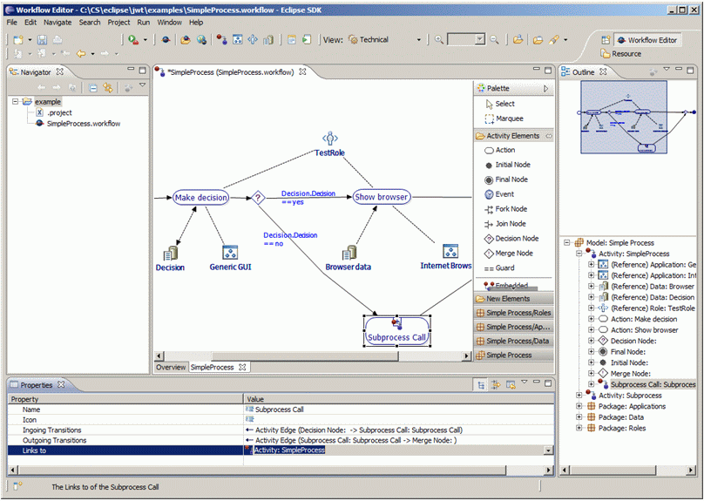
Eclipse SOA JWT
Versatile Business Process and Workflow tools & platform
Website : http://www.eclipse.org/jwt
Mailing list : jwt-dev@eclipse.org
What‘s new: BPMN view, EasySOA export
Provides:
Various views (UML AD, EPC, BPMN) and model extensions
Transformations to other representations (BPMN, Mangrove…)
Export to executable workflow formats (XPDL, Bonita, jPDL…)
Export of business process structure and documentation to Document Management Systems
  Nuxeo, Alfresco... and EasySOA service registry!

Slide 36
EasySOA Registry
An open, collaborative registry of SOA information across design time, development time and deployment time for all actors of the SOA process, built by the Open Wide-lead EasySOA consortium (also Talend, Bull, Nuxeo, EasiFab).
Website : http://www.easysoa.org
Mailing list : easysoa-dev@googlegroups.com
EasySOA Registry provides:
Service audit and discovery : from design, source, classpath, web, wire…
Service cartography and documentation : extracted & manual doc, collaborative editing, custom browsing UI
SOA sanity check : Indicators, change detection & validation, reports
SOA evolution management : collaborative business & architecture specifications, matching of developed services against requirements, up to runtime measure of expected business SLA

Slide 37
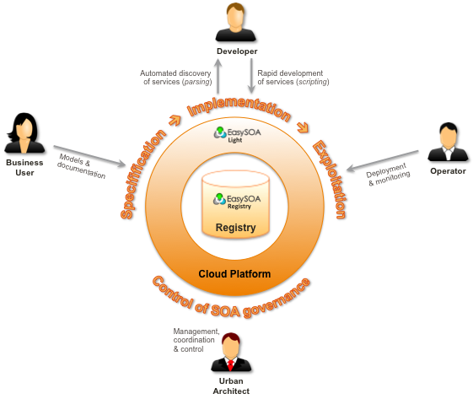
EasySOA
Functional
Architecture
The EasySOA Integration ecosystem brings along :
Integrated Business design tool: Eclipse SOA JWT
Integrated ESB platform: Talend ESB and Jasmine monitoring
Integrated Cloud RAD & prototyping platform: OW2 FraSCAti Studio
Testing tools: record / (templatized) replay, SOAPUI

Slide 38
Stardust (Eclipse Process Manager)

Slide 39
Stardust
Industry-proven, mature Business Process Management Suite Infinity Process Platform under Eclipse Public License
Workflow
System Integration
Document Management

Slide 40
Status
All Infinity Process Platform code submitted in 2012 – exceptions only „toxic“ licenses (e.g. for Hibernate Plug-In)
  Approval for > 130 third-party libraries - Eclipse Legal loves us …
In Incubation (Release 0.7)
Eclipse Build supported – if you want to build yourself
Update Site available (Release 0.7 RC5) – if you just want to use it
(Quite oppulent) Wiki and (quite active) Forum exists
Participating in Kepler Release (and will mature to Release status as part of Kepler)
Kepler M6 build completed

Slide 41

Ecosystem
Eclipse Community
SunGard
Contribution
Resources
Contribution
Consumption via
Eclipse Public License (EPL)
Infinity Process Platform
Update on important fixes
or enhancements
Stardust
Maintenance
Periodic update e.g. on
Eclipse Releases
Consumption via
SunGard-proprietary
commercial license
SunGard Customers

Slide 42
Access
Homepage: www.eclipse.org/stardust
Wiki: http://wiki.eclipse.org/STP/Stardust
Update Site: http://download.eclipse.org/stardust/milestones/helios
Git: http://git.eclipse.org/c/?q=stardust
Forum: http://www.eclipse.org/forums/index.php?t=thread&frm_id=225
Videos (constantly adding): http://www.eclipse.org/stardust/documentation/training-videos.php
Facebook: https://www.facebook.com/eclipsestardust

Slide 43
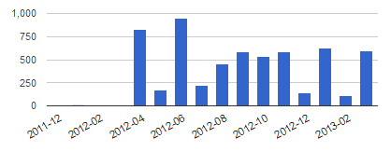
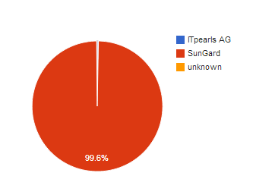

Project Activity and Diversity
Hundreds of commits/month due to synchronization
with IPP codebase
ITPearls joined to help on BPMN2 support

Slide 44




Interactive Workflow
Requirements
Simple configuration of organizational hierarchy including
departments
Flexible integration user management/SSO
Configurable Portal UI
Large number of parallel users
Stardust Solution
Department concept
LDAP/SAML integration
Flexible Portal mashups
Multiple Portal views
Reporting
Simulation
Stardust

Slide 45

Document Processing
Requirements
Document management and retrieval
Document viewing and editing (TIFF, PDF, HTML)
Process and document binding
Stardust Solution
Document Repository
TIFF Viewer and Editor
Servers-side PDF-Viewer
Scan client (WS communication to server)
Document Metadata Modeling
Document security (document, folder, type)
Stardust

Slide 46

Data Extraction and Transformation
Requirements
Receive request for data gathering from multiple systems
Data retrieval from these systems
Data transformation, normalization and merge
Return data
Possibly high record volume (~ 100.000)
Stardust Solution
Simple message transformations via drag & drop
Complex message transformation with JavaScript
Out-of-the-box connectivity to RDBMS, Files etc.
Well-defined Connector structure to be used for custom
connectors
Parallel data gathering via process topology
Stardust
Relational Database

Slide 47
Message Processing and Service Orchestration
Integration Requirements
Connectivity to financial networks
and protocols (FIX, SWIFT, XML)
Grouping of messages
Correlation of messages (e.g. for cancellation)
Content-based routing
Message multicast
Low(er) latency
Stardust Solution
FIX and SWIFT connectivity
Message transformation to normalized format
Caching and JMS channeling for sequencing
Routing via transition conditions
Transient processing/write-behind
for highest throughput/lowest latency
Stardust
e.g. Financial Networks

Slide 48

Event Processing and Client Push
Integration Requirements
Different incoming market data streams
(e.g. Market Map, Bloomberg, Reuters)
Normalization of content
Client push
Stardust Solution
FIX and SWIFT connectivity e.g. market data streams
Correlation of messages arriving in time window via
caching
Message transformation to normalized format
Rules for golden copy creation
Client push via publish/subscribe via REST Push and
HTML messaging
Stardust
e.g. Market Data Streams

Slide 49
Technologies used
Java
  J2EE
  JDBC/SQL
  JAAS
  Spring
Eclipse
  GEF
  EMF
  Eclipse Runtime
  Webtools
  BIRT
Web
  ICEfaces (deprecated)
  Require JS
  jQuery
  jQuery UI
  Raphael
  AngularJS

Slide 50
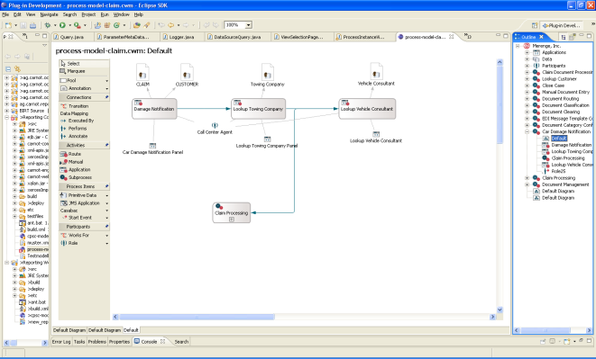
Overall Architecture
Process Modeling (Eclipse)
Stardust
Portal
Desktop
Client
Mobile
Client
Business Event
Stardust
Process Engine
Business Logic 1
(EJB)
Business Logic 2
(Spring)
Deployment
Model Repository
J2EE (Web) Application Server
(e.g.Tomcat)
JDBC
JMS
SOAP
Messaging
Apache Camel
Web Service
Audit Trail Database

Slide 51
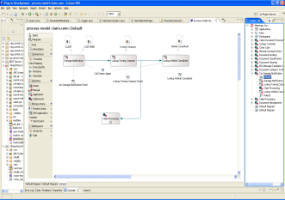
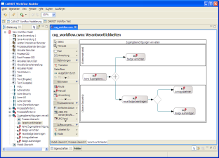
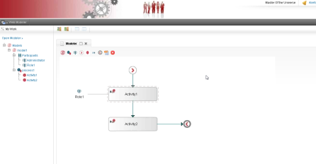
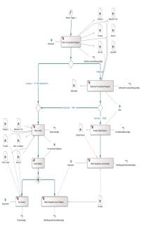
Process Modeling
Development
Business Analyst/Non-Java Developer
Migrated to „Bob‘s Editor“ over the next 1.5 years.
Not adopted by business …
Browser-based
Modeler
Eclipse
Business View
Controlling/Costs
Risk
Change Management
…
Technical/Integration
View
Application Integration
Data Integration
Transaction Management
…
Process Model
Common Elements
Process Structure
Basic Elements (Activities, Data,
Applications)
…

Slide 52
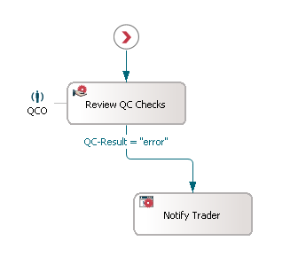
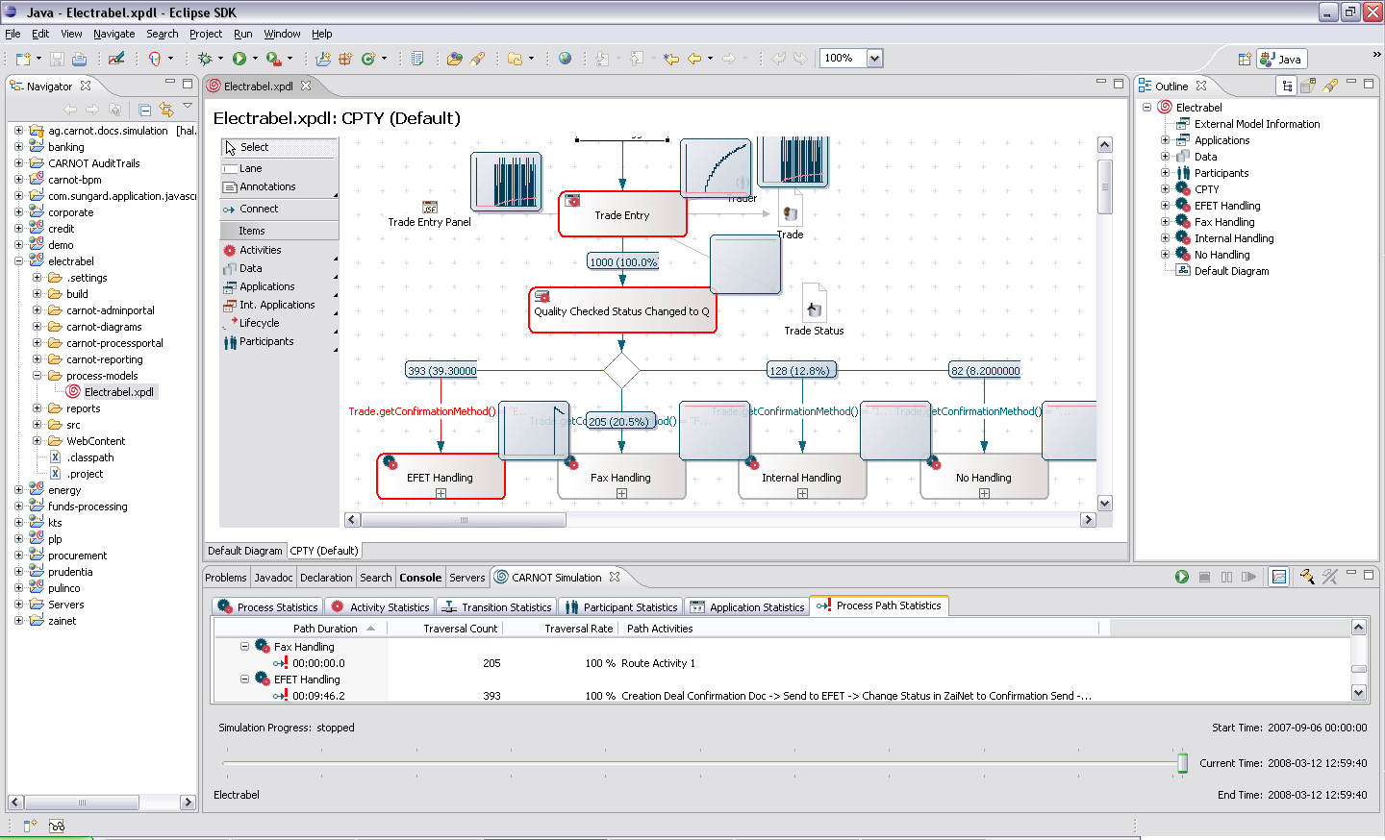
Simulation
Specify arrival rates for processes (e.g. trades over time)
Specify duration probabilities
Resource workload
Critical pathes
Simulation results can be copied e.g. into MS Excel or
written to process database
Specify traversal probabilities
Specify availabilities
Fast, in-memory algorithm
runs thousands of processes in seconds

Slide 53
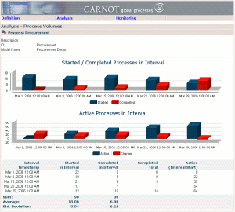
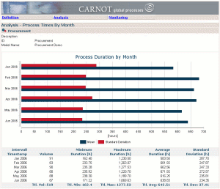
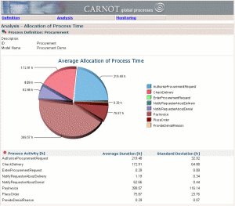
Simulation, Audit Trail and Reporting
Eclipse
Reports
Stardust
Simulation Engine
Infinity Process Platform
Simulation Engine
Infinity Process Platform
Reporting Component
Stardust
Reporting Component/
BIRT
Simulation results can be written to simulation audit trail database.
Simulation results can be used in audit trail reports as regular audit trail content.
Simulation parameters can be retrieved from produtcive audit trail.
Simulation
Audit Trail Database
Productive
Audit Trail Database
Simulation can be used to create test data for reports
Simulation run´ID can be used to filter reports and build sequences of what if-reports.

Slide 54
Process-aware Front End
Portal currently JSF-based,
transitioned into HTML5
Mashups possible with arbitrary
HTML-technologies
Server/application synchronization
via REST
Non-invasive, unidirectional protocol
Worklist
Workarea
Activation
GUI
Worklist
Query
Service Access
Activity
Completion
e.g. Customer Management
Process Database

Slide 55
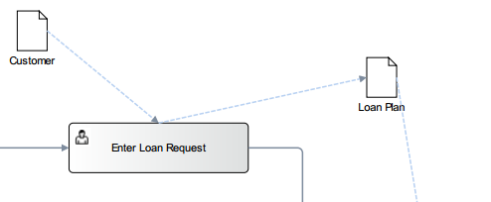
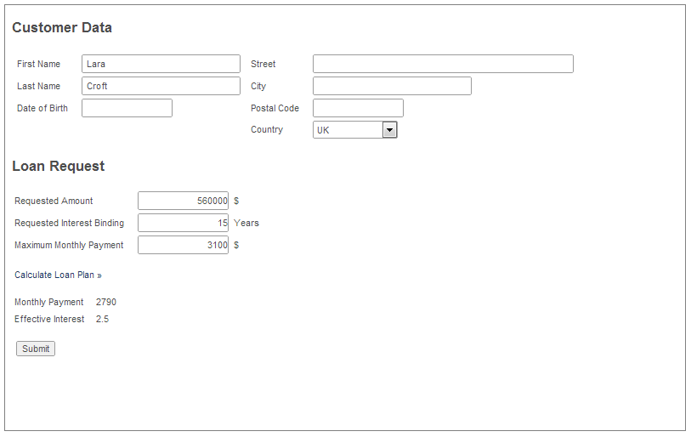
UI Mashup
IPP
External Web Application
External URL&ippPortalBaseUri=…
REST Call to retrieve Input Data
REST Call to set Output Data
…
REST Call to set Output Data
Optional REST Call to complete Activity

Slide 56
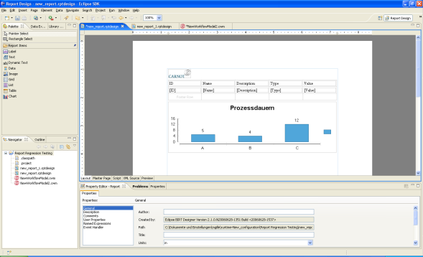
Reporting Architecture
BIRT Runtime
Stardust
Process Model and Runtime
ODA Data Sources
Other Sources (e.g. RDBMS, XML, DMS)
Eclipse/BIRT Designer
and Stardust Wizards
Stardust Audit Trail
Database
Customer Data
Documents
Risk Data
Stardust Process Engine
Reports

Slide 57
Browser-based BPMN Modeler
BPMN2 Diagram Notation
HTML-based implementation (jQuery, Raphael)
Model Storage currenly transitioned to BPMN
  Compatibility with „Bob‘s Modeler“
Highly extensible …
  Documented JavaScript Extension Points for Palette, Properties Panels, Outline Popups, Diagram Decoration
… and embeddable
  Can be mashed-up in arbitrary HTML Portals
Current code-base in Eclipse Git
Integration with Orion – demoed in other tracks at EclipseCon 13

Slide 58
Browser-Modeler Architecture
Again: „Bob‘s Editor“ over the next 1.5 years.
Stardust Eclipse Modeler
Stardust Browser Modeler
SunGard
XPDL
Marshaller/
Unmarshaller
BPMN
Marshaller/
Unmarshaller
BPMN/XPDL
Converter
Stardust
Runtime
Only Runtime-relevant
information
ITPearls
XPDL
BPMN

Slide 59
Panel Q & A

