Slide 1
Modeling and Monitoring Business Processes with Mangrove, BPMN2 Editor and Stardust
Adrian Mos (Xerox), Bob Brodt (Redhat), Oliver Kopp (Uni Stuttgart), Marc Gille (SunGard)
EclipseCon
San Francisco
3/18/2014
11:15-11:50 am

Slide 2


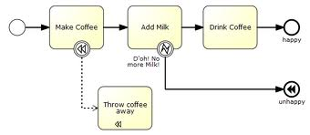


SOA Projects Collaboration
Mangrove
read/write
generate
monitoring
Domain Model
Process Portal
BPMN2 Model
read/write
Process Engine
read/write
Mobile Client
Stardust
BPMN2 Modeler
facilitate deployment
Winery

Slide 3
Mangrove

Slide 4
Mangrove Reminder
Bridge: Integrates design and runtime artefacts created or used in Eclipse SOA
Common metamodel (Mangrove Core) and transformation plugins enable partial transport of essential information between tools
Mangrove Core contains elements related to processes as well as SOA services

Slide 5
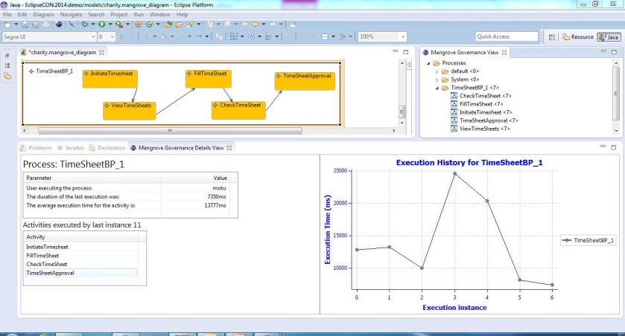
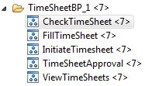
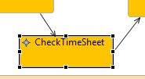
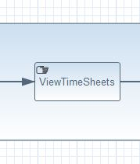
New in Mangrove: Monitoring
Client Side
Agent
Abstract Server-Side
Agent
Stardust Environment
Stardust BPMS
Agent

Slide 6
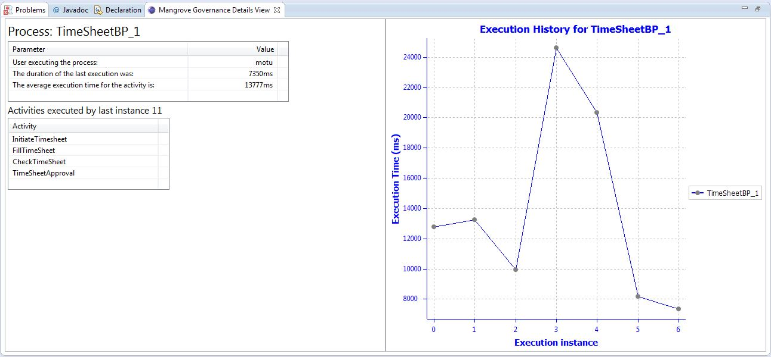
Monitoring Process View

Slide 7
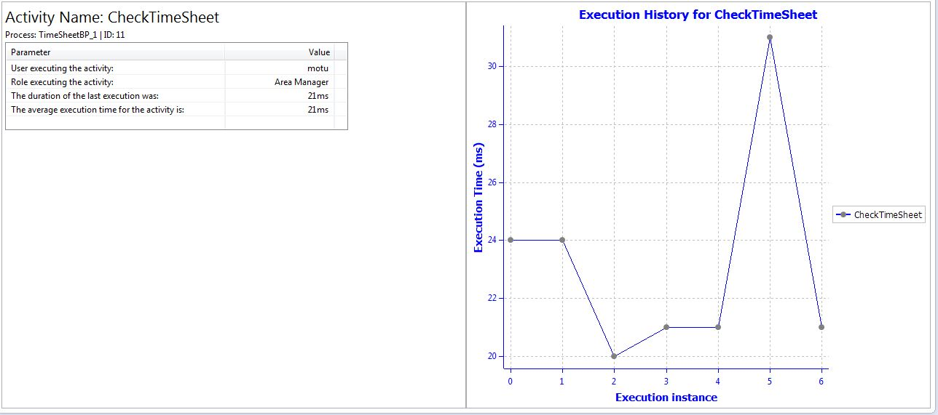
Monitoring Activity View

Slide 8
BPMN2 Modeler

Slide 9
Project Overview
Sponsored by Red Hat
BPMN2 Compliance: Full support with Eclipse BPMN2 metamodel project
Graphiti-based: Eclipse Graphiti 0.10.x
Extensible:
  Model & UI
  Plug-in API (extension points) and configuration files

Slide 10
Demo

Slide 11
Stardust

Slide 12
Stardust
Industry-proven, mature Business Process Management Suite Infinity Process Platform under Eclipse Public License
  Workflow
  System Integration
  Document Management
More than 1.600 production deployments worldwide
  > 10,000 users (Commerzbank, former Dresdner Bank)
  > 1,000,000 processes/day (CSS Insurance, SWIFT)
  > 300,000 documents/day (VAR Japan)
  Benchmarks exist with > 10,000 processes per second.
Largest BPMS in the industry (2.5M LOC, 726 person years)
  Bonitasoft (2M LOC, 589 person years)
  jBPM (738k LOC, 200 person years)

Slide 13
Browser-based Modeling
Normalized Services based on Web/REST Services, DB, File, Message Queues
and Data Models are provided and maintained
for all SunGard Systems
Services and Data Models can be reused for Client Processes
UI Mashup
Service Invocation
Use of Data Models

Slide 14
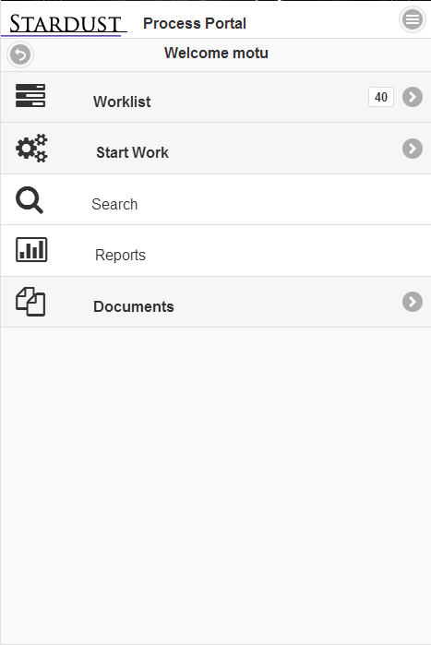
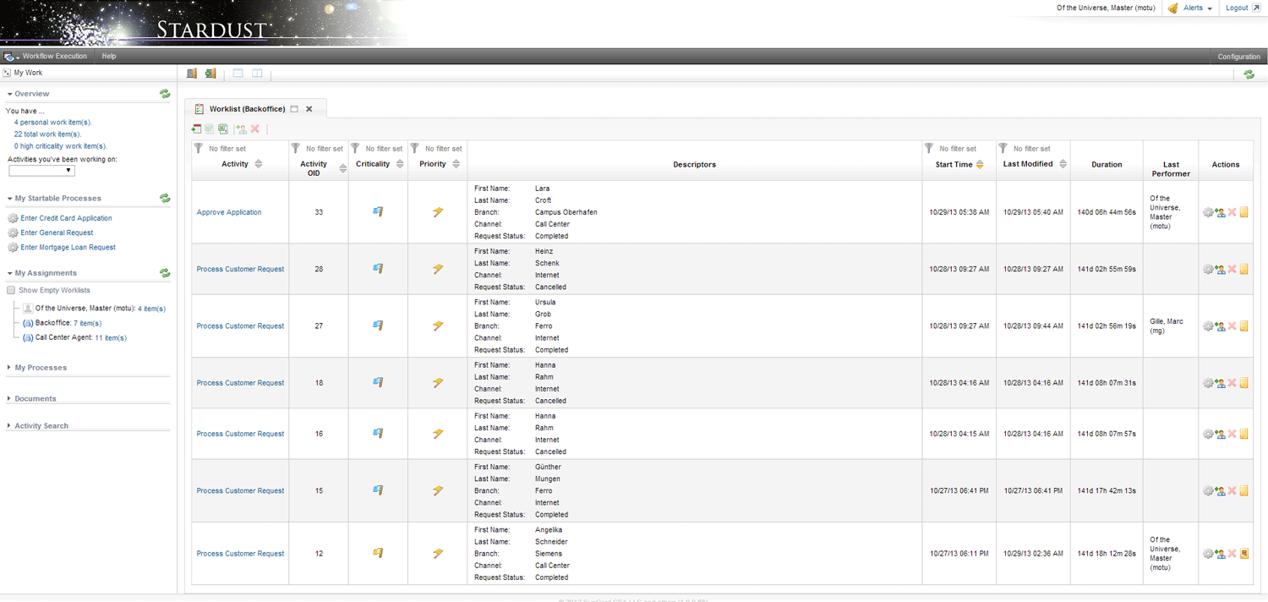
Browser/Mobile Portal
Worklists
UI Mashups
Document Management
Reporting
Administration
Device-independent
GPS, Camera, Call API used

Slide 15
Winery

Slide 16













OASIS TOSCA
Topology and Orchestration
Specification for Cloud Applications
Automation of Deployment and Management
Portability
Interoperability
Vendor-neutral ecosystem
100+ participants from
40+ companies

Slide 17
TOSCA Overview
Orchestration for
Deployment & Management
Service Structure
Start VM
Install Tomcat

Slide 18
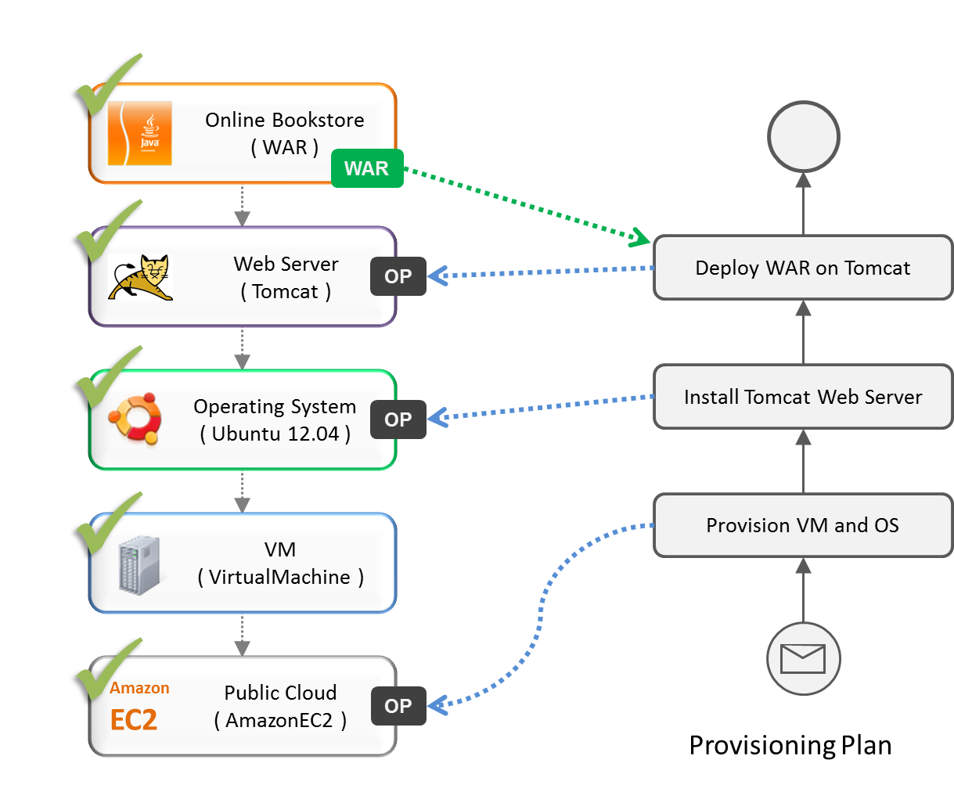
Using Workflows to deploy an Application

Slide 19
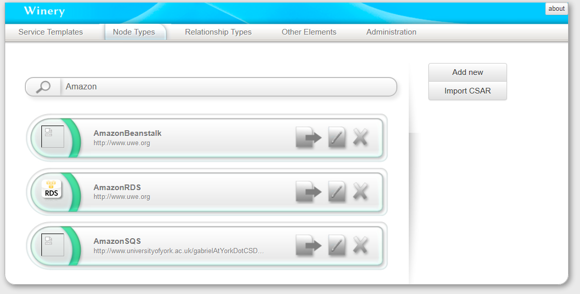
Modeling Tool
Container
Self-Service
Creation and modeling of TOSCA applications, including graphical modeling of topologies and management plans. Exported as Cloud Service Archive (CSAR) for TOSCA runtime.

Slide 20
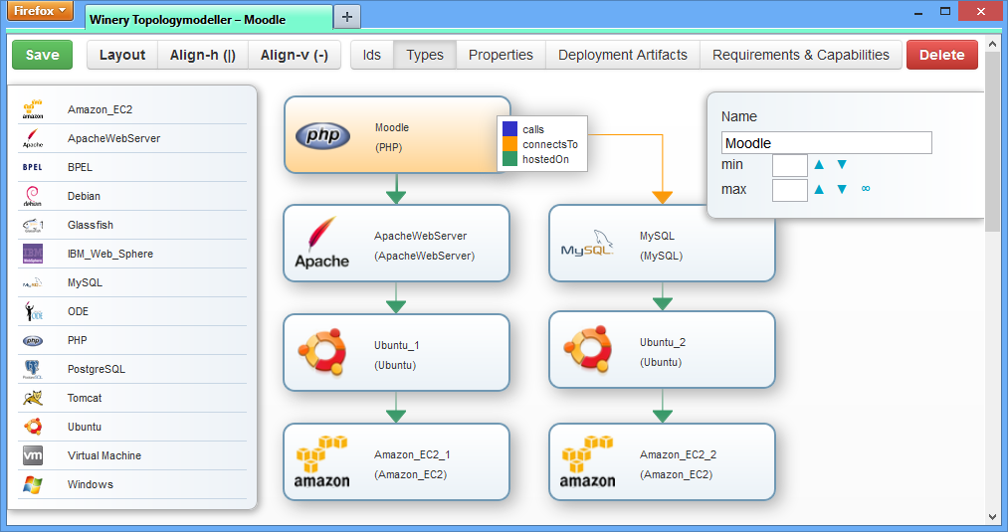
Modeling Tool
Container
Self-Service
Creation and modeling of TOSCA applications, including graphical modeling of topologies and management plans. Exported as Cloud Service Archive (CSAR) for TOSCA runtime.

Slide 21
Contacts/Resources
Mangrove
  www.eclipse.org/mangrove
  Adrian Mos (adrian.mos@xrce.xerox.com)
BPMN2 Editor
  www.eclipse.org/bpmn2-modeler
  Bob Brodt (bbrodt@redhat.com)
Stardust
  www.eclipse.org/stardust
  Marc Gille (marc.gille@sungard.com)
Winery
  www.eclipse.org/winery
  www.demo.opentosca.org
  Oliver Kopp (kopp.dev@gmail.com)

