Slide 1
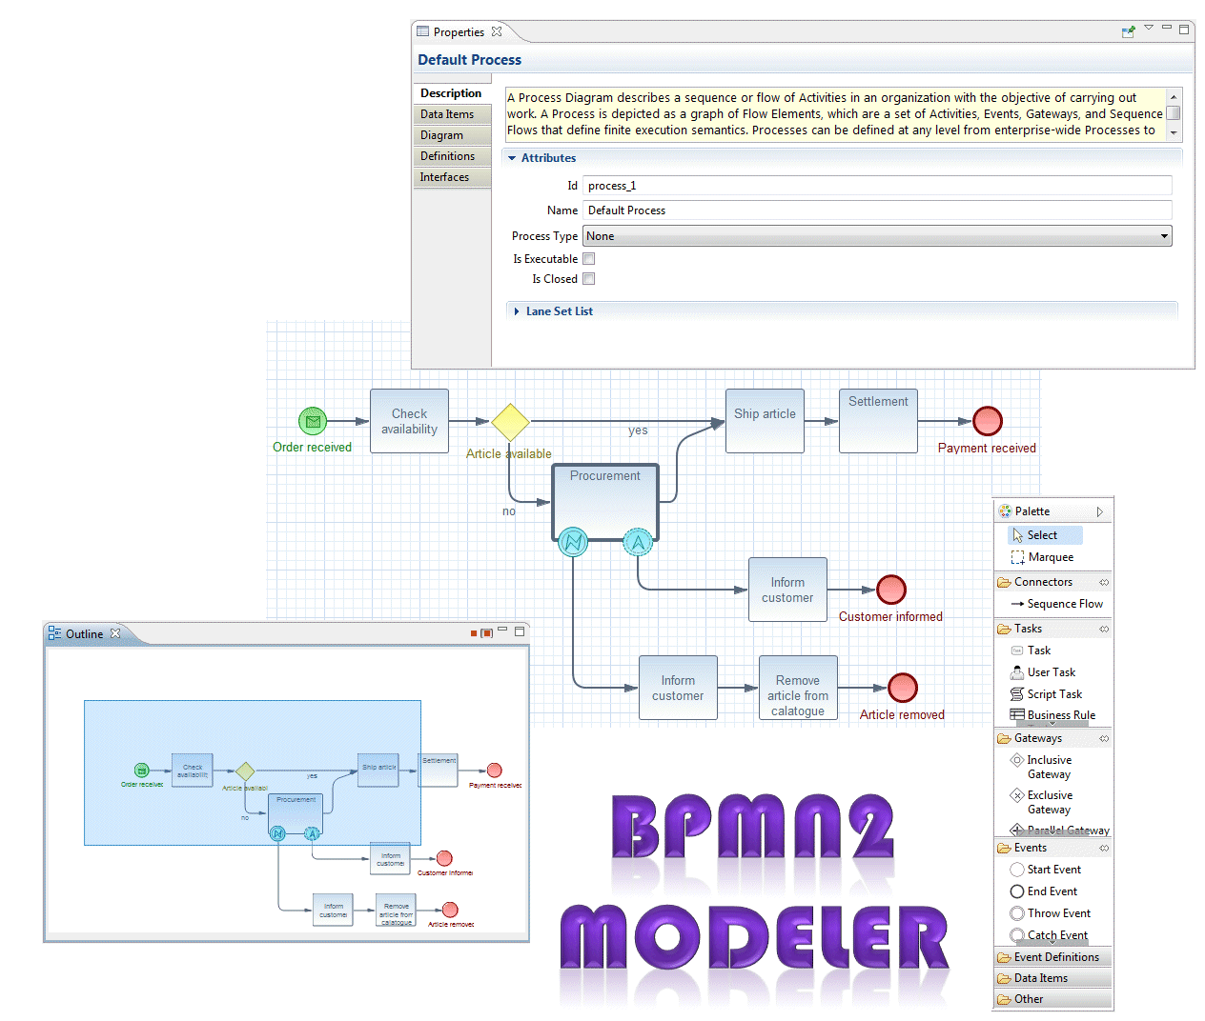
Project Lead: Bob Brodt bbrodt@redhat.com

Slide 2
Compatibility and Dependencies
Incubation Project
  current version 0.1.0 with service release planned in near future
BPMN 2.0 Spec Compliant
Graphiti versions 0.8.2 & 0.9.0
EMF
Supports Eclipse 3.6 through 4.2
Uses MDT BPMN2 meta model

Slide 3
UI and Supporting Views
New Diagram Wizard
  Processes
  Collaborations
  Choreographies
MultiPage Editor supports multiple BPMN Diagrams per file
XML Source View tab
Graphiti Tool Palette
Tabbed Property View
Outline View
  Tree View for BPMN2 Flow Elements
  Tree View for BPMN DI (Diagram Interchange)
  Graphical Thumbnails

Slide 4
Extension API
Selectable Target Runtime and Profiles
Property Sheets & Property Providers
BPMN 2.0 Model Extensions
Customizable Graphical Elements
Styling for Graphical Elements

Slide 5
Channels
Project Page
  http://eclipse.org/bpmn2-modeler
GIT Repository
  https://git.eclipse.org/c/bpmn2-modeler/org.eclipse.bpmn2-modeler.git
Bugzilla
  https://bugs.eclipse.org/bugs/buglist.cgi?classification=SOA&product=BPMN2Modeler
Eclipse Community Forum
  http://www.eclipse.org/forums/index.php/f/226/ddf71c892847b96912ebdb3c19ce41f5
Mailing List
  bpmn2-modeler-dev@eclipse.org

