Slide 1
Stardust – an Eclipse Platform for BPM, SOA and Document Processing
SOA Track
EclipseCon
Ludwigsburg, Germany
23.10.2012
Dr. Marc Gille, SVP Product Management
SunGard Infinity

Slide 2
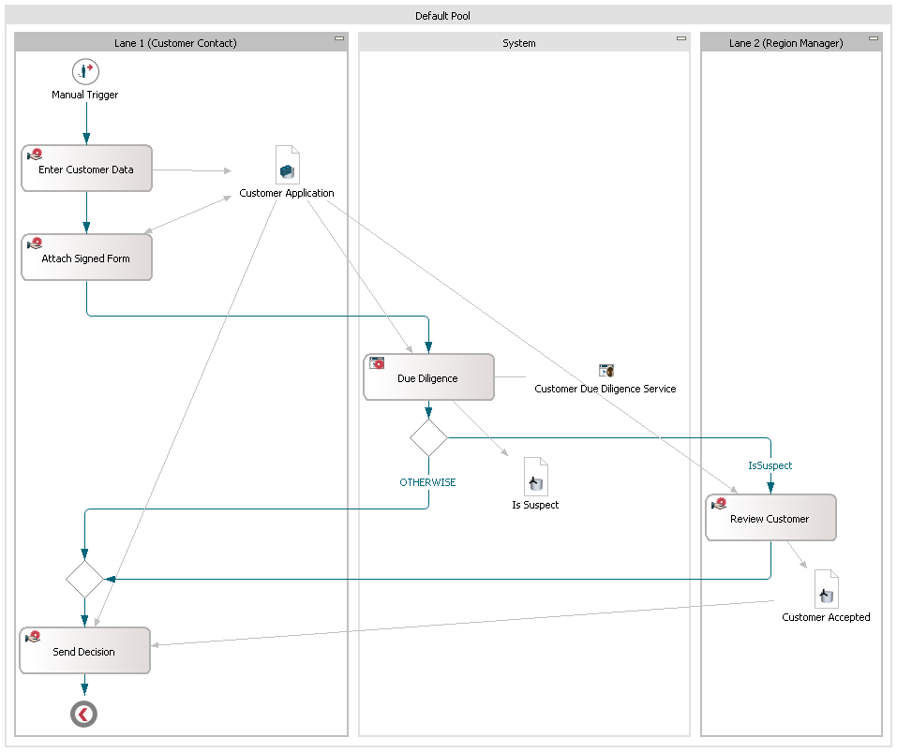
Workflow Participants
⇨ Business Aspects
Data Access
⇨ System Integration
Process Activities
⇨ Business Aspects
Service Invocation
⇨ System Integration

Slide 3
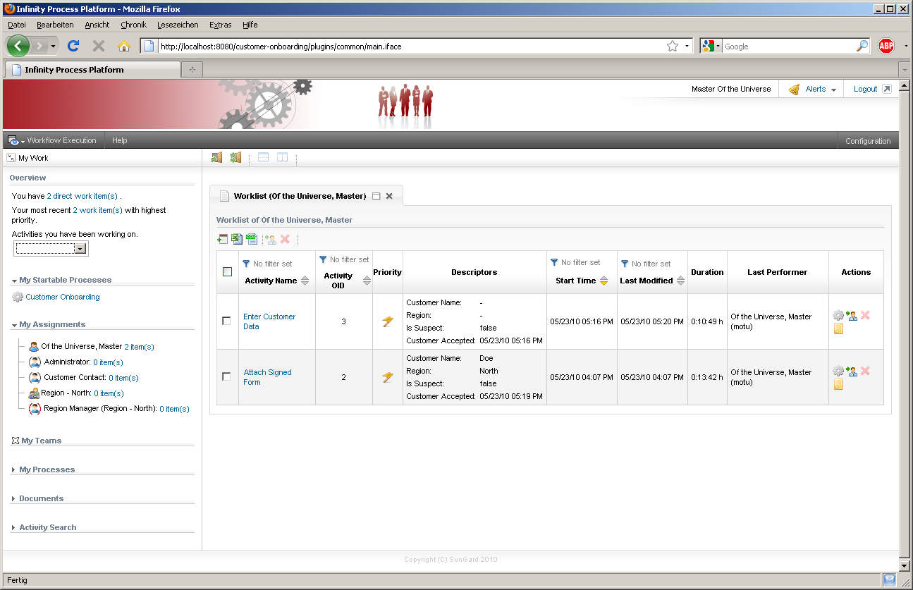
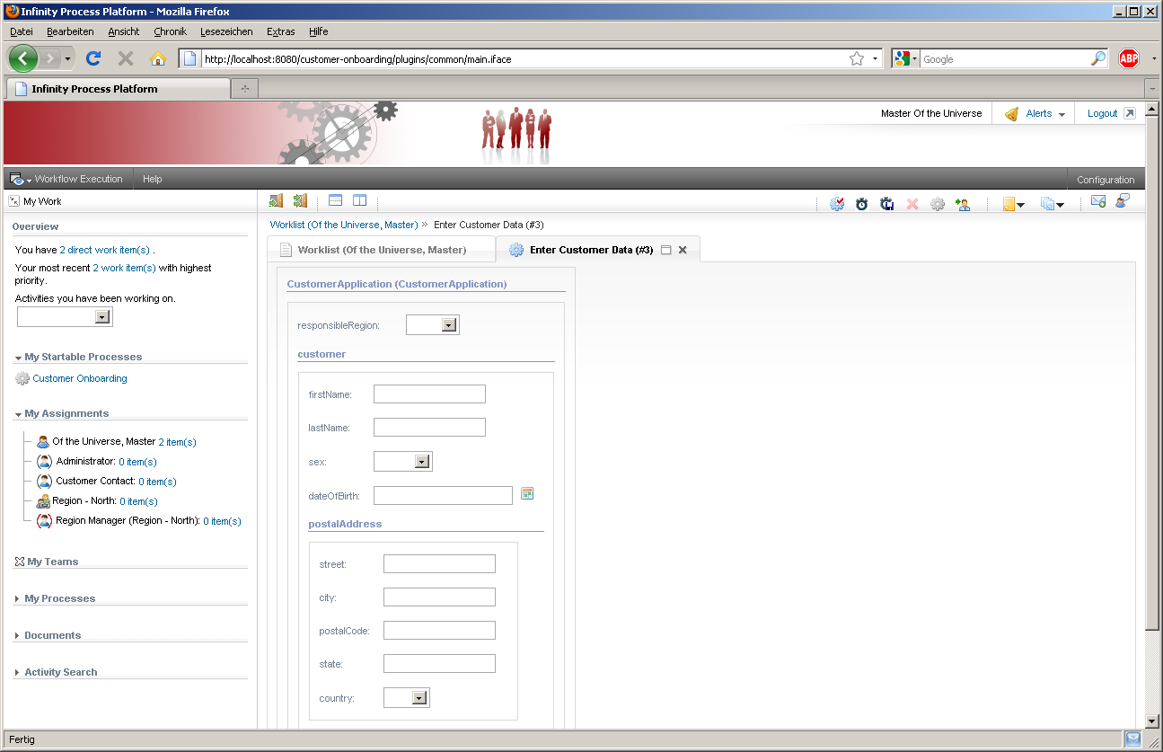
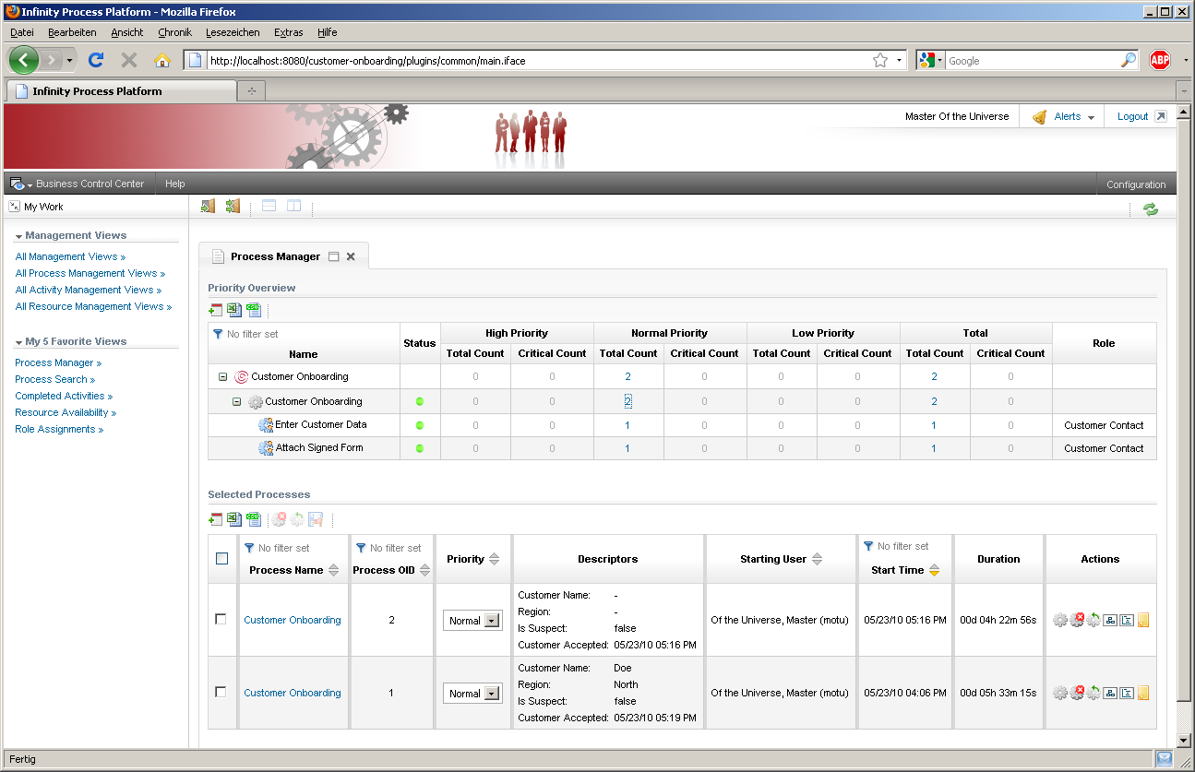
End User Portal

Slide 4
Origin and Approach

Slide 5
Origin
12-year-old, comprehensive BPMS
CARNOT AG
Founded in 2000 („Workflow and EAI for J2EE“)
Acquired by SunGard in November 2006
All key players still on board – and are Stardust committers
Rebranded CARNOT Process Engine as Infinity Process Platform (IPP).
Production deployments e.g. with
> 10,000 users (Commerzbank, former Dresdner Bank)
> 1,000,000 processes/day (CSS Insurance, Arkelis)
> 300,000 documents/day (VAR Japan)
Ranked #2 in Vision in Gartner MQ for BPMS.

Slide 6
Approach and Status
SunGard has contributed virtually the entire IPP codebase into Stardust under EPL.
Exceptions mainly caused by mismatching licenses (e.g. LGPL for Hibernate)
2,3 Mill. lines of code …
Process of IP review and 3rd party approval took Eclipse Legal and us more than a year …
Codebase in Git reflects the current status of IPP Trunk.
Maven/Tycho build supported - and executed via Hudson on Eclipse every night.

Slide 7
Ecosystem
Eclipse Community
SunGard
Contribution
Resources
Contribution
Consumption via
Eclipse Public License (EPL)
Infinity Process Platform
Update on important fixes
or enhancements
Stardust
Maintenance
Periodic update e.g. on Eclipse Releases
Consumption via
SunGard-proprietary commercial license
SunGard Customers

Slide 8
Access
Homepage: www.eclipse.org/stardust
Wiki: http://wiki.eclipse.org/STP/Stardust
Update Site: http://download.eclipse.org/stardust/nightly
Git: http://git.eclipse.org/c/?q=stardust
Forum: http://www.eclipse.org/forums/index.php?t=thread&frm_id=225
Videos (constantly adding): http://www.eclipse.org/stardust/documentation/training-videos.php
Facebook: https://www.facebook.com/eclipsestardust

Slide 9
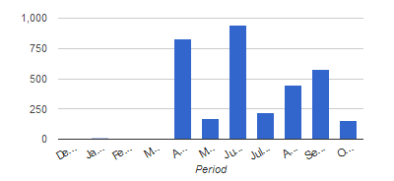
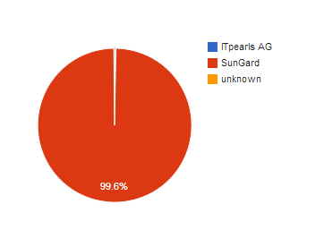
Project Activity and Diversity
Hundreds of commits/month due to synchronization
with IPP codebase
ITPearls joined to help on BPMN2 support

Slide 10
Use Cases

Slide 11
Interactive Workflow
Requirements
Simple configuration of organizational hierarchy including departments
Flexible integration user management/SSO
Configurable Portal UI
Large number of parallel users
Stardust Solution
Department concept
LDAP/SAML integration
Flexible Portal mashups
Multiple Portal views
Reporting
Simulation
Stardust

Slide 12
Document Processing
Requirements
Document management and retrieval
Document viewing and editing (TIFF, PDF, HTML)
Process and document binding
Stardust Solution
Document Repository
TIFF Viewer and Editor
Servers-side PDF-Viewer
Scan client (WS communication to server)
Document Metadata Modeling
Document security (document, folder, type)
Stardust

Slide 13
Data Extraction and Transformation
Requirements
Receive request for data gathering from multiple systems
Data retrieval from these systems
Data transformation, normalization and merge
Return data
Possibly high record volume (~ 100.000)
Stardust Solution
Simple message transformations via drag & drop
Complex message transformation with JavaScript
Out-of-the-box connectivity to RDBMS, Files etc.
Well-defined Connector structure to be used for custom connectors
Parallel data gathering via process topology
Stardust
Relational Database

Slide 14
Message Processing and Service Orchestration
Integration Requirements
Connectivity to financial networks and protocols (FIX, SWIFT, XML)
Grouping of messages
Correlation of messages (e.g. for cancellation)
Content-based routing
Message multicast
Low(er) latency
Stardust Solution
FIX and SWIFT connectivity
Message transformation to normalized format
Caching and JMS channeling for sequencing
Routing via transition conditions
Transient processing/write-behind for highest throughput/lowest latency
Stardust
e.g. Financial Networks

Slide 15
Event Processing and Client Push
Integration Requirements
Different incoming market data streams (e.g. Market Map, Bloomberg, Reuters)
Normalization of content
Client push
Stardust Solution
FIX and SWIFT connectivity e.g. market data streams
Correlation of messages arriving in time window via caching
Message transformation to normalized format
Rules for golden copy creation
Client push via publish/subscribe via REST Push and
HTML messaging
Stardust
e.g. Market Data Streams

Slide 16
Architecture

Slide 17
Technologies used
Java
J2EE
JDBC/SQL
JAAS
Spring
Eclipse
GEF
EMF
Eclipse Runtime
Webtools
BIRT
JavaScrip Development Tools

Slide 18
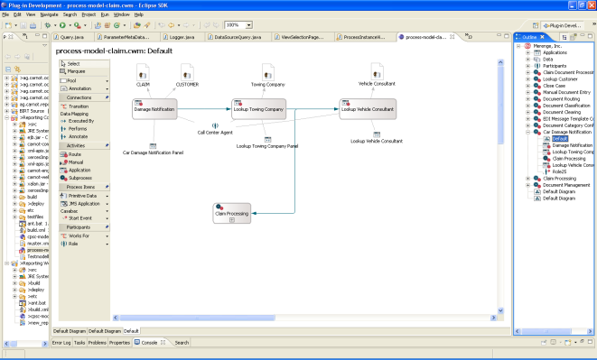
Overall Architecture
Process Modeling (Eclipse)
Stardust Process Portal
Desktop
Client
Mobile
Client
Business Event
Stardust Process Engine
Business Logic 1 (EJB)
Business Logic 2 (Spring)
Deployment
Model Repository
J2EE (Web) Application Server (e.g.Tomcat)
JDBC
JMS
SOAP
Messaging
Apache Camel
Web Service
Audit Trail Database

Slide 19
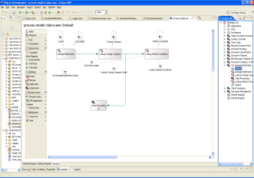
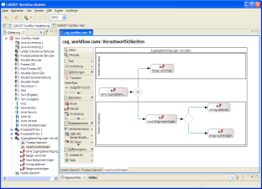
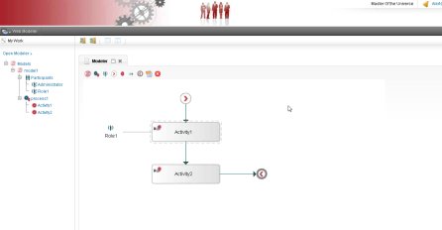
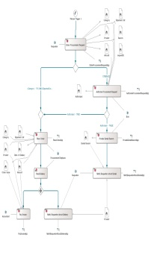
Process Modeling
Development
Business Analyst/Non-Java Developer
Browser-based Modeler
Eclipse
Business View
Controlling/Costs
Risk
Change Management
…
Technical/Integration View
Application Integration
Data Integration
Transaction Management
…
Process Model
Common Elements
Process Structure
Basic Elements (Activities, Data, Applications)
…

Slide 20
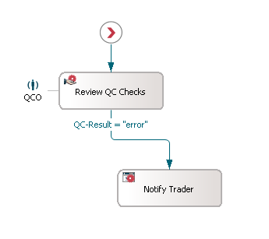
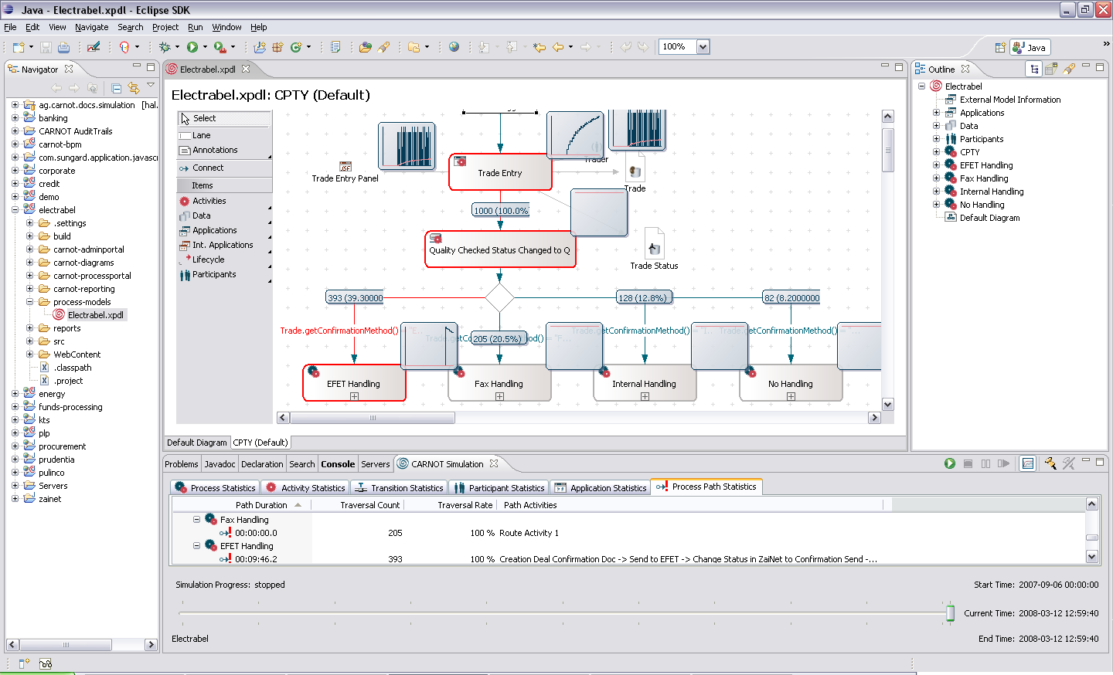
Simulation
Specify arrival rates for processes (e.g. trades over time)
Specify duration probabilities
Resource workload
Critical pathes
Simulation results can be copied e.g. into MS Excel or written to process database
Specify traversal probabilities
Specify availabilities
Fast, in-memory algorithm
runs thousands of processes in seconds

Slide 21
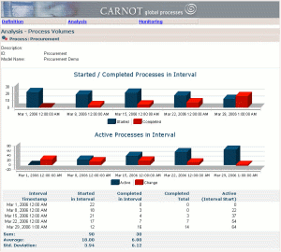
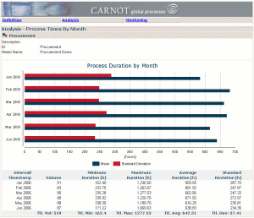
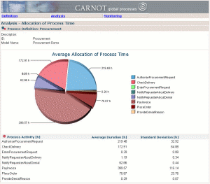
Simulation, Audit Trail Databases and Reporting
Simulation can be used to create test data for reports
Eclipse
Reports
Stardust Simulation Engine
Infinity Process Platform Simulation Engine
Infinity Process Platform Reporting Component
Stardust Reporting Component/
BIRT
Simulation results can be written to simulation audit trail database.
Simulation results can be used in audit trail reports as regular audit trail content.
Simulation parameters can be retrieved from produtcive audit trail.
Simulation Audit Trail Database
Productive Audit Trail Database
Simulation run´ID can be used to filter reports and build sequences of what if-reports.

Slide 22
Process-aware Front End
Portal currently JSF-based, transitioned into HTML5
Mashups possible with arbitrary HTML-technologies
Server/application synchronization via REST
Worklist
Workarea
Activation
GUI
Worklist
Query
Service Access
Activity Completion
e.g. Customer Management
Process Database

Slide 23
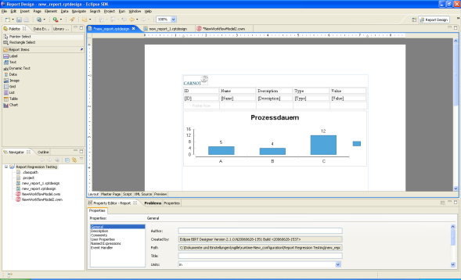
Reporting Architecture
BIRT Runtime
Stardust Process Model and Runtime ODA Data Sources
Other Sources (e.g. RDBMS, XML, DMS)
Eclipse/BIRT Designer
and Stardust Wizards
Stardust Audit Trail Database
Customer Data
Documents
Risk Data
Stardust Process Engine
Reports

Slide 24
Strategy and Community Collaboration

Slide 25
Roadmap and Collaboration
First Stardust Release in Q4/2012 – currently Milestone Releases
Participation in Kepler Release
Full use of BPMN2 Metamodel in Q2/2013
Homogenize Eclipse Modeler towards BPMN2 Modeler activities over time
Consider common Document Repository – for modeling and beyond

Slide 26
Browser-based BPMN Modeler
BPMN2 Diagram Notation
HTML-based implementation (jQuery, Raphael)
Model Storage currenly transitioned to BPMN
Highly extensible …
Documented JavaScript Extension Points for Palette, Properties Panels, Outline Popups, Diagram Decoration
… and embeddable
Can be mashed-up in arbitrary HTML Portals
Current code-base in Eclipse Git
Integration with ORION planned for Q1/2013

Slide 27
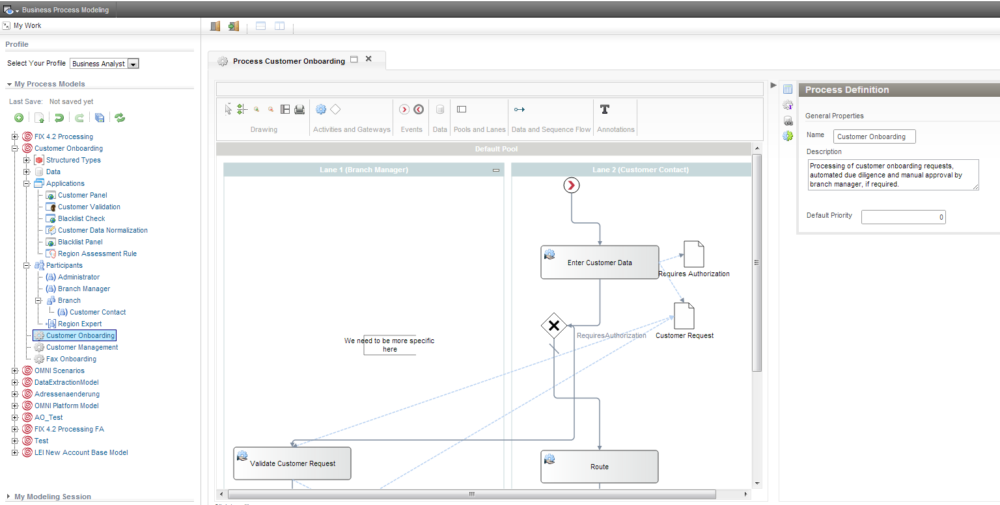
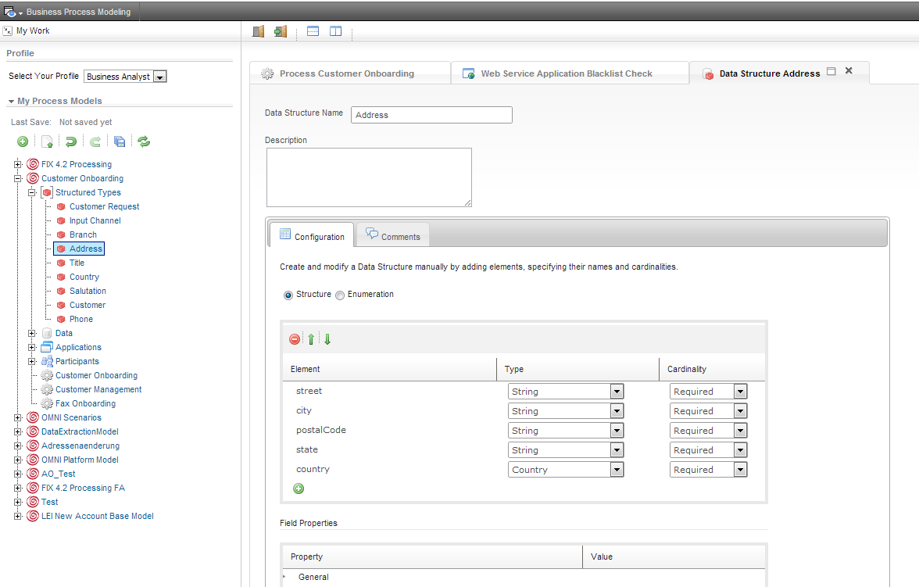
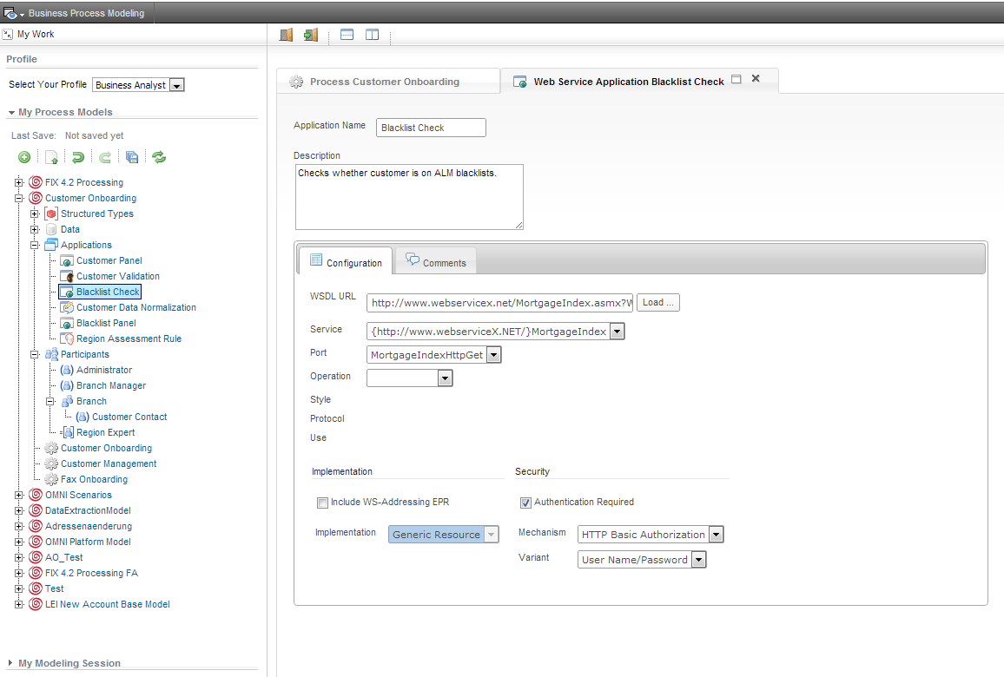
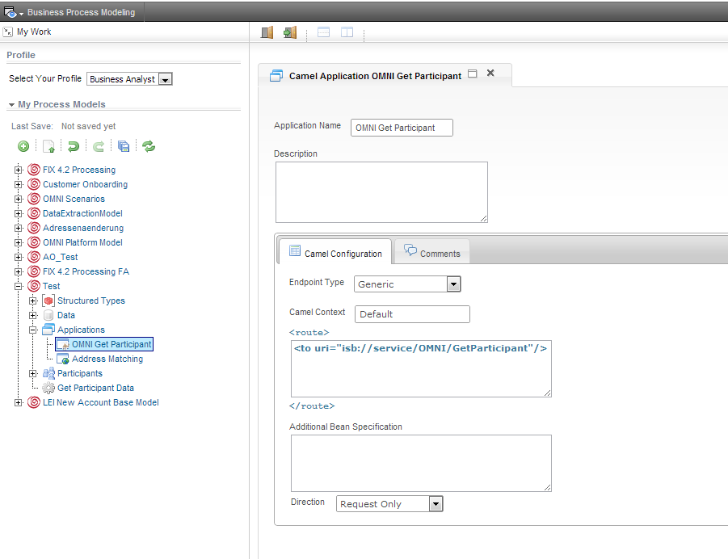
Browser Modeler User Journey

Slide 28
Demo and Contact
If you are interested in a Stardust demo we are happy to set up a BOF session are arrange a personal meeting.
Feel free to contact me at marc.gille@sungard.com

