Slide 1
Stardust 1.0 Release Review
  Stardust Graduation Review
  Planned Review Date: [Date]
  Communcation Channel: stardust-dev@eclipse.org
  Marc Gille (Marc.Gille@sungard.com)
  Herbert Neureiter (Herbert.Neureiter@sungard.com)
  Stardust Graduation Review © by SunGard CSA LLC and others
  Made available under the EPL
Notes:
Neutral File Format. The docuware must be published in an operating-system neutral file format. PPT and DOC files are not considered neutral. HTML or PDF are currently the best choices. The EMO can convert Open Office and Microsoft Office to PDF if you are unable to do so.
Archival Quality. The docuware must be comprehensible and complete on its own without requiring explanation by a human presenter. Archival quality is required because the document will be available on the eclipse.org website in perpetuity; future Eclipse users, adopters, and even new project committers will consult it long after the review conference call has been completed.
Correct Copyright and License. The document is being written (and thus copyrighted) by you, not by the Eclipse Foundation, and thus the copyright statement needs to be by you (or your employer). Similarly, the content should be licenses under the EPL.

Slide 2
Introduction
Project Stardust provides a comprehensive Business Process Management Suite, featuring:
  Process Modeling in eclipse Workspace as well as a Web-based Modeler
  J2ee compliant Process execution Engine that can be deployed on various servers
  Full Featured Workflow Portal
  Process Simulation Feature
  RAD Enviroment for getting started quickly
  See also http://www.eclipse.org/stardust/ for more Information

Slide 3
Demonstrable Codebase
Project Stardust is derived from a Commercial Product with a 13 year Track Record
Industry-proven, mature Business Process Management Suite
  Workflow
  System Integration
  Document Management
Production deployments e.g. with
  > 10,000 users
  > 1,000,000 processes/day
  > 300,000 documents/day
Milestone Builds were and are provided on a recurring Basis:
  Early Milestone Builds (based on Helios, outdated and archived meanwhile)
  Kepler Milestones starting with M5
    M5 (2013/02/08)
    M6 (2013/03/22)
    Further milestones and RCs as specified in http://projects.eclipse.org/projects/soa.stardust/releases/1.0

Slide 4
Active Communities
Committers and Contributors
  Due to the nature of the project (donation of existing product), the initial Committer and Contributor community still consists primarily of SunGard employees
  We are working on broadening the contributor diversity:
    New members from itpearls have joined the team. One of them has become committer meanwhile.
    We have some first contributions from ellucian (via bugzilla, not integrated into code baseline yet)

Slide 5
Active Communities
Users
  Stardust is already used in academia (e.g. Stevens Institute Hoboken, Technische Hochschule Mittelhessen)
  We do not have download stats yet, as we haven not configured this as needed (http://wiki.eclipse.org/Project_Download_Stats)
  A rich Wiki with more than hundred articles has been created.
  Over 100 topics were discussed in the Stardust User Forum

Slide 6
IP Policy and Dependencies
Major efforts have been undertaken to resolve all open IP issues:
  Lots of refactoring work has been done to eliminate more than 30 incompatible third-party dependencies prior to initial contribution
  To date, over 300 CQs have been created and processed
  Technical precautions have been taken in the build process to prevent introduction of new dependencies from going unnoticed
  Correct license headers, about.html files, etc. have been provided as required in thousands of places
  Clean IP Log is attached to the Release Review documentation that is submitted for review together with this document

Slide 7
Operating in the open
Planning and Sharing of Information
  Planning is done in public and key information is additionally posted in wiki documents, news posts and social media:
    https://projects.eclipse.org/projects/soa.stardust
    http://wiki.eclipse.org/Stardust
    https://www.facebook.com/eclipsestardust
Bugzilla
  Most of the early work on project Stardust was difficult to plan with Bugzilla, as it related mainly to refactoring work needed to prepare for the actual Initial Contribution
  Later work relating to the Kepler Release requirements was consistently planned via Bugzilla

Slide 8
Processes
Project Team is following the Eclipse Development Process
Stardust has joined Kepler Simultaneous Release and follows Simulateneous Relaese Requirements accordingly, e.g.
  Projects Plans for current and next Release were created and maintained
  Communication channels were established, e. g. via cross-project-issues-dev
  Fully automated maven-based build process, including:
    Signing
    Unit Tests
    Compliant Version Numbering requirement
    Etc.
  And many more
Guidelines for Cuntributing via Gerrit have been defined

Slide 9
Participating in Larger Eclipse Community
Stardust Team is actively presenting project state at Conferences, e. g. EclipseCon (e. g. [1], [2])
Project Stardust has successfully integrated into Kepler release train
Integration work within the SOA Platform project has been established between Mangrove, the BPMN2 Modeler and Stardust (see e.g. http://www.slideshare.net/marcgille7/soa-symposium-eclipse-con-2013)
Integration with ORION (see http://www.slideshare.net/marcgille7/stardust-orion-integration-orion-soa-symposium-eclipse-con-2013)

Slide 10
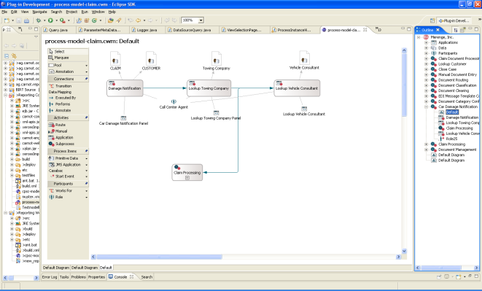

Technical Architecture (Overview)
Process Modeling (Eclipse)
Stardust
Portal
Desktop
Client
Mobile
Client
Business Event
Stardust
Process Engine
Business Logic 1
(EJB)
Business Logic 2
(Spring)
Deployment
Model Repository
J2EE (Web) Application Server
(e.g.Tomcat)
JDBC
JMS
SOAP
Messaging
Apache Camel
Web Service
Audit Trail Database

Slide 11
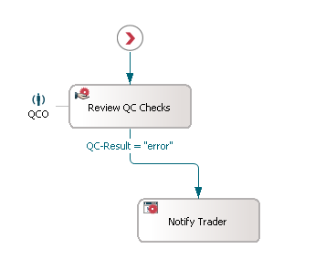
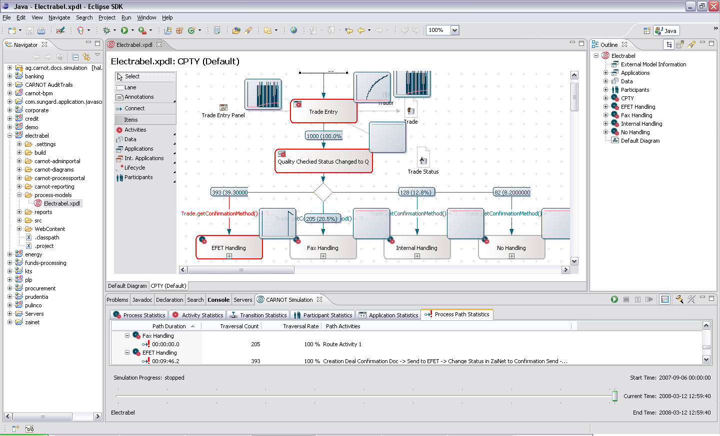
Technical Architecture (Simulation I)
Specify arrival rates for processes (e.g. trades over time)
Specify duration probabilities
Resource workload
Critical pathes
Simulation results can be copied e.g. into MS Excel or
written to process database
Specify traversal probabilities
Specify availabilities
Fast, in-memory algorithm
runs thousands of processes in seconds

Slide 12
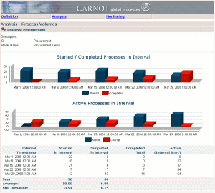
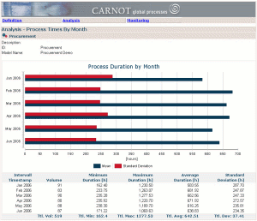
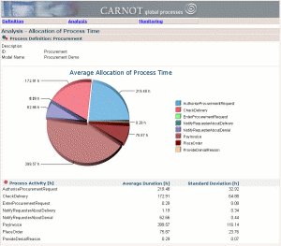
Technical Architecture (Simulation II)
Eclipse
Reports
Stardust
Simulation Engine
Infinity Process Platform
Simulation Engine
Infinity Process Platform
Reporting Component
Stardust
Reporting Component/
BIRT
Simulation results can be written to simulation audit trail database.
Simulation results can be used in audit trail reports as regular audit trail content.
Simulation parameters can be retrieved from produtcive audit trail.
Simulation
Audit Trail Database
Productive
Audit Trail Database
Simulation can be used to create test data for reports
Simulation run´ID can be used to filter reports and build sequences of what if-reports.

Slide 13
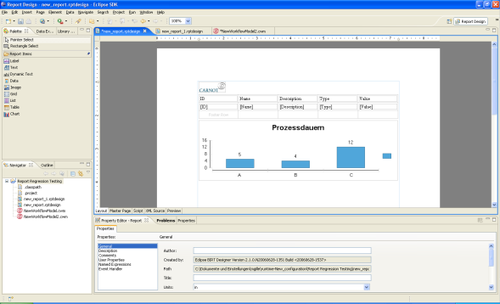
Technical Architecture (Reporting)
BIRT Runtime
Stardust
Process Model and Runtime
ODA Data Sources
Other Sources (e.g. RDBMS, XML, DMS)
Eclipse/BIRT Designer
and Stardust Wizards
Stardust Audit Trail
Database
Customer Data
Documents
Risk Data
Stardust Process Engine
Reports

Slide 14
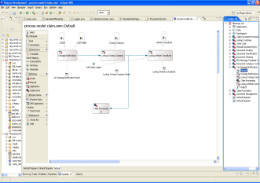
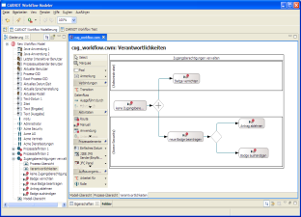
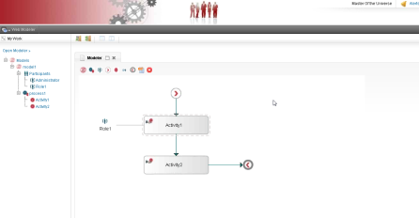
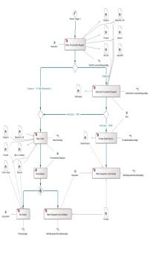
Technical Architecture (Modeling, BPMN)
Development
Business Analyst/Non-Java Developer
Browser-based
Modeler
To be migrated to BPMN2 Editor.
Eclipse
Business View
Controlling/Costs
Risk
Change Management
…
Technical/Integration
View
Application Integration
Data Integration
Transaction Management
…
Process Model
Common Elements
Process Structure
Basic Elements (Activities, Data,
Applications)
…

Slide 15
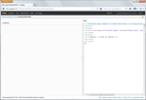
Technical Architecture (Orion)
Orion Shell
Stardust Browser Modeler
BPMN/XPDL/Rules
Marshaller/
Unmarshaller
Stardust
(Cloud)
Runtime
Document Adapter
BPMN/XPDL
Rules
BPMN/XPDL
Rules
Software Artefacts
Orion File Store
Document Repositiory

