Slide 1
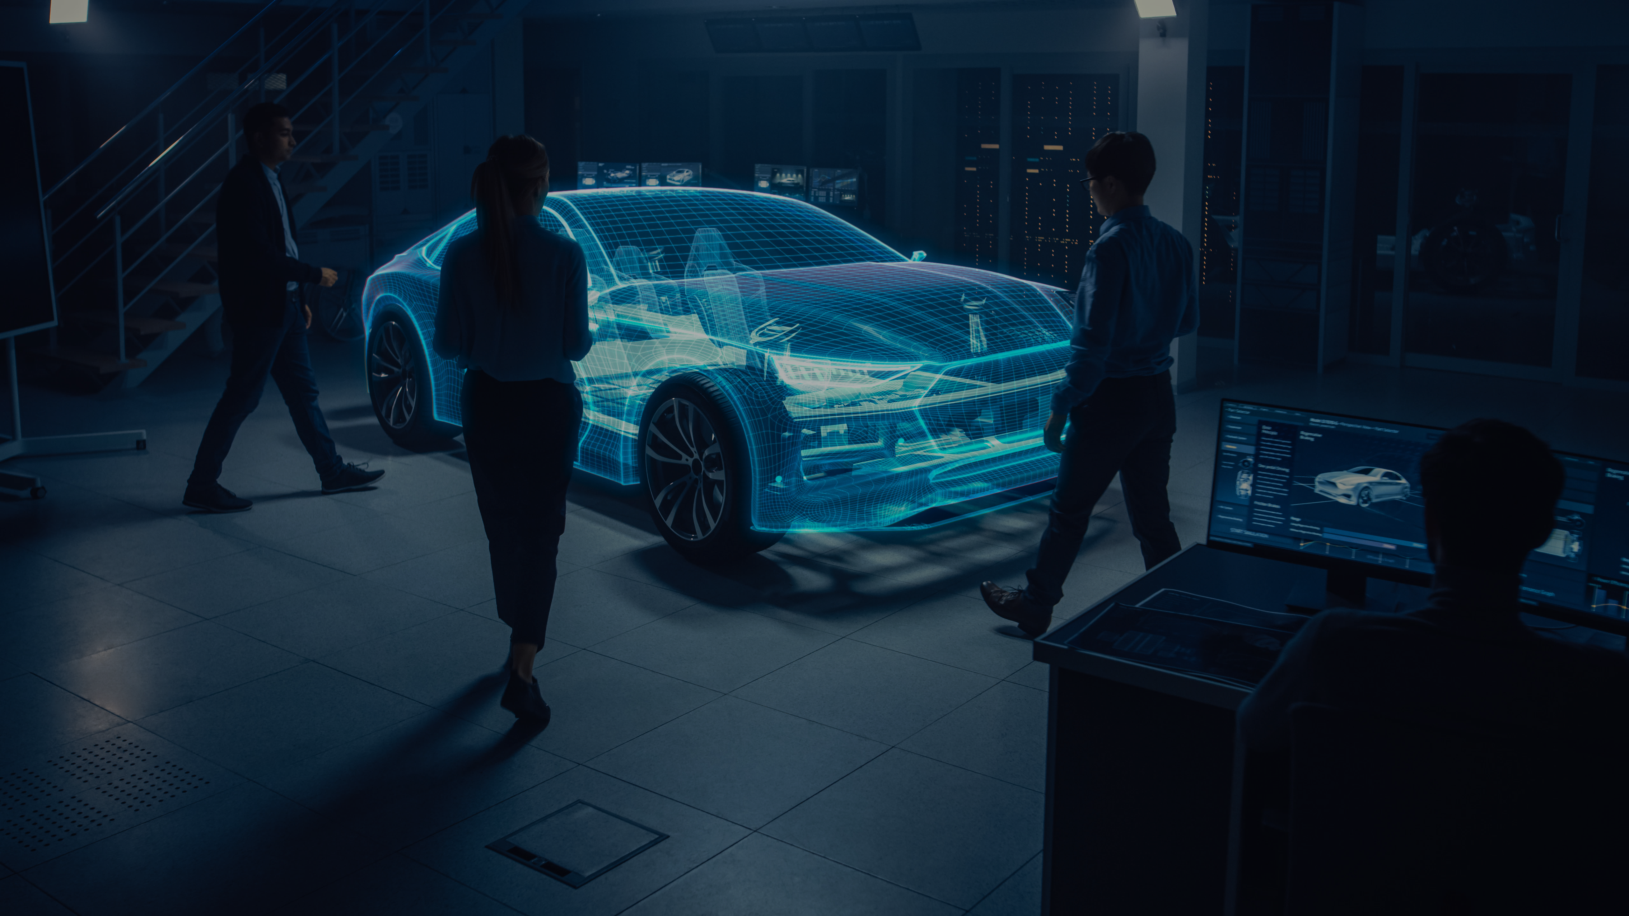

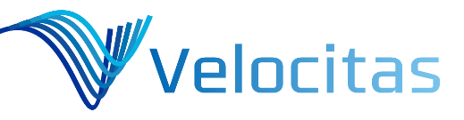

Fast and easy development of vehicle applications
for OEMs and Suppliers
For more information scan the QR code and visit our website.

Slide 2
Fast and easy development of vehicle applications
The Open Source project Eclipse Velocitas provides a modular development tool chain. This enables developers of OEMs and Suppliers to write vehicle applications in a vehicle independent way by using a vehicle API, a container technology and a pre-configured project setup.
Benefits:
Speed up and simplify development processes
Enable co-development beyond company borders
Allow portability of applications through containers
Innovate quickly and focus on business logic
Share efforts to provide a tool chain for vehicle applications
For more information scan the QR code and visit our website. ​

