Slide 1
Eclipse-uProtocol
And why open source?
https://github.com/eclipse-uprotocol/

Slide 2
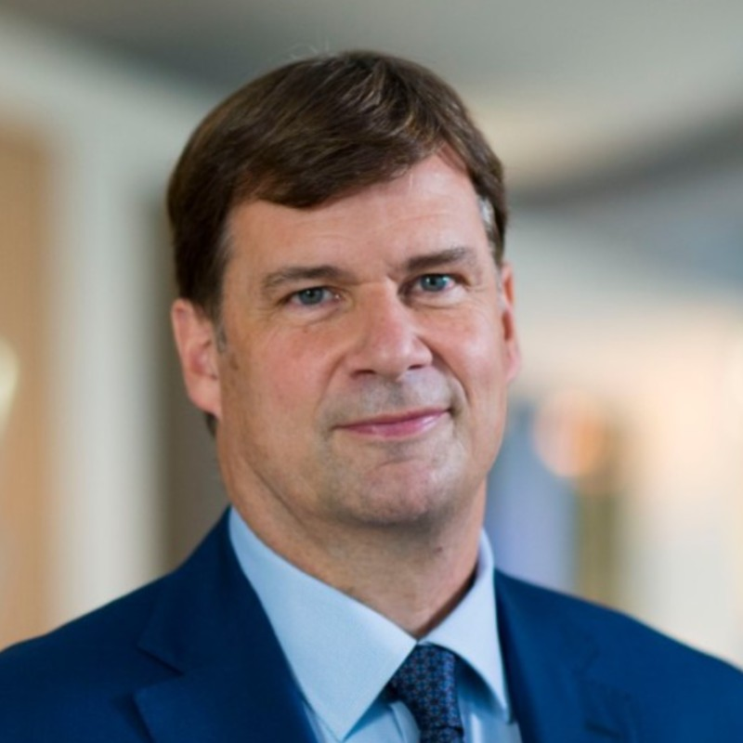
“The problem is that the software is all written by 150 different companies, and they don’t talk to each other.”
Jim Farley
  CEO, Ford
Source: link

Slide 3
Why Open-Source vs Proprietary?
Strength in numbers
Free & open-source communication middleware
Reduces software costs
OEMs can focus on adding customer value

Slide 4
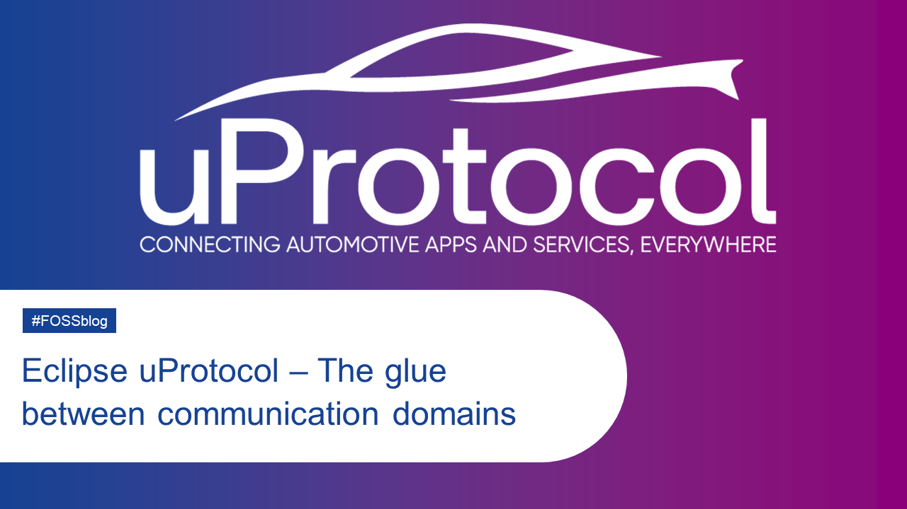
What is it?
A communication protocol that enables developers to build apps and services that communicate seamlessly across one of multiple inter-connected messaging middleware.
Key Principles
  Unified service addressing scheme
  Supporting fundamental design patterns of rpc, notifications, and pub/sub)
  Well-defined APIs formalized in protobuf for accessing services
  Simple layering of the protocol to make it easy for developers to use and implement
  Same subscription API across all platforms
Source: https://www.etas.com/en/company/news-eclipse-uprotocol.php
https://github.com/eclipse-uprotocol/

Slide 5
Brief History
Original concept was deployed in production vehicles in 2023
Open sourced in March 2023
Working (with the community) to expand scope & functionality

Slide 6
Status
Contributions
  5 Active companies (ETAS, Microsoft, Bosch, Zettascale, GM)
  Many more onboarding
  Adding new (non-GM) committers each week
5 supported languages
  C++, Rust, Java, Python, Kotlin
4 communication middleware's (and growing)
  Zenoh, SOME/IP, MQTT, Android Binder
Test Compatibility Kit (TCK) & Simulator
V1.0.0 Roadmap
  Goal to use in production QM & ASIL-B environments
https://projects.eclipse.org/projects/automotive.uprotocol/who

Slide 7
How to get involved
Join Slack #uprotocol channel
Attend weekly community meeting
Contribute code!
Build uEs (applications & services)

Slide 8
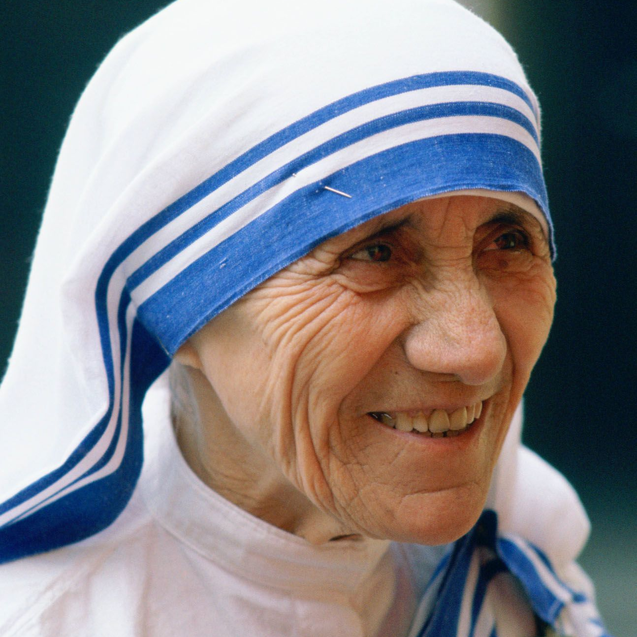
“I can do things you cannot, you can do things I cannot; together we can do great things.”
Mother Teresa

