Slide 1

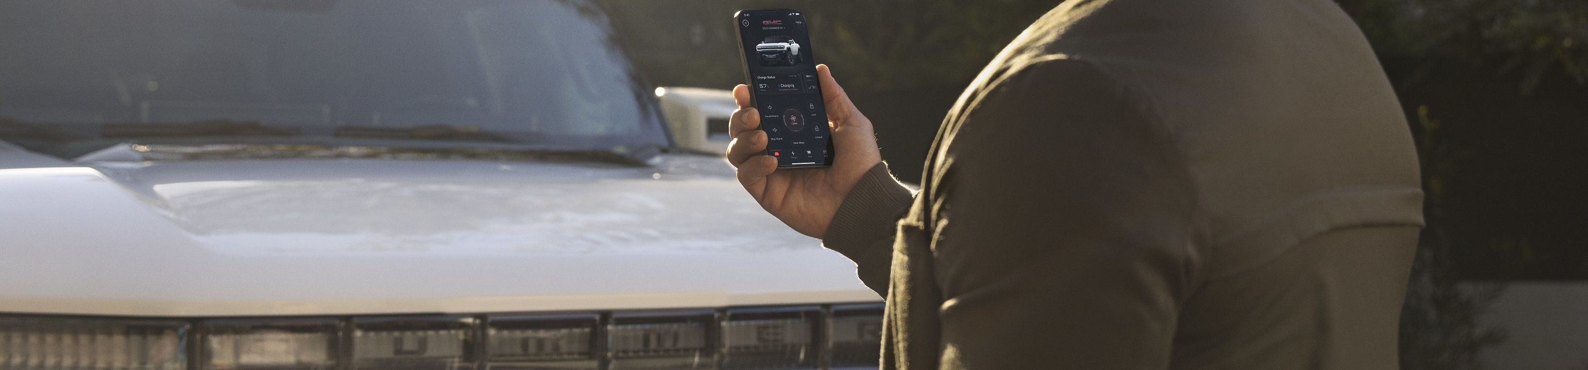
Welcome...
Sources: https://www.eclipse.org/org/artwork/

Slide 2
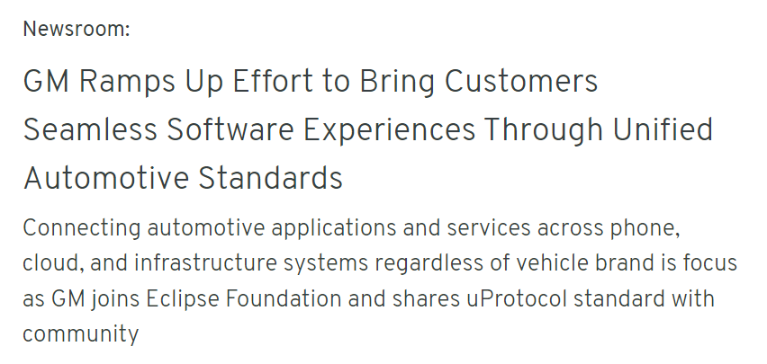

Eclipse and uProtocol
Connecting Automotive Apps and Services, Everywhere
Promoting collaboration on software solutions
A starting point for standardization
Builds on existing automotive and internet standards from the mechatronic layer to the cloud
Enabler for more efficient software development across multiple devices
Contributed as Open Source in Eclipse Foundation
Allows distributed applications and services to communicate regardless of where they are running
Sources: https://www.eclipse.org/org/artwork/
https://news.gm.com/newsroom.detail.html/Pages/news/us/en/2023/apr/0427-software.html

Slide 3
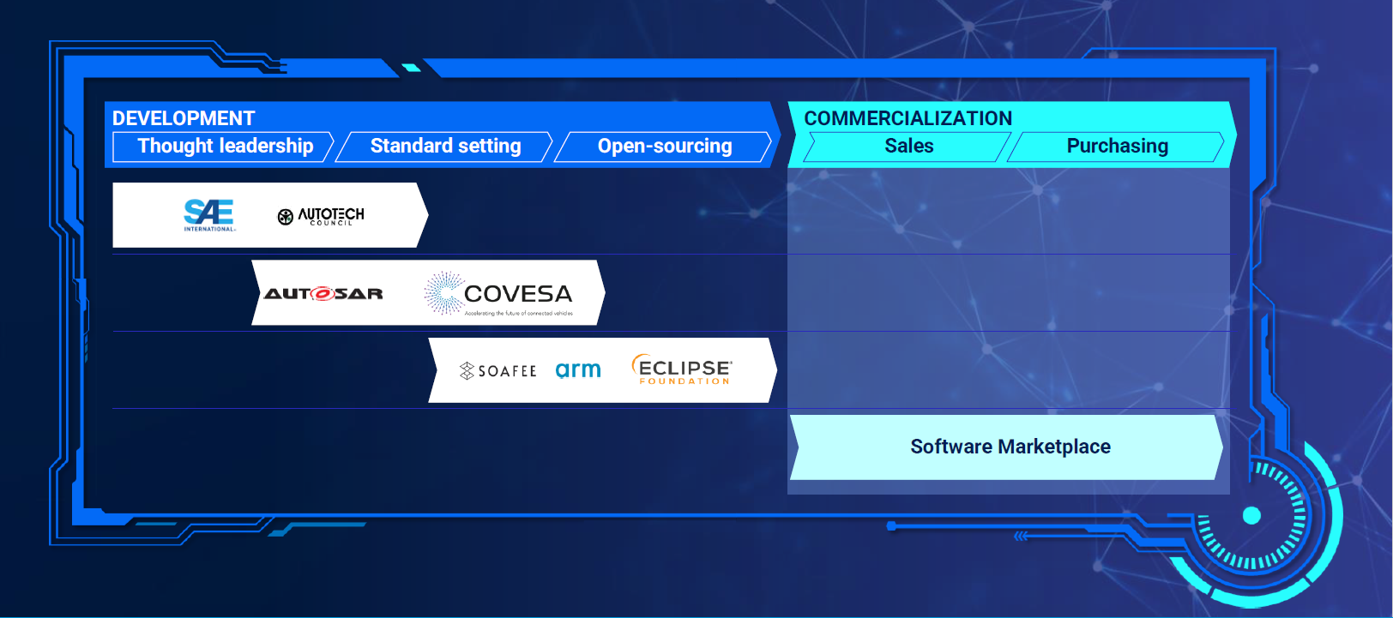

The SDV Landscape

Slide 4
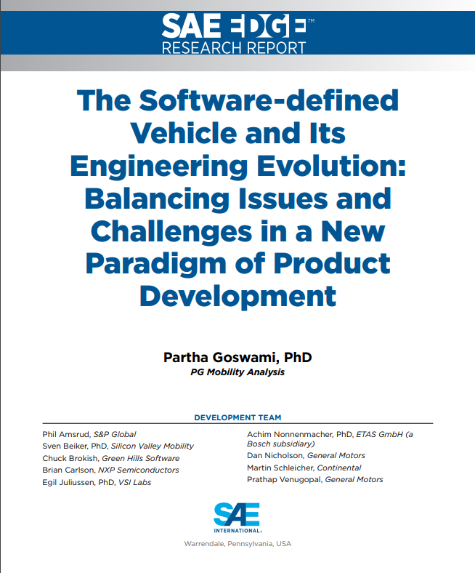
Source SAEMobilus: https://saemobilus.sae.org/content/EPR2024007

Slide 5
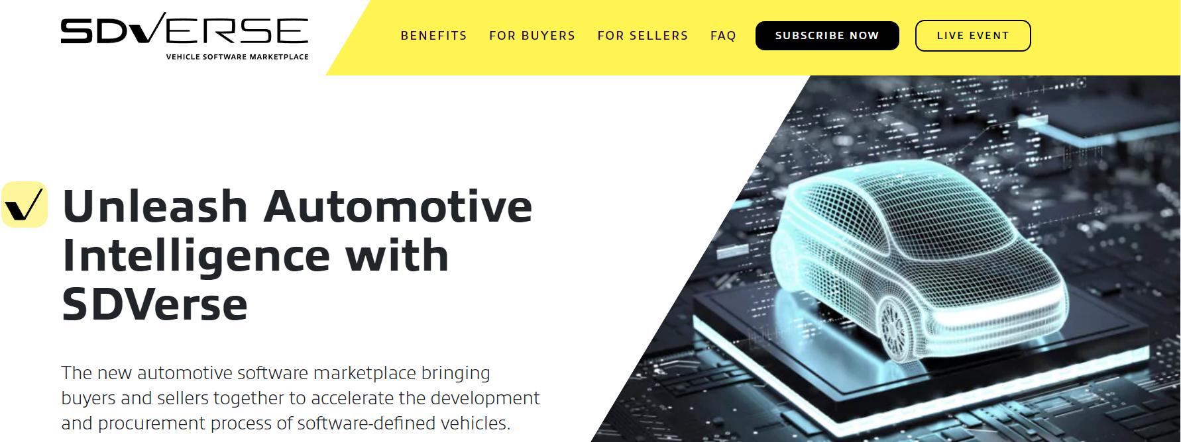
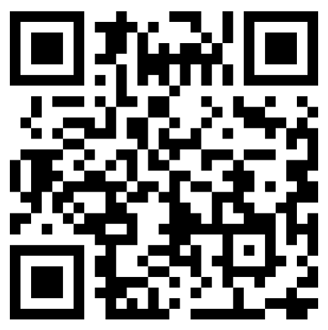
SDVerse panel discussion: Pioneering the vehicle software marketplace
April 4, 2024
11:00 AM-12:00 PM ET
sdverse.auto

Slide 6
Thank You.

