Slide 1


The OPENCOSS Approach
OPENCOSS Webinar for Polarsys
April 27th, 2015
Tim Kelly
OPENCOSS Technical Coordinator

Slide 2

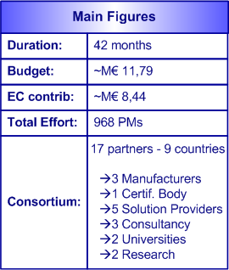














OPENCOSS at a Glance
External Advisory Board: 21 members
from industry, regulation organizations,
academia

Slide 3
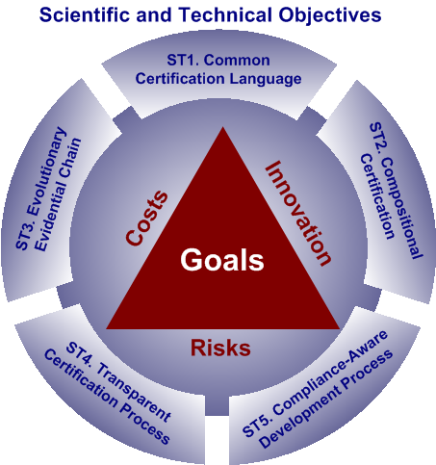
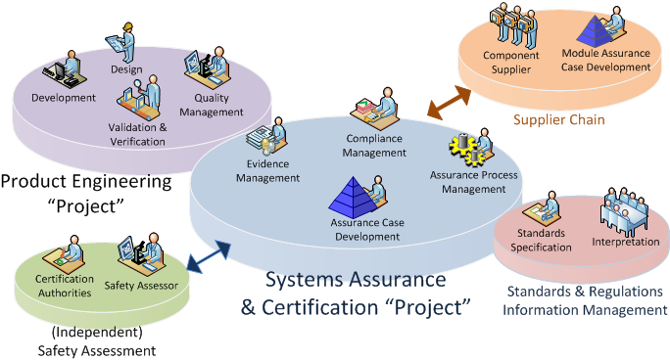
OPENCOSS Technical Objectives and Project Results
Industrial Usage Scenarios

Slide 4
ST1: Common Certification Language (CCL)
Structured Specification of Assurance/Certification Information
Conceptual Basis to Specify Assurance/Certification Assets
Common Concepts Across Application Domains
What
CCL
(Common Certification
Language)
Why
Facilitate Reuse of Assurance/Certification Assets
Automate Labor-intensive Certification-related Activities
Common Understanding and Interpretation of Assurance/Certification Information
© OPENCOSS – OPENCOSS Polarsys Webinar, April 27th, 2015

Slide 5


CCL Approach
Mappings
Safety Argumentation
Compliance management
CCF propositional language
Conceptual level
CCL provides the core concepts organized in semantically related groups
e.g. SBVR
Evidence Characterization
UE rules
ERMTS
UE
216/2008
Requirements
CS 25
FAR 25
National
Rules
IR 21
PART 21
Standard-specific
ARP4761
ARP4754
EN 50126
IEC 61508
Guidance
EN 50128
DO297
Safety assurance & certification processes
EN 50129
DO178
ISO 26262
EN 50159
DO254
CCL Vocabulary
Definition of certification scope
Cert. Project
Railways X
Cert. Project
Avionics Y
Re-use
Re-use
Process execution
Project-specific
Cert. items
Railways X.1
Safety cases
& evidence repository
Cert. items
Avionics X-Y.1
Cert. items
Railways X.2
Cert. items
Avionics Y.2
assessment
© OPENCOSS – OPENCOSS Polarsys Webinar, April 27th, 2015

Slide 6
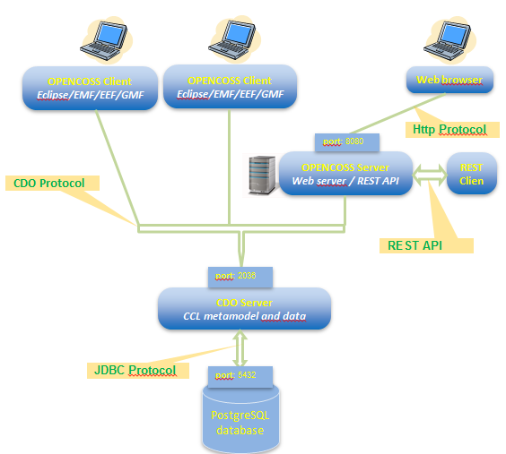
OPENCOSS Platform: CCL-based Centralized Architecture

Slide 7
ST2: Compositional Assurance/Certification
Contract-based Approach
OPENCOSS contributions to the Robust Composition of Assurance Information
Evidence Assessment Approach
CCL Vocabulary for Argumentation

Slide 8
ST3: Evolutionary Evidential Chain
1. Evidence storage
  Determination and specification of evidence and its lifecycle
2. Evidence traceability
  Specification and maintenance of artefact relationships
3. Evidence evaluation
  Assessment of evidence completeness and adequacy
4. Evidence change impact analysis
  Identification and analysis of possible effects resulting from changes in evidence
5. Integration with external tools
  Information import and export

Slide 9
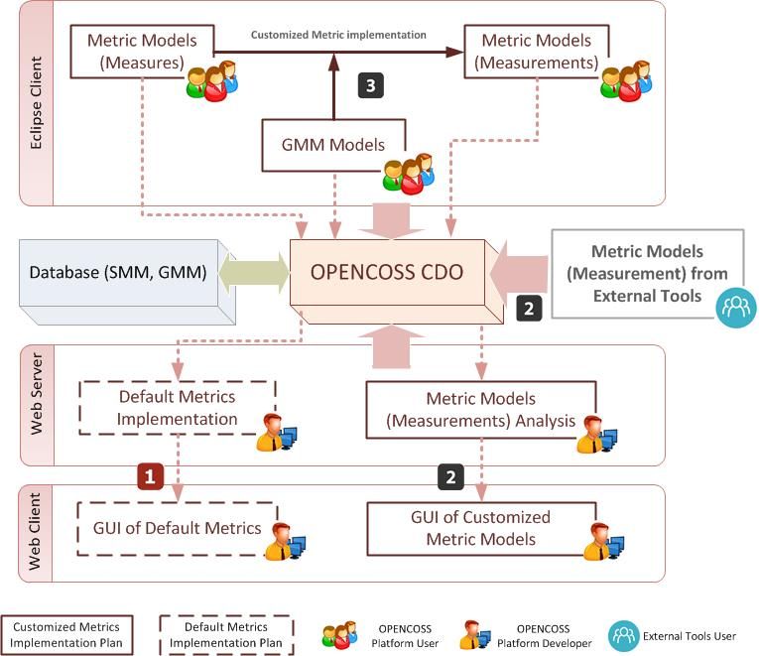
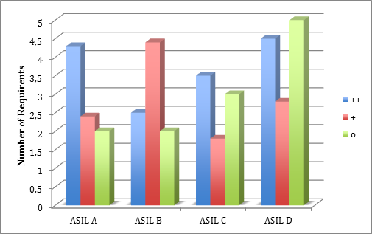
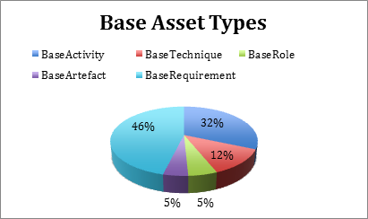
ST4: Transparent Certification Process

Slide 10
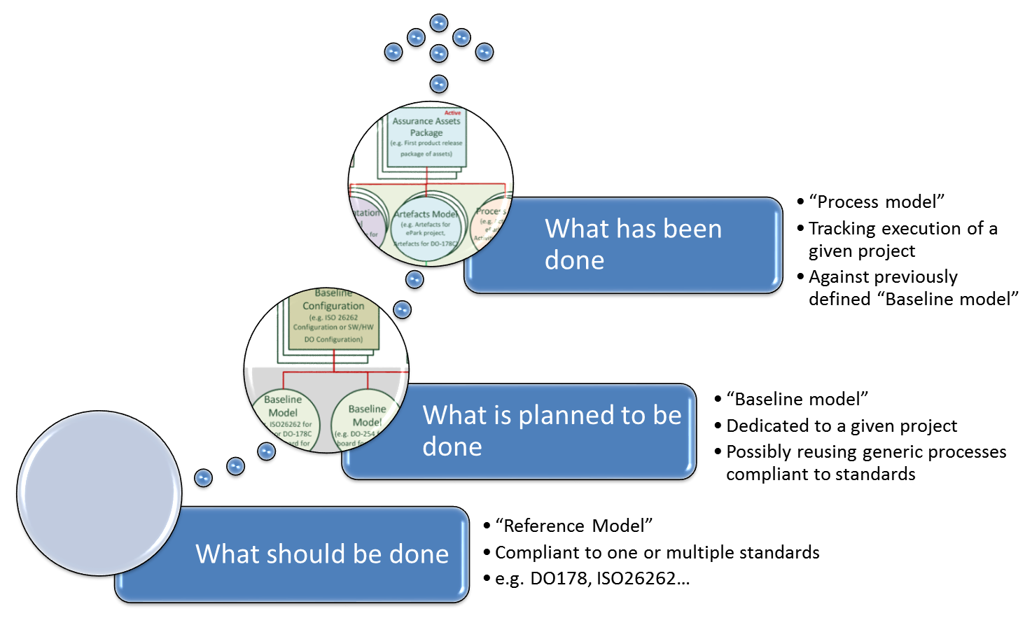
ST5: Compliance-Aware Development Process
Compliance through the whole Assurance/Certification process

Slide 11
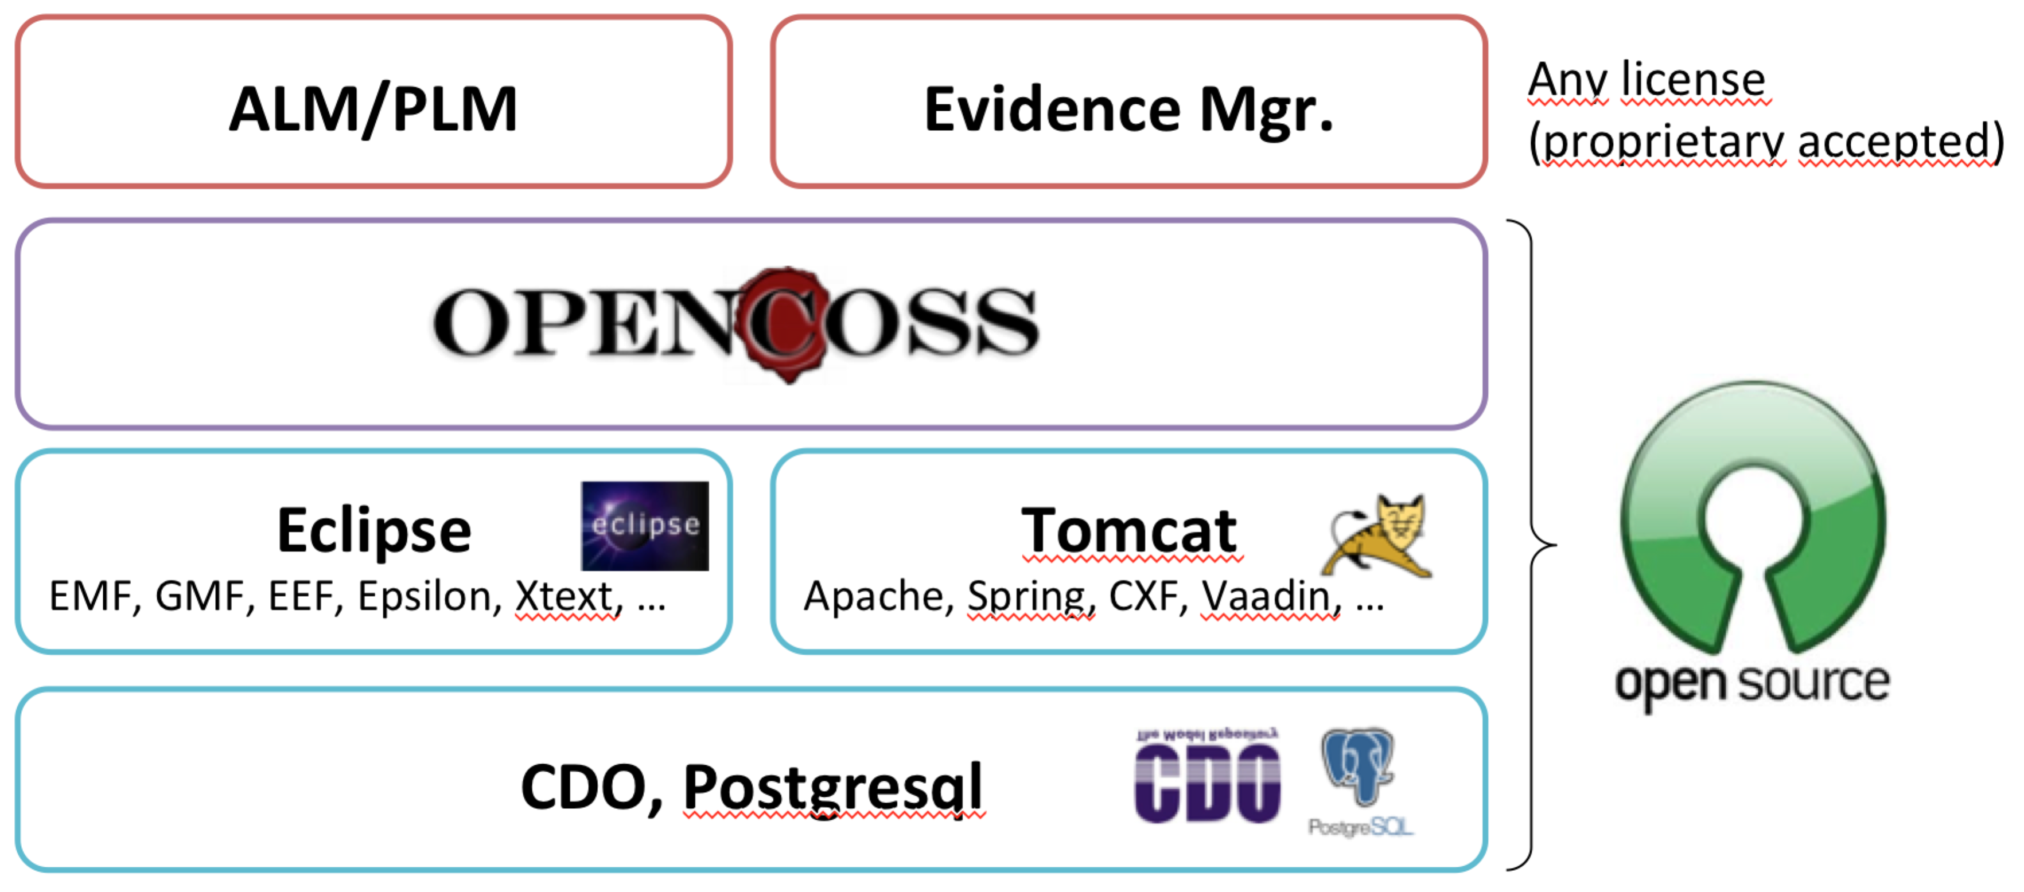
Layers of OPENCOSS platform distribution

Slide 12
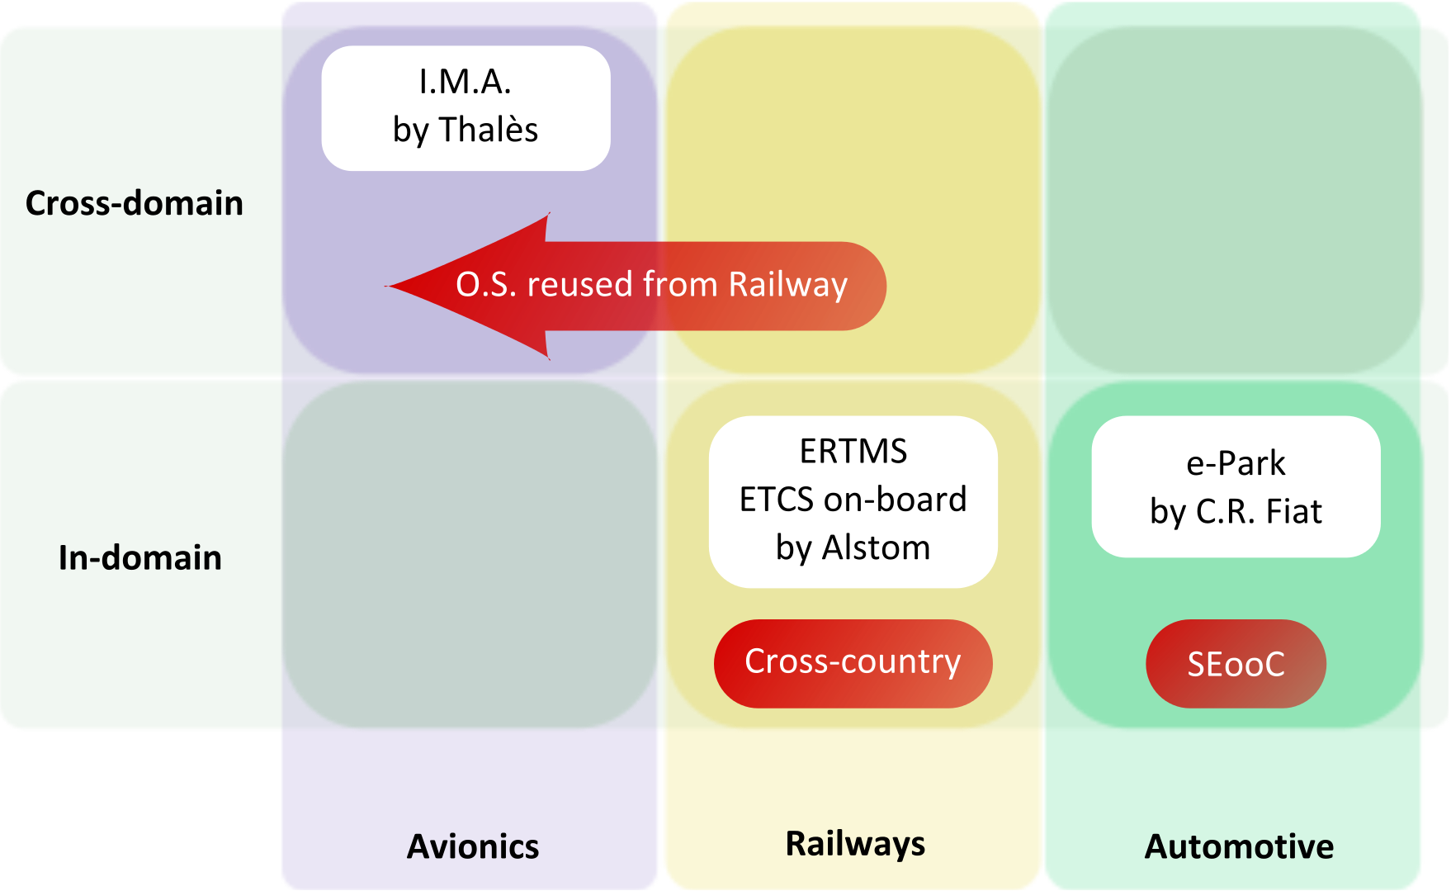
T1.2 Use Cases description and business impact
Expectation of Industry and Case Studies

