Slide 1
OpenADx Toolchain Proposal
Color code
V model step
OpenADx Blueprint Element
Currently not in blueprint
Not in V model, but probably needed
Possible solution

Slide 2
Requirements Elicitation
Requirements Engineering
“System of Systems
Test”
?
System Requirements Analysis
Requirements Engineering
System Test
Test drive, Connectivity based validation
Continuous Deployment
System Architectural Design
Architecture Definition
System Integration and Integration Test
Connectivity based validation
SW Requirements Analysis
Requirements Engineering
SW Test
Simulation based validation
SW Architectural Design
Architecture Definition
SW Integration and Integration Test
Integrate
SW Detailed Design and Implementation
Build
SW Unit Verification
Simulation and Test
Integrated Development Environment (IDE)

Slide 3
Requirements Elicitation
Requirements Engineering
? GitLab?
System Requirements Analysis
Requirements Engineering
?
Continuous Deployment
?
System Architectural Design
Architecture Definition
EMF, EMF.Cloud, Eclipse Theia, GLSP, Papyrus
SW Requirements Analysis
Requirements Engineering
?
SW Architectural Design
Architecture Definition
EMF, EMF.Cloud, Eclipse Theia, GLSP, Papyrus
SW Detailed Design and Implementation
Build
?
Integrated Development Environment (IDE)
VSCode, Eclipse IDE, Xtext, Eclipse Theia

Slide 4
“System of Systems
Test”
?
?
System Test
Test drive, Connectivity based validation
Eclipse Kuksa
System Integration and Integration Test
Connectivity based validation
Eclipse Kuksa
SW Test
Simulation based validation
Cloe, MCX
SW Integration and Integration Test
Integrate
Eclipse IDE, GitHub
SW Unit Verification
Simulation and Test
Cloe, MCX
Safety Compliance and Certification
GitLab

Slide 5
Backup

Slide 6
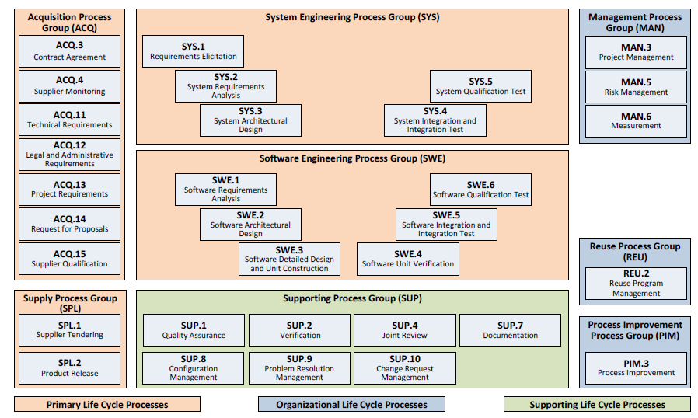

Slide 7
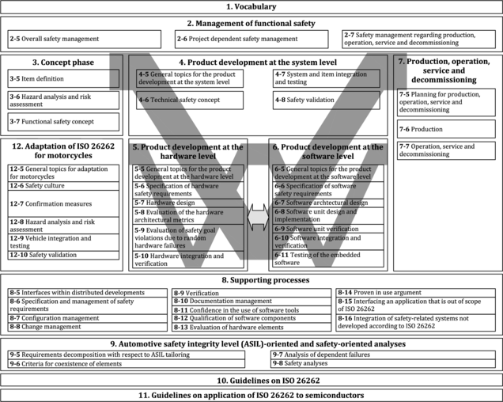

Slide 8
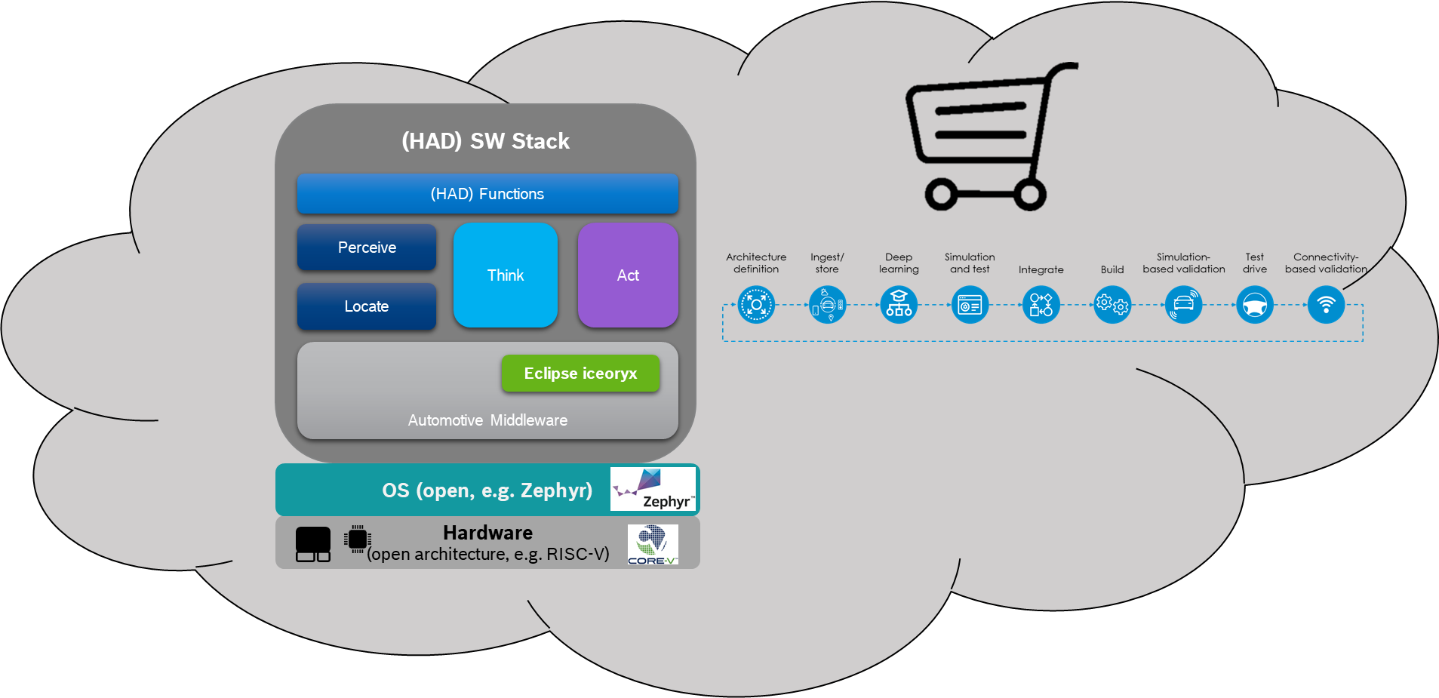
OpenADx – Big Picture – Vision
(HAD) SW Stack
(HAD) Functions
Perceive
Think
Act
Locate
0010
0011
0001
Automotive Middleware
Eclipse iceoryx
OS (open, e.g. Zephyr)
Hardware
(open architecture, e.g. RISC-V)
Developer

