Slide 1
openMDM® eclipse working group
Plenum meeting 2016
Steering committee report
Stuttgart, July 18th

Slide 2
openMDM® EWG time line
job split‘s end
MDM rich client
MDM|components
MDM@web
MDM|BL (business layer)
openMDM® Eclipse working group
Development process
Requirements management
Quality assurance
07/2014 – 06/2015
07/2015 – 06/2016
07/2015 – 06/2016

Slide 3
openMDM® EWG time line
job split‘s end
Operational readiness
(to be evaluated by
EWG‘s members)
WebClient development ✓
WebClient V1.0 07/2016
V1.x
V0.1
Deployment
06/2016
Best practices
Hackathon
04/2016
Component Architecture (CA4)
Hackathon
02/2016
Collaborative development of components
Basic development ✓
Availability @ eclipse.org ✓
Strategic Orientation, goals synchronization, concept development ✓
07/2015 – 06/2016
07/2016 – 06/2017

Slide 4
openMDM® EWG time line
V0.1
V1.0
Multi Connector✓
Login✓
Administration
Navigation✓
Test Planing (Ordering)
Detail Viewer✓
Search✓
Measuring Point
Shopping Basket✓
Measurement Quantities
Multi Language✓
Archiving
Export✓
„other“ Data Sources
Full Text Search✓
Security Handling
07/2015 – 06/2016
07/2016 – 06/2017

Slide 5
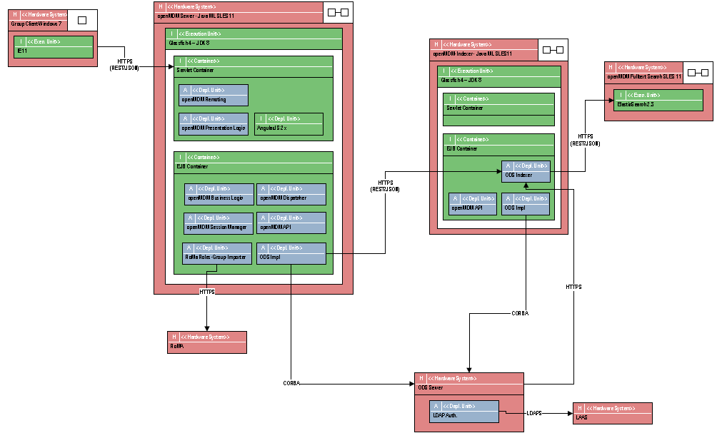
openMDM® status vs. architecture
✓
Standardized generic
Persistence layer
✓
Basic functions
Multiple database connect
Navigation
Search
Download
✓
Compatibility
MDM 4 database
?
Functions
Import
Administration
Template handling
✓
Business object model
✓
Big data readiness
!
API
✓
Collaboration readiness (modularization, QA)
!
ASAM ODS Applikationsmodell

Slide 6
openMDM® operational issues
Use of Jira:
All EWG members should be adressable within the Jira instances of the EWG
Create your account at https://openmdm.atlassian.net/admin/users/sign-up
Request authorization from jira@openmdm.atlassian.net

Slide 7
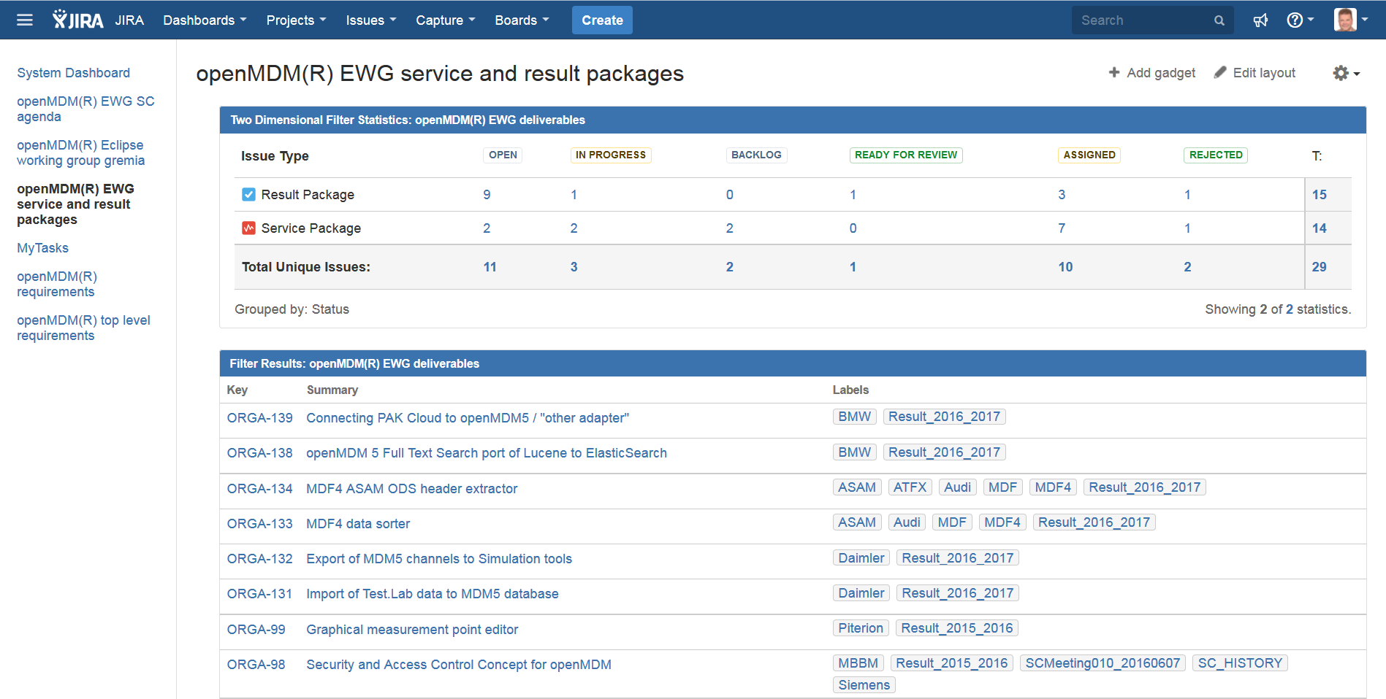
openMDM® operational issues
Use of Jira:
Involve yourself to the EWG‘s topics

Slide 8
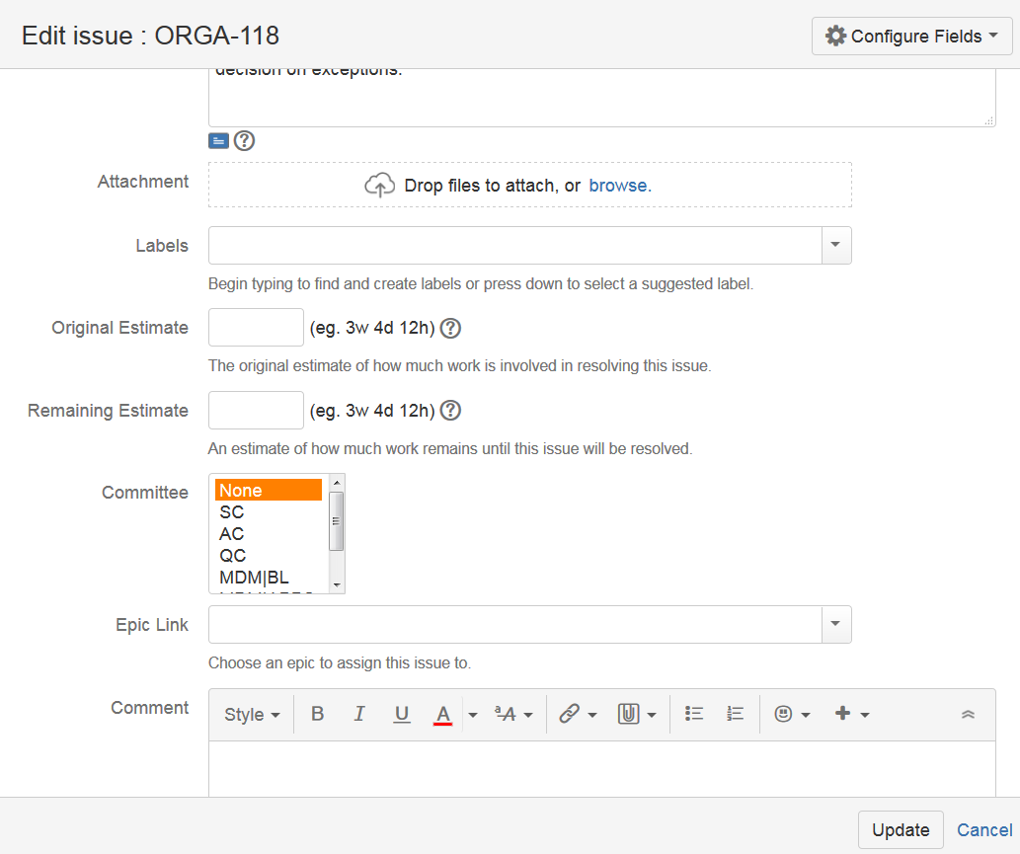
openMDM® operational issues
Use of Jira:
Use the meeting management features in the EWG‘s Jira
put issues on the agenda of EWG gremia by editing the committee field

Slide 9
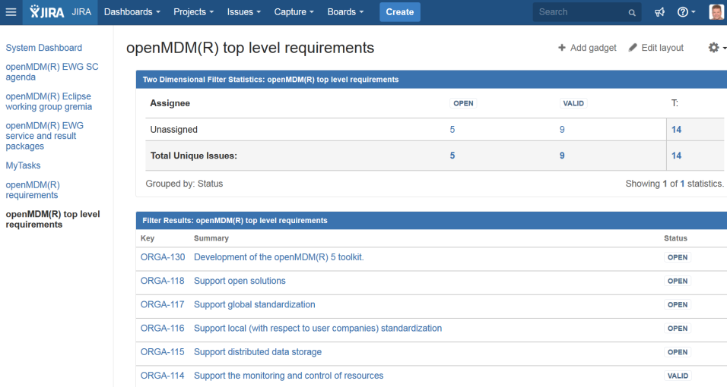
openMDM® operational issues
Top Level Requirements (Goals) Management
The steering committee decided to maintain a set of top level requirements, from which further actions or decisions can be derived. It should be visible to the public and thus serve for a vivid and transparent discussion – followed by a stringent focus on the common goals of the EWG. For that reason, the charter was transformed into a set of goals (as Jira tickets qualified by the issue type „top level requirement“).
This way, requests for strategic orientation and/or focus can be placed by the community members and validated by the steering committee. They serve furthermore to keep track of the strategic decisions of the community and to initiate and drive by the SC strategic changes if needed.

Slide 10
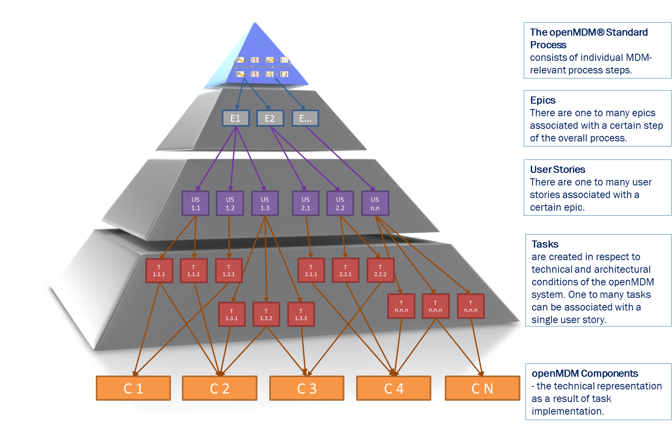
Requirements from Daimler 2016 ff
allways online and up to date with Jira-Link
Open MDM modules
Jira

Slide 11
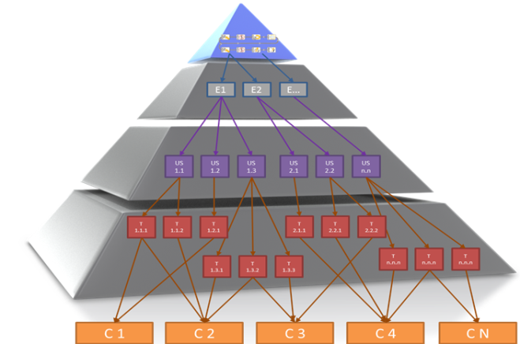
Requirements from Daimler 2016 ff
9 user storys planed
ambitious targets to open MDM® 5 - overview of the Daimler user storys #1-#9 -
user story | discription | decision date | leader | Pilot finished
#1 | MDM@WEB – Simulation kann Messdaten laden und mit Simulation vergleichen (Siemens) | 13.06.16 | Dr. Kammler | 06.2017
#2 | MDM@WEB – Simulation kann Messdaten laden und mit Simulation vergleichen (Müller BBM) | offen | (Rabenstein) | 06.2017
#3 | MDM@WEB – Messdatenbrowsing | offen | NN | 06.2017
#4 | Funktionsdatenmanagement - Anlieferung von Simulationsparameter durch Lieferanten | 2014 | Dr. Böhm | 12.2018
#5 | Volltextsuche z. B. für Thermo-Simulation | 19.05.16 | Gärtner | 08.2016
 | use cases, die open MDM nutzen könnten:
#6 | Messstellen-Editor im Engineering-Client | 02.2015 | Mathwig | 06.2016
#7 | Audio-Messstellen-Editor im Engineering-Client und open MDM (Tonstudio) | 28.06.16 | (Dr. Schulze) | 04.2017
#8 | Serienerprobung Dauerlauf – evt. gleiches Konzept für Immendingen mit Big Data? | offen
#9 | Werkstattsteuerungssystem auf Basis von open Source Windkanal und PKW-Powertrain-Entwicklung | 04.2016 | Heidrich | 12.2016

Slide 12
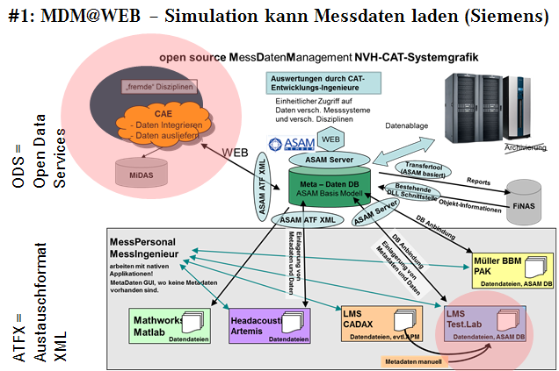
Requirements from Daimler 2016 ff - ambitious targets to open MDM® 5 -
- user story - example #1
#1: MDM@WEB – Engineer can load measured data and compare it with simulation (Siemens Test.Lab)
Jira
validation
save time
save money
quick analytic
new methodes

Slide 13
Requirements from Daimler 2016 ff

Slide 14
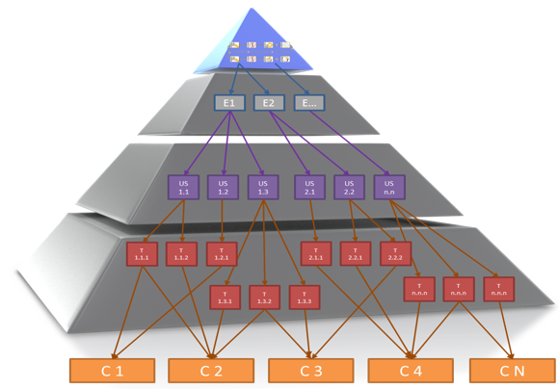
user storys - detail plans #1-#9
to do
new open MDM® 5 modules = ?
security
cloud
detail view x/y
quick audio
start with mime-type …

Slide 15
Summary of the plan 2017 Daimler
Realease the 9 user storys for use
(# = user story)
#1: add necessary modules to MDM|Components to
transforme the open MDM4® ODS-selection Test.Lab to open MDM5® by Siemens
#2: add necessary modules to MDM|Components for
analog to #1 with PAK by Müller BBM
#3: add necessary modules to MDM|Components for
data viewing like open MDM4 ® x/y and quick audio
to do: identify modules which we need

Slide 16
Requirements Siemens

Slide 17
Requirements Müller BBM

Slide 18
Requirements Company xyz … !

Slide 19
Backup

Slide 20
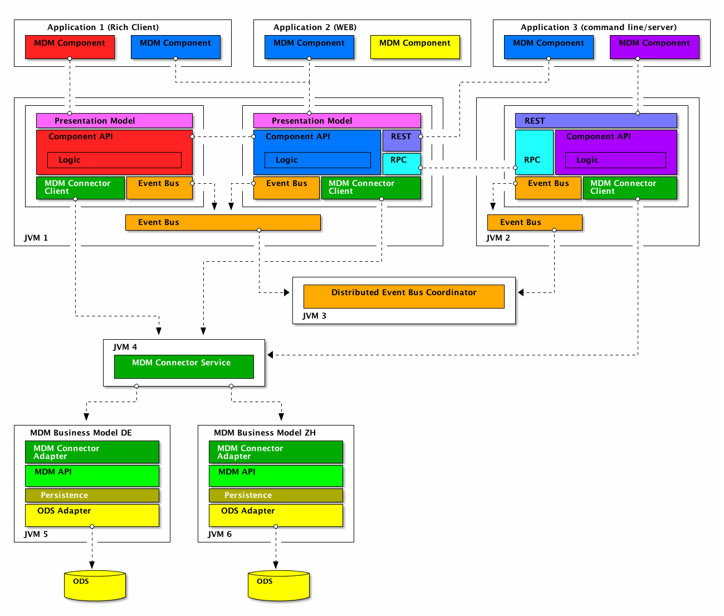
openMDM® status vs. architecture
✓
Standardized generic
Persistence layer
✓
Basic functions
Multiple database connect
Navigation
Search
Download
✓
Compatibility
MDM 4 database
✓
?
Functions
Import
Administration
Template handling
Business object model
✓
API
✓
Big data readiness
!
ASAM ODS Applikationsmodell
Collaboration readiness (modularization, QA)
!

