Slide 1
S12: Requirements Management
Open Measured Data Working Group
Sibylle Peter
Dr. Hans-Dirk Walter

Slide 2
Agenda
Proposal of RE process for open MDM
  Responsibilities
  Workflow of requirements
Discussion & adjustment of proposal
  →final proposal for steering committee
Lunch
? Roadmap timeline
Next steps

Slide 3
Proposal for RE in OpenMDM

Slide 5
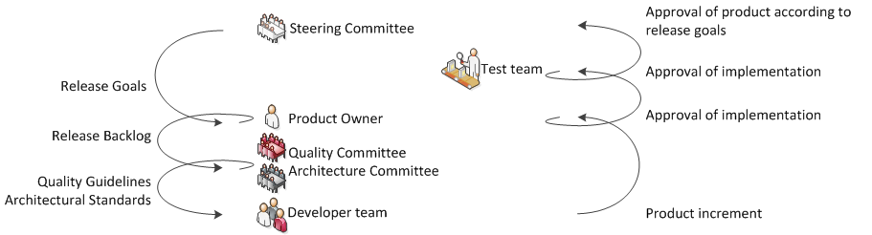
Participants & Responsibilities

Slide 6
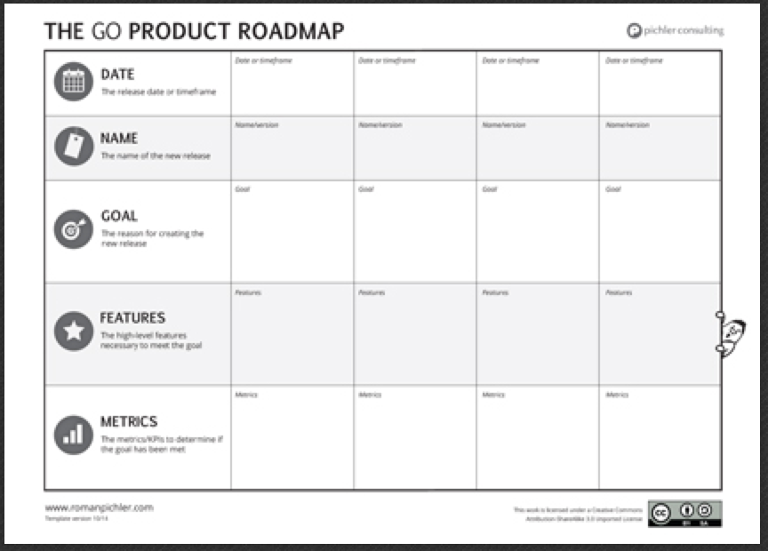
Roadmap
Notes:
Roadmap:
Goal driven
Plan – needs to be revisited regurarely
User driven – Personas

Slide 7
Participants & Responsibilities

Slide 8

PO Responsibilities
Cares about user needs & business goals
Product Vision
SUCCESS
Manage stakeholders
Product
Owner
Empowered to make decisions
Works with the Dev Team
Notes:
What the heck is a PO:
Vision: can explain the product vision to stakeholders and dev team
Keeps user needs and business goals in line
Communicator: works with stakeholders and dev team
Empowerment -> very important, needs to make decisions fast.

Slide 9
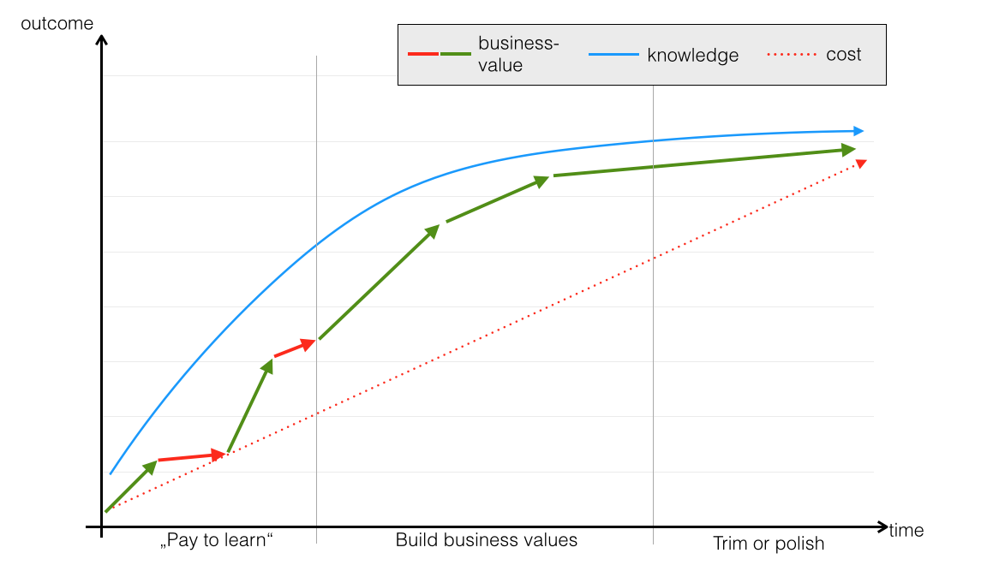

Slide 10
Participants & Responsibilities

Slide 11
Participants & Responsibilities

Slide 12
RE / backlog management
Everybody can create issues. It is the responsibility of the PO to filter the issues. (Backlog Management).
It is normal that in the backlog, not all issues have the same granularity.
Notes:
PO – say NO!

Slide 13
RE / backlog management II
As the PO is responsible for the product and meeting the release goals, the priority or severity set by the reporter is only a recommendation
The backlog needs to be filterable to work efficiently with such a project.
Notes:
PO – say NO!

Slide 14
Backlog items
Use case
User story
Specification document
?
Notes:
No matter what you call it – at first a requirement is a request or a whish that should be considered. It need to be in a form which is understandable but which also serves as communication

Slide 15
Recommended form of backlog items
User story
  not a requirement, but a communication tool.
  user centered
  when a story fits the release goals and the PO decides to implement it, the requirements (constraints, examples, business rules etc.) need to be specified (made sprint-ready).
Notes:
We recommend user stories because they avoid waste.

Slide 16
Formal requirements for the issues
(stories, tasks, bugs)
Summary
Description
Acceptance Criteria
  Define when the issue is completed
Bugs
  Version Bug appears
  Steps to reproduce
  Error message, log etc.
Notes:
A note on user stories

Slide 17
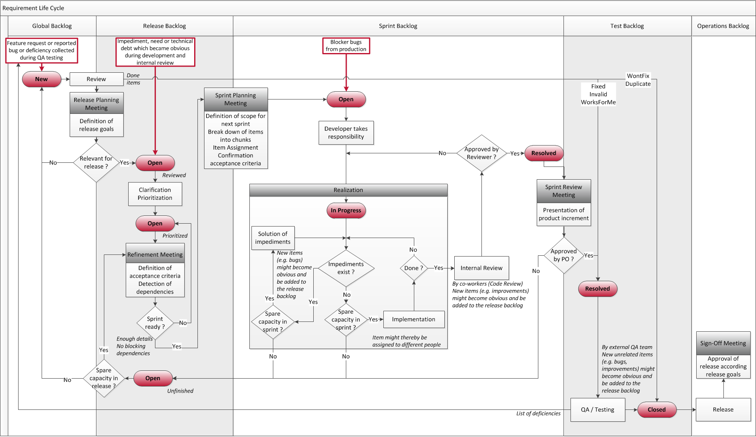
Workflow of an issue
Notes:
Describe workflow of requirement and states.
Blocker Bugs: Prevent people from working – loosing of money or credibility
Issues not relevant for release remain on new.
----- Meeting Notes (08/12/14 16:41) -----
Black Box einzeichnen:
Eingang priorisiertes Release Backlog und Ausgang: ReviewMeeting mit QA/Arch/GlobalPO.

Slide 18
Summary

Slide 19
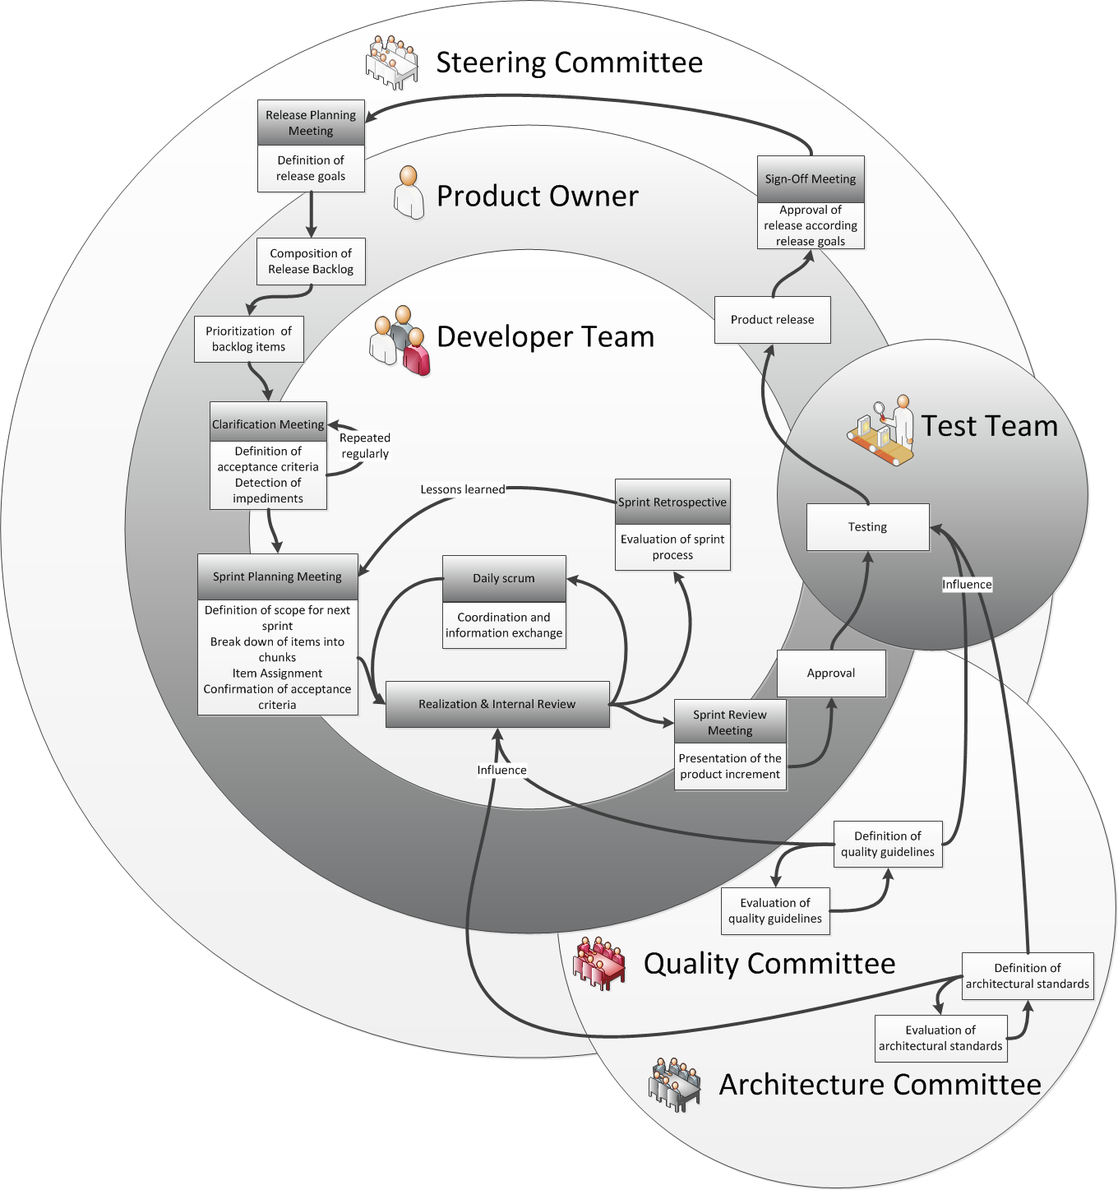

Slide 20
Summary of proposal
Control cost by fixed budget
Define 3 – 4 releases a year.
Plan High level roadmap (Goals)
Get People to implement the goals
Adjust regularly

Slide 21

Questions? Diskussion? Improvements?
Notes:
65% of the features are never or rarely used! -> Doing the wrong things.

Slide 22
Wir beantworten gerne Ihre Fragen
Ansprechpartner
Firmenadresse
Sibylle Peter
Head Customer Solutions / Agile Coach
Dr. Hans-Dirk Walter
Chief Executive Officer
hans-dirk.walter@canoo.com
Canoo Engineering AG
Kirschgartenstrasse 5
4051 Basel/Switzerland
T +41 61 228 94 44
F +41 61 228 94 49
www.canoo.com
info@canoo.com

Slide 23
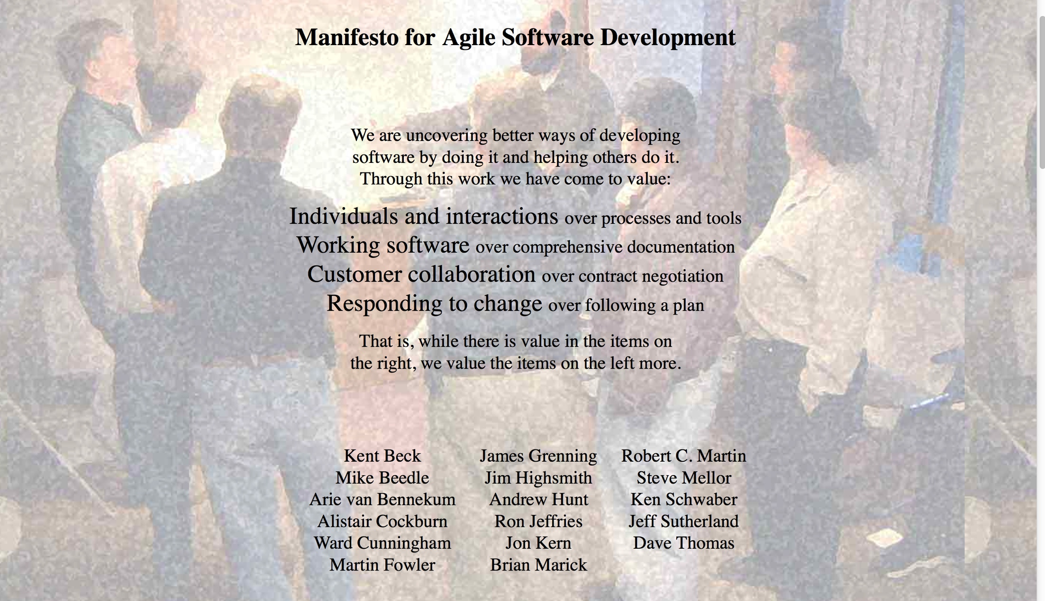

Slide 24
Our highest priority is to satisfy the customer through early and continuous delivery of valuable software.
Welcome changing requirements, even late in development.
Deliver working software frequently, from a couple of weeks to a couple of months, with a preference to the shorter timescale.
Business people and developers must work together daily throughout the project.
Notes:
First 4 principles of the Agile Manifesto – influence on RE

Slide 25
Biggest waste in Software Development?
Notes:
65% of the features are never or rarely used! -> Doing the wrong things.

Slide 26
Schedule
Risk
Scope
Budget
People
Quality
Notes:
So what do we need to do – manage scope -> hence importance of requirements
One way of doing this is having fixed budget and schedule and adjusting Scope…
But not only scope – we also have other factors to manage: Quality, Risk, People…
In agile we agree on the right level of quality and then no longer compromise it. People are out of scope here…
The next slides focus on Scope & Risks (not all).

Slide 27
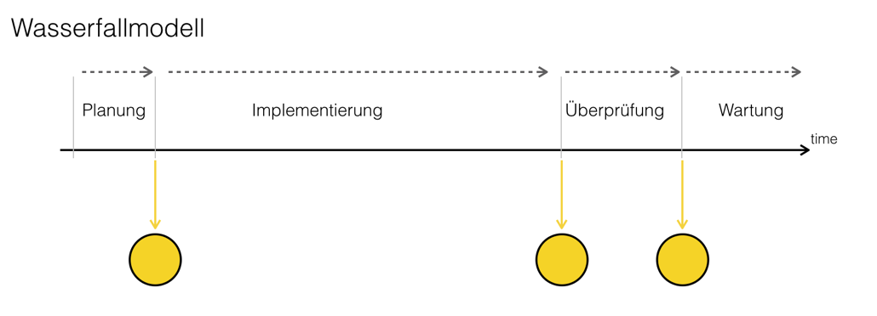

Slide 28
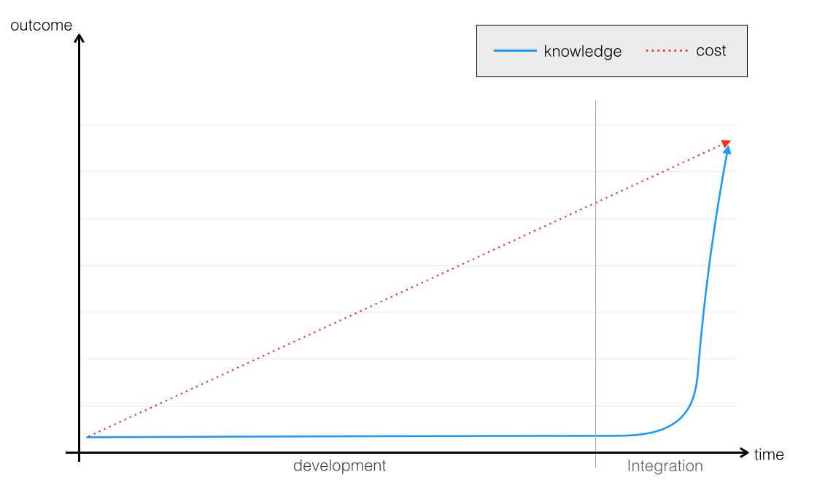

Slide 29
