Slide 1
summit
Goofy's strawman plan*
and dev process proposal
Jasmine's lessons learned
* https://www.linkedin.com/pulse/strawman-project-plan-what-why-should-you-use-one-brian-fredrickson

Slide 2
RETROSPECTION

Slide 3
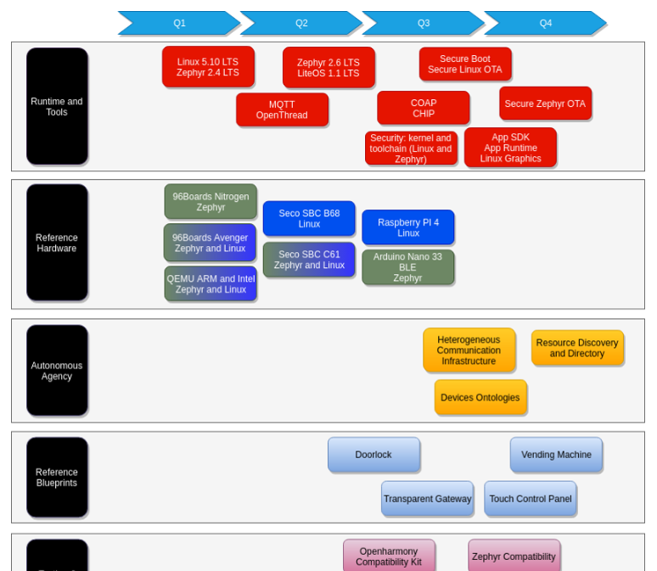
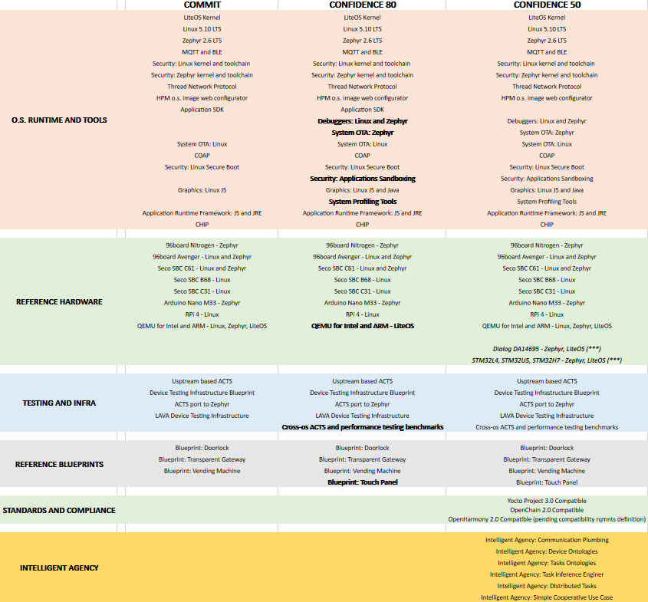
Jasmine’s development plan
Designing the roadmap
Requirements gathering
HW Roadmap definition
Requirements acceptance
Requirements decomposition and workload estimation
Team capacity planning
Plan execution with ongoing plan vs execution verification
Periodical requirements backlog update
😐

Slide 4
Release schedule
Release Schedule
22 Feb – Aladdin Features Freeze
2 Apr – Go/No-go
12 Apr – Aladdin General Availability 22 Jun – Jasmine Alpha
14 Sep – Jasmine Beta
22 Nov – Jasmine Release Candidate
?? Dec – Go/No-go
20 Dec – Jasmine General Availability
1st official Oniro LTS release
*Quarterly realease cycle
😀

Slide 5
Jasmine’s scrum
Sprints schedule
Sprint 1 (21 Apr - 11 May)
Sprint 2 (12 May - 01 Jun)
Sprint 3 (02 Jun - 22 Jun)
Sprint 4 (23 Jun - 13 Jul)
Sprint 5 (14 Jul - 03 Aug)
Sprint 6 (04 Aug - 24 Aug)
Sprint 7 (25 Aug - 14 Sep)
Sprint 8 (15 Sep - 05 Oct)
Sprint 9 (06 Oct - 28 Oct)
Sprint 10 (29 Oct - 16 Nov)
*3 weeks cycle
🙁

Slide 6
Jasmine’s scrum meetings
Weekly Update - every Thursday, 10 - 11 AM CET
Sprint Review - every 3rd Tuesday, 2 - 3 PM CET
Sprint Retrospective - every 3d Wednesday, 12 - 1 PM CET
Sprint Planning - every 3rd Friday, 10 - 11 AM CET
😀

Slide 7
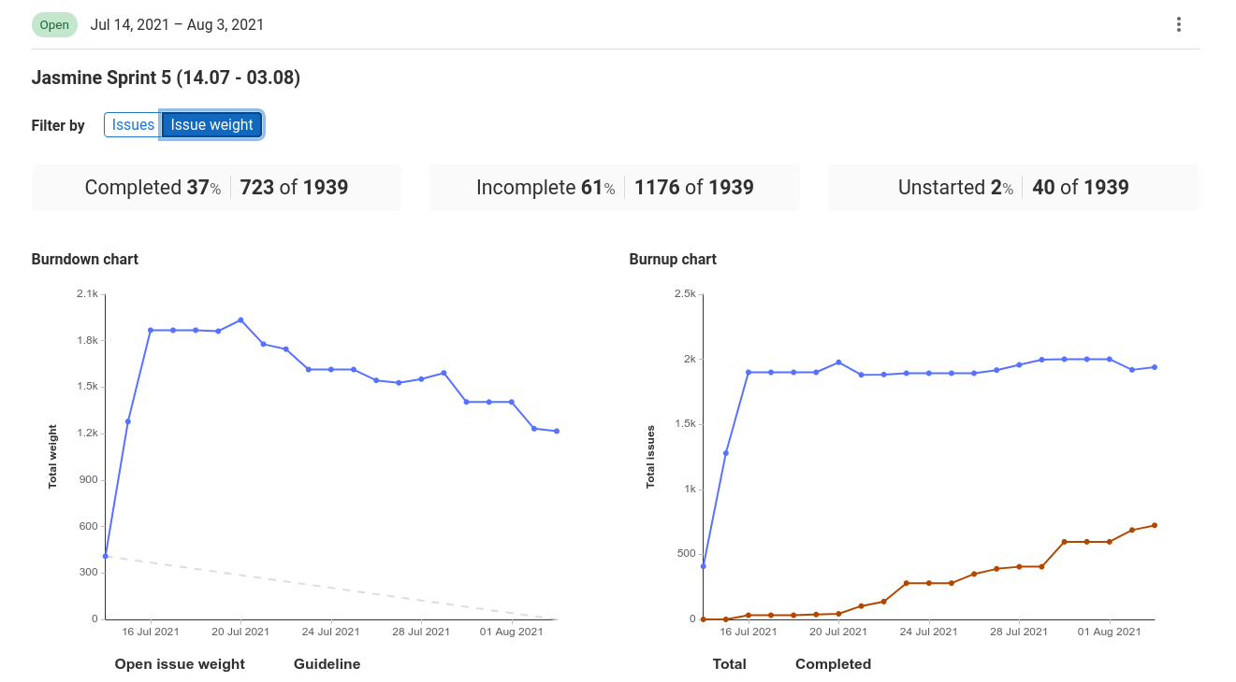
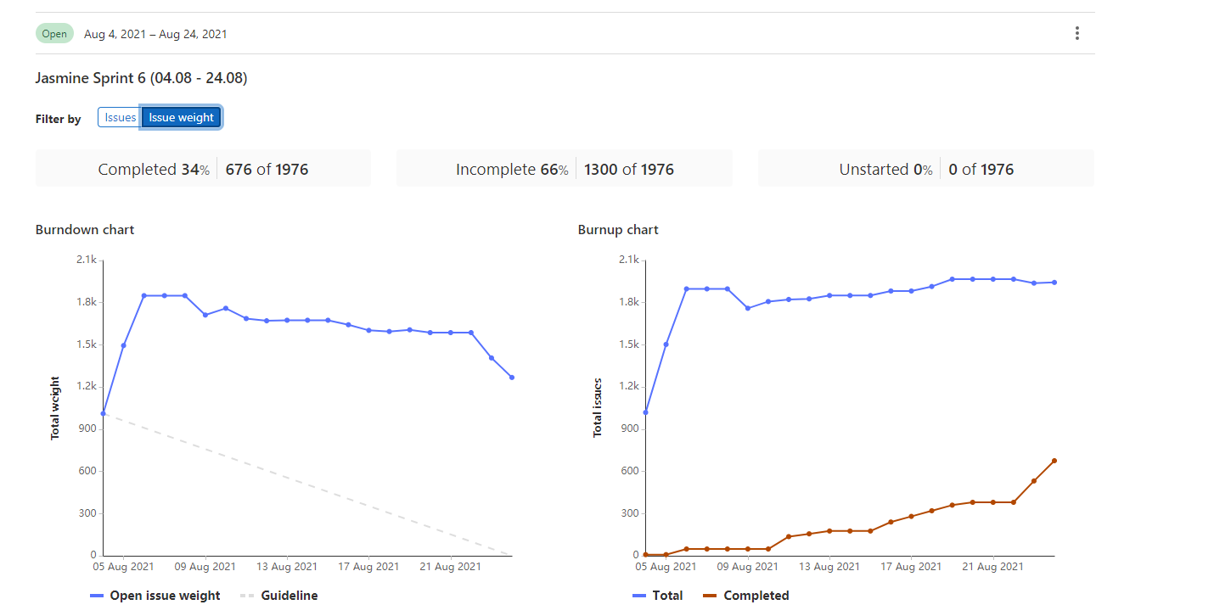
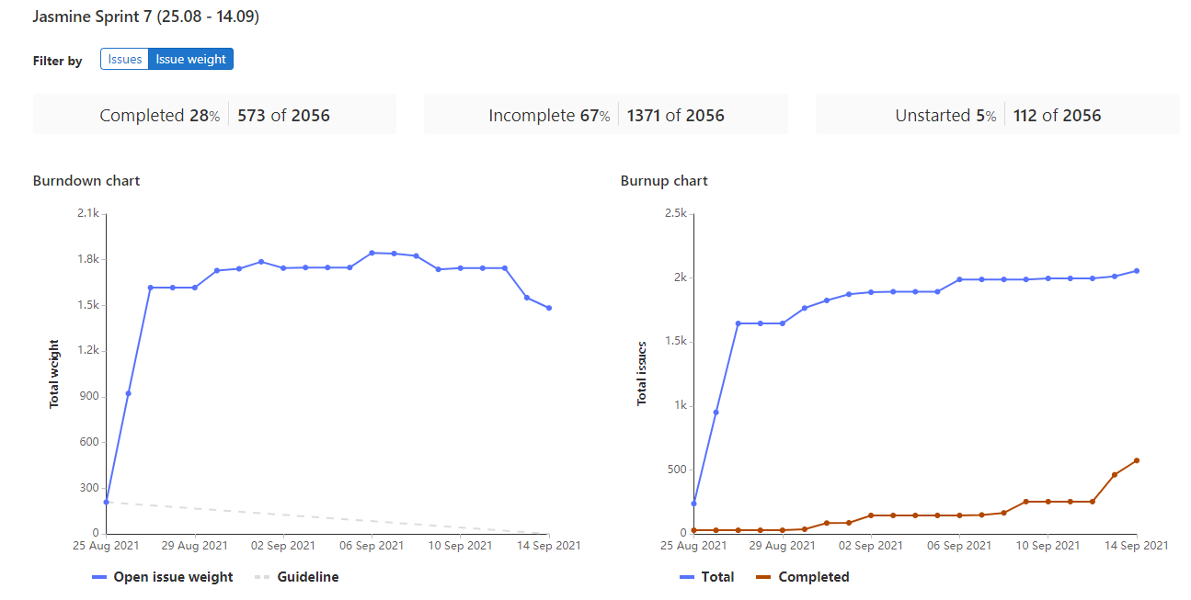
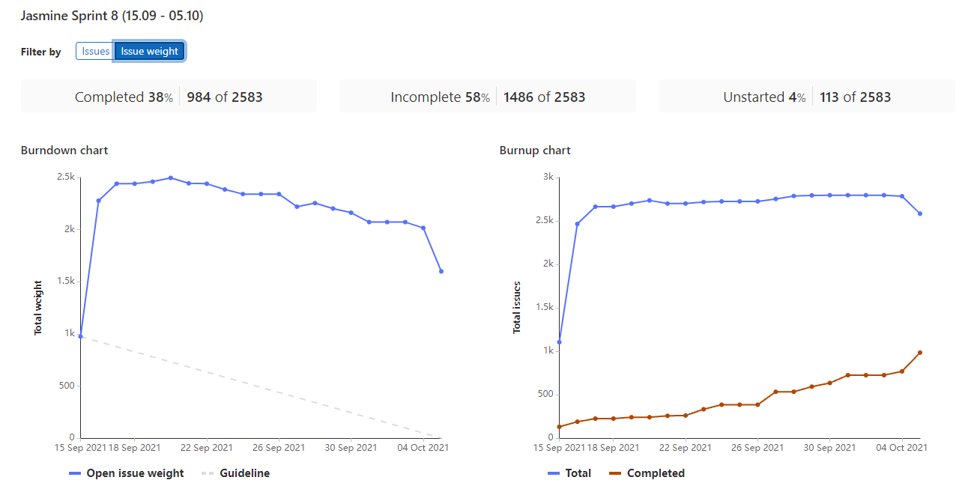
Sprint planning vs execution
Misalignment between planning and execution
Overoptimistic planning
Underestimated side activities
New and growing team
To big chunks of works too hard to estimate
Reasearch type of work
🙁

Slide 8
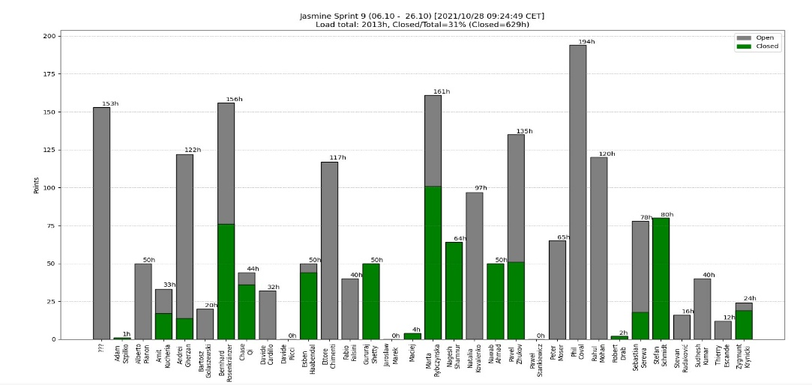
Performance monitoring
Lack of automated performance monitoring
🙁

Slide 9
Requirements management
Selection:
Acceptance of requirements set for release
Ongoing requirements backlog filling
Periodical requirements backlog review and release backlog update
OpenProject and then GitLab as a system of choice
May be proposed by any but must be agreed by all partners
Ambiguous closing criteria
Execution spanning multiple sprints and even releases
😐

Slide 10
Systems we’ve used
OSTC GitLab - code, tasks management, planning, documents storage
Booting GitLab - code, tasks management, planning, documents storage
OSTC Mattermost - chat
Booting Mattermost- still booting
OSTC Discourse - forum
OSTC OpenProject - requirements management (deprecated)
IRC - IRC public chat
🙁

Slide 11
Planning, monitoring, reporting
Tasks managed in GitLab
Requirements managed in OpenProject, moved to GitLab lately
Planning and review meetings every sprint cycle
Weekly engineering syncup meetings documented in GitLab
Weekly report sent by project manager to all parties on Friday
Periodical requirements review meeting
https://git.ostc-eu.org/OSTC/planning/scrum/-/blob/master/WGEngineeringWeeklyReports/README.md
https://git.ostc-eu.org/OSTC/planning/scrum/-/wikis/home
https://git.ostc-eu.org/groups/OSTC/-/boards/100?iteration_id=Current
https://project.ostc-eu.org/projects/open-source-technology-center-eu/
https://git.ostc-eu.org/OSTC/requirements/-/issues
😀

Slide 12
WHAT NOW?

Slide 13
Designing the roadmap
Goofy roadmap design should follow Jasmin best practices
Requirements gathering (ongoing)
Final release scope definition (end of Feb 2022)
Workload estimation done by whole engineering team (change)
Manpower and cost estimation (time is bounded, quality defined by requirements)
Release scope reevaluation (if necessary)
Project execution
Ongoing requirements review
What kind of manpower we can expect for Goofy?
😀

Slide 14
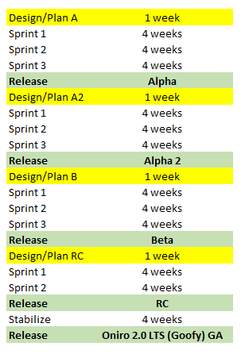
Release cycle for Oniro 2.0 LTS (Goofy)
Longer sprints to minimize related overhead
Release every quarter
Stabilization phase with intense testing before GA
Planning considered in schedule
52 weeks total = 1 year
😀

Slide 15
Scrum updated
4 weeks cycle
Effort planning
Moving from hours to points (??)
Better control over under/over planning to improve predictability (supported by automated tools)
Done by allocated sub-groups divided by technological areas
Maintained periodical meetings (planning, closing, retro, weekly)
Rotational Project Management
Who will drive Goofy?
😀

Slide 16
Requirements management improvements
Requirements should:
clearly define benefits
indicate beneficent(-s)
have accountable person(-s) assigned
span for no more than 2 sprints
have clear testing and closing criteria
be automatically linked with tasks (same system preferred)
Lack of test team
How to staff test team before Goofy starts?
😀

Slide 17
Other improvements
Define and follow QA process
Automate data gathering including project metrics
Minimize number of systems used
Common videoconferencing system for whole WG
😀

Slide 18
JOIN ONIRO PROJECT
Thank you!
Join us on oniroproject.org

Slide 19
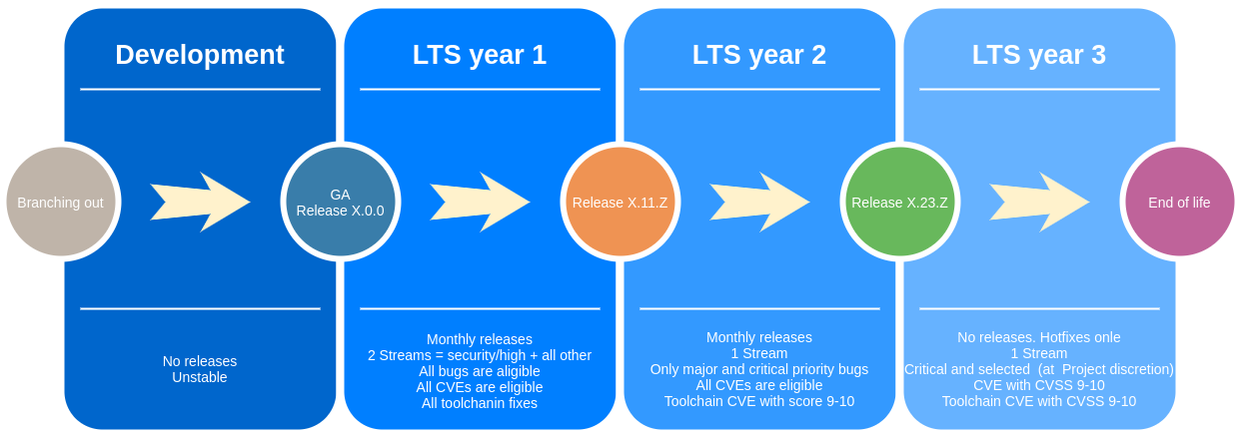
PRODUCT RELEASE LIFECYCLE
* https://git.ostc-eu.org/OSTC/planning/maintenance/-/wikis/Releases-and-supportability

Slide 20
HARDWARE ENABLEMENT ROADMAP
Q1
Q2
Q3
Q4
Linux 5.10 LTS
Zephyr 2.4 LTS
Zephyr 2.6 LTS
LiteOS 21.1 LTS
Secure Boot
Secure System OTA
Runtime and
Tools
MQTT
Open Thread
COAP
CHIP
Security kernel and toolchain
App SDK, App Runtime,
Linux Graphics
(Linux and Zephyr)
96Boards Nitrogen Zephyr
Reference
Hardware
Seco SBC B68 Linux
Raspberry PI4 Linux
96Boards Avenger Zephyr and Linux
Seco SBC C61 Zephyr and Linux
Arduino Nano 33 BLE Zephyr
QEMU ARM and Intel Zephyr and Linux
Autonomous
Agency
Heterogeneous Communication Infrastructure
Resource Discovery and Directory
Devices Ontologies
Reference
Blueprints
Doorlock
Vending Machine
Trasparent Gateway
Touch Control Panel
Testing &
Infrastructure
OpenHarmony Compatibility Kit
Zephyr Compatibility
Device Testing Blueprint
LAVA based Device Testing Infrastucture
Standards &
Compliance
Yocto Project
Compatible
Openharmony
Compatibility
OpenChain
Compilance

Slide 21
LIFECYCLE AND RELEASE SCHEDULE
2020
2021
2022
2023
2024
2025
2026
^{1.0 JASMINE RELEASE}
(2021)
^{KERNEL UPGRADE}
Development
LTS y.1
LTS y.2
LTS y.3
^{TOOLCHAIN UPGRADE}
^{USER SPEC UPGRADE}
^{BSPS UPGRADE/OBSOLENCE}
^{2.0 GOOFY RELEASE}
Development
LTS y.1
LTS y.2
LTS y.3
(2022)
^{3.0 DAISY RELEASE}
Development
LTS y.1
LTS y.2
LTS y.3
(2023)
BUGS
CVEs
YEAR 1
All
All
YEAR 2
P1/P2
All Toolchain CVSS 9-10
YEAR 3
P1
CVSS 7-10
Toolchain CVSS 9-10

Slide 22
DEVELOPMENT TOOLS: COMPILERS, DEBUGGERS, IDE,...
TOOL
TYPE
VERSION
SUPPORTED
ARCHITECTURE
SUPPORTED
KERNEL
TARGET PERSONAS
TARGET RELEASE
YEAR OF RELEASE
GCC
Toolchain
11.1
ARM, Intel, RISC-V
Linux, Zephyr,
Liteos, FreeRTOS
Kernel and app developer
Jasmine
2021
LLVM
Toolchain
12.0.1
ARM, Intel, RISC-V
Linux, Zephyr,
Liteos, FreeRTOS
Kernel and app developer
Jasmine
2021
binutils
Toolchain
2.37
ARM, Intel, RISC-V
Linux, Zephyr,
Liteos, FreeRTOS
Kernel and app developer
Jasmine
2021
gdb
debugger
9.1
ARM, Intel
Linux, Zephyr,
Liteos, FreeRTOS
App developer
Jasmine
2021
kgdb over ethernet
debugger
5.10.x
ARM, Intel
Linux
Kernel and HW developer
Jasmine
2021
kgdb over serials
debugger
5.10.x
ARM, Intel
Linux
Kernel and HW developer
Jasmine
2021
strace
syscall tracing
5.5
ARM, Intel
Linux
Kernel and app developer
Jasmine
2021
TBD-heaptrack?
memory profiling
Kernel developer
Jasmine
2021
Systemd-analyze
boot time analysis
244.5
ARM, Intel
Linux
Kernel/System developer
Jasmine
2021
perf
cpu load profiling
5.10.x
ARM, Intel
Kernel developer
Jasmine
2021
sysroot
application sdk
*
ARM, Intel
Linux, Zephyr,
Liteos, FreeRTOS
App developer
Jasmine
2021
openjdk
java sdk
TBD
ARM, Intel
Linux
App developer
Jasmine
2021
<add>
Fronted developer
Jasmine
2021

