Slide 1
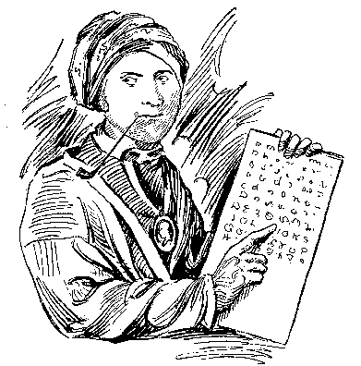
Mobile Industry Working Group
provides
Roadmap
Sequoyah
Project
provides
Execution
Pulsar
is the
Result

