Slide 1




framework
protocols
tools

Slide 2




hardware abstraction
server communication
application container
scripting engine
framework
protocols
tools

Slide 3



unreliable networks
limited bandwidth
semantics
framework
protocols
tools

Slide 4




develop
simulate
debug
deploy
framework
protocols
tools

Slide 5
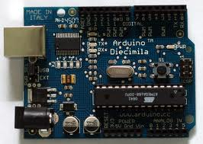
Arduino

Slide 6
Sensors
Arduino

Slide 7
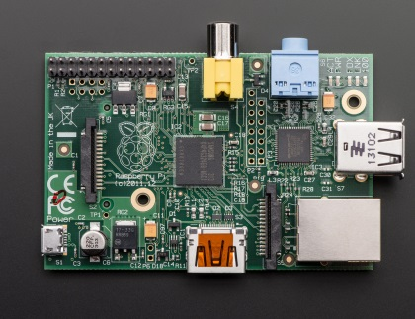
Sensors
Arduino
USB
Modbus
Raspberry Pi
Lua + Mihini

Slide 8
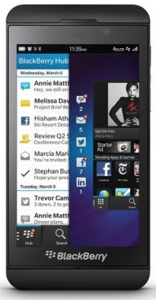
Sensors
Arduino
USB
Modbus
802.11n
Raspberry Pi
MQTT
Lua + Mihini

Slide 9
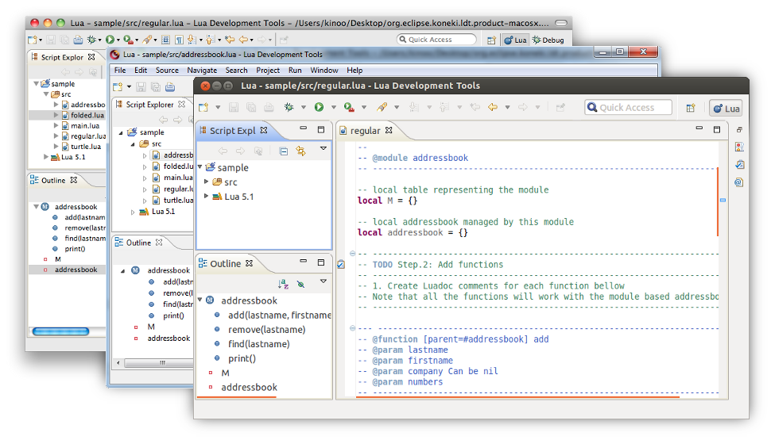
Sensors
Koneki – Lua development tools
Arduino
USB
Modbus
802.11n
Raspberry Pi
MQTT
Lua + Mihini

Slide 10

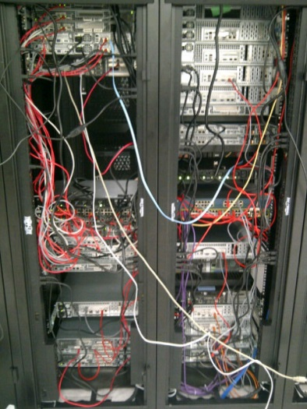
Sensors
Koneki – Lua development tools
Arduino
USB
Modbus
802.11n
3G
Raspberry Pi
MQTT
MQTT
Lua + Mihini

Slide 11

Sensors
Koneki – Lua development tools
Arduino
USB
Modbus
802.11n
Raspberry Pi
MQTT
MQTT
Lua + Mihini

Slide 12
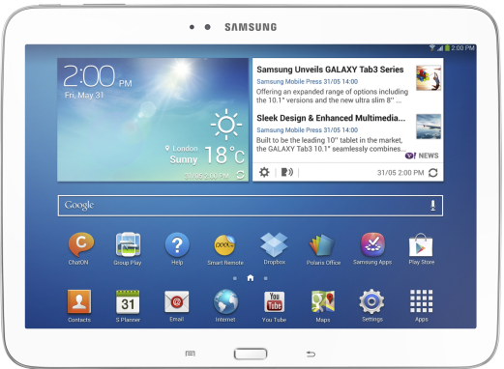
Sensors
Koneki – Lua development tools
Android
Arduino
USB
Modbus
MQTT
802.11n
Raspberry Pi
MQTT
MQTT
Lua + Mihini

Slide 13
Sensors
Koneki – Lua development tools
Android
Arduino
Thanks to Benjamin Cabe’ !!
USB
Modbus
MQTT
802.11n
Raspberry Pi
MQTT
MQTT
Lua + Mihini

