Slide 1

MqGnatt
Driving Instructions
Version: 0.17
Author: Arlen Nipper
Notes:
.15 – Initial Version
.16 - Revisions from Scott de Deugd
.17 – Integrated into new Power Point Format

Slide 2
Audience
MqGnatt is a general purpose utility to aid in the development, demonstration, and testing of the MQTT messaging transport protocol.
The primary reason that I developed this utility (or amalgamated group of utilities) is to quickly and easily show a large quantity of simulated MQTT enabled devices interacting with an MQTT Broker and “Interesting” consumer clients wanting a view of the real-time data. In order to see and understand the real advantages of an MQTT based infrastructure, you need be able to visually interact and see a real pub/sub system in action.
This utility is currently a work in progress but I feel it is functional to the point of use as a demonstration tool and initial feasibility studies in the design and implementation of complete, dynamic, reliable, and highly available MQTT based infrastructures.
Arlen Nipper

Slide 3
Acknowlegments
MqGnatt was built using the Eclipse “Juno” Java IDE and the WindowBuilder SWT tooling.
MqGnatt uses the Eclipse Java MQTTV3 reference protocol implementation from the Eclipse M2M Industry Working Group Paho project.
Working examples reference the MQTT Broker infrastructure hosted at m2m.eclipse.org.
MqGnatt was written by Cirrus Link Solutions LLC.
The “intent” is for this to become an open source project within the Paho project.

Slide 4
Getting Started – Understanding the Components.
MQTT is all about enabling embedded platforms and sensors to provide “interesting” data, in real-time, to interested consumers. MQTT is also a bi-directional transport that enables the publishing of commands/setpoints or other “interesting” data back to the end devices.
So with this in mind, MqGnatt introduces the following components used to build out an effective network simulation:
Instruments – Instruments represent the measurement points of physical sensor measurements, process variables or calculated information. Just about anything that can be measured, captured, sensed, or calculated, analog or digital or images, could be considered an Instrument point.
Devices – Devices are considered a termination point for one or more Instruments. Devices represent real world embedded hardware platforms that consolidate Instrument measurements such as Edge Controller, Edge Nodes, Communications Gateways, PLC’s or RTU’s.
Clients – Instruments and Devices represent a simulation of physical real world devices. In MqGnatt, Clients represent the MQTT protocol agent that is responsible for connecting to configured Brokers. In some instances this agent will be included in the device, and in others it will be a separate Gateway device, talking natively to the device and sending data via MQTT to the broker.
Brokers – In MqGnatt, the tooling provides for the configuration of available MQTT Brokers to connect to.
B
C
D
I

Slide 5
Simulated Topologies
The entire reason for the MqGnatt utility is to provide a tool to create fairly complex representations of real world MQTT infrastructures. This is a topology diagram showing what a some typical configuration might provide. The MqGnatt tool simulates everything in this diagram except the Brokers.
Brokers
Temperature
I
Pressure
I
D
Flowrate
C
C
I
Primary
Broker
On/Off Status
On/Off Command
I
D
B
Setpoint
C
GPS Position
C
RPM
D
Secondary
Broker
Speed
I
C
Voltage
B
D
C
C
JPEG Image
I
Sensors
Actuators
Instruments
Devices
Device
MQTT Clients
MqGnatt Tool
“Application”
MQTT Clients

Slide 6
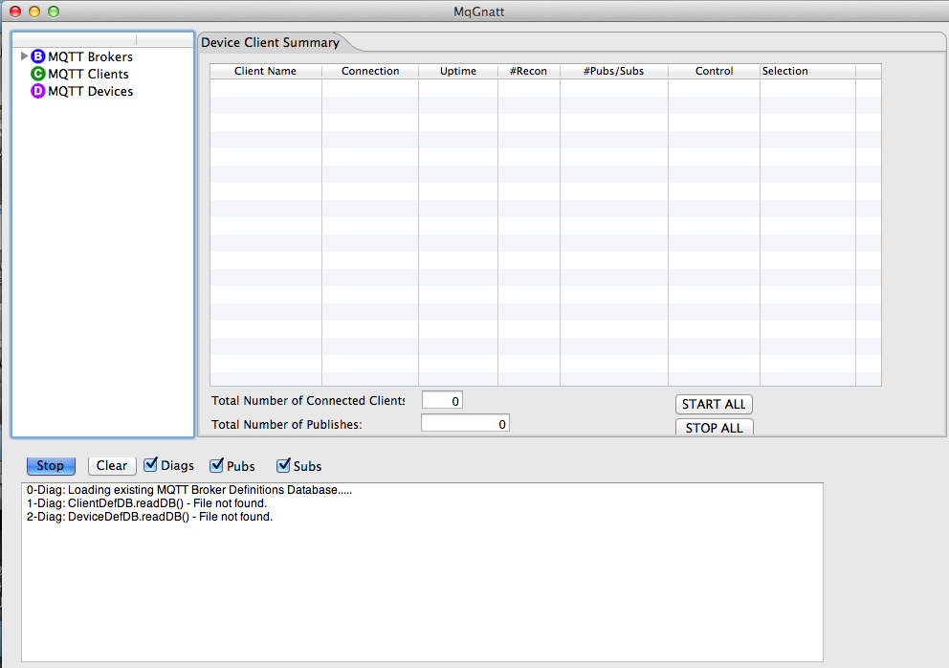
Startup Window:
When MqGnatt is started for the first time, the user interface will look like this. Note that on different OS’s, the dropdown menu components may appear in different places (OSX vs Linux vs Windows).
Configuration
Explorer
Device Client
Summary
Diag Message
Window

Slide 7
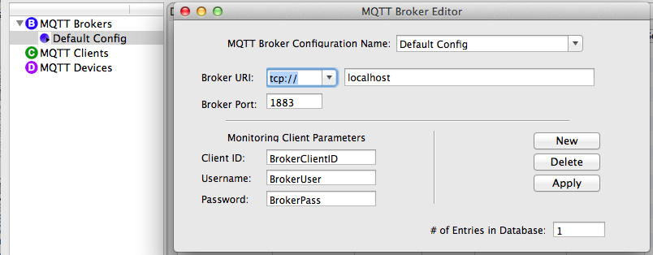
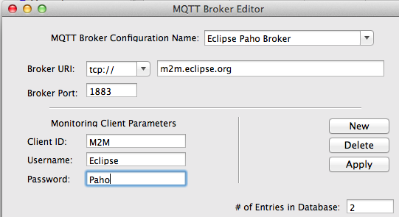
Initial Configuration: Brokers (1 of 3)
When started up for the first time, MqGnatt only has a single default MQTT broker defined for “localhost”. Right click on MQTT Brokers in the Configuration Explorer to open up the Broker Editor:
Click on the “New” button to create another Broker configuration. For this example we will configure the parameters for the MQTT Broker that the Eclipse Paho project has available for general use:

Slide 8
Initial Configuration: Brokers (2 of 3)
When you have the parameters entered press the “Apply” button. You will see the “# of Entries in the Database” parameter increment from 1 to 2:
It is worth noting here that the “Monitoring Client Parameters” entered here will be used by subsequent MQTT Viewers as the credentials to connect to this Broker. This eliminates the need to enter credentials every time you connect to a Broker. In order to avoid any potential duplicate ClientID conflicts when connecting multiple viewers to the same Broker instance, the ClientID is suffixed with a random 4 digit value for every Viewer connection. You will see more information on where these credentials are used in the Broker Viewer section of this document.

Slide 9
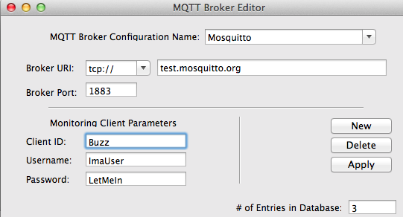
Initial Configuration: Brokers (3 of 3)
In order to show how redundant Brokers can be used by the MQTT Device Clients, we can go ahead and add another generally available MQTT Broker provided by the developers of the Mosquitto MQTT Broker. Go ahead and create another MQTT Broker configuration with the following parameters and save it:
We now have 3 MQTT Broker configurations to choose from for the subsequent configurations of our MQTT Device Clients. You can definitely add more or use the parameters required for any other MQTT Broker you want to connect to.

Slide 10
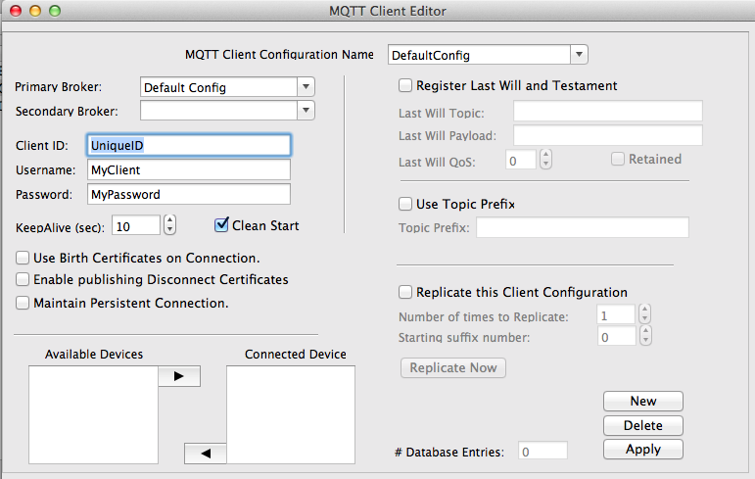
Initial Configuration: MQTT Device Client (1 of 4)
When MqGnatt is first started up, there are no MQTT Device Clients configured. Right click on “MQTT Clients” in the Configuration Explorer to open up a Client configuration dialog.

Slide 11
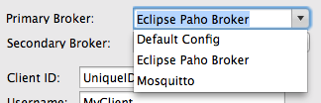
Initial Configuration: MQTT Device Client (2 of 4)
There is a LOT of detailed information that can be provided by an MQTT Device Client configuration. Initially, some of the configuration is optional, but being at least somewhat familiar with the MQTT protocol would be of benefit. Since the MQTT Device Client is the most important aspect of MqGnatt, we will try to address the configuration parameters in detail.
The “MQTT Client Configuration Name” is just a user friendly name for this client configuration for reference and is not tied to any MQTT protocol specific parameter in any way. It can contain spaces and most printable ASCII characters.
The next part of the MQTT Client configuration is the selection of Broker(s) that you want this client to connect to. The MQTT Brokers that you have already configured will appear in the drop down selection for both the Primary and Secondary Broker selections. If you don’t want to use a secondary Broker then just leave that field blank.

Slide 12


Initial Configuration: MQTT Device Client (3 of 4)
In this example we have selected the Eclipse Paho Broker as the primary Broker for this client and the Mosquitto Broker as a secondary Broker.
The next set of configuration parameters for the MQTT Device Client are the ID and credentials used for establishing an MQTT session. This includes the MQTT “Client ID”, the Username, and the Password. Note that the Client ID chosen for this client configuration MUST be unique across all clients connecting to a particular Broker instance. The MQTT specification states that all MQTT clients must provide a unique ClientID for connections to the Broker. If a duplicate ID is seen connecting to a Broker, the Broker will disconnect an established connection and create a new MQTT session for the most recent connecting ClientID. The Username and Password parameters are optional and are used in conjunction with the Access Control List on the Broker. If enabled, then the proper Username and Password must be provided in conjunction with the Client ID.

Slide 13
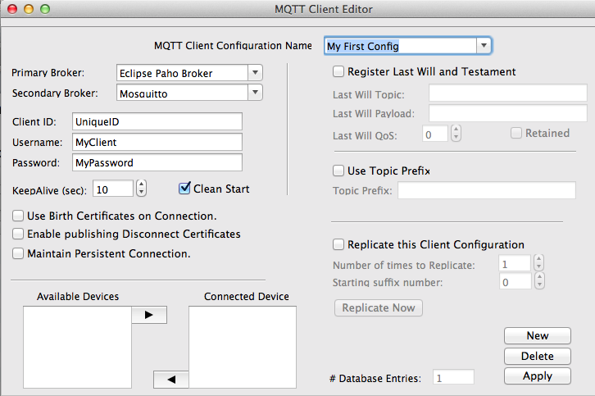
Initial Configuration: MQTT Device Client (4 of 4)
So we now have an MQTT Device Client configured with a minimum of parameters to use it. The configuration should look as follows:
Press the “Apply” button to save this configuration (note the # Database Entries now shows 1) and close the MQTT Client Editor dialog.

Slide 14
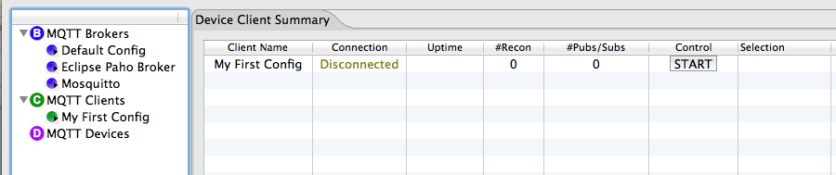
First Connection to the Broker: (1 of 2)
With this configuration we should now be able to test out a successful connection of our new Client to an MQTT Broker. Note that after saving your first MQTT Device Client configuration you now have an entry in the MQTT Device Status tab in the main view window:

Slide 15
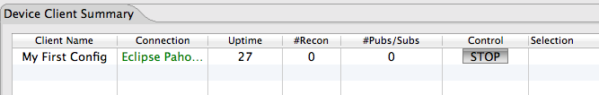
First Connection to the Broker: (2 of 2)
Configuration Name
# of seconds this connection has been established.
# of publish and subscribe messaged for this client
Name of the Broker connected to.
# of reconnection attempts
Start/Stop Control
If everything is configured properly, you should be able to press the “START” button in the summary grid and note that an MQTT session is established looking at the Diagnostics text box and see the connection “Uptime” start to increment.
This is not a very “interesting” connection, but you have proven that your MQTT Device Client can establish a connection to the configured set of MQTT Brokers. The next step is to start adding Instruments and Devices to this Client to make it MUCH more of an interesting and dynamic connection!
You can press the STOP button to proceed to the next section.

Slide 16


Defining MQTT Devices and Instruments
One of the primary reasons for developing the MqGnatt tooling was to be able to configure and demonstrate an MQTT infrastructure that would represent a real world infrastructure with lots of embedded sensors and platforms publishing real time information. In order to accomplish this, we need the ability to define an “MQTT Device” and then attach “Instruments” to this device.
We will start with a very simple exercise here building up the following topology to demonstrate a very simple temperature instrument.
Temperature
Measurement
Instrument that provides a temperature value at a periodic rate on a defined MQTT Topic.
The MQTT Client we have already configured will be associated with the Device.
B
C
D
C
I
The Device basically just represents a logical connection point for one or more Instruments.
The MQTT Broker.
An MQTT Client subscribed to the “Topics” the Temperature Device is publishing on.

Slide 17
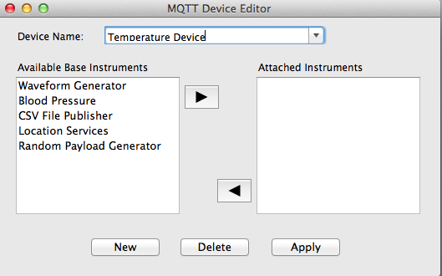
Defining MQTT Devices (1 of 3)
To add a new MQTT Device right click on the “MQTT Device” Icon in the Configuration Explorer:
The “Device Name” will be used to refer to this device from the other configuration utilities. The name can be any ASCII character and can include spaces. For this example we will name this device “Temperature Device”, and “connect” it to and sensor based instrument.
Similarly, a Blood Pressure Monitor device could have been created and attached to a sensor based instrument that provides pressure and pulse readings.
Once we have a name for our device, we’ll proceed to start attaching Base Instruments to it to create it’s operational functionality.

Slide 18


Timeout..… a note on the Available MQTT Instruments
The vision behind the MqGnatt utility is that the available pool of “Instruments” can grow dynamically as the development community at large becomes involved. I have a few pre-configured instruments to choose from in the current release. Be assured that additional and more complex instruments will be added going forward.
The notion of an instrument is that it will provide some level of functionality within the simulation of an MQTT infrastructure. The current Java plug-in infrastructure has common Interface attributes of:
An MQTT Topic to Publish On
A periodic Rate to publish the Instrument data parameters
A payload indicative of the instrument being simulated.
Hopefully the community will use the Eclipse Paho project to contribute many more instruments tailored to specific vertical markets. Even with the few simple instruments provided with this version of MqGnatt, we’ll see how we can build up some pretty interesting devices to play with.
Call for more MQTT Instrument Plug-Ins !

Slide 19
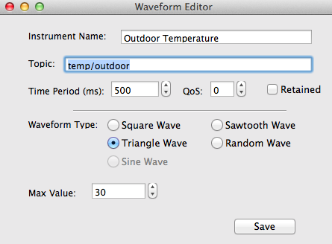
Defining MQTT Devices (2 of 3)
Now select the “Waveform Generator” in the list of Available Instruments and click the Right Arrow. This will bring up the Waveform Editor. For the Temperature Device, let’s define an Instrument that is the Outdoor Temperature and publish it on the MQTT Topic of “temp/outdoor”. Then we’ll select an Triangle waveform for a temperature that will ramp between a value of 0 to 30 and back down again. Finally let’s publish this parameter every 500ms with an MQTT Quality of Service (QoS) of zero. The configuration will look like the following screen shot:
Once you have these parameters entered, press the “Save” button and close the Waveform Editor dialog.

Slide 20
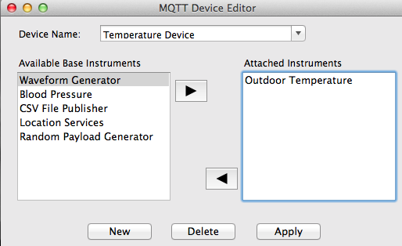
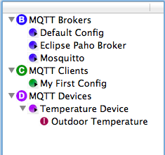

Defining MQTT Devices (3 of 3)
You should now see the “Outdoor Temperature” Instrument connected to your new Temperature Device.
Now click on the Apply button to save this Device configuration and close the Device Editor dialog box. You should now be able to observe a new Device added to the Configuration Explorer tree with the associated Outdoor Temperature Instrument attached to it.
Ok, now let’s take this newly created MQTT Device and use it to make our MQTT Client a much more interesting MqGnatt creature.

Slide 21
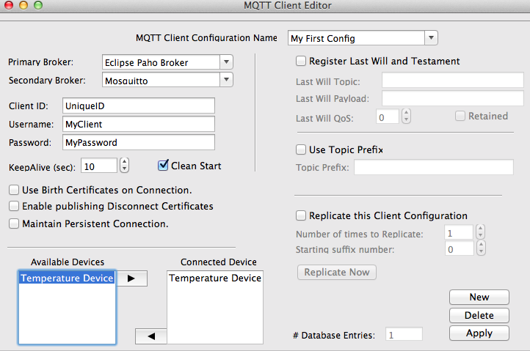
Attaching MQTT Devices to MQTT Clients (1 of 3)
Go back to the Configuration Explorer and open the MQTT Client Configuration editor again. You should now have the new Temperature Device you just created in the list box called “Available Device”. Highlight the Temperature Device and click on the right arrow to connect it to this MQTT Client. Then press the “ Apply” button to save this configuration.
#1
#3
#2

Slide 22
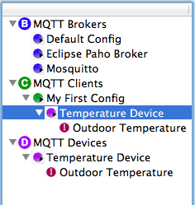
Attaching MQTT Devices to MQTT Clients (2 of 3)
If you fully expand the Configuration Explorer now, you should start what is starting to look like a much more interesting infrastructure. Now you have an Outdoor Temperature instrument connected to a Temperature Device connected to an MQTT Client with a number of MQTT Brokers to connect to:
Now lets go back to the Device Client Summary tab and click on the “START” button again to see what happens. Note that after your “My First Config” MQTT Client connects to the Broker, you will start to see the Temperature Device publishing messages every 500ms. You can press the “Stop” button on the Diag Window view to pause the output and observe what is happening.

Slide 23
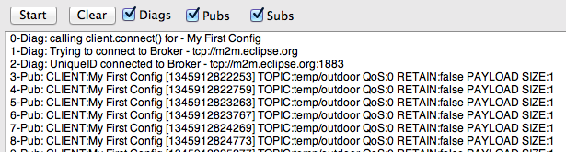
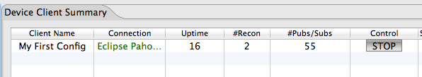
Attaching MQTT Devices to MQTT Clients (3 of 3)
“My First Config” Connecting to the Broker
The Outdoor Temperature being published every 500ms on the Topic of “temp/outdoor”
Broker we are connected to
Number of messages Published

Slide 24
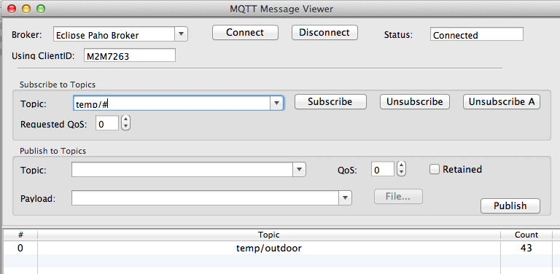
Viewing the Publish Messages – (1 of 3)
Now that you have a “Device” publishing interesting MQTT information we can use other MQTT Client utilities to subscribe to this data stream. MqGnatt has some MQTT Client Viewers built in and we can look at other applications that will let us subscribe to and monitor MQTT messages. This viewer is serving as an “Application Client” in our sample topology.
The viewer built into MqGnatt can be accessed by clicking on the dropdown Menu item “Windows” and selecting the “MQTT Message Viewer”. The following console will appear:
Select the Broker to connect to.
Connection status.
Randomized ClientID has already been generated.
Topic you are interested in.
Topics this Viewer has seen to date.
Number of messages received on this topic.
The Message Viewer already knows what the Username and Password are for this Broker connection so all you have to do is to select the desired Broker and click on the “Connect” button.

Slide 25
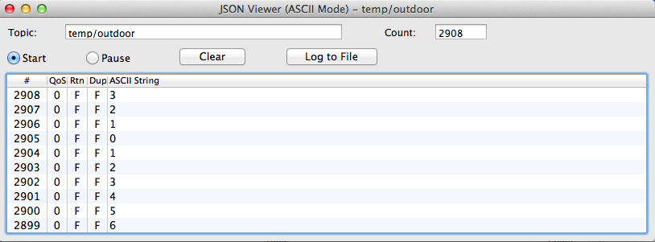
Viewing the Publish Messages – (2 of 3)
Right click on the “MQTT Topic” that you are interested in viewing now. Currently the default MQTT Viewer will default to a JSON/ASCII view depending on the message structure being published. If the viewer can determine the message is in valid JSON format it will attempt to parse out the column data for display. Otherwise this viewer will default to simply printing payload in ASCII. For the Outdoor Temperature example, the viewer will post the messages in ASCII.

Slide 26
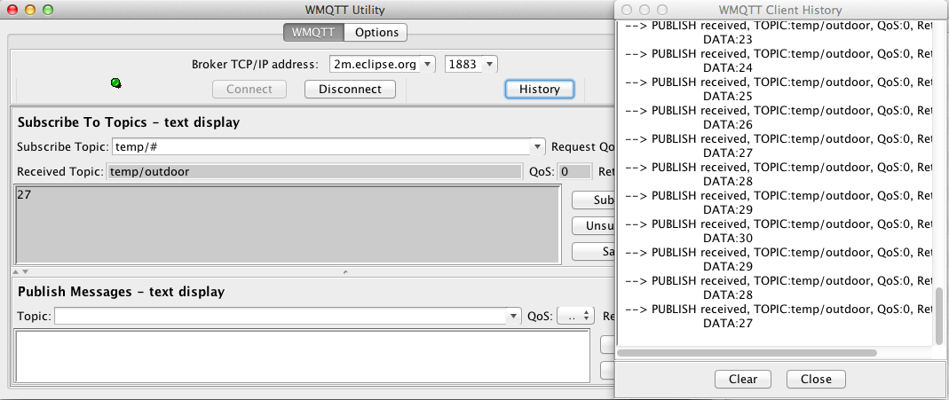
Viewing the Publish Messages – (3 of 3)
As stated earlier on, the real intent of MqGnatt is to create device infrastructures using the MQTT transport protocol. You can still use any available MQTT Client to view the resulting messages with (hey, that is the beauty of MQTT, you can have as many clients viewing as you want to spin up !). Here is the well known IA92 “wmqttSample.jar” viewer connected to the Eclipse Paho Broker viewing the same message topic:

Slide 27
Summary to this point …….
To summarize to this point, we have used the MqGnatt utility to do the following:
Define a number of available MQTT Brokers with associated access credentials.
Defined a MQTT Client and confirm that it could establish an MQTT Session with the Brokers
Created an Outdoor Temperature Instrument that would publish data on a defined MQTT Topic at a configured period.
Attached the Outdoor Temperature Instrument to a Temperature Device.
Attached the Temperature Device to the defined MQTT Client.
Started up the MQTT Client and observed it publishing outdoor temperature readings every 500ms.
Started up a couple of MQTT Client to subscribe to the Topic and view the resulting data.

Slide 28
It’s just now getting interesting !! - Advanced Configurations
Now that we have some baseline configurations entered and working we can proceed to some of the more advanced configurations and start to create a larger population of MQTT Client to really make things interesting.
What we will do in the next couple of slides is to add more temperature instruments to our Temperature Device and then once we have everything just the way we want it working, we’ll see how to replicate our MQTT Client to create 10’s and then 100’s of devices all operating as individual “simulated” MQTT enabled embedded devices.
First, using the same process as we used above, create two additional instruments to add to our Temperature Device. We’ll call one “Indoor Temperature” and the other a “Temperature Alarm” instrument.

Slide 29
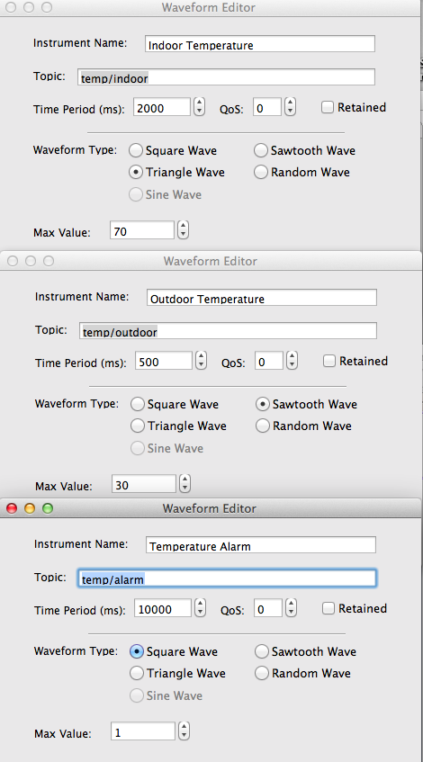
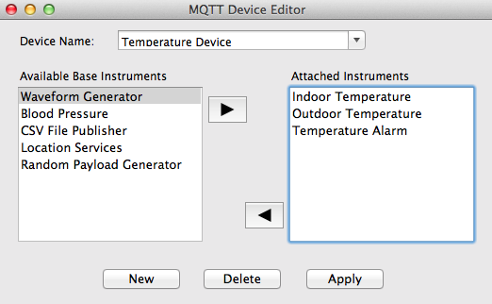
Adding more Instruments to the Temperature Device
Add an “Indoor Temperature” instrument publishing a Triangle waveform value every 2 seconds on a topic of “temp/indoor”.
Add a “Temperature Alarm” instrument that will be a Square Wave value between 0 and 1 that will publish a message on “temp/alarm” every 10 seconds.
Save all of these configurations and then press “Apply” on the Device Editor and close it.

Slide 30
Our Simulated Topology Now
If we go back and review what some of the simulated topologies start to look like, we now have this topology in our MqGnatt configuration:
C
Primary
Broker
B
MqGnatt MQTT Message Viewer
“My First Config”
MQTT Client
Outdoor
Temperature
I
C
Eclipse Paho Broker @
m2m.eclipse.org
Indoor
Temperature
I
D
C
Temperature
Alarm
I
Temperature
Device
Secondary
Broker
IA92 wmqttsample
MQTT Client
B
Mosquitto Broker @
test.mosquitto.org
“Application”
MQTT Clients
Sensors
Actuators
Instruments
Devices
Device
MQTT Clients
Brokers

Slide 31
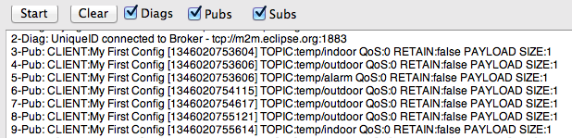
Adding more Instruments to the Temperature Device (2 of 3)
Go back to the “Device Client Summary” tab on the main window. If the “My First Config” client is still running, press the STOP button and then press the START button else just press the START button again (the new Temperature Device configuration is only read in and deployed when a client is first started, therefore the need to STOP/START any running clients for the changes to come into effect).
Now if you look at the diagnostic window (press the “Stop” button to freeze the output) you will see that MQTT messages are now being published on 3 different Topics at 3 different rates. We can go to our MQTT message viewers now to see the results.

Slide 32
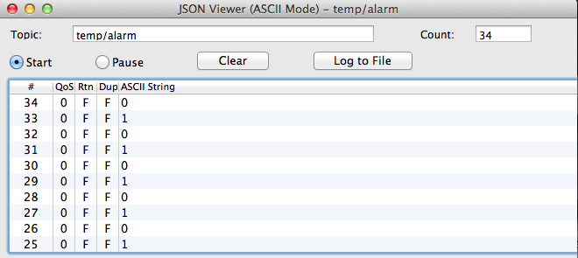
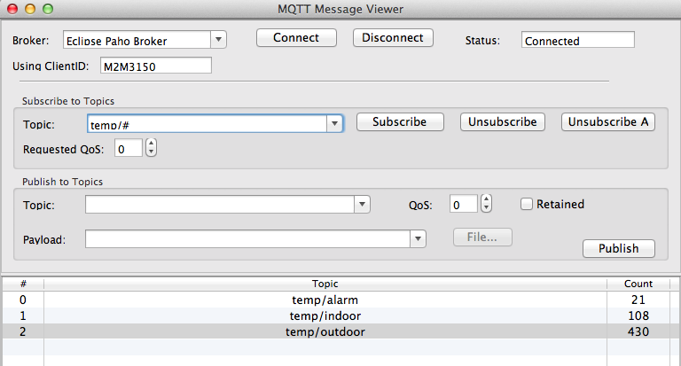
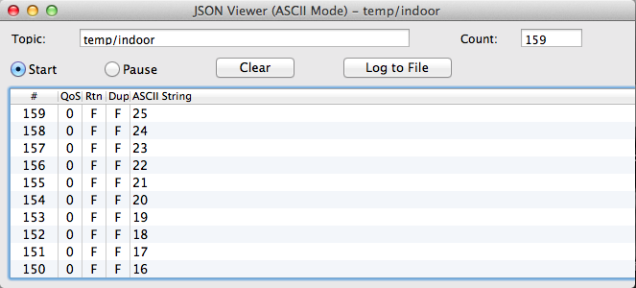
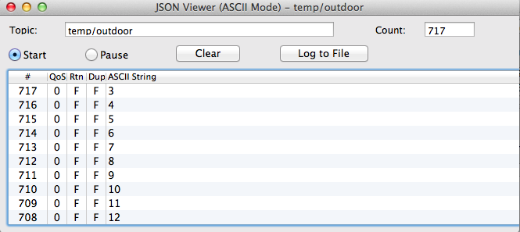
Adding more Instruments to the Temperature Device (3 of 4)
MqGnatt Viewer …..

Slide 33
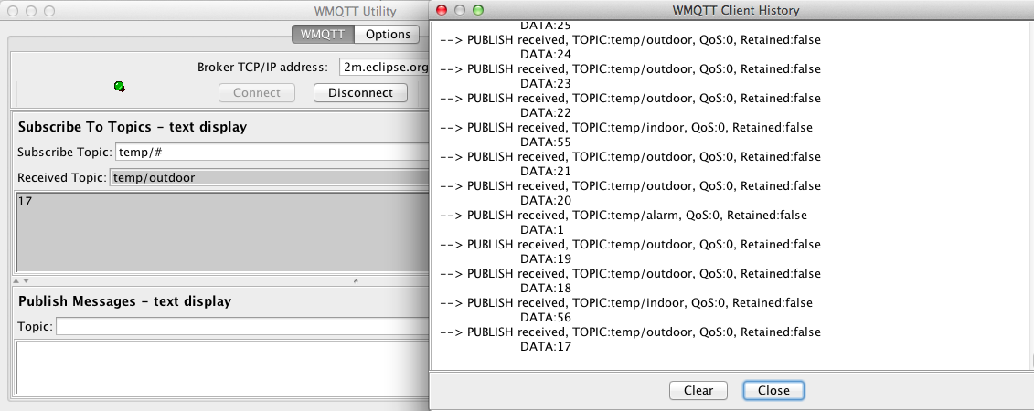
Adding more Instruments to the Temperature Device (4 of 4)
IA92 wmqttsample viewer…..

Slide 34
Replicating MQTT Clients (1 of N)
C
C
Things can get really interesting now that we have a configuration that all works. One of the difficult concepts to explain/demonstrate is how a system designed using MQTT works when there are LOTS of clients connected. How is the performance? How can application clients dial in to see subsets and supersets of the resulting data stream in the namespace? How easy is it for additional data producers and/or consumers to join in?
Of course one way to do this is to have a lot of embedded devices available to connect or have a number of laptops running MQTT clients. But with MqGnatt, we can take a working MQTT Client configuration and simply “Replicate” it N number of times to create a complete MQTT infrastructure.
The code base for the MQTT clients in MqGnatt takes great care in trying to simulate a “real” MQTT client as much as possible. Each MQTT Client instance is a standalone Java Thread that uses the Java MQTTV3 client protocol as released by the Eclipse Paho project. Depending on the platform, OS, Java Thread configurations, and machine capability, MqGnatt has been able to simulate over 1000 MQTT Clients all running within the utility.
C
C
C
C
C
C
C
C
C
C
C
C
C
C
C
C
C
C
C
C
C
C
C
C
C
C
C
C
C
C
C
C
C

Slide 35

Replicating MQTT Clients (2 of N)
Go to the Configuration Explorer and open the MQTT Client Editor again. The first parameter that we will need to add before we replicate this configuration is a Topic Prefix parameter.
Select the “Use Topic Prefix” checkbox and provide a Topic prefix in standard topic nomenclature.
Once you have added the Topic Prefix to the configuration, make sure you press the “Apply” button so that is is saved before we replicate this configuration!
The reason we are adding a Topic Prefix to all MQTT messages from this MQTT client is that we need to create a “unique” namespace for each of the MQTT Clients that we are going to replicate. MqGnatt will automatically add a numeric suffix to the ClientID and to the Topic Prefix to ensure that the MQTT message namespace is unique for all Clients. You can leave the Topic Prefix blank and everything will still work, but you would not be able differentiate one “temp/outdoor” from another.

Slide 36
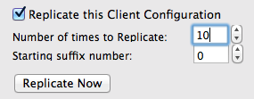
Replicating MQTT Clients (3 of N)
Once you have a Topic Prefix entered and have saved the configuration, select the “Replicate this Client Configuration” checkbox. Then enter how many MQTT Clients you want to create and the starting suffix number to append to the end of the ClientID and Topic Prefix to make each MQTT Client unique. In this example we will create 10 additional clients from our “My First Config” configuration.
Then just press the “Replicate Now” button.

Slide 37
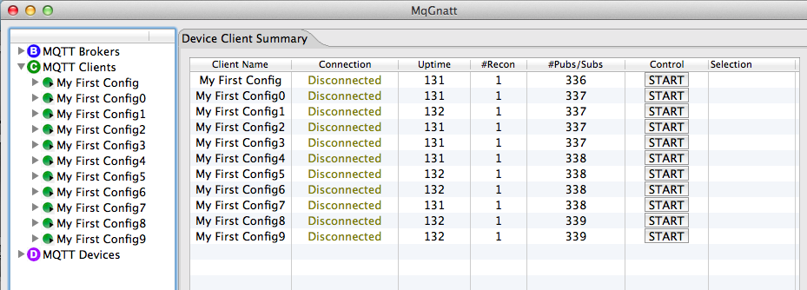
Replicating MQTT Clients (4 of N)
Once you close the Client Editor, you will see that the Configuration Explorer now shows 11 Mqtt Device Clients, and the Device Client Summary tab now shows the 10 new clients in addition to the first original client configuration.
To START/STOP the clients you can still use the discrete START/STOP button provided on each row of the Client Summary grid, but you can also use the START ALL and STOP ALL buttons provided at the bottom of the summary grid to start/stop all of the defined clients as a group.

Slide 38
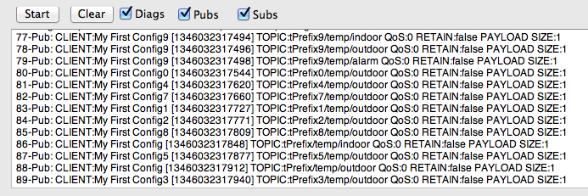
Replicating MQTT Clients (5 of N)
Press the START ALL button and then observe the Diagnostic Window to see what is happening now. Each of the configured MQTT Clients are now publishing information from their associated Temperature Device, but with each on a unique namespace topic as defined by the Topic Prefix value we entered. I the screenshot below you can see topic values being published by the various MQTT Clients on “tPrefix9/../..”, tPrefix0/../..”, tPrefix4/../..” etc…

Slide 39
End of MqGnatt Tutorial #1

Slide 40
Testing the Last Will and Testament
TODO……

Slide 41
Testing Primary/Secondary Broker Connections
TODO……

Slide 42
Serendipitous Data Discovery
TODO……

Slide 43
Many to Many
TODO……

Slide 44
Testing Broker Performance
Todo….

Slide 45
MqGnatt
The End

