Slide 1
Eclipse IoT monthly report
November 2017

Slide 2
Monthly projects development activity
NOV '17 | (color indicates variation compared to previous month)
 | Opened bugs | Closed bugs | Code authors | Commits | Posted messages | Senders
4diac | 21 | 21 | 3 | 32 | 0 | 0
californium | 13 | 19 | 5 | 85 | 0 | 0
concierge | 4 | 5 | 1 | 1 | 0 | 0
ditto | 9 | 9 | 13 | 130 | 0 | 0
eclipsescada | 1 | 0 | 0 | 0 | 0 | 0
edje | 0 | 0 | 0 | 0 | 0 | 0
hawkbit | 3 | 3 | 2 | 9 | 0 | 0
hono | 20 | 15 | 6 | 53 | 0 | 0
kapua | 141 | 107 | 9 | 225 | 0 | 0
krikkit | 0 | 0 | 0 | 0 | 0 | 0
kura | 40 | 36 | 9 | 55 | 0 | 0
leshan | 18 | 12 | 2 | 36 | 0 | 0
milo | 23 | 21 | 3 | 61 | 0 | 0
mosquitto | 18 | 6 | 0 | 0 | 0 | 0
om2m | 32 | 32 | 3 | 53 | 0 | 0
paho | 73 | 50 | 12 | 57 | 0 | 0
paho.incubator | 0 | 0 | 0 | 0 | 0 | 0
ponte | 0 | 0 | 1 | 1 | 0 | 0
risev2g | 0 | 0 | 0 | 0 | 0 | 0
smarthome | 75 | 61 | 20 | 95 | 0 | 0
tinydtls | 0 | 1 | 0 | 0 | 0 | 0
unide | 7 | 1 | 2 | 2 | 0 | 0
vorto | 10 | 12 | 5 | 28 | 0 | 0
wakaama | 1 | 0 | 3 | 5 | 0 | 0
whiskers | 0 | 0 | 1 | 6 | 0 | 0
ALL PROJECTS | 509 | 411 | 100 | 934 | 0 | 0

Slide 3
Yearly projects development activity
DEC '16 - NOV '17 | (color indicates variation compared to previous period)
 | Opened bugs | Closed bugs | Code authors | Commits | Posted messages | Senders
4diac | 184 | 184 | 9 | 355 | 57 | 9
californium | 125 | 115 | 25 | 697 | 445 | 33
concierge | 9 | 10 | 5 | 16 | 2 | 1
ditto | 18 | 12 | 24 | 192 | 0 | 0
eclipsescada | 7 | 1 | 3 | 273 | 0 | 0
edje | 0 | 1 | 1 | 2 | 8 | 5
hawkbit | 56 | 47 | 8 | 191 | 14 | 9
hono | 172 | 149 | 23 | 855 | 336 | 31
kapua | 496 | 388 | 27 | 3032 | 438 | 19
krikkit | 0 | 0 | 0 | 0 | 1 | 1
kura | 417 | 438 | 12 | 1288 | 167 | 28
leshan | 93 | 79 | 18 | 329 | 299 | 74
milo | 51 | 45 | 10 | 226 | 97 | 20
mosquitto | 205 | 119 | 30 | 156 | 248 | 74
om2m | 250 | 284 | 5 | 281 | 13 | 12
paho | 653 | 464 | 82 | 1053 | 322 | 140
paho.incubator | 0 | 0 | 0 | 0 | 0 | 0
ponte | 21 | 5 | 3 | 10 | 4 | 3
risev2g | 1 | 4 | 1 | 7 | 0 | 0
smarthome | 825 | 737 | 85 | 1182 | 35 | 9
tinydtls | 20 | 22 | 3 | 35 | 80 | 12
unide | 17 | 8 | 5 | 29 | 7 | 3
vorto | 174 | 225 | 14 | 374 | 11 | 9
wakaama | 60 | 51 | 16 | 151 | 95 | 51
whiskers | 0 | 0 | 2 | 7 | 4 | 3
ALL PROJECTS | 3854 | 3388 | 359 | 10741 | 2683 | 351

Slide 4
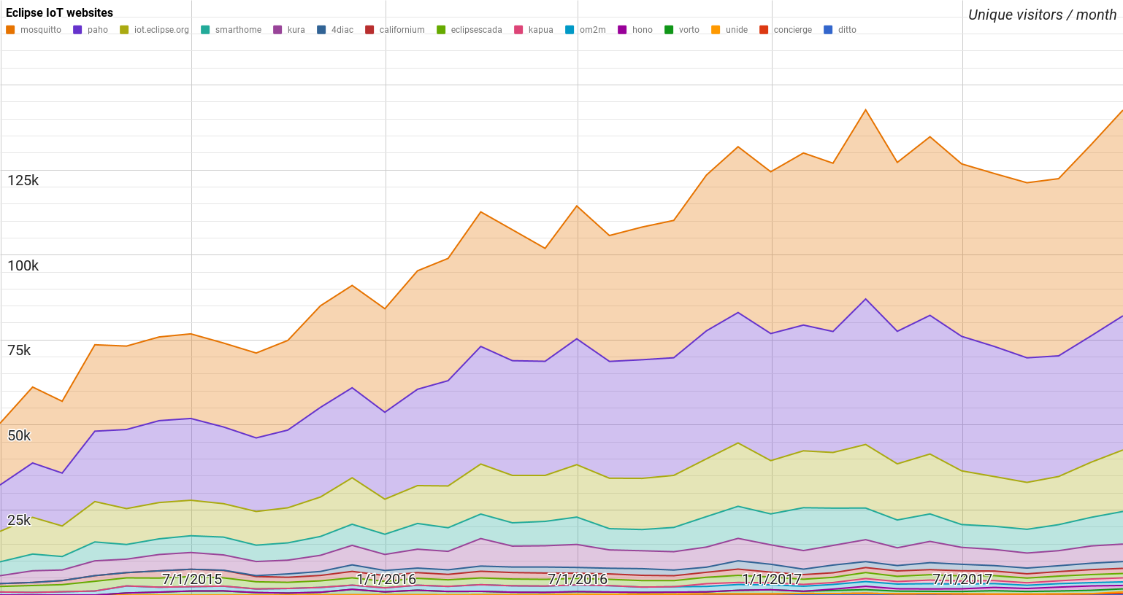
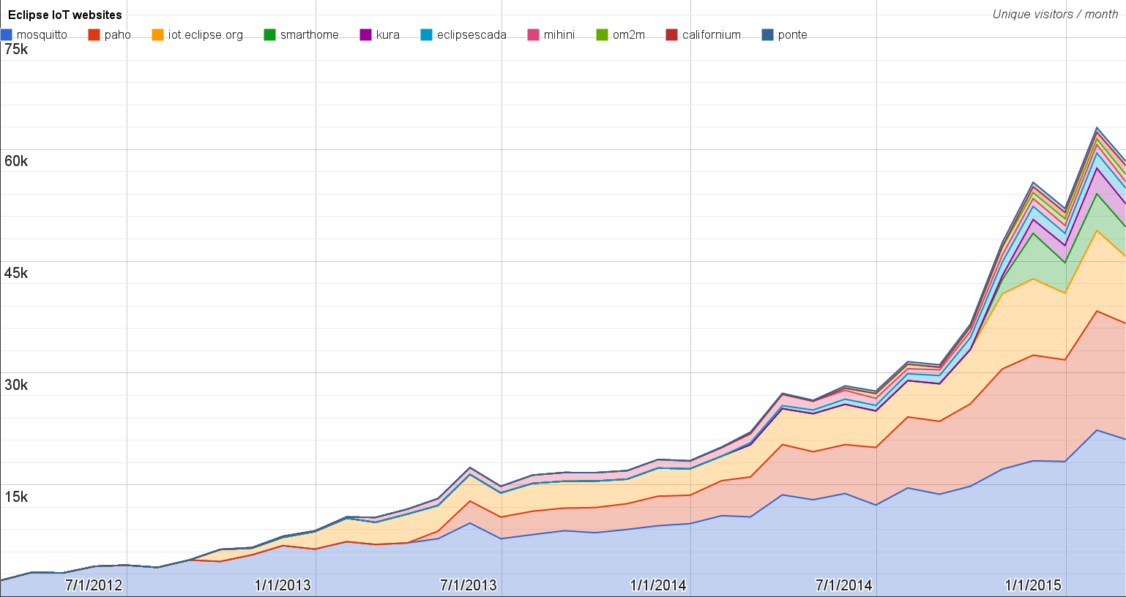
Websites
https://docs.google.com/spreadsheets/d/1MT8vUectDG7qnt83LBts-B7oECMsICXyB4Tn4Kxl64U/pubchart?oid=1293913369&format=image
Number of unique visitors this month | 142K
Month-over-month variation | +7%
Project with the highest growth this month | Eclipse Kapua (+11%)
Year-over-year variation | +20% (1.29K → 1.55M visitors)

Slide 5
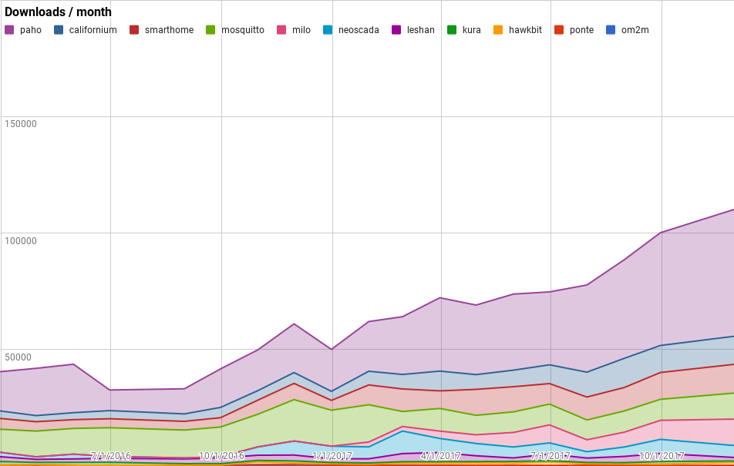
Downloads
https://docs.google.com/spreadsheets/d/1MT8vUectDG7qnt83LBts-B7oECMsICXyB4Tn4Kxl64U/pubchart?oid=1715994217&format=image
Downloads this month:
paho | 54416
smarthome | 12332
californium | 12048
milo | 11323
mosquitto | 11167
neoscada | 5129
leshan | 1509
hawkbit | 1205
kura | 655
ponte | 167
om2m | 158
Grand Total | 110109

Slide 6
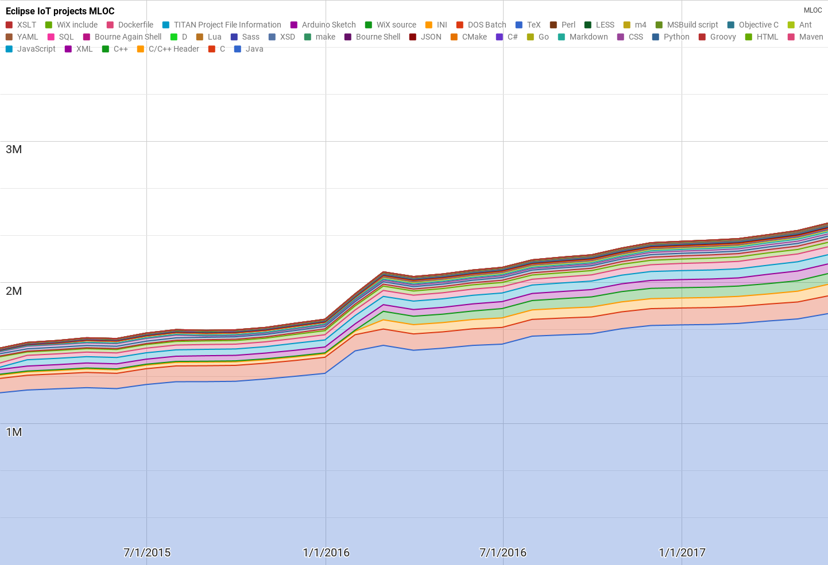
Lines of code (as of May-31, 2017)
https://docs.google.com/spreadsheets/d/1MT8vUectDG7qnt83LBts-B7oECMsICXyB4Tn4Kxl64U/pubchart?oid=1652481431&format=image

Slide 7
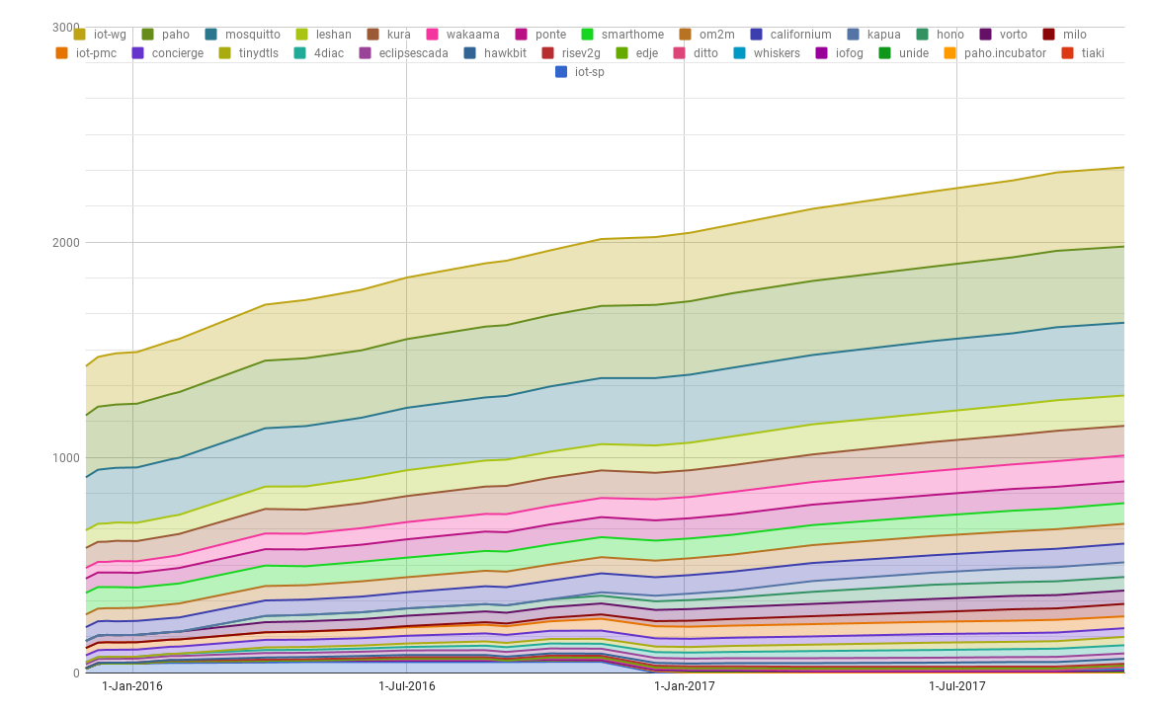
Mailing list subscriptions
https://docs.google.com/spreadsheets/d/1MT8vUectDG7qnt83LBts-B7oECMsICXyB4Tn4Kxl64U/pubchart?oid=1893372427&format=image

