Slide 1
Eclipse IoT monthly report
July 2017

Slide 2
Monthly projects development activity
JUL '17 | (color indicates variation compared to previous month)
 | Opened bugs | Closed bugs | Code authors | Commits | Posted messages | Senders
4diac | 18 | 16 | 6 | 19 | 1 | 1
californium | 9 | 7 | 5 | 47 | 34 | 6
concierge | 0 | 0 | 0 | 0 | 0 | 0
ditto | 0 | 0 | 0 | 0 | 0 | 0
eclipsescada | 0 | 0 | 0 | 0 | 0 | 0
edje | 0 | 0 | 0 | 0 | 1 | 1
hawkbit | 4 | 2 | 2 | 8 | 6 | 3
hono | 22 | 23 | 9 | 77 | 45 | 12
kapua | 19 | 11 | 6 | 412 | 71 | 9
krikkit | 0 | 0 | 0 | 0 | 1 | 1
kura | 50 | 38 | 9 | 78 | 26 | 12
leshan | 2 | 3 | 5 | 22 | 36 | 12
milo | 1 | 1 | 2 | 6 | 28 | 8
mosquitto | 16 | 18 | 9 | 27 | 18 | 8
om2m | 10 | 117 | 2 | 8 | 0 | 0
paho | 57 | 66 | 8 | 94 | 51 | 14
paho.incubator | 0 | 0 | 0 | 0 | 0 | 0
ponte | 2 | 0 | 0 | 0 | 0 | 0
risev2g | 0 | 1 | 1 | 4 | 0 | 0
smarthome | 61 | 42 | 18 | 74 | 8 | 3
tinydtls | 0 | 0 | 0 | 0 | 0 | 0
unide | 0 | 0 | 0 | 0 | 0 | 0
vorto | 16 | 24 | 6 | 55 | 0 | 0
wakaama | 6 | 4 | 3 | 16 | 0 | 0
whiskers | 0 | 0 | 0 | 0 | 0 | 0
ALL PROJECTS | 293 | 373 | 91 | 947 | 326 | 90

Slide 3
Yearly projects development activity
AUG '16 - JUL '17 | (color indicates variation compared to previous period)
 | Opened bugs | Closed bugs | Code authors | Commits | Posted messages | Senders
4diac | 203 | 203 | 9 | 312 | 13 | 3
californium | 124 | 113 | 19 | 732 | 510 | 35
concierge | 24 | 3 | 5 | 15 | 8 | 6
ditto | 0 | 0 | 1 | 1 | 0 | 0
eclipsescada | 4 | 4 | 3 | 310 | 9 | 2
edje | 1 | 1 | 2 | 70 | 8 | 5
hawkbit | 47 | 47 | 13 | 606 | 11 | 8
hono | 116 | 111 | 15 | 752 | 276 | 41
kapua | 344 | 227 | 13 | 3595 | 416 | 18
krikkit | 0 | 0 | 0 | 0 | 1 | 1
kura | 542 | 482 | 23 | 1699 | 461 | 42
leshan | 81 | 67 | 20 | 357 | 310 | 62
milo | 49 | 47 | 6 | 224 | 119 | 24
mosquitto | 193 | 123 | 30 | 183 | 356 | 130
om2m | 95 | 127 | 5 | 64 | 13 | 12
paho | 569 | 433 | 60 | 939 | 460 | 188
paho.incubator | 0 | 0 | 0 | 0 | 0 | 0
ponte | 22 | 5 | 2 | 3 | 4 | 3
risev2g | 4 | 4 | 1 | 14 | 0 | 0
smarthome | 807 | 708 | 64 | 1105 | 41 | 9
tinydtls | 21 | 21 | 3 | 37 | 94 | 19
unide | 6 | 4 | 2 | 14 | 8 | 5
vorto | 183 | 156 | 13 | 410 | 12 | 9
wakaama | 65 | 53 | 13 | 140 | 107 | 40
whiskers | 2 | 0 | 2 | 21 | 11 | 8
ALL PROJECTS | 3502 | 2939 | 221 | 11603 | 3248 | 380

Slide 4
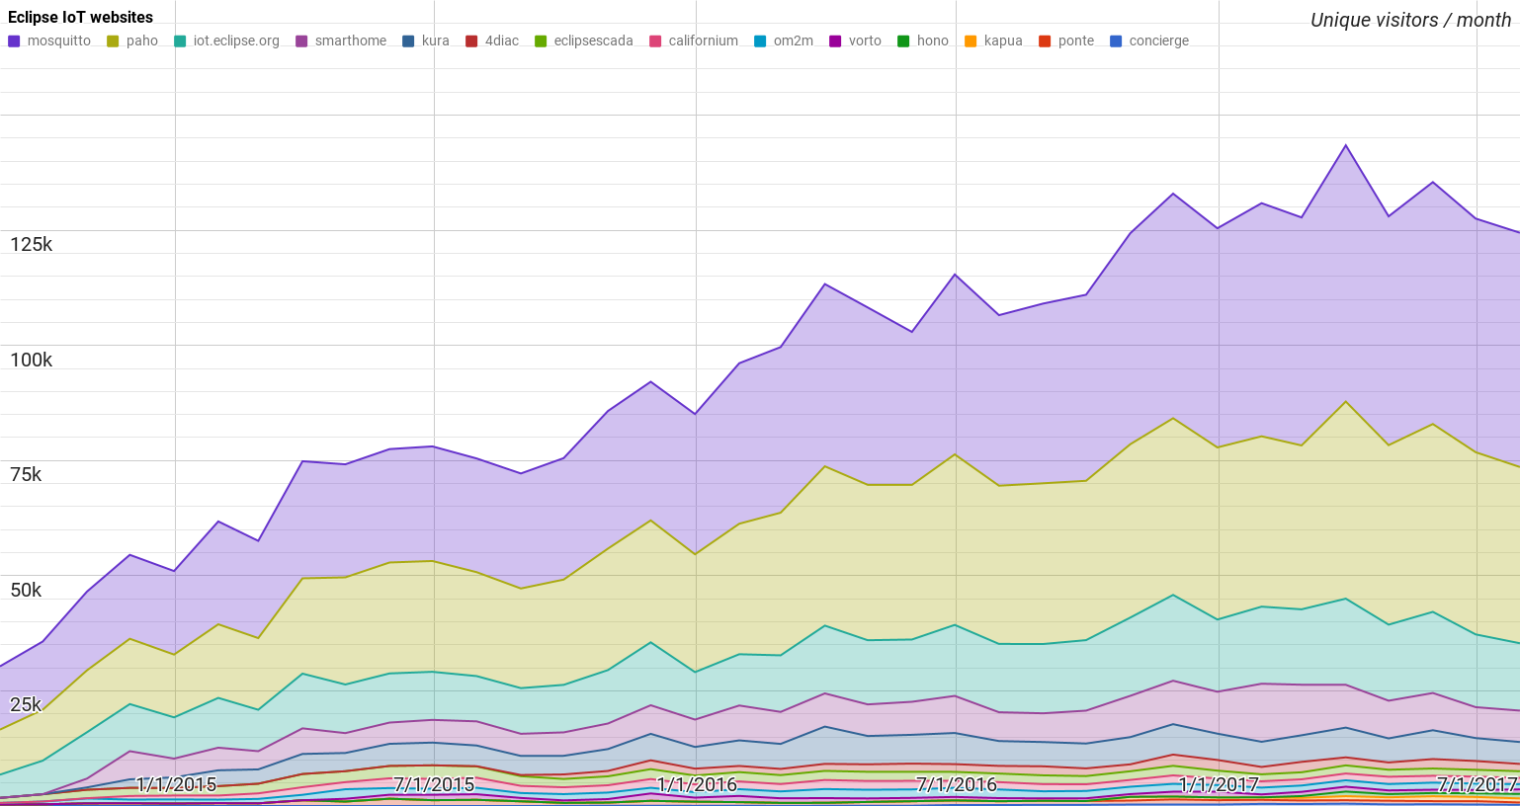
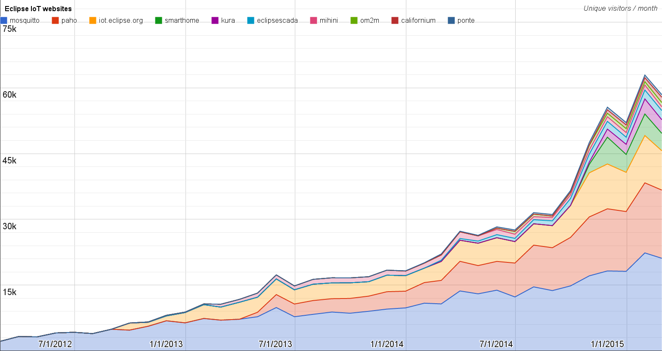
Websites
https://docs.google.com/spreadsheets/d/1MT8vUectDG7qnt83LBts-B7oECMsICXyB4Tn4Kxl64U/pubchart?oid=1293913369&format=image
Number of unique visitors this month | 124.5K
Month-over-month variation | -2%
Project with the highest growth this month | Eclipse Vorto (+37%)
Year-over-year variation | +32% (1.15K → 1.52M visitors)

Slide 5
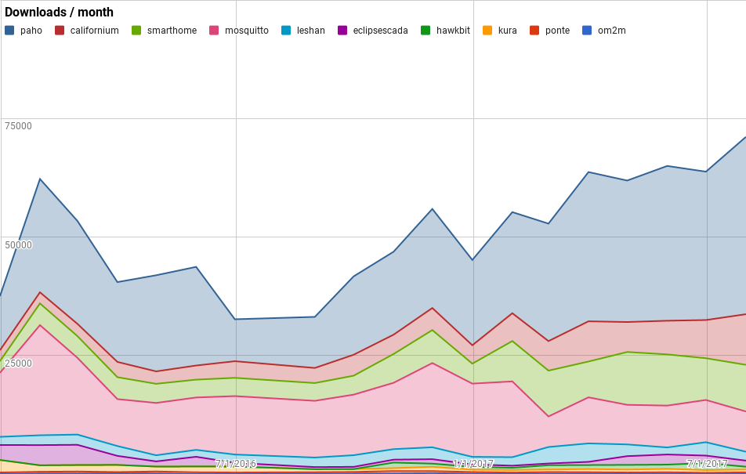
Downloads
https://docs.google.com/spreadsheets/d/1MT8vUectDG7qnt83LBts-B7oECMsICXyB4Tn4Kxl64U/pubchart?oid=1715994217&format=image
Downloads this month:
paho | 37411
californium | 10683
smarthome | 9841
mosquitto | 8489
leshan | 1882
eclipsescada | 1281
hawkbit | 594
kura | 590
ponte | 270
om2m | 95
TOTAL | 71136

Slide 6
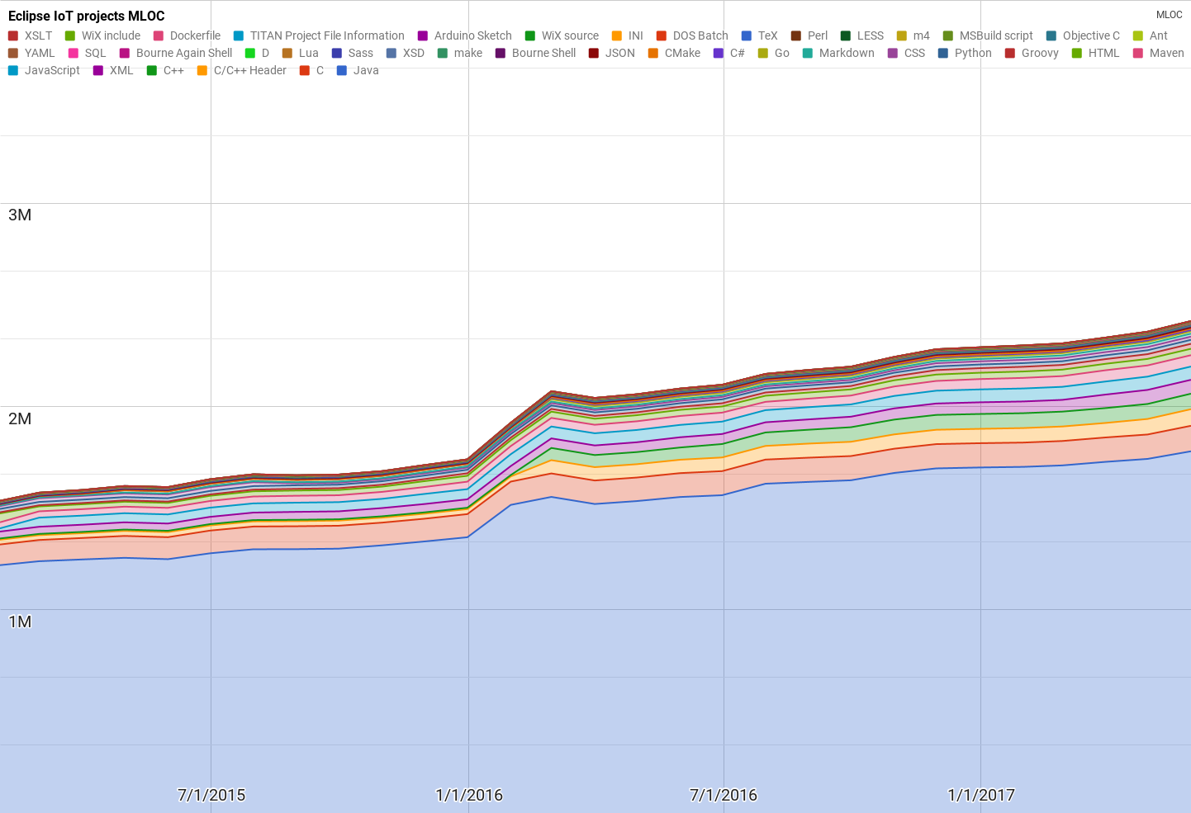
Lines of code (as of May-31, 2017)
https://docs.google.com/spreadsheets/d/1MT8vUectDG7qnt83LBts-B7oECMsICXyB4Tn4Kxl64U/pubchart?oid=1652481431&format=image

Slide 7
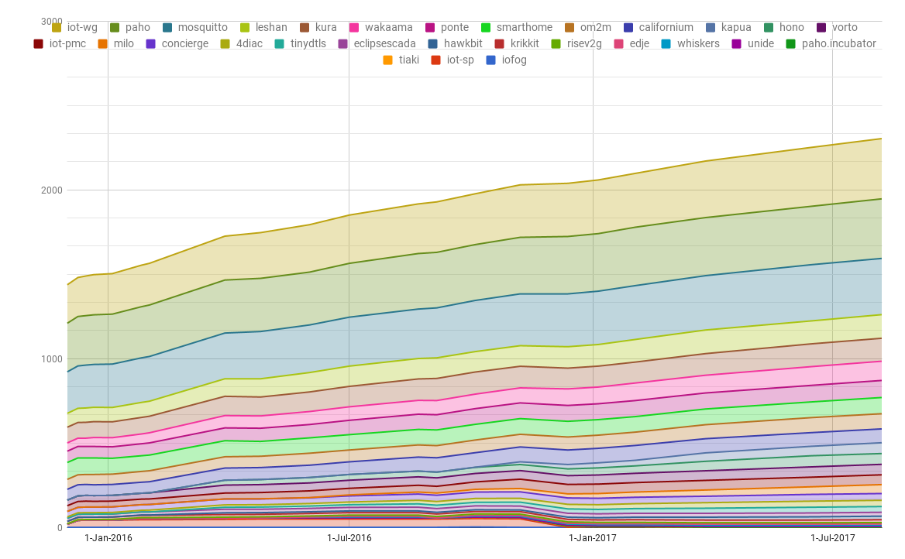
Mailing list subscriptions
https://docs.google.com/spreadsheets/d/1MT8vUectDG7qnt83LBts-B7oECMsICXyB4Tn4Kxl64U/pubchart?oid=1893372427&format=image

