Slide 1

Eclipse IoT monthly report
September 2016

Slide 2
Monthly projects development activity
SEP '16 | (color indicates variation compared to previous month)
 | Opened bugs | Closed bugs | Code authors | Commits | Posted messages | Senders
4diac | 8 | 8 | 5 | 18 | 0 | 0
californium | 3 | 4 | 5 | 43 | 20 | 5
concierge | 0 | 0 | 0 | 0 | 2 | 2
eclipsescada | 0 | 0 | 1 | 24 | 0 | 0
edje | 0 | 0 | 0 | 0 | 0 | 0
hawkbit | 1 | 0 | 5 | 63 | 0 | 0
hono | 3 | 4 | 2 | 35 | 5 | 2
krikkit | 0 | 0 | 0 | 0 | 0 | 0
kura | 47 | 40 | 10 | 157 | 12 | 4
leshan | 6 | 5 | 7 | 21 | 3 | 2
milo | 9 | 6 | 3 | 14 | 4 | 1
mosquitto | 15 | 8 | 5 | 9 | 30 | 9
om2m | 0 | 0 | 0 | 0 | 0 | 0
paho | 33 | 30 | 15 | 30 | 33 | 7
paho.incubator | 0 | 0 | 0 | 0 | 0 | 0
ponte | 0 | 0 | 0 | 0 | 0 | 0
risev2g | 1 | 0 | 0 | 0 | 0 | 0
smarthome | 64 | 56 | 18 | 87 | 3 | 2
tinydtls | 0 | 0 | 0 | 0 | 0 | 0
vorto | 10 | 5 | 4 | 15 | 0 | 0
wakaama | 3 | 0 | 1 | 2 | 3 | 1
whiskers | 0 | 0 | 1 | 6 | 0 | 0
ALL PROJECTS | 203 | 166 | 82 | 524 | 115 | 35

Slide 3
Yearly projects development activity
OCT '15 - SEP '16 | (color indicates variation compared to previous period)
 | Opened bugs | Closed bugs | Code authors | Commits | Posted messages | Senders
4diac | 82 | 137 | 11 | 133 | 12 | 2
californium | 52 | 41 | 19 | 468 | 323 | 14
concierge | 12 | 3 | 5 | 92 | 18 | 6
eclipsescada | 0 | 19 | 3 | 366 | 4 | 2
edje | 0 | 0 | 2 | 2 | 1 | 1
hawkbit | 26 | 5 | 22 | 1298 | 1 | 1
hono | 36 | 32 | 5 | 247 | 116 | 6
krikkit | 0 | 0 | 1 | 1 | 0 | 0
kura | 298 | 146 | 21 | 1047 | 111 | 20
leshan | 44 | 50 | 20 | 409 | 157 | 20
milo | 28 | 21 | 7 | 84 | 11 | 4
mosquitto | 252 | 172 | 19 | 221 | 273 | 40
om2m | 1 | 1 | 7 | 73 | 25 | 4
paho | 312 | 225 | 54 | 401 | 429 | 54
paho.incubator | 0 | 0 | 0 | 0 | 0 | 0
ponte | 0 | 0 | 3 | 8 | 0 | 0
risev2g | 2 | 1 | 1 | 17 | 2 | 2
smarthome | 665 | 567 | 83 | 994 | 55 | 7
tinydtls | 0 | 2 | 2 | 14 | 21 | 3
vorto | 258 | 141 | 21 | 496 | 1 | 2
wakaama | 55 | 50 | 14 | 201 | 65 | 13
whiskers | 0 | 0 | 2 | 28 | 1 | 1
ALL PROJECTS | 2123 | 1613 | 322 | 6600 | 1626 | 54

Slide 4
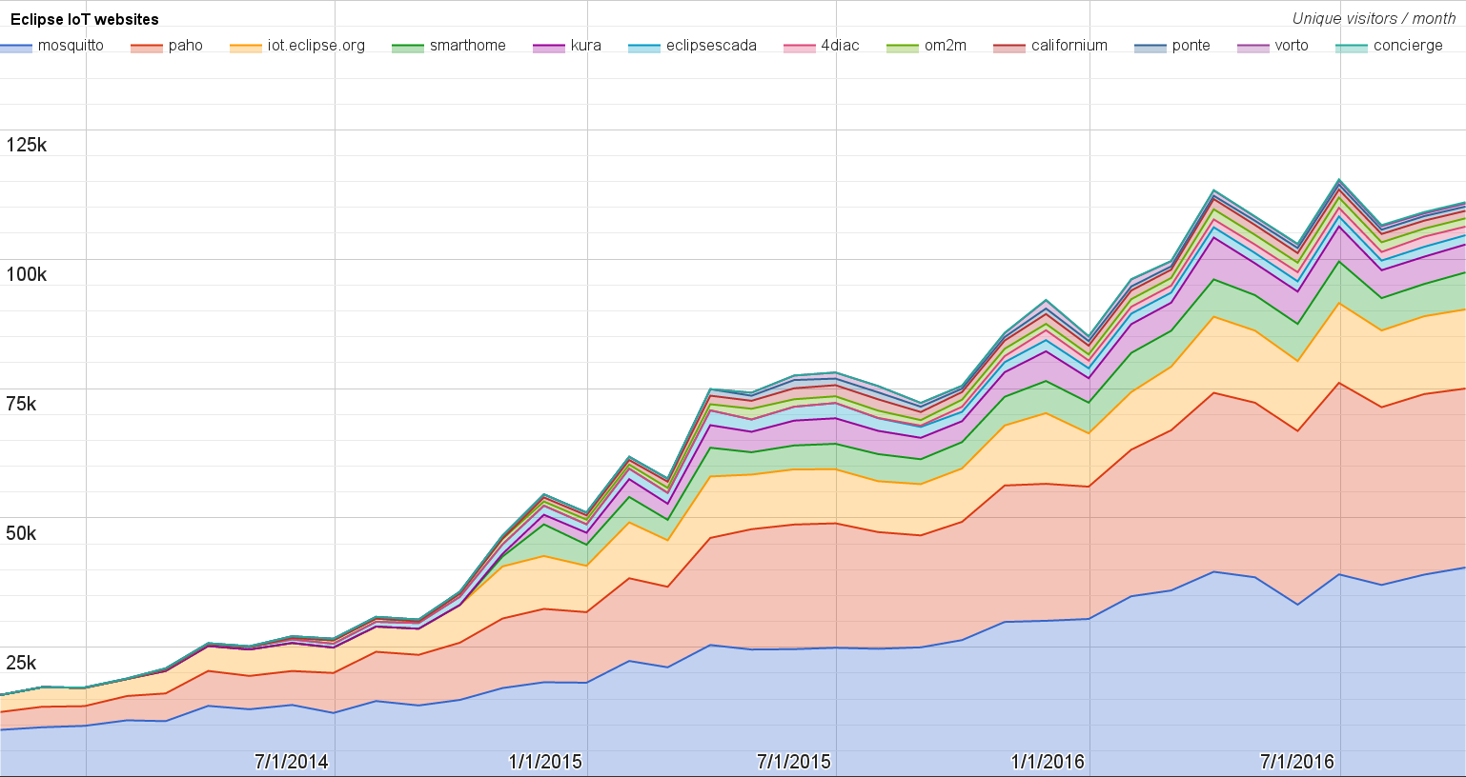
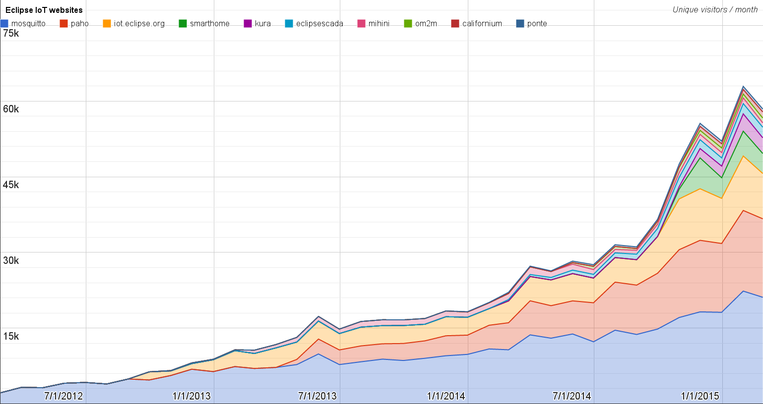
Websites
https://docs.google.com/spreadsheets/d/1MT8vUectDG7qnt83LBts-B7oECMsICXyB4Tn4Kxl64U/pubchart?oid=1293913369&format=image
Number of unique visitors this month | 111K
Month-over-month variation | +2%
Project with the highest growth this month | Eclipse SmartHome (+14%)
Year-over-year variation | +51% (809K → 1.22M visitors)

Slide 5
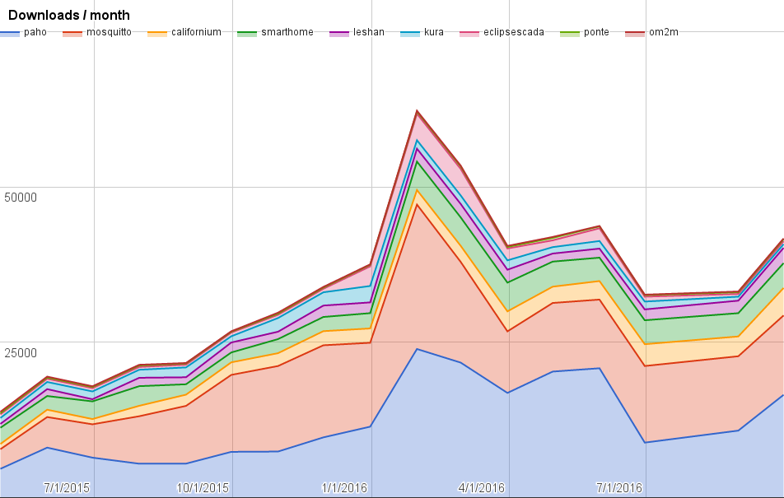
Downloads
https://docs.google.com/spreadsheets/d/1MT8vUectDG7qnt83LBts-B7oECMsICXyB4Tn4Kxl64U/pubchart?oid=1715994217&format=image
Downloads this month:
paho | 1653
paho | 12777
californium | 4420
smarthome | 3993
leshan | 2456
kura | 600
eclipsescada | 475
ponte | 321
om2m | 124

Slide 6
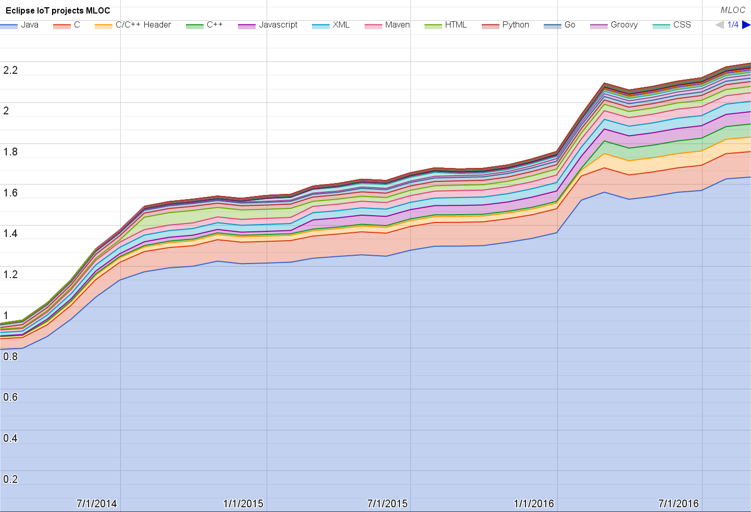
Lines of code (as of Aug-31, 2016)
https://docs.google.com/spreadsheets/d/1MT8vUectDG7qnt83LBts-B7oECMsICXyB4Tn4Kxl64U/pubchart?oid=1652481431&format=image

Slide 7
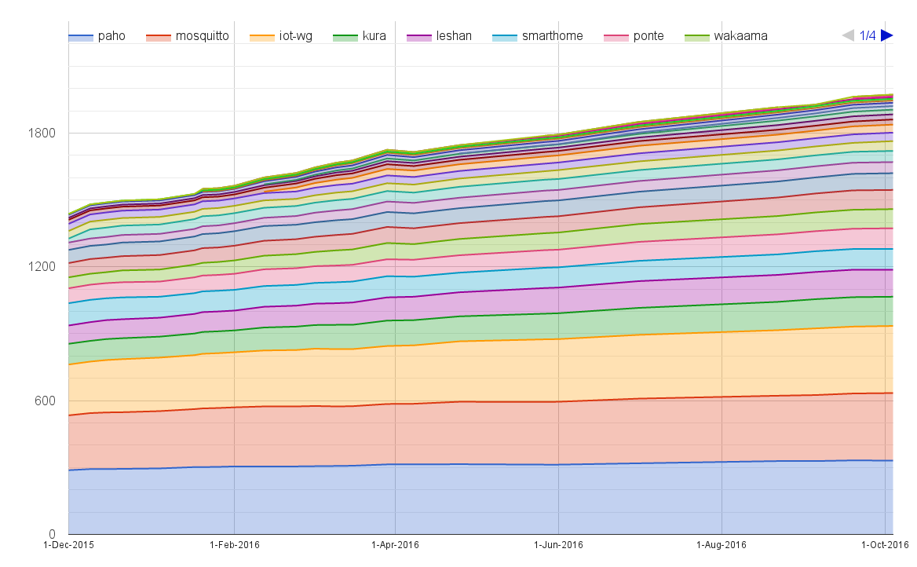
Mailing list subscriptions
https://docs.google.com/spreadsheets/d/1MT8vUectDG7qnt83LBts-B7oECMsICXyB4Tn4Kxl64U/pubchart?oid=1893372427&format=image

Slide 8
Sandbox servers (MQTT, CoAP, LwM2M)
http://vs0.inf.ethz.ch/logs/origin-trace/
MQTT (Mosquitto)
882 active clients (-12% monthly)
CoAP
209 unique IP addresses (-44% monthly)
LWM2M
See Bug 467101

