Slide 1
Eclipse Californium
Project Update 2020

Slide 2

Overview
Californium is a powerful CoAP framework targeting back-end services and stronger Internet of Things devices.
It provides a convenient API for RESTful Web services that support all of CoAP's features.
Own eclipse sandbox:
coap://californium.eclipse.org (also coap://californium.eclipseprojects.io)
Supports also coaps, and experimental coap-tcp and coaps-tcp

Slide 3
Stats
Initial Code Contribution | Apr 2014
Committers | Mainly 1 active, over all 5 (+/- 0)
Contributors | 6 (- 4)
Commits | ~2250 (+ 480) (master)
PRs (last month) | 12 (merged)
Issues opened (last month) | 3
Issues closed (last month) | 9
Unique GitHub cloners | 44 (+6)

Slide 4
Release Plan – Near Future
Version | Date | Content
2.0.0 | December 2019, done!
- 2.4.1 | September 2019 | PSK with async API Redesign DTLS record layer OSCORE, more features X25519/Ed25519 support Multicast improvements http-cross-proxy, new proxy2 implemenation Bugfixes
2.5.0 | November 2020 | CoAPs Load Balancer based on DTLS CID Certificate-verifier supports new async mechanism

Slide 5
Release Plan – Far Future (you never know ☺ )
Version | Date | Content
3.0.0-M1 | December 2020 | Just remove deprecated
3.0.0-M2 | March 2021 | Cleanup DTLS, remove addresses from inner functions. SessionCache? Persistent DTLS associations (Connections) for graceful shutdown? ???
3.0.0-M3 |  | DTLS 1.3? ???

Slide 6
Challenges
IETF, DTLS 1.2 Connection ID discussion still seems to doze
None conformant clients,
  e.g. nonconforming response for rejects
  long-term operation in dynamic networks without DTLS session management
Too less people for too much wishes
  DTLS 1.3, CoAP over TCP
  SessionCache

Slide 7



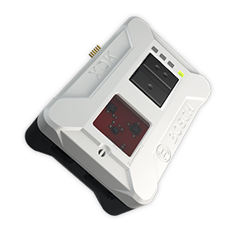


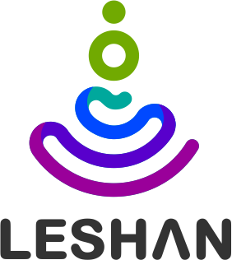
Established Collaboration
LAN
Cloud
USB
<<Gateway>>
<<Protocol Adapter>>
MQTT
BT LE
WiFi
MQTT
AMQP 1.0
HTTP
<<Protocol Adapter>>
CoAP(s)
AMQP 1.0
AMQP 1.0
HTTP (?)
AMQP 1.0

Slide 8
Established Collaboration
LAN
Cloud
HTTP-Proxy2
CoAP(s)

