Slide 1
Eclipse IoT monthly report
June 2017

Slide 2
Monthly projects development activity
JUN '17 | (color indicates variation compared to previous month)
 | Opened bugs | Closed bugs | Code authors | Commits | Posted messages | Senders
4diac | 6 | 8 | 3 | 9 | 0 | 0
californium | 13 | 16 | 2 | 44 | 48 | 8
concierge | 0 | 0 | 0 | 0 | 2 | 1
ditto | 0 | 0 | 0 | 0 | 0 | 0
eclipsescada | 0 | 0 | 2 | 32 | 0 | 0
edje | 0 | 0 | 0 | 0 | 5 | 2
hawkbit | 2 | 4 | 5 | 23 | 0 | 0
hono | 18 | 15 | 6 | 219 | 53 | 9
kapua | 31 | 19 | 3 | 437 | 9 | 3
krikkit | 0 | 0 | 0 | 0 | 0 | 0
kura | 19 | 27 | 9 | 87 | 8 | 3
leshan | 7 | 6 | 3 | 33 | 18 | 6
milo | 6 | 6 | 2 | 28 | 2 | 2
mosquitto | 17 | 10 | 5 | 22 | 37 | 13
om2m | 0 | 0 | 0 | 0 | 2 | 1
paho | 42 | 26 | 12 | 42 | 34 | 12
paho.incubator | 0 | 0 | 0 | 0 | 0 | 0
ponte | 0 | 0 | 0 | 0 | 0 | 0
risev2g | 0 | 0 | 0 | 0 | 0 | 0
smarthome | 88 | 84 | 18 | 132 | 0 | 0
tinydtls | 0 | 0 | 0 | 0 | 6 | 5
unide | 0 | 0 | 1 | 3 | 0 | 0
vorto | 57 | 45 | 8 | 123 | 2 | 1
wakaama | 5 | 5 | 2 | 9 | 21 | 9
whiskers | 0 | 0 | 0 | 0 | 0 | 0
ALL PROJECTS | 311 | 271 | 81 | 1243 | 247 | 75

Slide 3
Yearly projects development activity
JUL '16 - JUN '17 | (color indicates variation compared to previous period)
 | Opened bugs | Closed bugs | Code authors | Commits | Posted messages | Senders
4diac | 195 | 195 | 9 | 314 | 12 | 3
californium | 124 | 107 | 19 | 692 | 485 | 35
concierge | 24 | 3 | 5 | 15 | 8 | 6
ditto | 0 | 0 | 1 | 1 | 0 | 0
eclipsescada | 4 | 4 | 3 | 310 | 9 | 2
edje | 1 | 1 | 2 | 71 | 7 | 5
hawkbit | 47 | 45 | 13 | 736 | 5 | 3
hono | 94 | 88 | 13 | 698 | 235 | 36
kapua | 325 | 216 | 9 | 3183 | 346 | 18
krikkit | 0 | 0 | 0 | 0 | 0 | 0
kura | 534 | 456 | 24 | 1698 | 452 | 23
leshan | 83 | 68 | 20 | 358 | 291 | 62
milo | 64 | 59 | 6 | 248 | 99 | 21
mosquitto | 197 | 115 | 24 | 179 | 384 | 123
om2m | 123 | 123 | 5 | 42 | 16 | 13
paho | 552 | 378 | 60 | 893 | 428 | 201
paho.incubator | 0 | 0 | 0 | 0 | 0 | 0
ponte | 20 | 5 | 2 | 3 | 4 | 3
risev2g | 4 | 3 | 1 | 13 | 0 | 0
smarthome | 815 | 733 | 61 | 1139 | 33 | 9
tinydtls | 21 | 23 | 3 | 37 | 102 | 20
unide | 6 | 4 | 2 | 14 | 8 | 5
vorto | 194 | 156 | 13 | 403 | 12 | 9
wakaama | 64 | 55 | 13 | 135 | 108 | 40
whiskers | 2 | 0 | 2 | 21 | 11 | 8
ALL PROJECTS | 3493 | 2837 | 286 | 11203 | 3055 | 415

Slide 4
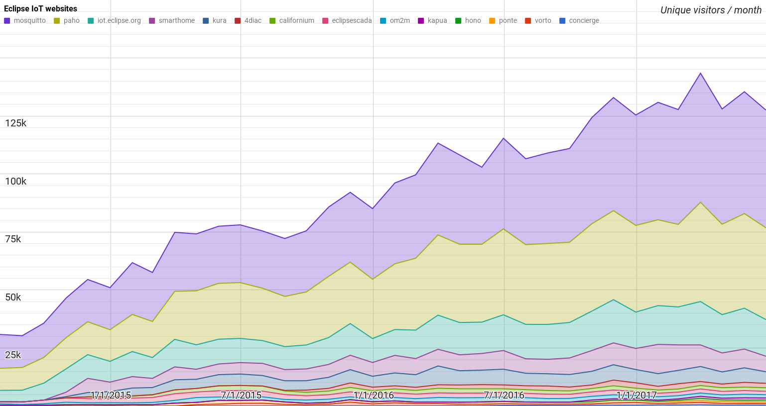
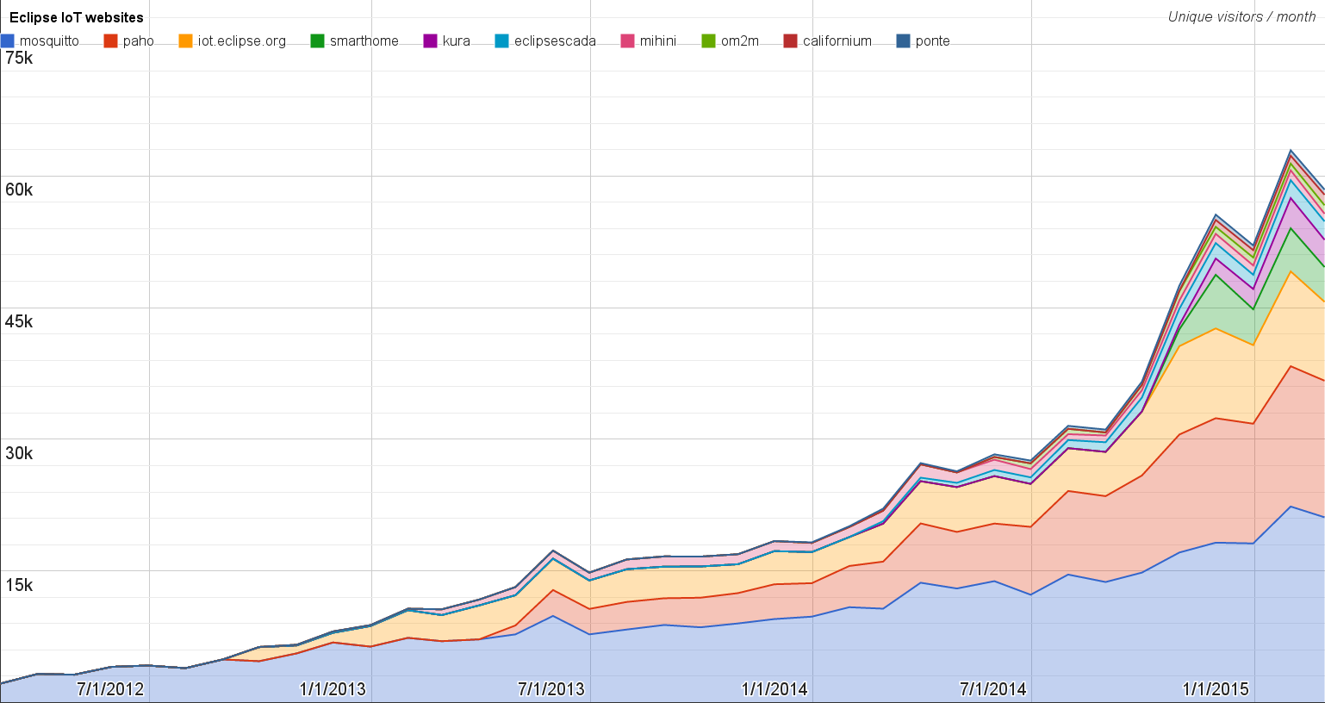
Websites
https://docs.google.com/spreadsheets/d/1MT8vUectDG7qnt83LBts-B7oECMsICXyB4Tn4Kxl64U/pubchart?oid=1293913369&format=image
Number of unique visitors this month | 127.5K
Month-over-month variation | -5%
Project with the highest growth this month | Eclipse Hono (+11%)
Year-over-year variation | +33% (1.12K → 1.5M visitors)

Slide 5
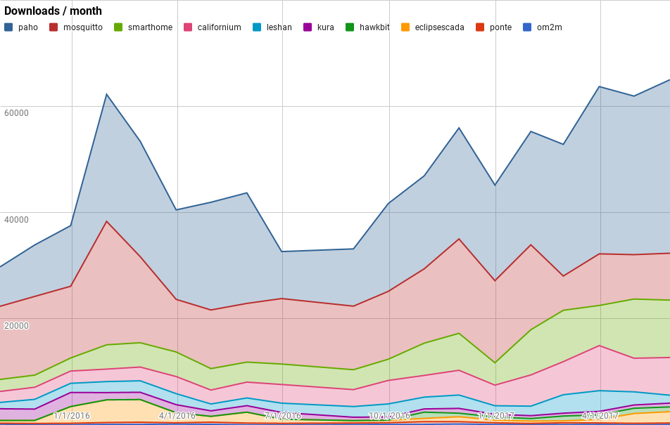
Downloads
https://docs.google.com/spreadsheets/d/1MT8vUectDG7qnt83LBts-B7oECMsICXyB4Tn4Kxl64U/pubchart?oid=1715994217&format=image
Downloads this month:
paho | 32657
smarthome | 10800
mosquitto | 8830
californium | 7101
eclipsescada | 2132
leshan | 1492
hawkbit | 889
kura | 715
ponte | 269
om2m | 117

Slide 6
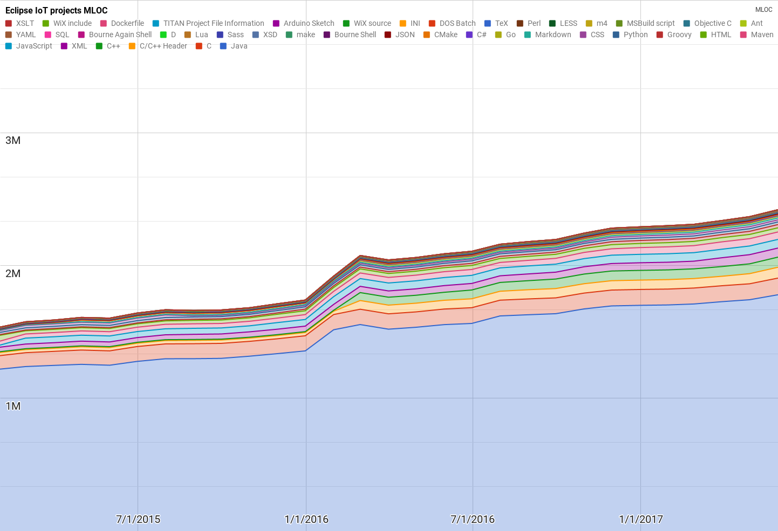
Lines of code (as of May-31, 2017)
https://docs.google.com/spreadsheets/d/1MT8vUectDG7qnt83LBts-B7oECMsICXyB4Tn4Kxl64U/pubchart?oid=1652481431&format=image

Slide 7
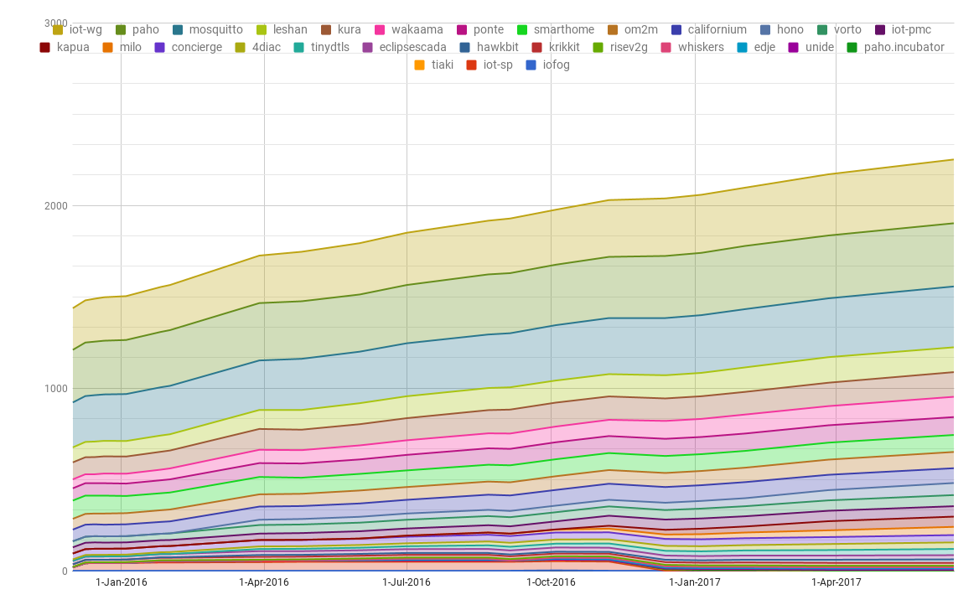
Mailing list subscriptions
https://docs.google.com/spreadsheets/d/1MT8vUectDG7qnt83LBts-B7oECMsICXyB4Tn4Kxl64U/pubchart?oid=1893372427&format=image

