Slide 1
Like it or not, we are all IoT developers now
Kilton Hopkins
Co-founder & CEO of IOTRACKS

Slide 2
Who’s talking?
Kilton Hopkins
IoT Advisor, City of San Francisco
Long time programmer
Native of Chicago

Slide 3
Our mission is to give developers the best possible way to build for the Internet of Things

Slide 4
Internet of Things overview

Slide 5
Most importantly…
it is not brand-new devices that each have a smartphone app

Slide 6
IoT – What’s so new?
Connectivity Options
Variable destinations
APIs without contracts
Multiple use cases for the same data
Ad-hoc value through integration
Web developers using circuit boards
Internet connection focus vs. LAN focus

Slide 7
IoT – What’s so new?
Identity and Privacy
Commands from abroad
Real-time analytics
Systems of systems (edges paired up)
Routing around the cloud
Non-HTTP protocols
Sustained connections

Slide 8
… And what’s old?
Embedded software
Battery conservation
Wireless and R/F technology (ex. RFID)
Small data packets
Specialty networks
System-on-a-chip
Security (not identity)
Real-time processing
Batch reporting and uploading
Action from information

Slide 9
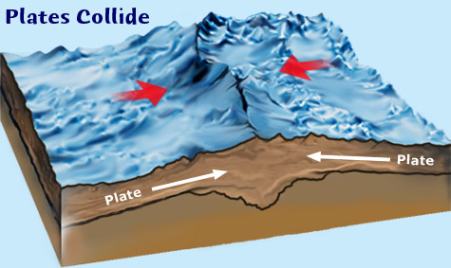
M2M meets Internet

Slide 10
What survives from M2M
All of the current (legacy) installations
The team members and their skills
Solution ownership (politics)
Protocols
Latency requirements
Business relationships
Stability expectations
Sensor hardware and networks

Slide 11
What dies?
Waterfall project approach
Stability of project requirements
Uniformity of hardware
Development model limitations
Tethered connection device updates
IT department networking
Closed edge systems
Vertical solution silos

Slide 12
Why are we building the Internet of Things?
(a functional perspective)

Slide 13
Computer interaction with reality

Slide 14
Automation

Slide 15
New sources of data

Slide 16
Vast quantities of data

Slide 17
Extending the human-computer interface

Slide 18
The IoT Stack
Devices

Slide 19
The IoT Stack
Connectivity¹
Devices

Slide 20
The IoT Stack
Gateways, Hubs, Base Stations
Connectivity¹
Devices

Slide 21
The IoT Stack
Edge Processing
Gateways, Hubs, Base Stations
Connectivity¹
Devices

Slide 22
The IoT Stack
Connectivity²
Edge Processing
Gateways, Hubs, Base Stations
Connectivity¹
Devices

Slide 23
The IoT Stack
Ingestion / Backend Ingress
Connectivity²
Edge Processing
Gateways, Hubs, Base Stations
Connectivity¹
Devices

Slide 24
The IoT Stack
Central Processing
Ingestion / Backend Ingress
Connectivity²
Edge Processing
Gateways, Hubs, Base Stations
Connectivity¹
Devices

Slide 25
The IoT Stack
Presentation / Application
Central Processing
Ingestion / Backend Ingress
Connectivity²
Edge Processing
Gateways, Hubs, Base Stations
Connectivity¹
Devices

Slide 26
The IoT Stack
Presentation / Application
Central Processing
Ingestion / Backend Ingress
Connectivity²
Edge Processing
Gateways, Hubs, Base Stations
Connectivity¹
Devices

Slide 27
Device classification
Light
No TCP/IP
Cheap wireless
Wired connection
Small data
No runtime
Single purpose
Bulk provisioned
Long battery life
Medium
TCP/IP Present
Maybe HTTP
W-Fi or cellular
Small runtime
Good battery life
Remote update
Heavy
TCP/IP present
HTTP and more
Big runtime
Poor battery life
Wall outlet power
Flexible
Wi-Fi or cellular
Remote update

Slide 28
Our systems are limited by the weakest device capabilities…

Slide 29
So we run to the cloud

Slide 30
…and it suffers from “destination abuse”

Slide 31
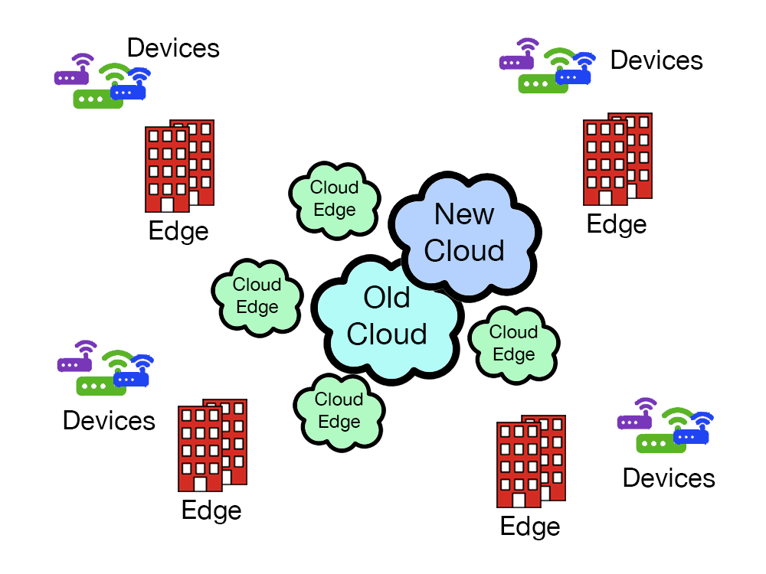
The new landscape

Slide 32
What’s being done right now

Slide 33
IoT device peer-to-peer

Slide 34
Full Internet of Things connections

Slide 35
What matters for device connectivity¹
Installation and setup
Licensed vs. unlicensed spectrum
Range
Power consumption
Hardware costs
Network and data fees
Developer skill sets (IT doesn’t provide these networks today)

Slide 36
Open source for connectivity
LoRaWAN – a star of stars topology
https://www.lora-alliance.org/

Slide 37
Open source for connectivity
LPWAN – both licensed and unlicensed
www.weightless.org/

Slide 38
Open source for connectivity
www.bluetooth.com

Slide 39
Open source for connectivity
www.zigbee.org

Slide 40
Open source for connectivity
www.threadgroup.org

Slide 41
Open source for connectivity
COAP
MQTT
I2C
Z-Wave Alliance
802.11x (Wi-Fi)
TCP/IP
6LoWPAN (IPv6 over PAN)

Slide 42
The IoT Stack
Presentation / Application
Central Processing
Ingestion / Backend Ingress
Connectivity²
Edge Processing
Gateways, Hubs, Base Stations
Connectivity¹
Devices

Slide 43
On a gateway…
Protocol translation
Filtering
Some data normalization
Connectivity enhancement
Some edge processing
Some integration

Slide 44
Why edge processing?
Low latency
Prevent the tidal wave of traffic
Avoid storage of unwanted data
Pre-normalization
Real-time analytics with automation
Privacy and security
System of systems architecture
No other way to connect devices

Slide 45
Why edge processing?
Distributed computing
Solution robustness
No fees on the edge
Fully owned deployments
Hardware appropriate for use case

Slide 46
7 ways to connect devices
https://github.com/iotracks/iofabric/blob/master/docs/ioFabric-Device-Connections.md

Slide 47
The IoT Stack
Presentation / Application
Central Processing
Ingestion / Backend Ingress
Connectivity²
Edge Processing
Gateways, Hubs, Base Stations
Connectivity¹
Devices

Slide 48
What matters for ingestion?
Fat pipe
Ability to work on real-time streams
Ability to store incoming data
Framework for going up the stack

Slide 49
What matters for central processing?
Speed
All instances – same data access
Development model
Consumable outputs
Scalability
Extensibility

Slide 50
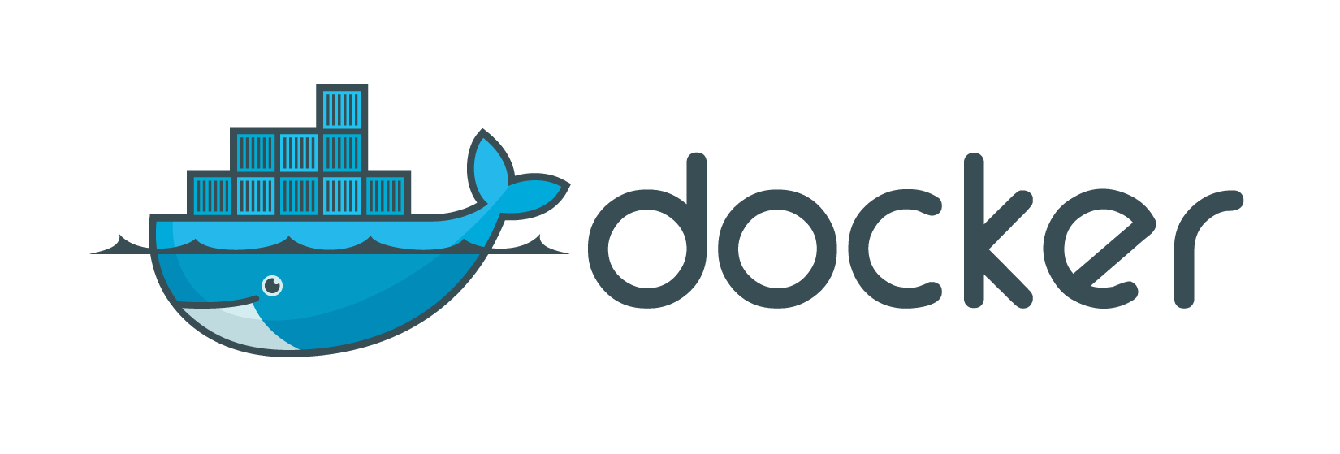
And what about this??!!!??
docker.com

Slide 51
Proprietary but noteworthy
Sigfox
Jasper
Cisco IoX
AWS IoT
IBM Stuff (Watson now)

Slide 52
Proprietary but noteworthy
SAP HANA
Electric Imp
GE Predix
Foghorn
Resin.io

Slide 53
My concerns :

Slide 54
Real-time

Slide 55
Security

Slide 56
Development Model

Slide 57
Internet Traffic

Slide 58
Privacy

Slide 59
Legacy!!!

Slide 60
Setup & Install

Slide 61
Mutability

Slide 62
Portability
(microservices)

Slide 63
Maintenance

Slide 64
Empty Fat Pipes

Slide 65
Bi-Directional Communication

Slide 66
Part 2: The impact
on software development

Slide 67
Estimates will be way off

Slide 68
New environments
Development env. with hardware?
Test env. with enough scale?
Production with remote access?
What does deployment look like?

Slide 69
Difficult to simulate scale at this time

Slide 70
Data modeling is now a first-class citizen
REST APIs are great
IoT devices have APIs
IoT devices do not have REST APIs
Data modeling becomes really important part of IoT projects…

Slide 71
Sensors and devices will change after deploy

Slide 72
QA challenges
Actuation is a new thing for most companies
Information can be verified by querying for it, etc.
How do you QA verify a water valve being widened by 5%

Slide 73
Some IoT project hang-ups (preventing rapid IoT adoption)

Slide 74
Legacy integration
LDAP and Active Directory
M2M systems (RFID is common)
Logic sits in embedded code
Existing backends with no IoT inlets
Production systems at risk

Slide 75
Load planning
It’s BACK!!!
Deployed hardware has limitations
We need to think about what software goes where... For the first time in a long time

Slide 76
My favorite most terrible thing

Slide 77
Can’t just build IoT solutions directly… must handle some slogging

Slide 78
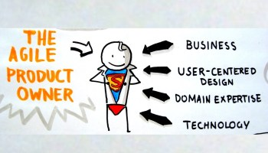
For product owners

Slide 79
Beware the metering

Slide 80
Unknown interaction models (no screens, no keyboards)

Slide 81
Setup, deploy, and provisioning experience is user’s first impression

Slide 82
Real capital outlay

Slide 83
Like it or not… all will be impacted by IoT

Slide 84
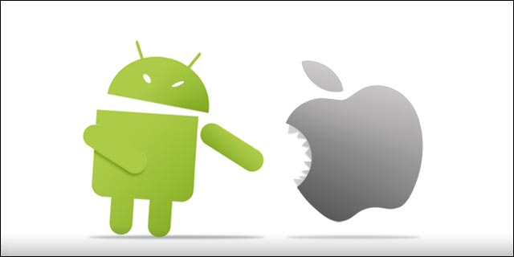
Remember mobile? (responsive design)

Slide 85
No such thing as an IoT developer… yet

Slide 86
Large percentage not comfortable with Linux command line, for example

Slide 87
Career Planning
Look to open source
Stay focused on business drivers
Train early on the tech
Do pilots and prototypes now
Just be part of anything IoT
Avoid end-to-end system lock-in

Slide 88
Must-Know Items
Docker and containerization
Bluetooth Smart / 4.0 / Low Energy
Long-range low-power wireless
Latest security models (keep up)
Edge processing / fog computing

Slide 89
Help with our research!
Developers: I really want to talk to you

Slide 90
Thanks!
Kilton Hopkins
kilton@iotracks.com
@kiltonhopkins
@iotracks

