Slide 1

Eclipse IoT monthly report
December 2017

Slide 2
Monthly projects development activity
DEC '17 | (color indicates variation compared to previous month)
 | Opened bugs | Closed bugs | Code authors | Commits | Posted messages | Senders
4diac | 7 | 8 | 5 | 51 | 0 | 0
californium | 9 | 10 | 2 | 34 | 0 | 0
concierge | 0 | 0 | 0 | 0 | 0 | 0
ditto | 2 | 4 | 11 | 211 | 0 | 0
eclipsescada | 0 | 0 | 1 | 2 | 0 | 0
edje | 0 | 0 | 0 | 0 | 0 | 0
hawkbit | 3 | 2 | 6 | 14 | 0 | 0
hono | 7 | 9 | 6 | 100 | 0 | 0
kapua | 128 | 21 | 10 | 106 | 0 | 0
krikkit | 0 | 0 | 0 | 0 | 0 | 0
kura | 18 | 31 | 10 | 84 | 0 | 0
leshan | 5 | 2 | 2 | 19 | 0 | 0
milo | 2 | 3 | 2 | 84 | 0 | 0
mosquitto | 22 | 19 | 3 | 15 | 0 | 0
om2m | 10 | 14 | 2 | 11 | 0 | 0
paho | 52 | 32 | 12 | 89 | 0 | 0
paho.incubator | 0 | 0 | 0 | 0 | 0 | 0
ponte | 0 | 0 | 1 | 1 | 0 | 0
risev2g | 0 | 0 | 0 | 0 | 0 | 0
smarthome | 65 | 33 | 17 | 83 | 0 | 0
tinydtls | 19 | 12 | 1 | 3 | 0 | 0
unide | 1 | 1 | 1 | 3 | 0 | 0
vorto | 6 | 3 | 4 | 23 | 0 | 0
wakaama | 1 | 0 | 1 | 1 | 0 | 0
whiskers | 0 | 0 | 0 | 0 | 0 | 0
ALL PROJECTS | 357 | 204 | 97 | 934 | 0 | 0

Slide 3
Yearly projects development activity
JAN '17 - DEC '17 | (color indicates variation compared to previous period)
 | Opened bugs | Closed bugs | Code authors | Commits | Posted messages | Senders
4diac | 170 | 174 | 11 | 383 | 57 | 9
californium | 117 | 120 | 20 | 661 | 410 | 29
concierge | 9 | 9 | 5 | 20 | 2 | 1
ditto | 20 | 16 | 17 | 445 | 0 | 0
eclipsescada | 7 | 1 | 3 | 183 | 0 | 0
edje | 0 | 1 | 1 | 2 | 8 | 5
hawkbit | 47 | 41 | 12 | 185 | 14 | 8
hono | 173 | 152 | 20 | 948 | 334 | 28
kapua | 604 | 398 | 24 | 3079 | 423 | 36
krikkit | 0 | 0 | 0 | 0 | 1 | 1
kura | 382 | 408 | 20 | 1274 | 135 | 27
leshan | 90 | 80 | 15 | 318 | 272 | 52
milo | 52 | 47 | 9 | 355 | 94 | 18
mosquitto | 216 | 120 | 25 | 166 | 208 | 66
om2m | 260 | 294 | 6 | 292 | 12 | 8
paho | 668 | 490 | 88 | 1135 | 301 | 75
paho.incubator | 0 | 0 | 0 | 0 | 0 | 0
ponte | 12 | 4 | 3 | 11 | 4 | 3
risev2g | 1 | 4 | 1 | 7 | 0 | 0
smarthome | 824 | 719 | 86 | 1200 | 28 | 10
tinydtls | 23 | 34 | 3 | 37 | 67 | 15
unide | 18 | 9 | 10 | 74 | 7 | 4
vorto | 169 | 214 | 13 | 379 | 10 | 8
wakaama | 59 | 51 | 16 | 154 | 88 | 31
whiskers | 0 | 0 | 2 | 7 | 4 | 3
ALL PROJECTS | 3921 | 3386 | 371 | 11315 | 2479 | 334

Slide 4
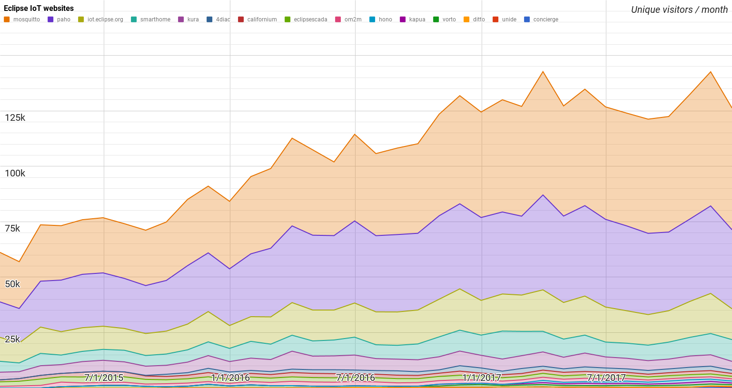
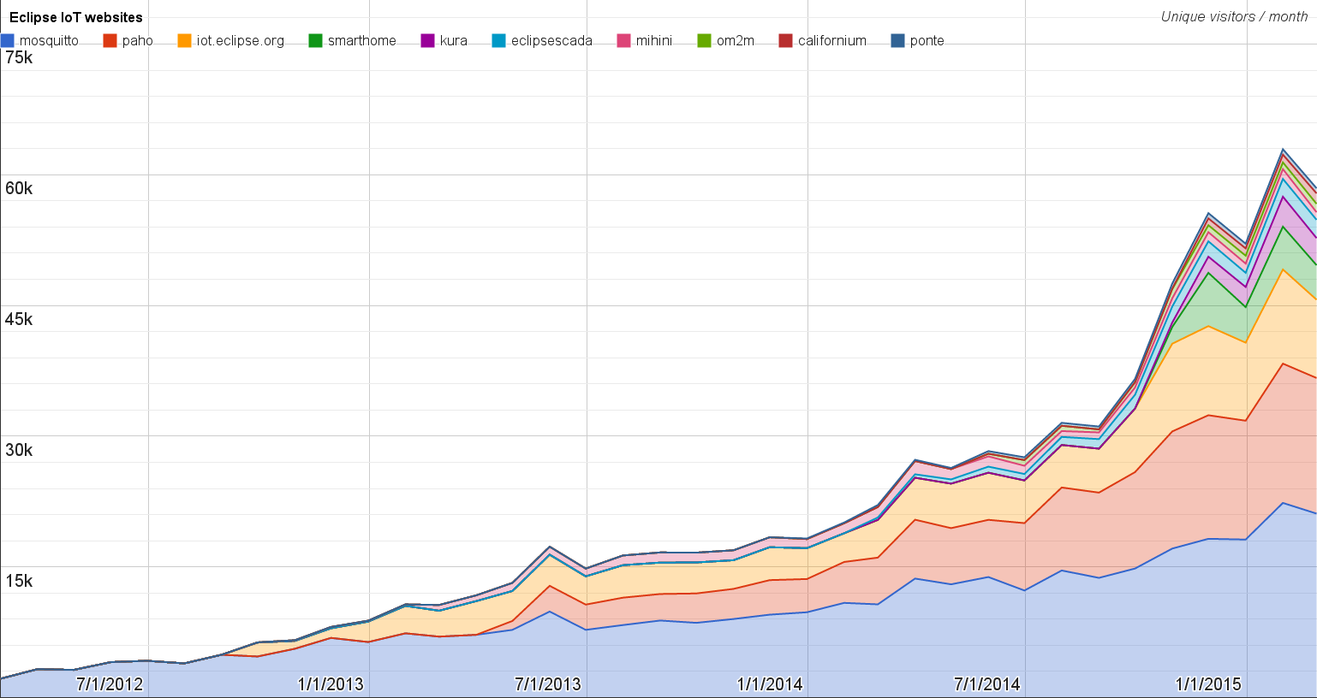
Websites
https://docs.google.com/spreadsheets/d/1MT8vUectDG7qnt83LBts-B7oECMsICXyB4Tn4Kxl64U/pubchart?oid=1293913369&format=image
Number of unique visitors this month | 126K
Month-over-month variation | -11%
Project with the highest growth this month | Eclipse Ditto (+54%)
Year-over-year variation | +16% (1.33K → 1.56M visitors)

Slide 5
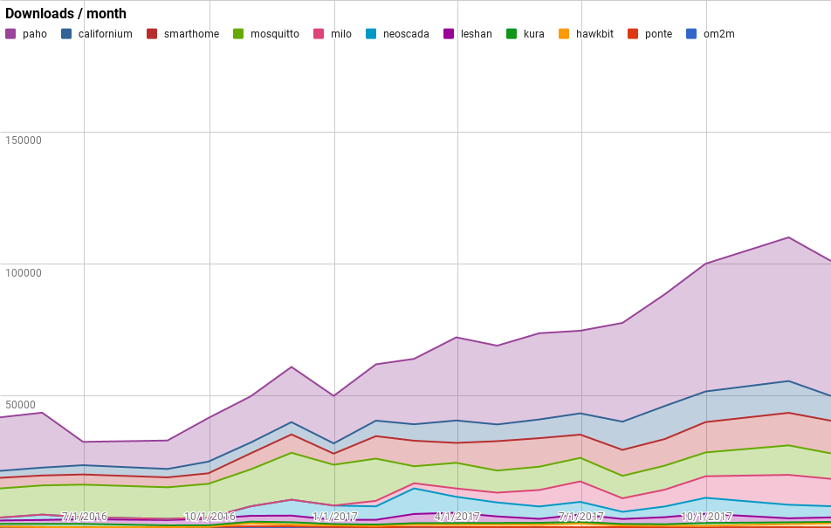
Downloads
https://docs.google.com/spreadsheets/d/1MT8vUectDG7qnt83LBts-B7oECMsICXyB4Tn4Kxl64U/pubchart?oid=1715994217&format=image
Downloads this month:
paho | 51119
smarthome | 12378
milo | 10350
mosquitto | 9657
californium | 9387
neoscada | 4239
ditto | 3217
leshan | 1704
hawkbit | 1602
kura | 514
om2m | 133
ponte | 84
Grand Total | 104384

Slide 6
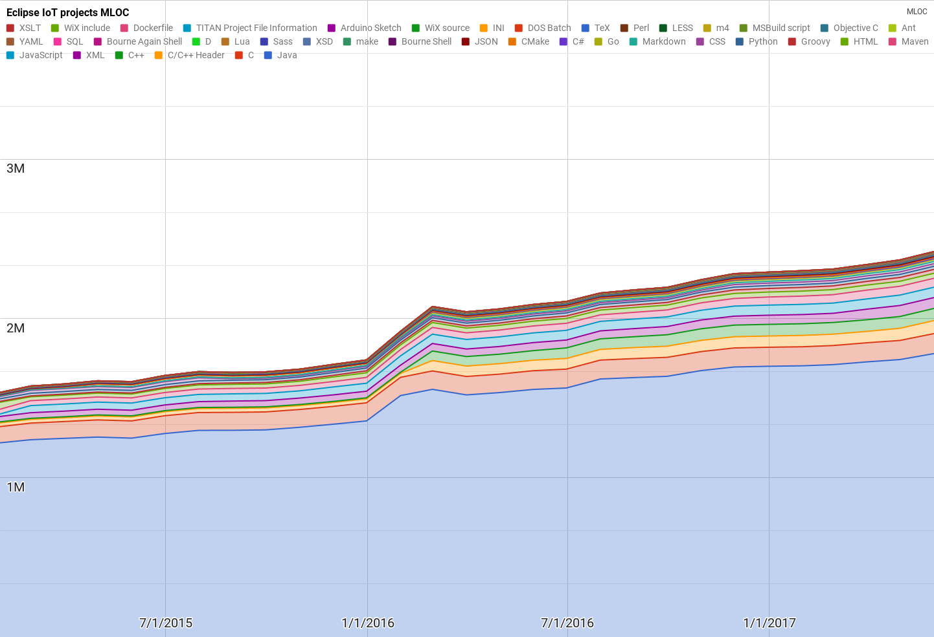
Lines of code (as of May-31, 2017)
https://docs.google.com/spreadsheets/d/1MT8vUectDG7qnt83LBts-B7oECMsICXyB4Tn4Kxl64U/pubchart?oid=1652481431&format=image

Slide 7
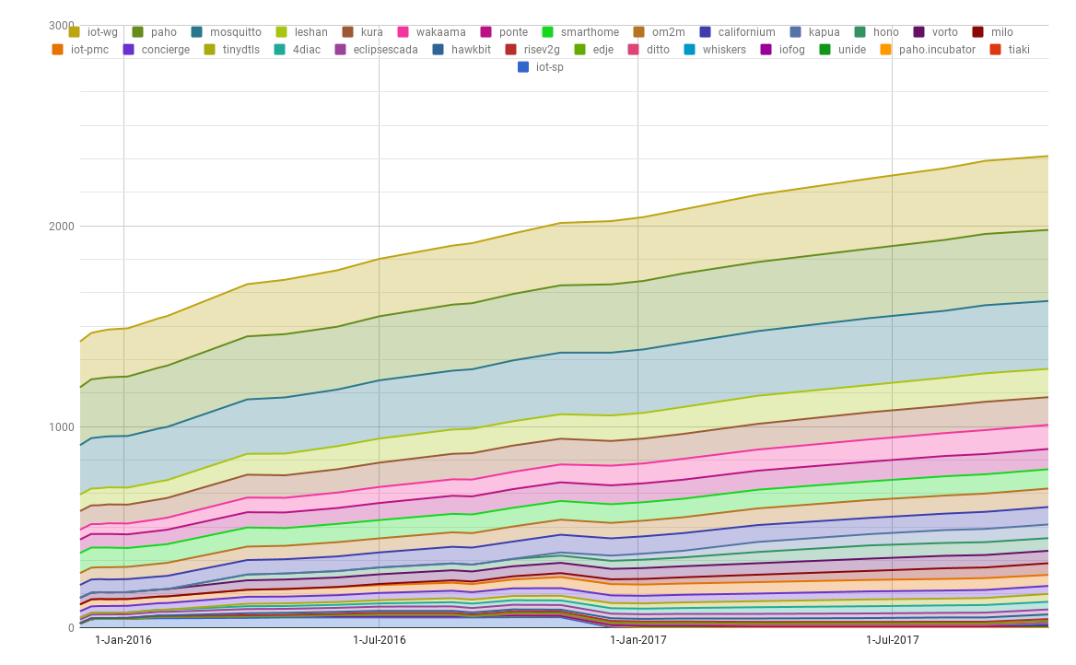
Mailing list subscriptions
https://docs.google.com/spreadsheets/d/1MT8vUectDG7qnt83LBts-B7oECMsICXyB4Tn4Kxl64U/pubchart?oid=1893372427&format=image

