Slide 1
Eclipse IoT monthly report
April 2016

Slide 2
Monthly projects development activity
APR '16 | (color indicates variation compared to previous month)
 | Opened bugs | Closed bugs | Code authors | Commits | Posted messages | Senders
4diac | 32 | 31 | 3 | 4 | 0 | 0
californium | 0 | 0 | 5 | 30 | 42 | 8
concierge | 0 | 0 | 1 | 16 | 0 | 0
eclipsescada | 0 | 0 | 2 | 94 | 0 | 0
hawkbit | 0 | 0 | 8 | 123 | 0 | 0
hono | 0 | 0 | 3 | 49 | 51 | 9
krikkit | 0 | 0 | 1 | 1 | 0 | 0
kura | 0 | 0 | 7 | 72 | 30 | 9
leshan | 0 | 0 | 5 | 27 | 29 | 16
mosquitto | 2 | 1 | 2 | 9 | 27 | 13
om2m | 3 | 3 | 2 | 7 | 0 | 0
paho | 2 | 10 | 11 | 34 | 67 | 17
paho.incubator | 0 | 0 | 0 | 0 | 0 | 0
ponte | 0 | 0 | 0 | 0 | 0 | 0
risev2g | 0 | 0 | 1 | 8 | 0 | 0
smarthome | 0 | 0 | 18 | 85 | 36 | 6
tiaki | 0 | 0 | 0 | 0 | 1 | 1
vorto | 0 | 0 | 5 | 18 | 1 | 1
wakaama | 0 | 0 | 3 | 9 | 34 | 11
ALL PROJECTS | 39 | 45 | 77 | 586 | 318 | 91

Slide 3
Github Activity
Pull requests
Issues
 | March 2016 | April 2016
iot.californium | 11 | 12
iot.hawkbit | 55 | 44
iot.hono | 1 | 1
iot.kura | 9 | 6
iot.leshan | 20 | 16
iot.mosquitto | 1 | 7
iot.paho | 18 | 48
iot.ponte | 1 | 1
iot.risev2g | 0 | 0
iot.smarthome | 165 | 125
iot.tiaki | 0 | 0
iot.vorto | 17 | 8
iot.wakaama | 30 | 11
Grand Total | 328 | 279
 | March 2016 | April 2016
iot.californium | 12 | 17
iot.hawkbit | 8 | 4
iot.hono | 11 | 20
iot.kura | 11 | 70
iot.leshan | 12 | 7
iot.mosquitto | 151 | 6
iot.paho | 94 | 44
iot.ponte | 0 | 0
iot.risev2g | 0 | 0
iot.smarthome | 107 | 97
iot.tiaki | 0 | 0
iot.vorto | 74 | 29
iot.wakaama | 17 | 6
Grand Total | 497 | 300

Slide 4
Yearly projects development activity
MAY '15 - APR '16 | (color indicates variation compared to previous period)
 | Opened bugs | Closed bugs | Code authors | Commits | Posted messages | Senders
4diac | 96 | 55 | 5 | 35 | 44 | 10
californium | 41 | 46 | 23 | 564 | 541 | 34
concierge | 28 | 23 | 4 | 150 | 28 | 8
eclipsescada | 15 | 45 | 2 | 530 | 8 | 4
hawkbit | 0 | 0 | 15 | 508 | 23 | 7
hono | 0 | 0 | 5 | 85 | 125 | 13
krikkit | 0 | 0 | 2 | 2 | 2 | 2
kura | 14 | 8 | 14 | 965 | 149 | 28
leshan | 7 | 7 | 20 | 350 | 351 | 54
mosquitto | 68 | 46 | 8 | 179 | 465 | 110
om2m | 9 | 6 | 6 | 27 | 29 | 7
paho | 141 | 81 | 29 | 279 | 789 | 116
paho.incubator | 0 | 0 | 0 | 0 | 0 | 0
ponte | 1 | 0 | 3 | 13 | 1 | 1
risev2g | 0 | 0 | 2 | 24 | 3 | 3
smarthome | 124 | 180 | 69 | 778 | 91 | 14
tiaki | 0 | 0 | 3 | 12 | 3 | 3
vorto | 155 | 156 | 12 | 199 | 10 | 5
wakaama | 3 | 0 | 11 | 215 | 224 | 42
ALL PROJECTS | 702 | 653 | 228 | 4915 | 2886 | 451

Slide 5
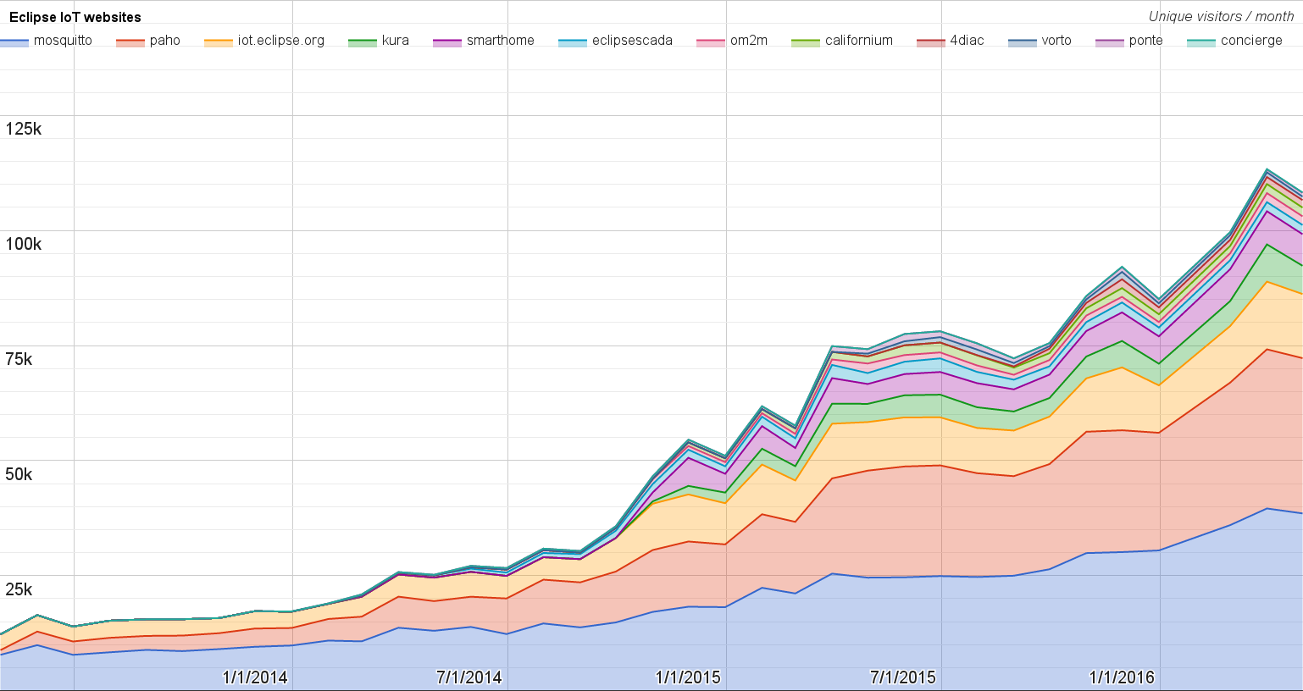
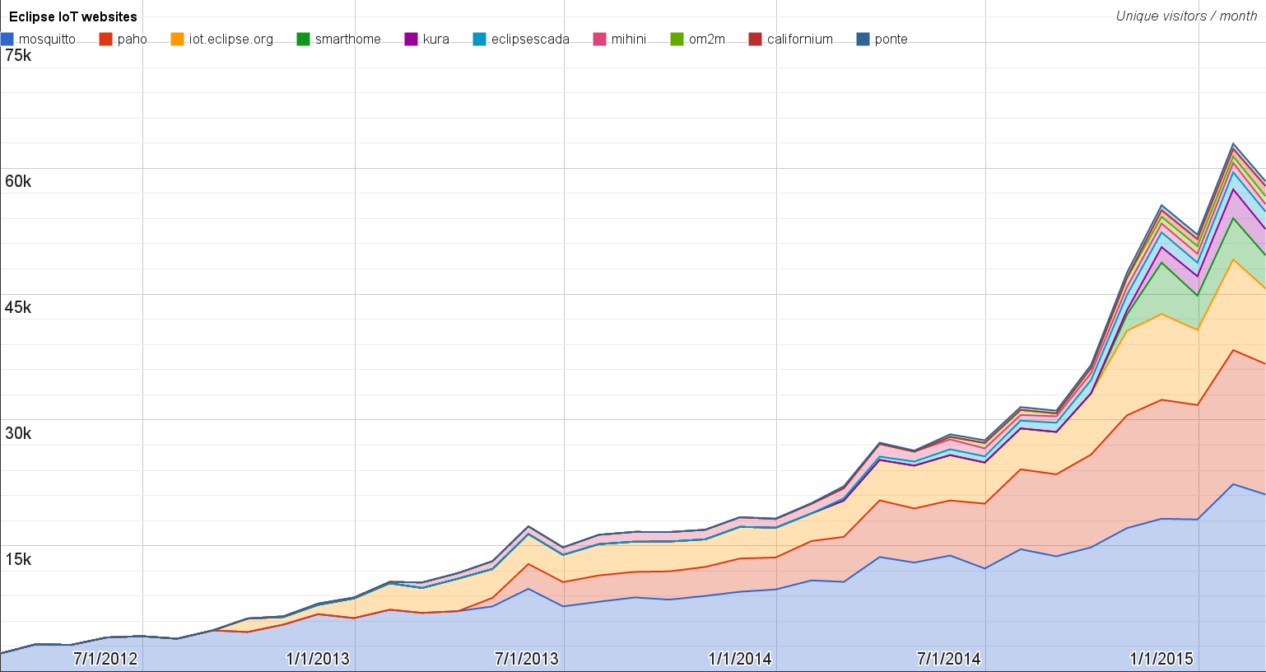
Websites
https://docs.google.com/spreadsheets/d/1MT8vUectDG7qnt83LBts-B7oECMsICXyB4Tn4Kxl64U/pubchart?oid=1293913369&format=image
Number of unique visitors this month | 108K
Month-over-month variation | - 4%
Project with the highest growth this month | Eclipse Ponte (+27%)
Year-over-year variation | +95% (533K → 1.04M unique visitors)

Slide 6
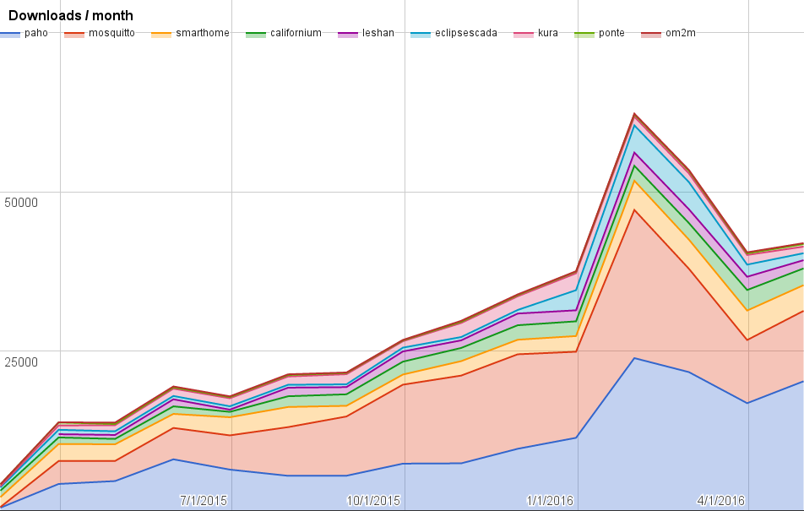
Downloads
https://docs.google.com/spreadsheets/d/1MT8vUectDG7qnt83LBts-B7oECMsICXyB4Tn4Kxl64U/pubchart?oid=1715994217&format=image
Downloads this month:
paho | 20276
mosquitto | 11039
paho | 5050
smarthome | 4034
californium | 2624
leshan | 1294
neoscada | 1091
kura | 1035
ponte | 407
om2m | 138

Slide 7
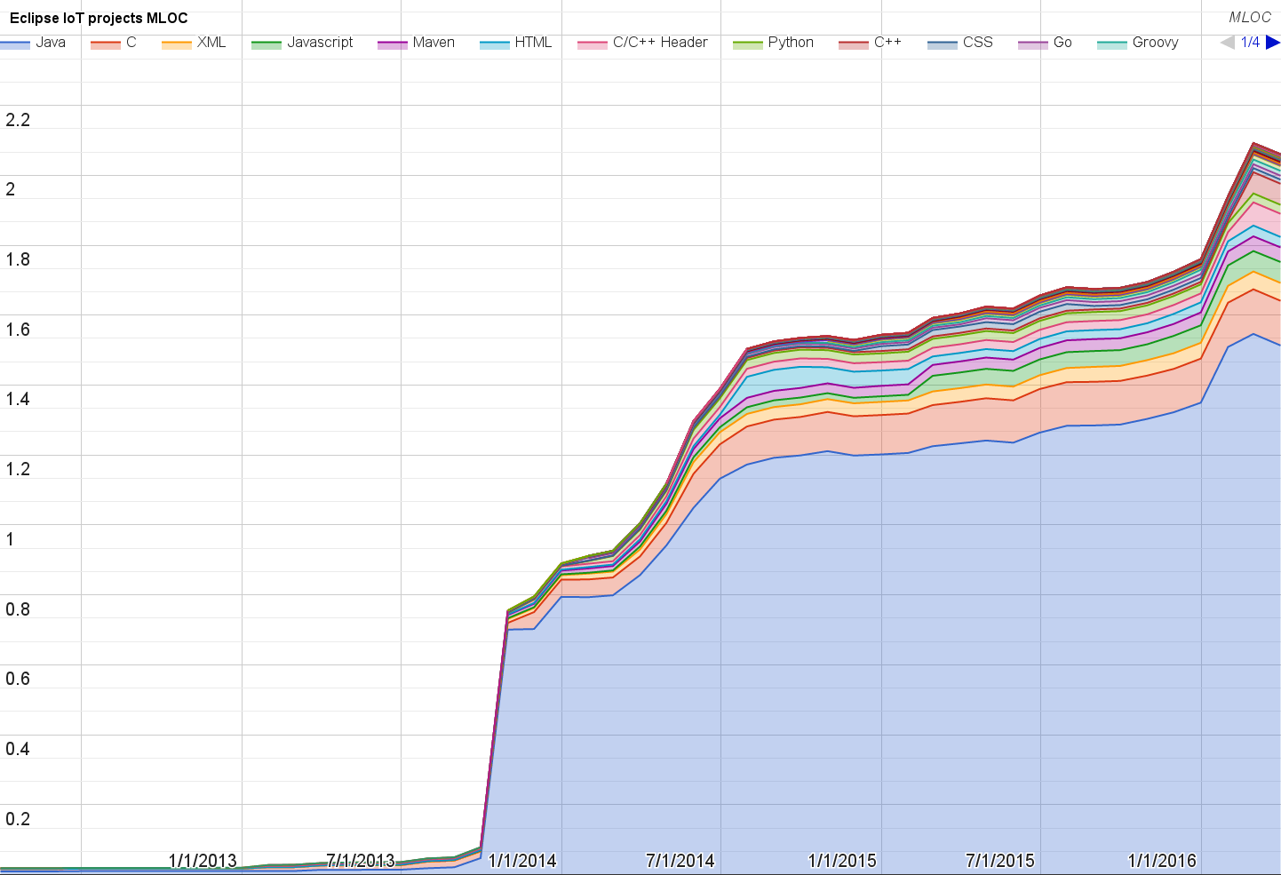
Lines of code (as of Mar-31, 2016)
https://docs.google.com/spreadsheets/d/1MT8vUectDG7qnt83LBts-B7oECMsICXyB4Tn4Kxl64U/pubchart?oid=1652481431&format=image

Slide 8
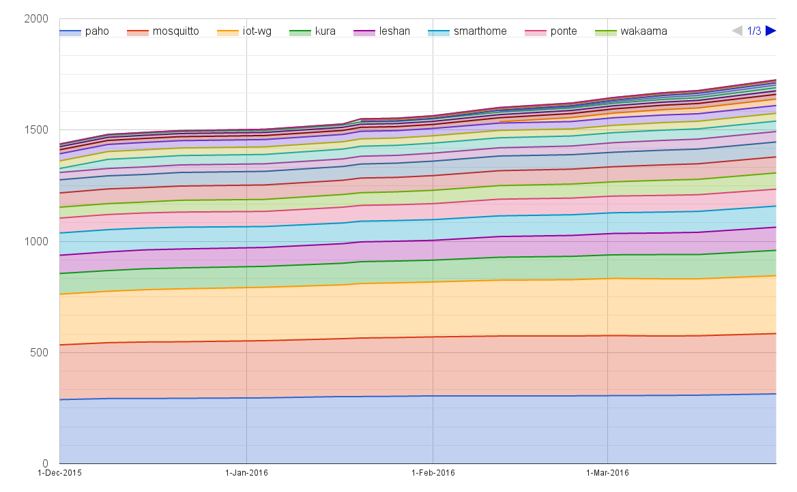
Mailing list subscriptions
https://docs.google.com/spreadsheets/d/1MT8vUectDG7qnt83LBts-B7oECMsICXyB4Tn4Kxl64U/pubchart?oid=1893372427&format=image

Slide 9
Sandbox servers (MQTT, CoAP, LwM2M)
MQTT (Mosquitto)
539 active clients (-1% monthly)
CoAP
192 unique IP addresses
LWM2M
See Bug 467101

