Slide 1

Eclipse IoT monthly report
August 2016

Slide 2
Monthly projects development activity
AUG '16 | (color indicates variation compared to previous month)
 | Opened bugs | Closed bugs | Code authors | Commits | Posted messages | Senders
4diac | 3 | 13 | 4 | 20 | 0 | 0
californium | 2 | 4 | 2 | 4 | 1 | 1
concierge | 0 | 0 | 0 | 0 | 0 | 0
eclipsescada | 0 | 0 | 0 | 0 | 0 | 0
edje | 0 | 0 | 0 | 0 | 0 | 0
hawkbit | 0 | 0 | 6 | 105 | 0 | 0
hono | 1 | 3 | 1 | 2 | 0 | 0
krikkit | 0 | 0 | 0 | 0 | 0 | 0
kura | 43 | 31 | 10 | 86 | 11 | 2
leshan | 6 | 3 | 3 | 5 | 2 | 1
milo | 3 | 2 | 1 | 6 | 3 | 2
mosquitto | 20 | 8 | 3 | 11 | 12 | 6
om2m | 0 | 0 | 1 | 1 | 0 | 0
paho | 44 | 17 | 5 | 9 | 11 | 4
paho.incubator | 0 | 0 | 0 | 0 | 0 | 0
ponte | 0 | 0 | 0 | 0 | 0 | 0
risev2g | 0 | 0 | 0 | 0 | 0 | 0
smarthome | 55 | 57 | 16 | 49 | 0 | 0
tinydtls | 0 | 0 | 0 | 0 | 0 | 0
vorto | 17 | 21 | 5 | 31 | 0 | 0
wakaama | 5 | 7 | 2 | 3 | 1 | 1
whiskers | 0 | 0 | 0 | 0 | 0 | 0
ALL PROJECTS | 199 | 166 | 59 | 332 | 41 | 17

Slide 3
Yearly projects development activity
SEP '15 - AUG '16 | (color indicates variation compared to previous period)
 | Opened bugs | Closed bugs | Code authors | Commits | Posted messages | Senders
4diac | 72 | 128 | 9 | 106 | 12 | 2
californium | 53 | 48 | 21 | 476 | 358 | 14
concierge | 12 | 3 | 5 | 104 | 19 | 6
eclipsescada | 0 | 19 | 2 | 342 | 4 | 2
edje | 0 | 0 | 2 | 2 | 1 | 1
hawkbit | 25 | 5 | 22 | 1159 | 1 | 1
hono | 33 | 28 | 5 | 195 | 111 | 6
krikkit | 0 | 0 | 1 | 1 | 0 | 0
kura | 255 | 107 | 18 | 940 | 97 | 19
leshan | 41 | 49 | 17 | 382 | 161 | 21
milo | 19 | 15 | 5 | 58 | 7 | 3
mosquitto | 242 | 171 | 17 | 223 | 275 | 46
om2m | 1 | 1 | 7 | 72 | 25 | 4
paho | 287 | 198 | 40 | 342 | 431 | 57
paho.incubator | 0 | 0 | 0 | 0 | 0 | 0
ponte | 0 | 0 | 3 | 8 | 0 | 0
risev2g | 1 | 1 | 1 | 17 | 2 | 2
smarthome | 605 | 513 | 82 | 926 | 53 | 7
tinydtls | 0 | 2 | 2 | 14 | 20 | 3
vorto | 248 | 136 | 20 | 570 | 1 | 2
wakaama | 52 | 50 | 14 | 199 | 67 | 15
whiskers | 0 | 0 | 2 | 22 | 1 | 1
ALL PROJECTS | 1946 | 1474 | 295 | 6158 | 1646 | 57

Slide 4
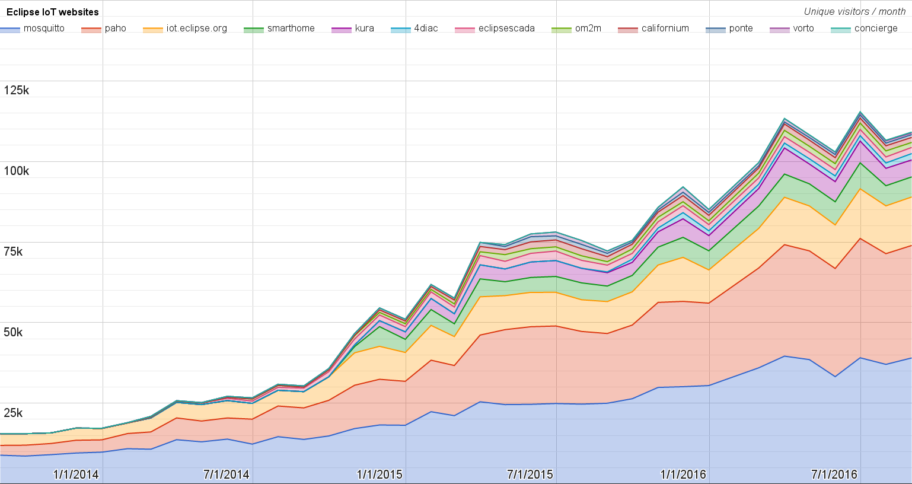
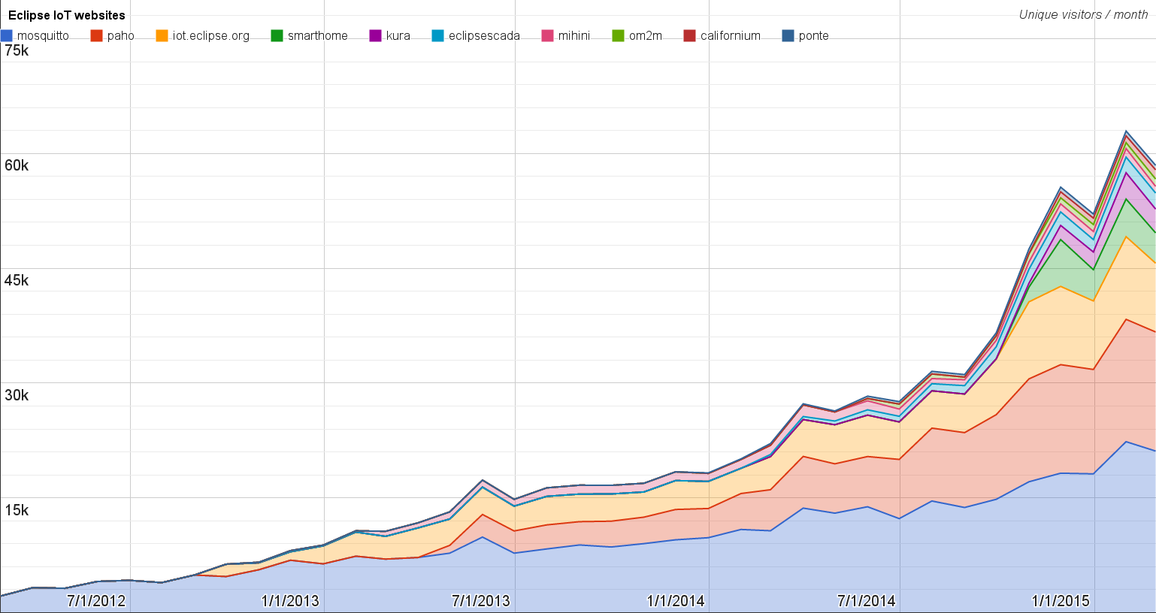
Websites
https://docs.google.com/spreadsheets/d/1MT8vUectDG7qnt83LBts-B7oECMsICXyB4Tn4Kxl64U/pubchart?oid=1293913369&format=image
Number of unique visitors this month | 109K
Month-over-month variation | +2%
Project with the highest growth this month | Eclipse Concierge (+23%)
Year-over-year variation | +60% (729K → 1.17M visitors)

Slide 5
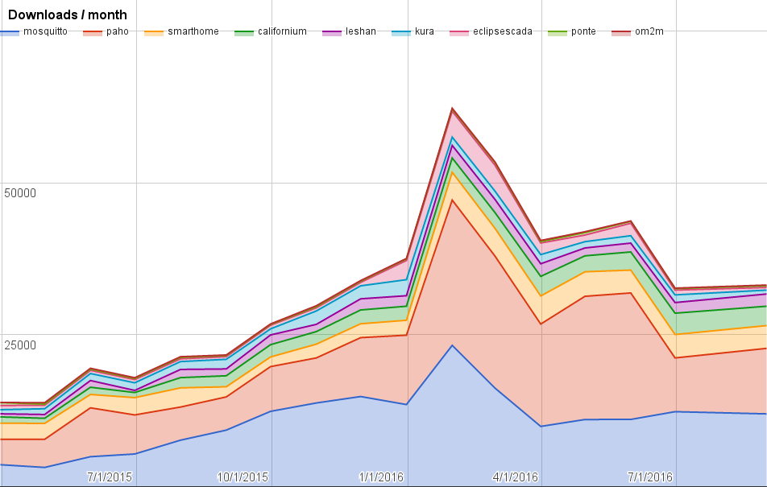
Downloads
https://docs.google.com/spreadsheets/d/1MT8vUectDG7qnt83LBts-B7oECMsICXyB4Tn4Kxl64U/pubchart?oid=1715994217&format=image
Downloads this month:
mosquitto | 11966
paho | 10777
smarthome | 3748
californium | 3184
leshan | 2012
kura | 641
eclipsescada | 42
ponte | 279
om2m | 110

Slide 6
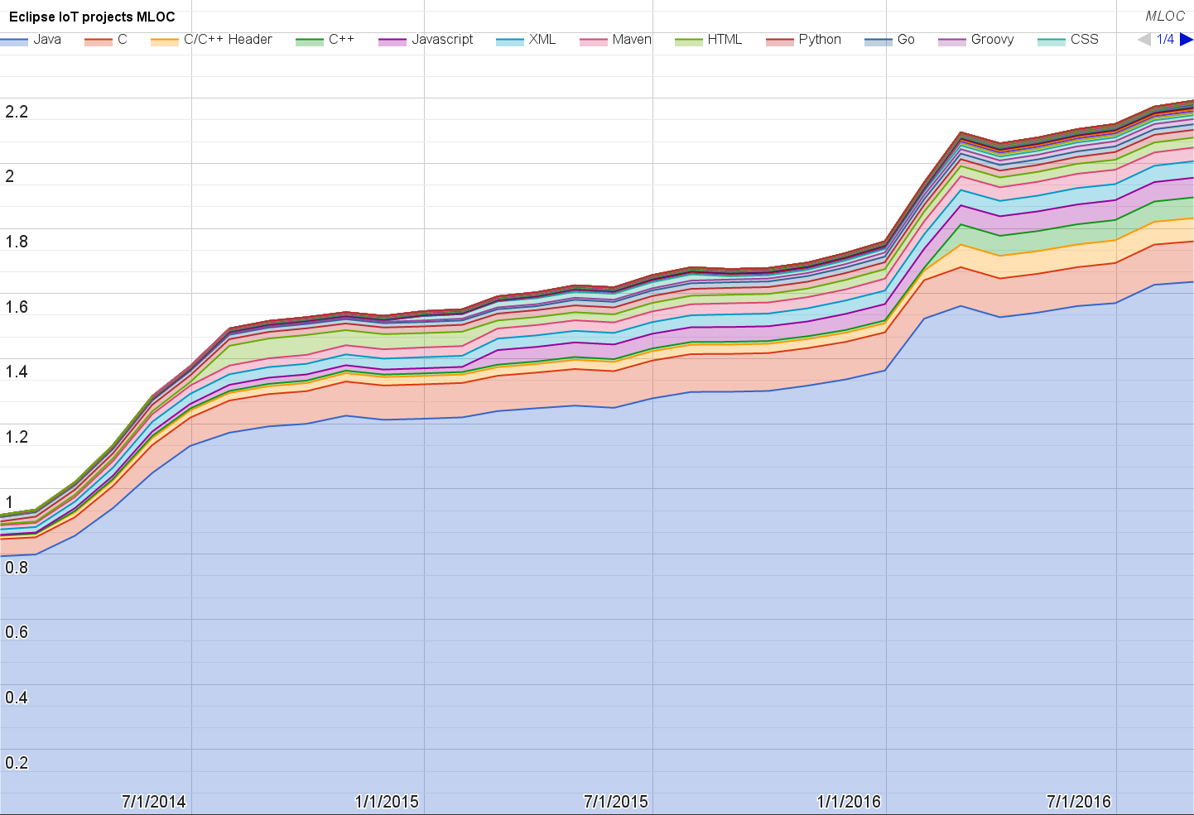
Lines of code (as of Aug-31, 2016)
https://docs.google.com/spreadsheets/d/1MT8vUectDG7qnt83LBts-B7oECMsICXyB4Tn4Kxl64U/pubchart?oid=1652481431&format=image

Slide 7
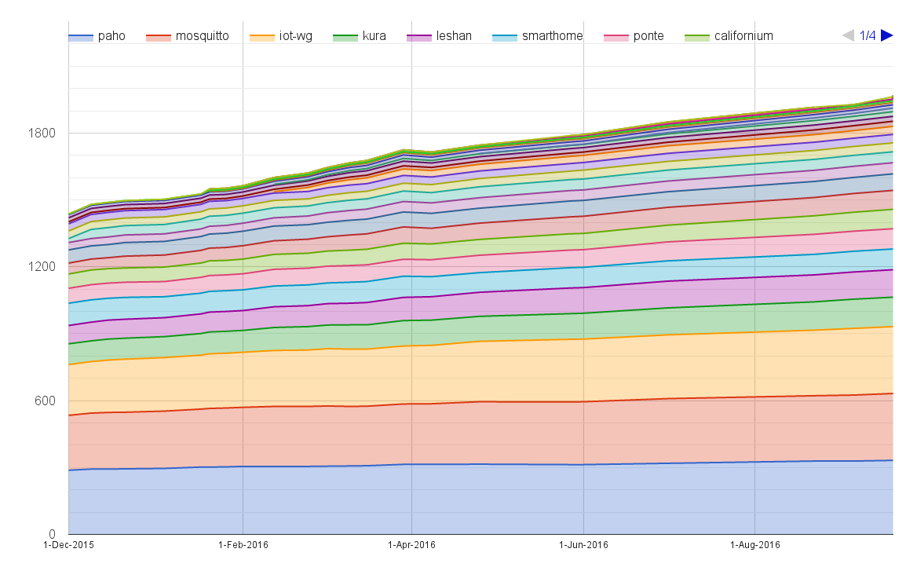
Mailing list subscriptions
https://docs.google.com/spreadsheets/d/1MT8vUectDG7qnt83LBts-B7oECMsICXyB4Tn4Kxl64U/pubchart?oid=1893372427&format=image

Slide 8
Sandbox servers (MQTT, CoAP, LwM2M)
MQTT (Mosquitto)
1006 active clients (+20% monthly)
CoAP
372 unique IP addresses (+46% monthly)
LWM2M
See Bug 467101

