Slide 1
Eclipse IoT monthly report
January 2016

Slide 2
Monthly projects development activity
JAN '16 | (color indicates variation compared to previous month)
 | Opened bugs | Closed bugs | Code authors | Commits | Posted messages | Senders
4diac | 0 | 0 | 0 | 0 | 0 | 0
californium | 0 | 0 | 5 | 17 | 35 | 4
concierge | 1 | 0 | 0 | 0 | 0 | 0
eclipsescada | 0 | 0 | 2 | 84 | 0 | 0
hawkbit | 0 | 0 | 0 | 0 | 0 | 0
krikkit | 0 | 0 | 0 | 0 | 0 | 0
kura | 0 | 0 | 5 | 25 | 0 | 0
leshan | 0 | 0 | 4 | 30 | 13 | 4
mosquitto | 2 | 1 | 1 | 4 | 16 | 8
om2m | 0 | 0 | 1 | 2 | 0 | 0
paho | 0 | 0 | 3 | 4 | 13 | 4
paho.incubator | 0 | 0 | 0 | 0 | 0 | 0
ponte | 0 | 0 | 0 | 0 | 0 | 0
risev2g | 0 | 0 | 0 | 0 | 0 | 0
smarthome | 0 | 0 | 16 | 51 | 3 | 2
tiaki | 0 | 0 | 0 | 0 | 0 | 0
vorto | 0 | 0 | 1 | 2 | 0 | 0
wakaama | 0 | 0 | 3 | 6 | 5 | 3
ALL PROJECTS | 3 | 1 | 41 | 225 | 85 | 25

Slide 3
Yearly projects development activity
FEB '15 - JAN '16 | (color indicates variation compared to previous period)
 | Opened bugs | Closed bugs | Code authors | Commits | Posted messages | Senders
4diac | 0 | 0 | 0 | 0 | 7 | 3
californium | 14 | 17 | 18 | 482 | 386 | 29
concierge | 15 | 5 | 4 | 140 | 10 | 5
eclipsescada | 21 | 28 | 3 | 360 | 21 | 4
hawkbit | 0 | 0 | 1 | 1 | 0 | 0
krikkit | 0 | 0 | 2 | 4 | 2 | 2
kura | 9 | 2 | 12 | 841 | 80 | 20
leshan | 4 | 6 | 17 | 321 | 238 | 33
mosquitto | 58 | 58 | 6 | 190 | 464 | 89
om2m | 6 | 8 | 4 | 43 | 28 | 5
paho | 89 | 67 | 14 | 214 | 620 | 94
paho.incubator | 0 | 0 | 1 | 4 | 1 | 1
ponte | 1 | 0 | 3 | 7 | 0 | 0
risev2g | 0 | 0 | 3 | 17 | 4 | 3
smarthome | 147 | 115 | 48 | 518 | 32 | 6
tiaki | 0 | 0 | 3 | 12 | 1 | 1
vorto | 64 | 16 | 7 | 131 | 4 | 2
wakaama | 2 | 4 | 146 | 277 | 268 | 297
ALL PROJECTS | 430 | 326 | 292 | 3562 | 2166 | 594

Slide 4
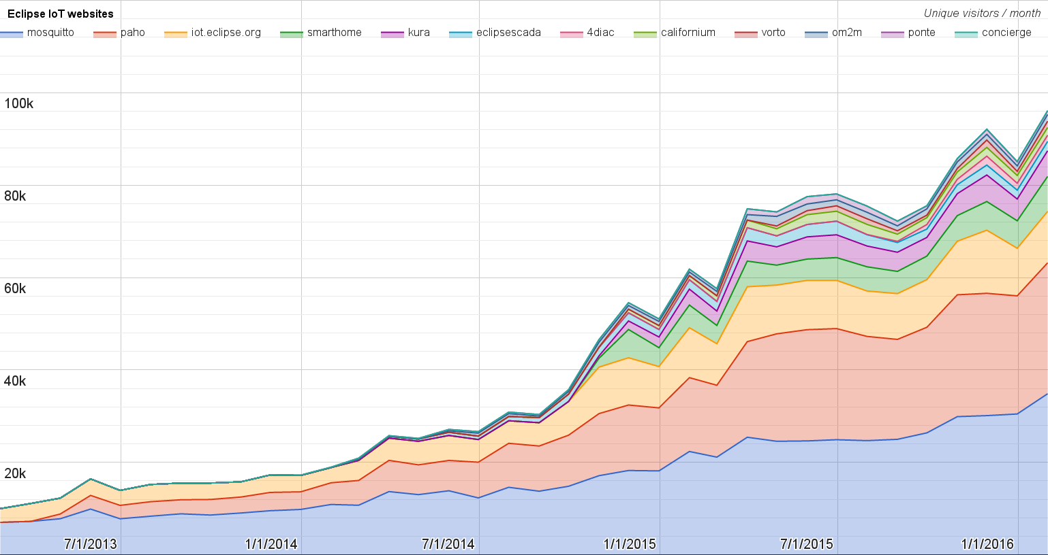
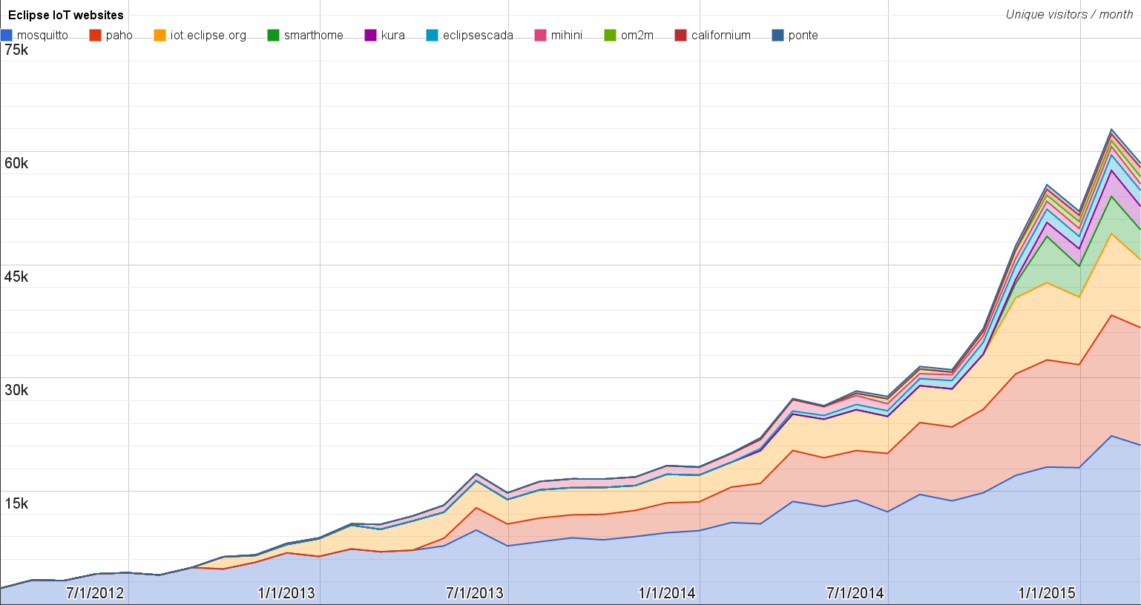
Websites
https://docs.google.com/spreadsheets/d/1MT8vUectDG7qnt83LBts-B7oECMsICXyB4Tn4Kxl64U/pubchart?oid=1293913369&format=image
Number of unique visitors this month | 96.1K
Month-over-month variation | +13%
Project with the highest growth this month | Vorto (+52%)
Year-over-year variation | +111% (448K → 950K unique visitors)

Slide 5
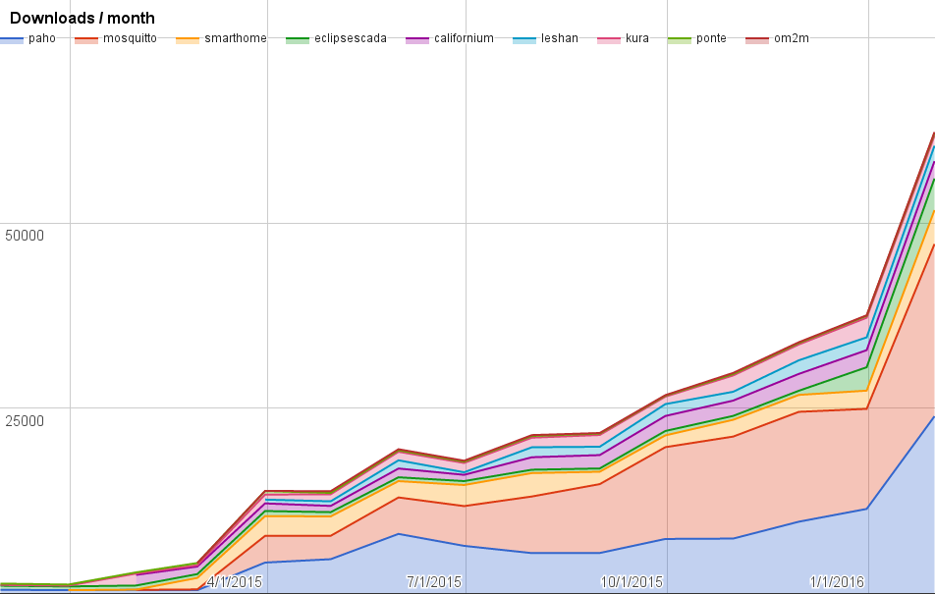
Downloads
https://docs.google.com/spreadsheets/d/1MT8vUectDG7qnt83LBts-B7oECMsICXyB4Tn4Kxl64U/pubchart?oid=1715994217&format=image
Downloads this month:
paho | 23909
mosquitto | 23237
smarthome | 4575
eclipsescada | 4262
californium | 2346
leshan | 2073
kura | 1366
ponte | 354
om2m | 128

Slide 6
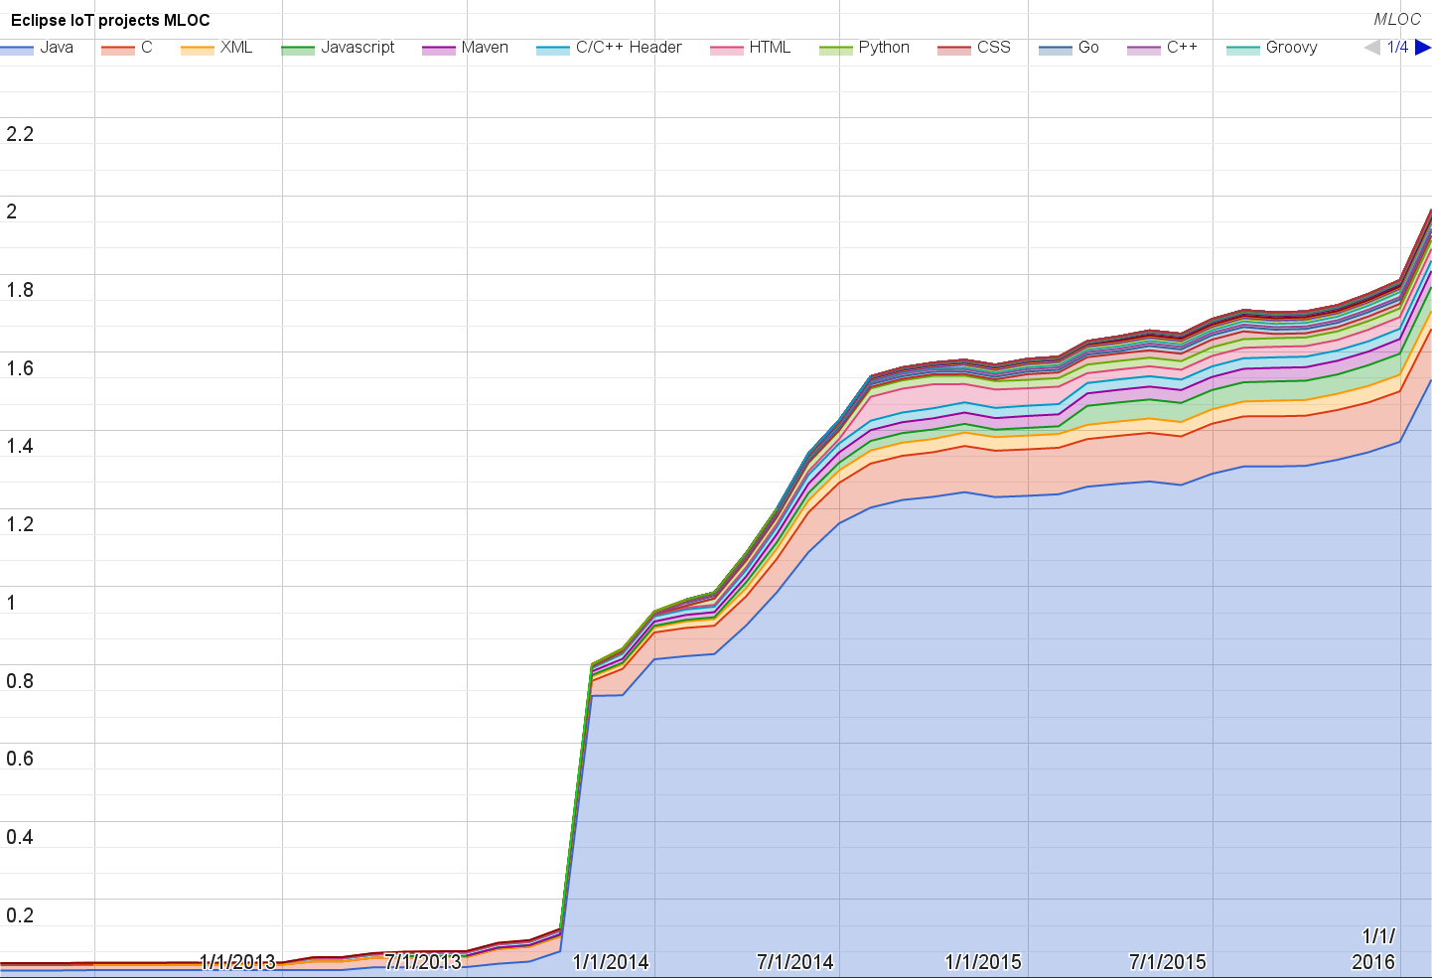
Lines of code (as of Jan-16)
https://docs.google.com/spreadsheets/d/1MT8vUectDG7qnt83LBts-B7oECMsICXyB4Tn4Kxl64U/pubchart?oid=1652481431&format=image

Slide 7
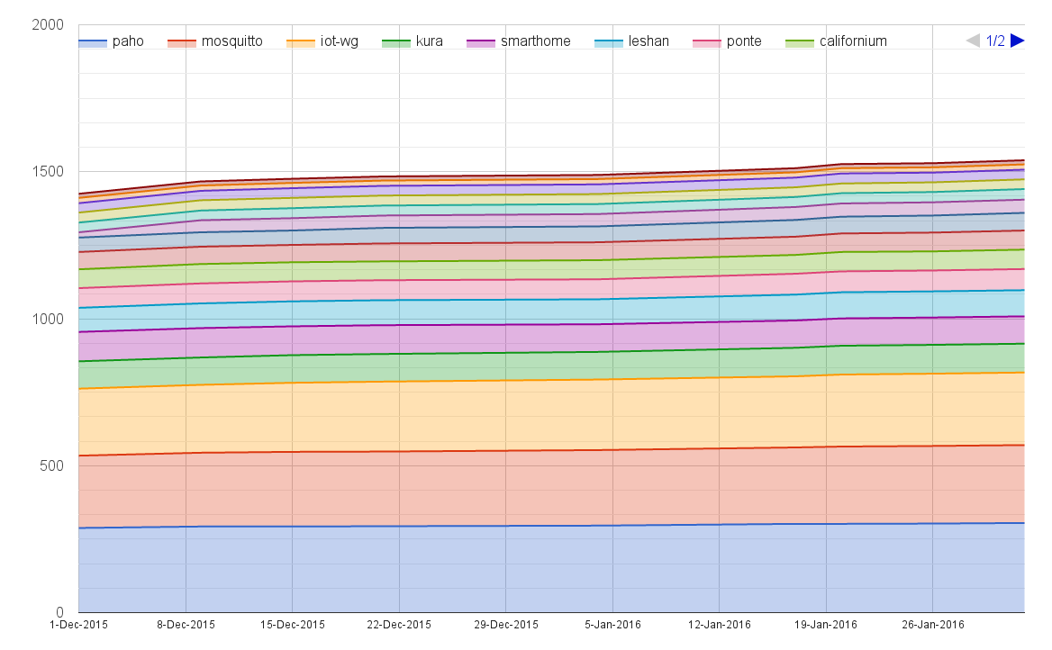
Mailing list subscriptions
https://docs.google.com/spreadsheets/d/1MT8vUectDG7qnt83LBts-B7oECMsICXyB4Tn4Kxl64U/pubchart?oid=1893372427&format=image

Slide 8
Sandbox servers (MQTT, CoAP, LwM2M)
MQTT (Mosquitto)
1188 active clients (+113% monthly)
CoAP
N/A this month
LWM2M
See Bug 467101

