Slide 1

Eclipse IoT monthly report
March 2016

Slide 2
Monthly projects development activity
MAR '16 | (color indicates variation compared to previous month)
 | Opened bugs | Closed bugs | Code authors | Commits | Posted messages | Senders
4diac | 31 | 16 | 2 | 18 | 8 | 5
californium | 0 | 0 | 6 | 25 | 10 | 5
concierge | 0 | 0 | 1 | 1 | 1 | 1
eclipsescada | 0 | 0 | 2 | 25 | 7 | 3
hawkbit | 0 | 0 | 8 | 160 | 20 | 6
hono | 0 | 0 | 2 | 18 | 40 | 8
krikkit | 0 | 0 | 0 | 0 | 2 | 2
kura | 0 | 0 | 7 | 127 | 19 | 7
leshan | 0 | 0 | 7 | 38 | 39 | 14
mosquitto | 0 | 5 | 2 | 40 | 29 | 14
om2m | 1 | 1 | 0 | 0 | 1 | 1
paho | 4 | 1 | 10 | 21 | 83 | 28
paho.incubator | 0 | 0 | 0 | 0 | 0 | 0
ponte | 0 | 0 | 0 | 0 | 1 | 1
risev2g | 0 | 0 | 0 | 0 | 0 | 0
smarthome | 1 | 0 | 22 | 134 | 14 | 5
tiaki | 0 | 0 | 0 | 0 | 1 | 1
vorto | 7 | 68 | 4 | 24 | 1 | 1
wakaama | 0 | 0 | 6 | 73 | 30 | 15
ALL PROJECTS | 44 | 91 | 79 | 704 | 306 | 117

Slide 3
Yearly projects development activity
APR '15 - MAR '16 | (color indicates variation compared to previous period)
 | Opened bugs | Closed bugs | Code authors | Commits | Posted messages | Senders
4diac | 64 | 24 | 2 | 29 | 44 | 10
californium | 46 | 52 | 20 | 567 | 513 | 36
concierge | 28 | 23 | 4 | 130 | 28 | 8
eclipsescada | 21 | 47 | 3 | 463 | 28 | 6
hawkbit | 0 | 0 | 13 | 375 | 23 | 7
hono | 0 | 0 | 3 | 34 | 74 | 13
krikkit | 0 | 0 | 1 | 1 | 2 | 2
kura | 15 | 8 | 14 | 943 | 130 | 27
leshan | 8 | 8 | 19 | 366 | 377 | 51
mosquitto | 81 | 57 | 7 | 197 | 491 | 114
om2m | 11 | 9 | 4 | 41 | 29 | 7
paho | 149 | 85 | 23 | 246 | 803 | 119
paho.incubator | 0 | 0 | 1 | 4 | 0 | 0
ponte | 1 | 0 | 4 | 15 | 1 | 1
risev2g | 0 | 0 | 2 | 16 | 4 | 3
smarthome | 152 | 211 | 62 | 735 | 55 | 11
tiaki | 0 | 0 | 3 | 12 | 2 | 3
vorto | 155 | 156 | 10 | 181 | 9 | 5
wakaama | 4 | 1 | 12 | 306 | 211 | 41
ALL PROJECTS | 735 | 681 | 205 | 4661 | 2824 | 454

Slide 4
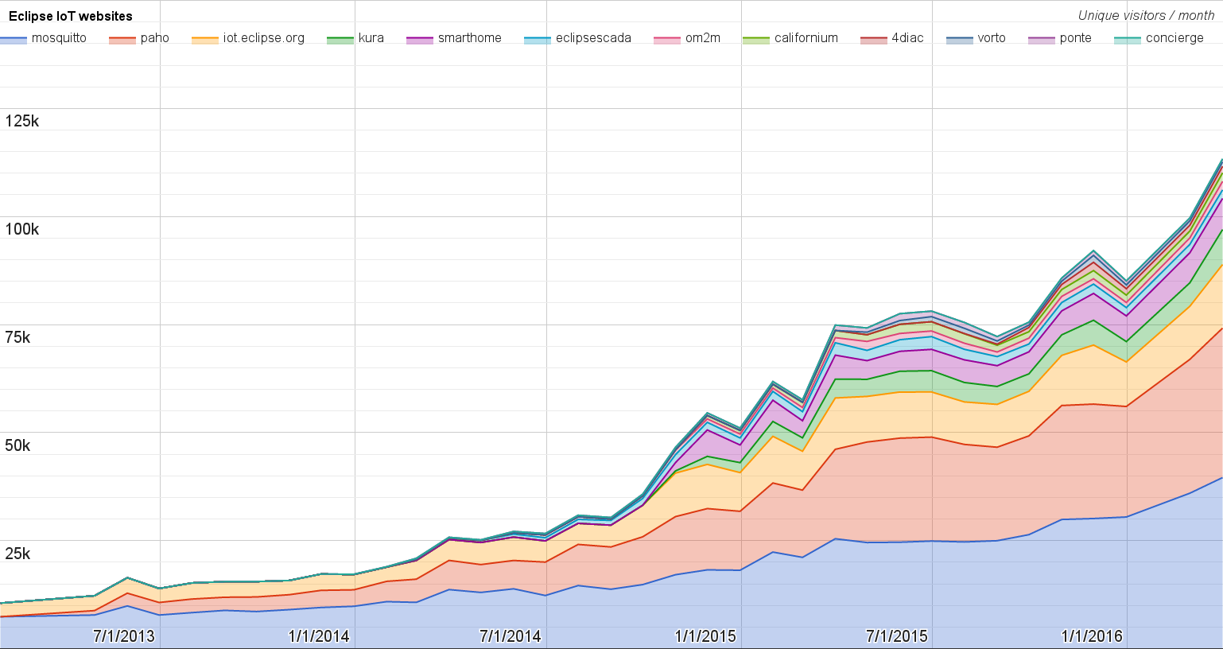
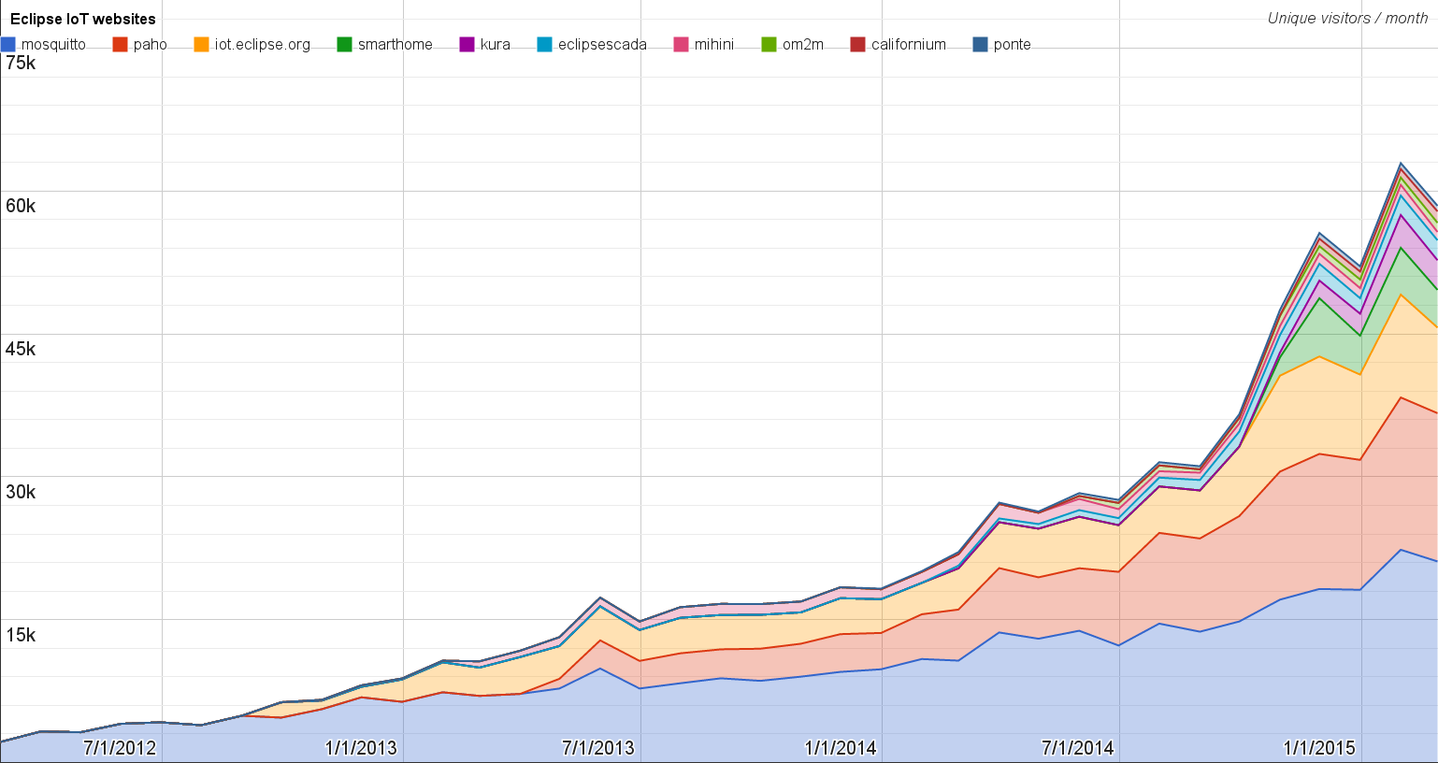
Websites
https://docs.google.com/spreadsheets/d/1MT8vUectDG7qnt83LBts-B7oECMsICXyB4Tn4Kxl64U/pubchart?oid=1293913369&format=image
Number of unique visitors this month | 113.3K
Month-over-month variation | +13%
Project with the highest growth this month | Eclipse Kura (+49%)
Year-over-year variation | +108% (485K → 1M unique visitors)

Slide 5
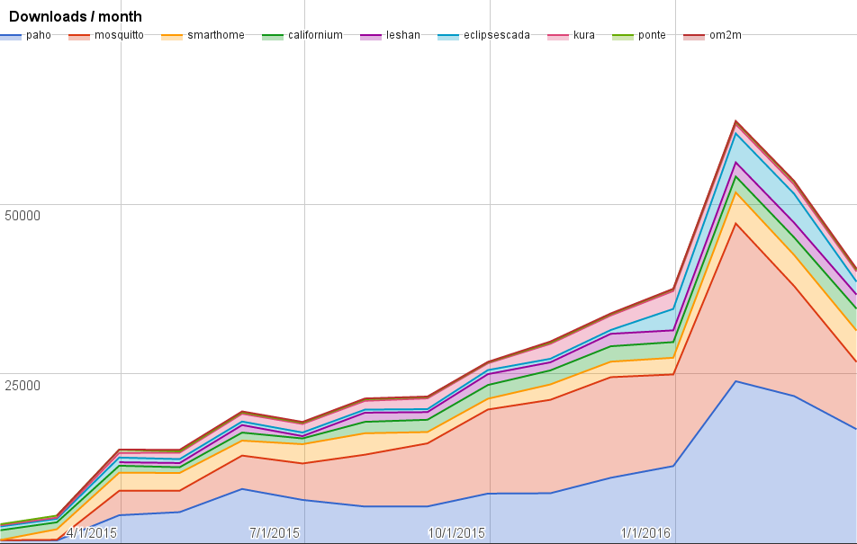
Downloads
https://docs.google.com/spreadsheets/d/1MT8vUectDG7qnt83LBts-B7oECMsICXyB4Tn4Kxl64U/pubchart?oid=1715994217&format=image
Downloads this month:
paho | 11792
mosquitto | 9903
paho | 5050
smarthome | 4623
californium | 3221
leshan | 2075
eclipsescada | 1905
kura | 1509
ponte | 245

Slide 6
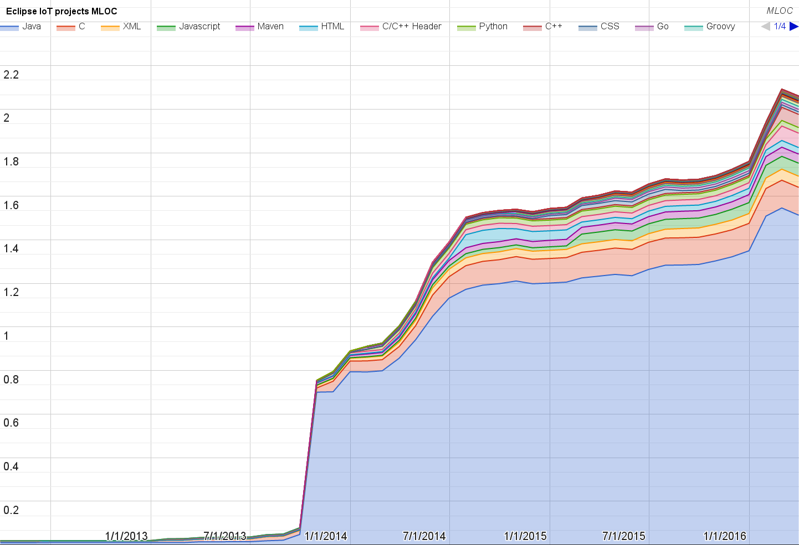
Lines of code (as of Mar-31, 2016)
https://docs.google.com/spreadsheets/d/1MT8vUectDG7qnt83LBts-B7oECMsICXyB4Tn4Kxl64U/pubchart?oid=1652481431&format=image

Slide 7
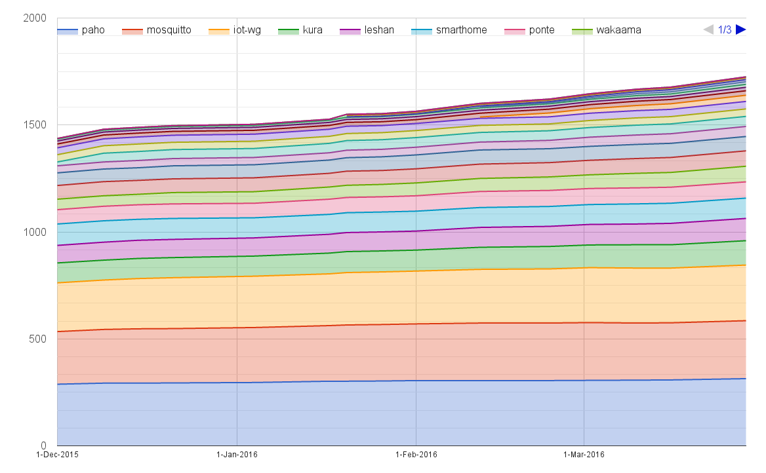
Mailing list subscriptions
https://docs.google.com/spreadsheets/d/1MT8vUectDG7qnt83LBts-B7oECMsICXyB4Tn4Kxl64U/pubchart?oid=1893372427&format=image

Slide 8
Sandbox servers (MQTT, CoAP, LwM2M)
MQTT (Mosquitto)
539 active clients (-1% monthly)
CoAP
192 unique IP addresses
LWM2M
See Bug 467101

