Slide 1
Eclipse ESCET ™ community meeting #1 Synthesis-Based Engineering of supervisory controllers
Dennis Hendriks, Eclipse ESCET project lead, ESI (TNO) / Radboud University
March 30, 2022, 10:00 – 12:00 CEST (UTC+2)

Slide 2
Meeting agenda
10:00 – 10:30 Introduction to Eclipse ESCET and Synthesis-Based Engineering (SBE)
Dennis Hendriks, Eclipse ESCET project lead, ESI (TNO) / Radboud University
10:30 – 11:00 Eclipse ESCET and SBE at Rijkswaterstaat
Harry Lammeretz, Rijkswaterstaat
11:00 – 11:50 Community discussion
11:50 – 12:00 Roundup

Slide 3
Introduction to Eclipse ESCET and Synthesis-Based Engineering (SBE)
Dennis Hendriks
Eclipse ESCET project lead
ESI (TNO) / Radboud University

Slide 4
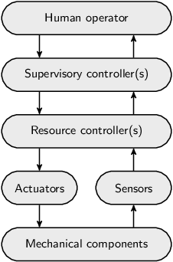
Supervisory control
Eclipse ESCET
Eclipse Supervisory Control Engineering Toolkit
Cyber-physical systems
E.g., X-ray/MRI systems, industrial printers, lithography systems, waterway locks, airport baggage handling systems
More and more complexity
More complex control software (the cyber part)
Supervisory controllers
Traditionally a layer above resource controllers
Ensure correct and safe behavior
Higher-level controllers control lower-level ones (layered system)

Slide 5
Synthesis-Based Engineering (SBE) of supervisory controllers
Engineering approach →
Traditional Engineering
Model-Based Engineering
Verification-Based Engineering
Synthesis-Based Engineering
↓ Development step
Requirements design
Document-based
Document-based
Model-based (formal)
Model-based (formal)
Controller design
Document-based
Model-based (formal)
Model-based (formal)
Computer-aided (formal)
Realization in software
(implementation code)
Traditional software engineering (coding)
Code generation (fault-free code)
Code generation (fault-free code)
Code generation (fault-free code)
Verification
(against requirements)
Testing
Testing +
Model-based testing
Formal verification
(model checking)
Correct-by-construction (guaranteed)
Validation
(of requirements)
Testing
Testing +
Simulation
Testing +
Simulation
Testing +
Simulation
Legend:
Manual work / Focus
(Semi-)automatic

Slide 6
Example: a simple manufacturing system to process products
The system itself already ensures that:
enter → start
finished → exit
→ redo
→ leave

Slide 7
Example: a simple FIFO requirement
Requirement:
“Products must enter and exit the system in FIFO order.”
What control conditions are needed?

Slide 8
Example: the control conditions
Movement done1 is only allowed if the following two conditions both hold:
Either there is no product at the DISP place, or it is a later product than at the OP1 place.
Either there is no product at the OP2 place, or it is a later product than at the OP1 place.
Movement done2 is only allowed if the following two conditions both hold:
Either there is no product at the DISP place, or it is a later product than at the OP2 place.
Either there is no product at the OP1 place, or it is a later product than at the OP2 place.
Movement start is only allowed if one of the following two conditions holds:
At the DISP place, OP1 place, OP2 place, and CHK place, there is in total at most one product.
At the DISP place, OP1 place, and OP2 place, there is in total at most one product. There is also a product at the CHK place and the check indicates the product was successfully processed.
Movement enter is only allowed if less than four products are in the system.
Conclusion
This is a lot to consider, and quite subtle!
This is still simple (small system, single requirement)
Would you have arrived at this solution?
How long would it have taken you to?

Slide 9
Synthesis-Based Engineering has many benefits
Better quality controllers, by reducing human error
Model-based approach Intuitive, unambiguous, complete, consistent, up-to-date specifications (single source of truth)
Design assistance Automatically detect conflicting requirements, prevent livelocks, and more
Synthesis Automatically compute correct-by-construction control conditions, for every possible scenario
Code generation Automatically generate correct-by-construction controller code
Reduced engineering effort, by focusing on what is essential
Computer-aided Automation and computer-aided design save valuable time, shortening the development cycle
Early validation Analyze the system behavior virtually (e.g., digital twins) already during early development phases
Solution-centric Not problems (iterative counter examples), but solutions (in one go the correct control conditions)
Vendor independence With the push of a button generate code for different programming languages and vendors
The right focus Focus on what the controller should do (requirements/validation), not how (controller design/impl.)
Supports large industrial systems, by efficient controller engineering
Incremental engineering Modular design and re-synthesis upon changes enable incremental engineering, to ease evolution
Comprehensible/traceable Fine-grained modeling, for small/intuitive specifications, superior traceability, and a good overview
Uniformity/efficiency Create a library of standardized models, to be easily reused and combined in different ways
Minimally restrictive Synthesis imposes minimal restrictions, preserving performance-optimal behavior
Learn more at: https://eclipse.org/escet/cif/synthesis-based-engineering (SBE, its value, challenges, FIFO example, …)

Slide 10
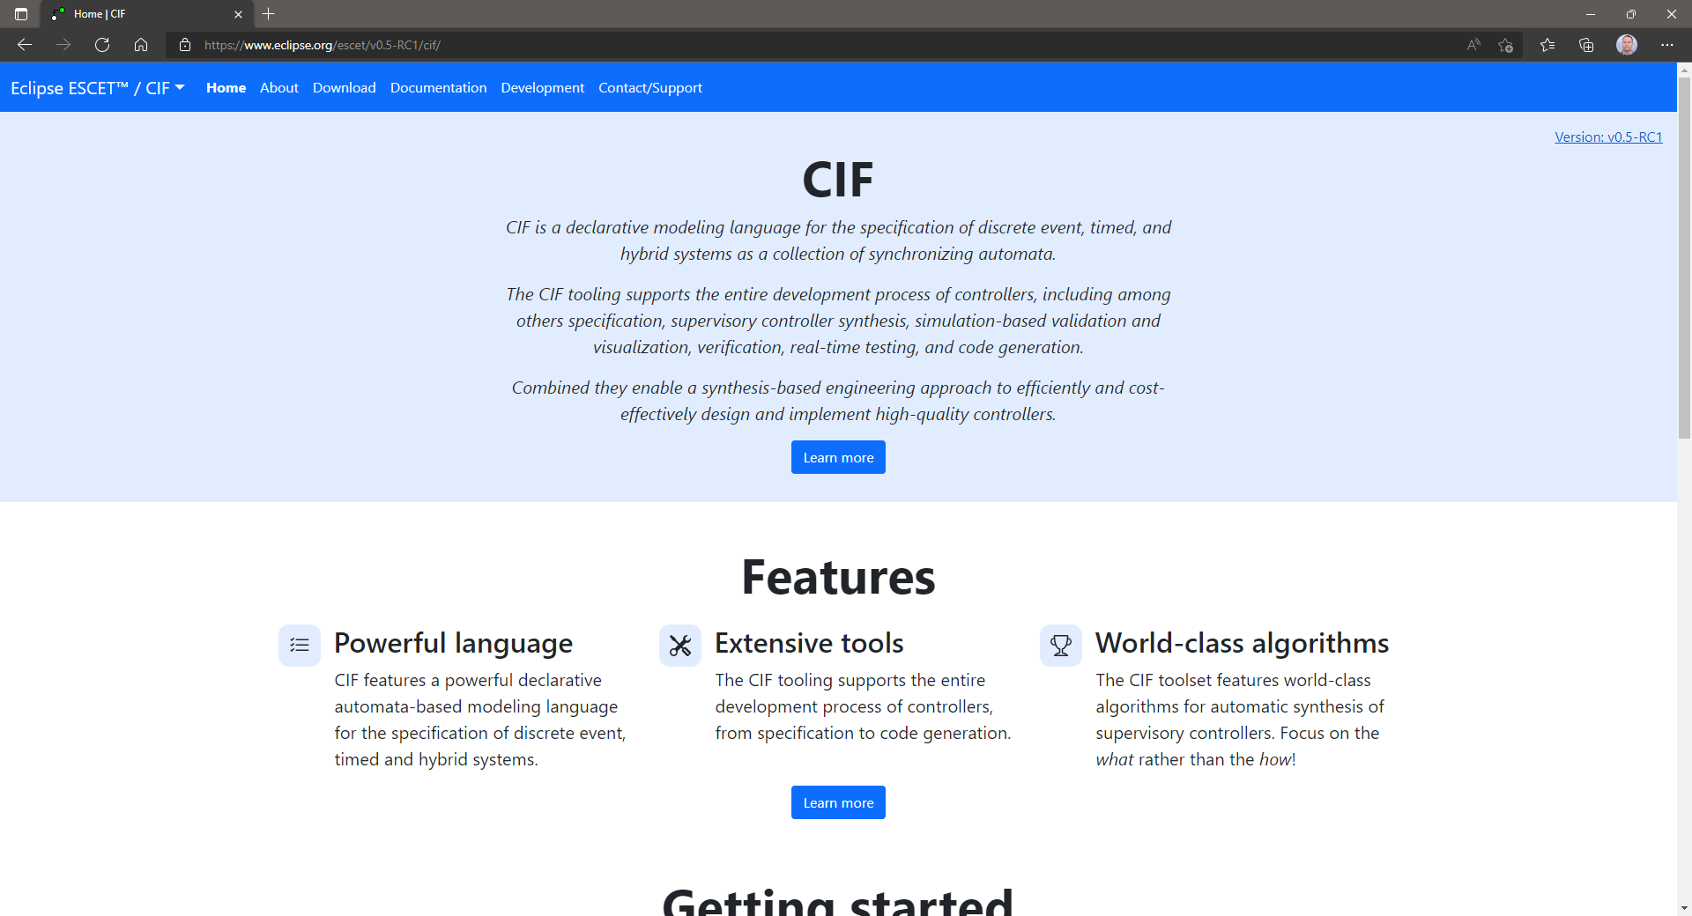
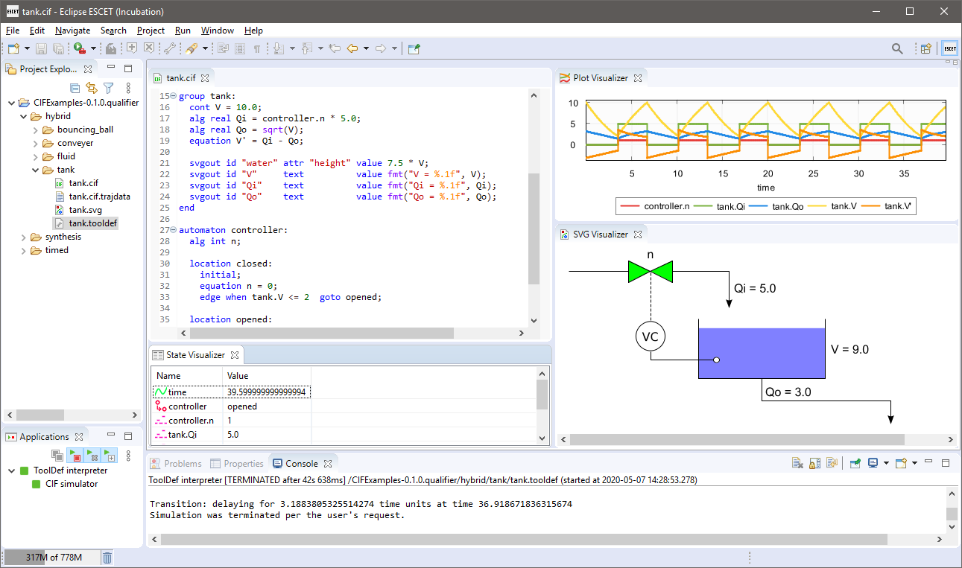
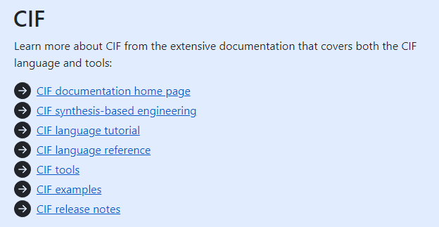
Synthesis-Based Engineering with CIF
What is CIF?
CIF is a modeling language and extensive toolset supporting the synthesis-based engineering of supervisory controllers
Powerful modeling language (automata / state machines)
Extensive tools for the entire development process of controllers
Specification, synthesis, simulation and visualization, validation and verification, code generation, and more
Extensive documentation
SBE, CIF language/tools, examples
15 years history of CIF research and tool development
Learn more at: https://eclipse.org/escet/cif

Slide 11
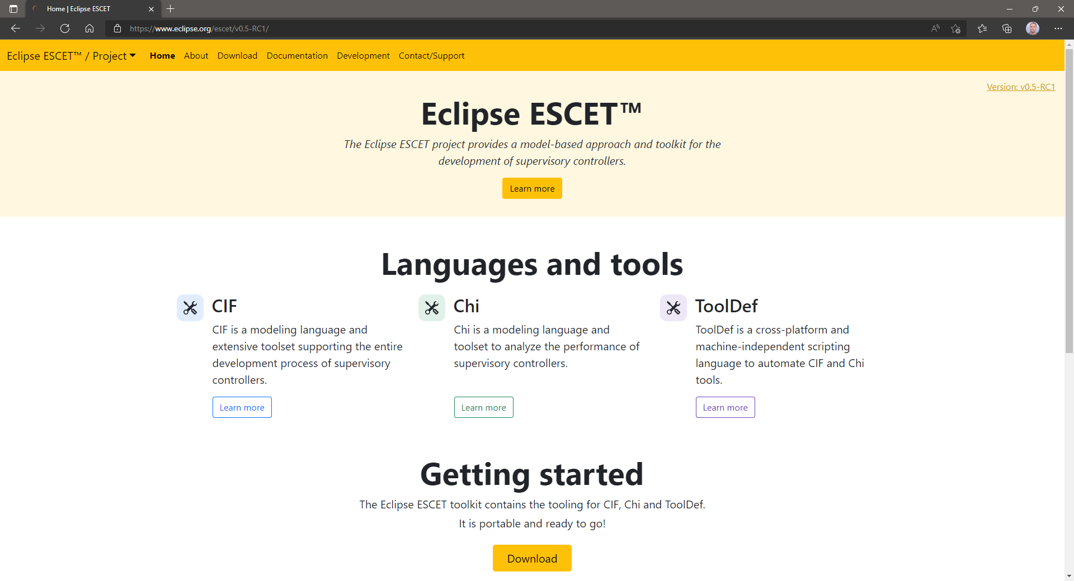
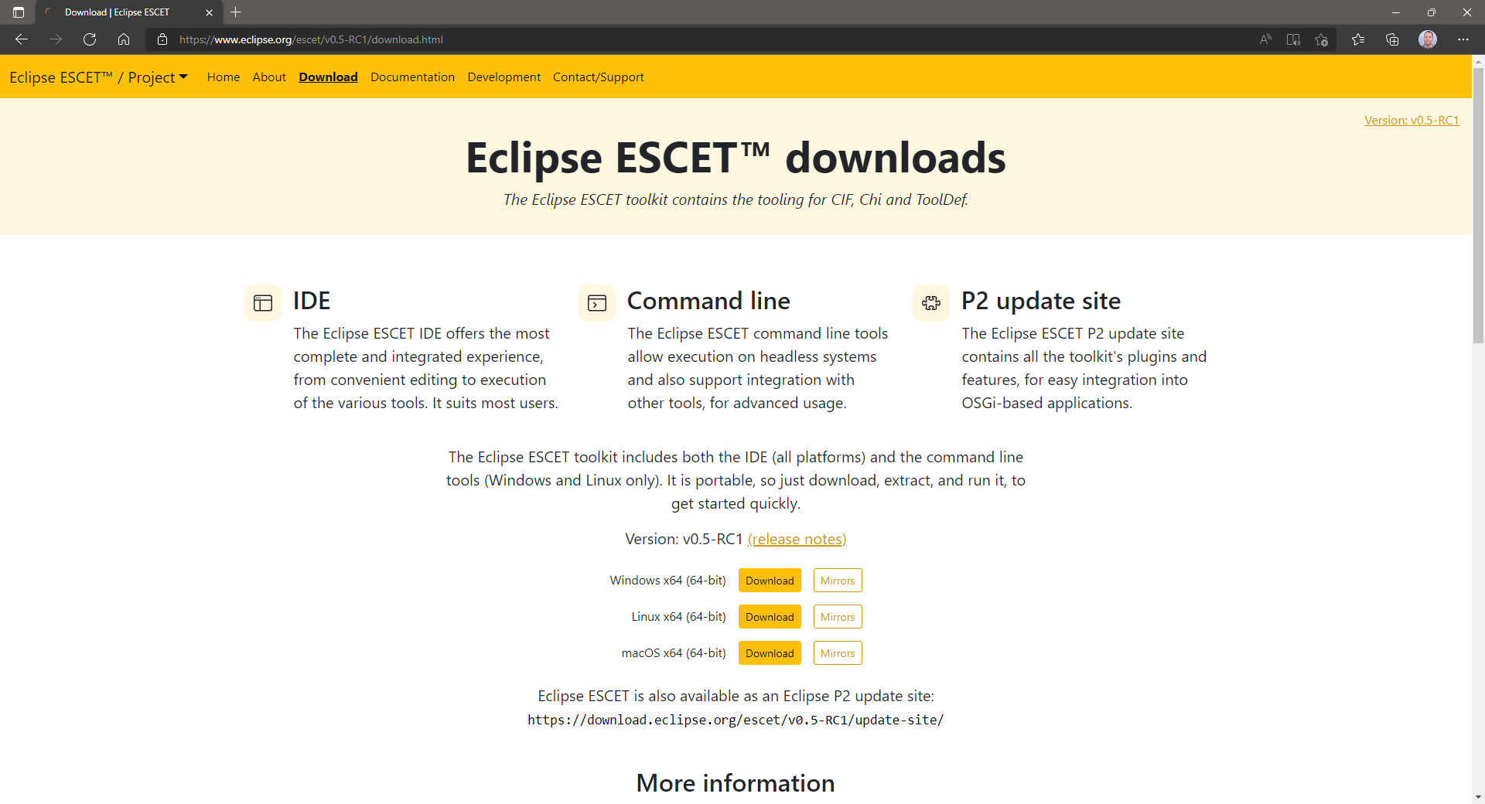
Eclipse ESCET open-source project
Eclipse ESCET project
An Eclipse Foundation project since 2020
Home to CIF, and some other tools (Chi and ToolDef)
Downloads
Eclipse ESCET IDE and command line tools
Windows, Linux, macOS
Portable: extract and use
Learn more at: https://eclipse.org/escet
You can get started today!

Slide 12
Eclipse ESCET open-source project: status
5th Eclipse ESCET release yesterday; 100+ end user visible improvements and fixes since April 2021
Some CIF highlights:
v0.1 First release as Eclipse Foundation project
v0.2 (✓ 39) Various tools support more CIF language concepts, bug fixes, improved usability, new tools and options
v0.3 (✓ 15) Synthesis supports more CIF concepts, synthesis checks more common mistakes, new finite response checker
v0.4 (✓ 34) Simulate input variables, more synthesis performance statistics, new website, bug fixes, improved robustness
v0.5 (✓ 13) Full synthesis invariant support, generate S7/SIMATIC PLC code, SBE docs, FIFO example, 4 new tools
Learn more at: https://eclipse.org/escet/release-notes.html
We’re currently working on:
Multi-level synthesis tool
Named (requirement) invariants
… and more

Slide 13
Synthesis-based engineering: take-aways
Synthesis-based engineering of supervisory controllers
Combines model-based engineering with computer-aided design
Produces correct-by-construction controllers, as automated as possible
Reduces development time and improves controller quality
Mature and proven technology
30+ years of research, 15 years of CIF tool development
Method maturity has greatly improved E.g., symbolic/multi-level synthesis, fault-tolerant controllers
Successful case studies in many domains E.g., healthcare, automotive, infrastructure, semiconductor
Proven real-world maturity E.g., car cruise control in real traffic, bridge site acceptance test
You can get started now!

Slide 14
Eclipse ESCET and SBE at Rijkswaterstaat
Harry Lammeretz Rijkswaterstaat (Dutch Directorate-General for Public Works and Water Management)

Slide 15
Community discussion

Slide 16
Community discussion
Discussion about needs and next steps for synthesis-based engineering with Eclipse ESCET
The value
Do you see the value of SBE?
Why are you interested in SBE/ESCET?
Are you using SBE/ESCET, and for what?
The future
Do you see potential to apply SBE/ESCET (more) in the future?
What hinders you to apply SBE/ESCET (more) in the future?
What are your needs regarding SBE/ESCET (new functionality, support, education, training, …)?
How can we as a community take these next steps?

Slide 17
Roundup
Questions
Was this meeting useful for you?
How often should we have community meetings?
What is a good topic for the next community meeting?

Slide 18
Thanks for joining! We hope to see you again next time
Eclipse ESCET and ESCET are trademarks of the Eclipse Foundation. Eclipse and the Eclipse Logo are registered trademarks of the Eclipse Foundation. Other names may be trademarks of their respective owners.
Copyright (c) 2010, 2022 Contributors to the Eclipse Foundation.

