Slide 1
Lean Thinking EPF Library
draft

Slide 2
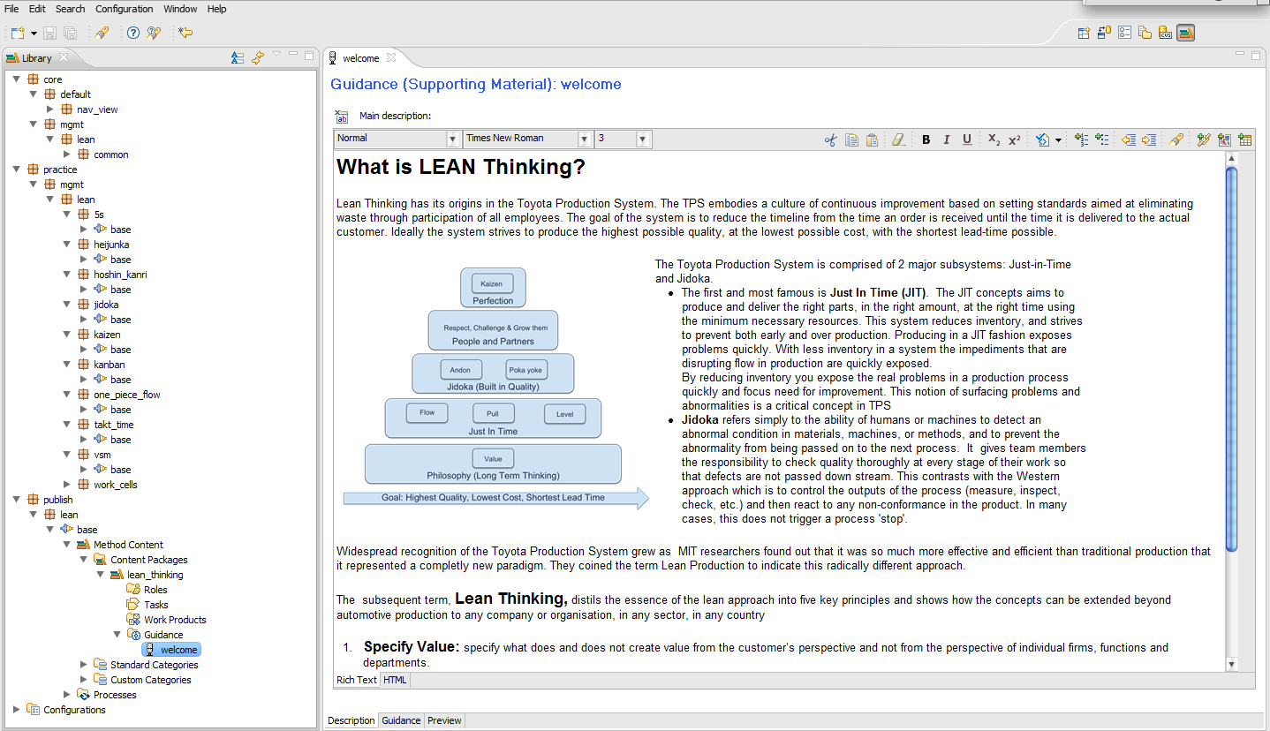
Library Structure

Slide 3
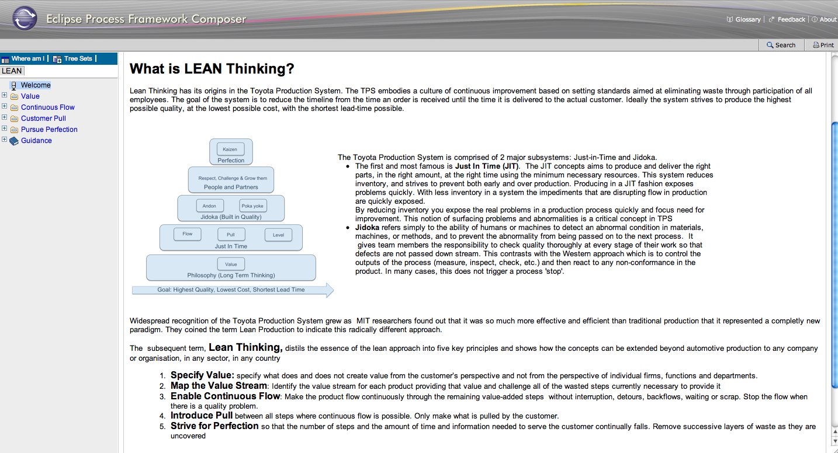
Publishing View organized according to the 5 lean thinking principles

Slide 4
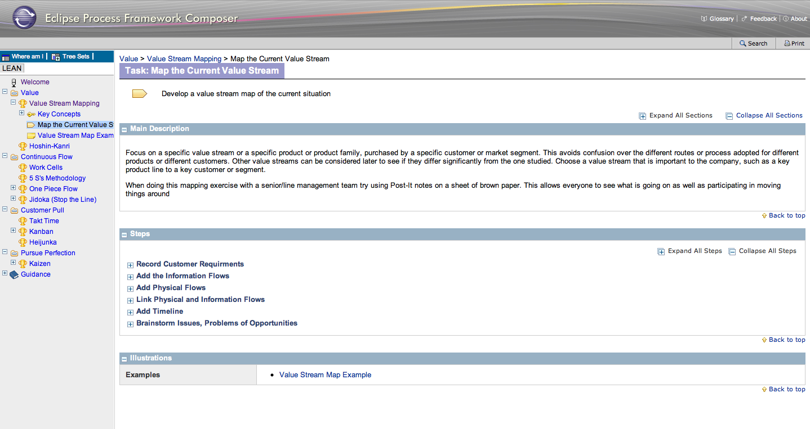
Value

Slide 5
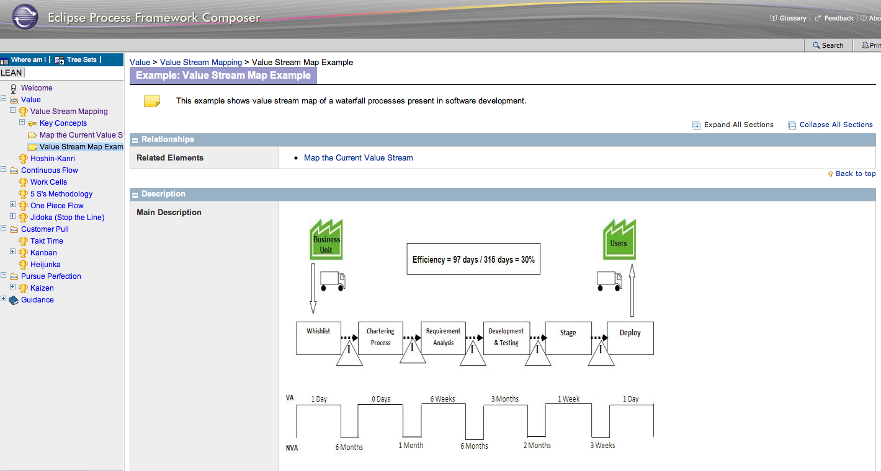

Slide 6
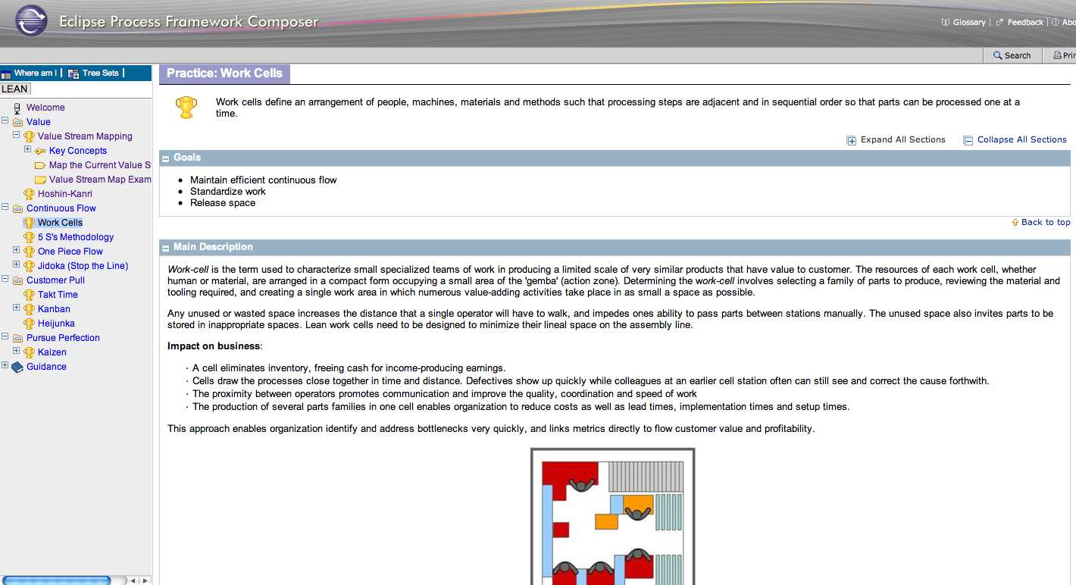
Flow

Slide 7
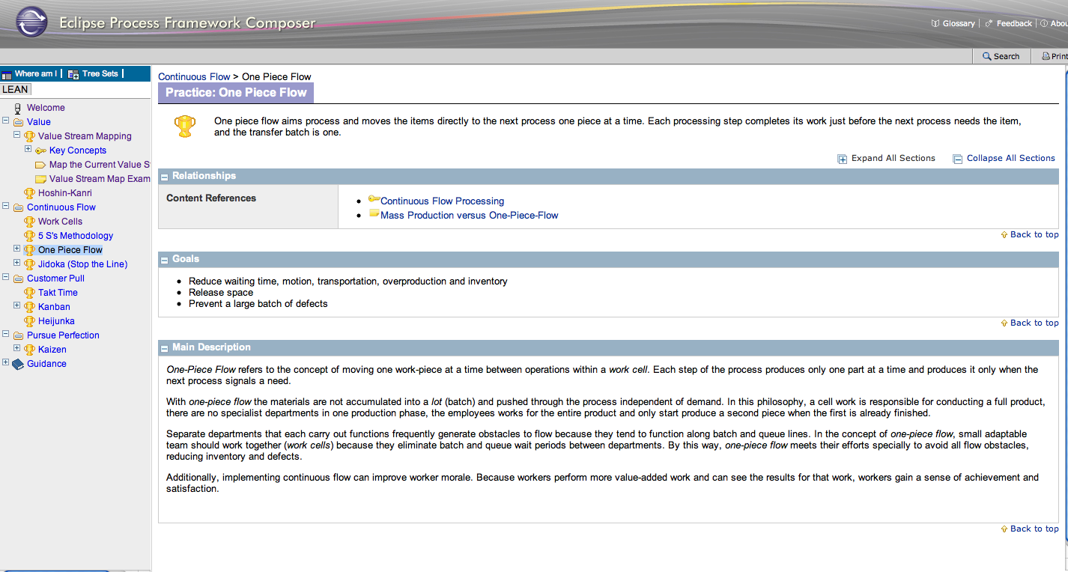
Flow

Slide 8
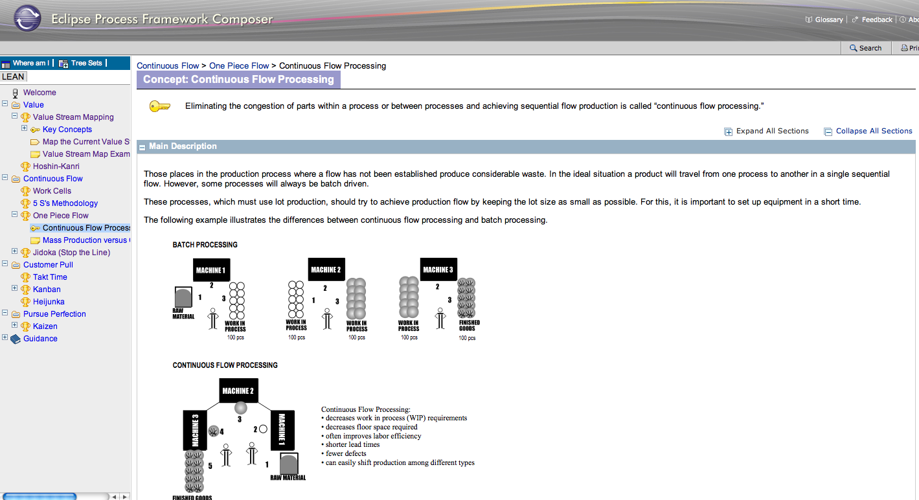
Flow

Slide 9
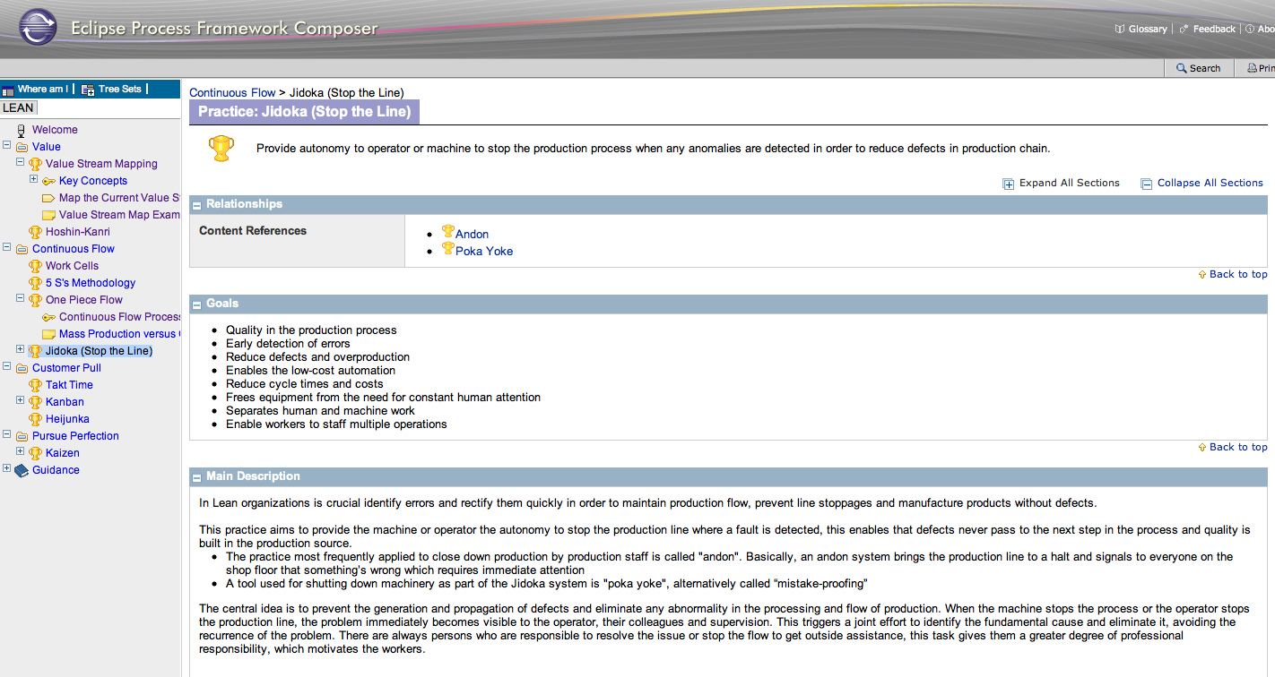
Flow

Slide 10
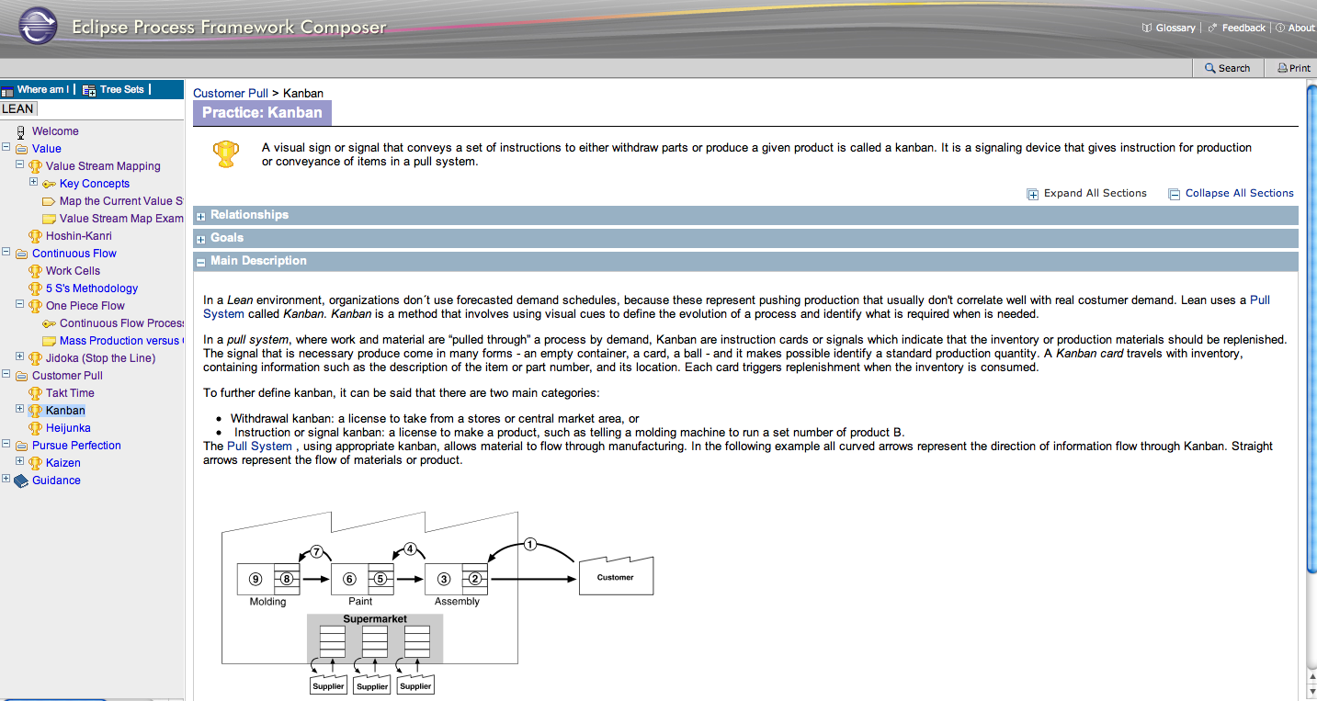
Pull

Slide 11
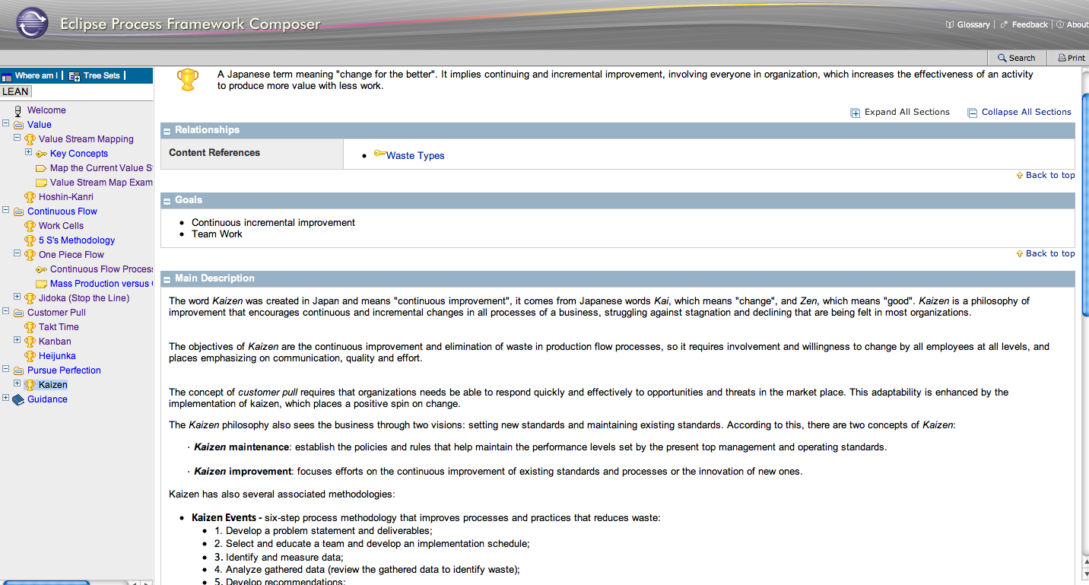
Perfection - Improvement

Slide 12
Next steps
review content to hide explicit references to manufacturing
extend practices for software development and make analogy with agile ..example: kanban boards for software development

