Slide 1
ECLIPSE IDE Working Group: Improving Eclipse Sponsoring with Yatta Checkout
COPYRIGHT (C) 2021 ECLIPSE FOUNDATION | MADE AVAILABLE UNDER THE ECLIPSE PUBLIC LICENSE 2.0 (EPL-2.0)

Slide 2
Introduction
The Eclipse IDE working group (“WG”) and the Eclipse Foundation (“EF”) believe that (i) the Eclipse IDE is crucial for the Eclipse community—and (ii) the IDE needs additional funding for maintenance and development
The Eclipse Foundation collects individual and corporate sponsorings at its websites https://www.eclipse.org/sponsor/ and https://www.eclipse.org/org/corporate_sponsors/
Collected sponsorings (“donations”) are expected to be 75.000€ in 2022, and the donated funds were used to support the Foundation’s actions in support of the IDE
EF and WG has a desire to increase the sponsoring volumes by adding sponsoring options (e.g., payment options, electronic corporate sponsoring) and improving the overall donation experience
For these reasons, EF and WG are proposing to investigate integrating Yatta Checkout including the Checkout for Eclipse (https://yatta.de/checkout-for-eclipse) in a customized edition for the online and in-app (i.e., within the Eclipse IDE) collection of donations

Slide 3
Issues collecting Eclipse Sponsorings (today)
Individual Sponsorings (“donations”) on website
Payments only in USD, no local currencies displayed—and no SEPA payments (!)
Recurring payments (i.e., monthly/yearly) only via PayPal, not via credit cards
No invoicing (kills corporate sponsorships payments)—no tax deduction for users
Little to no return for sponsors (e.g., honorable mentions, badges, certificates, …)
Corporate Sponsorships on different website
Manual process that requires signing of the Eclipse Foundation Corporate Sponsorship Agreement kills the conversion rate from lead-to-donation
Result: There is currently only one corporate sponsor listed
No in-app donations
“Donate” item in Eclipse Oomph installations only, not in Eclipse Packages
If available, the “Donate” entry links to an external browser resulting into high drop-rates from the IDE over the browser to the donation

Slide 4
Intended Solution
What we are suggesting …
Optimize the Eclipse Sponsorship website (see screens as follows)
Collect donations (sponsorships and payments) with a customized Yatta Checkout (e.g., no payment account required for one-time donations)
Enable multi-currency payments, recurring credit cards payments
Automate VAT calculation and invoicing—enabling Corporate Sponsorships
Enable in-app payments in the Eclipse IDE packages (see screens as follows)
By enabling users to donate funds to Eclipse within the Eclipse IDE
Promote, encourage and facilitate donations (i.e. sponsoring of Eclipse)
Raise additional funds for the open-source development of the IDE through streamlined automated sponsoring and payment processes

Slide 5
Following layouts are initial drafts as proposed by Yatta

Slide 6
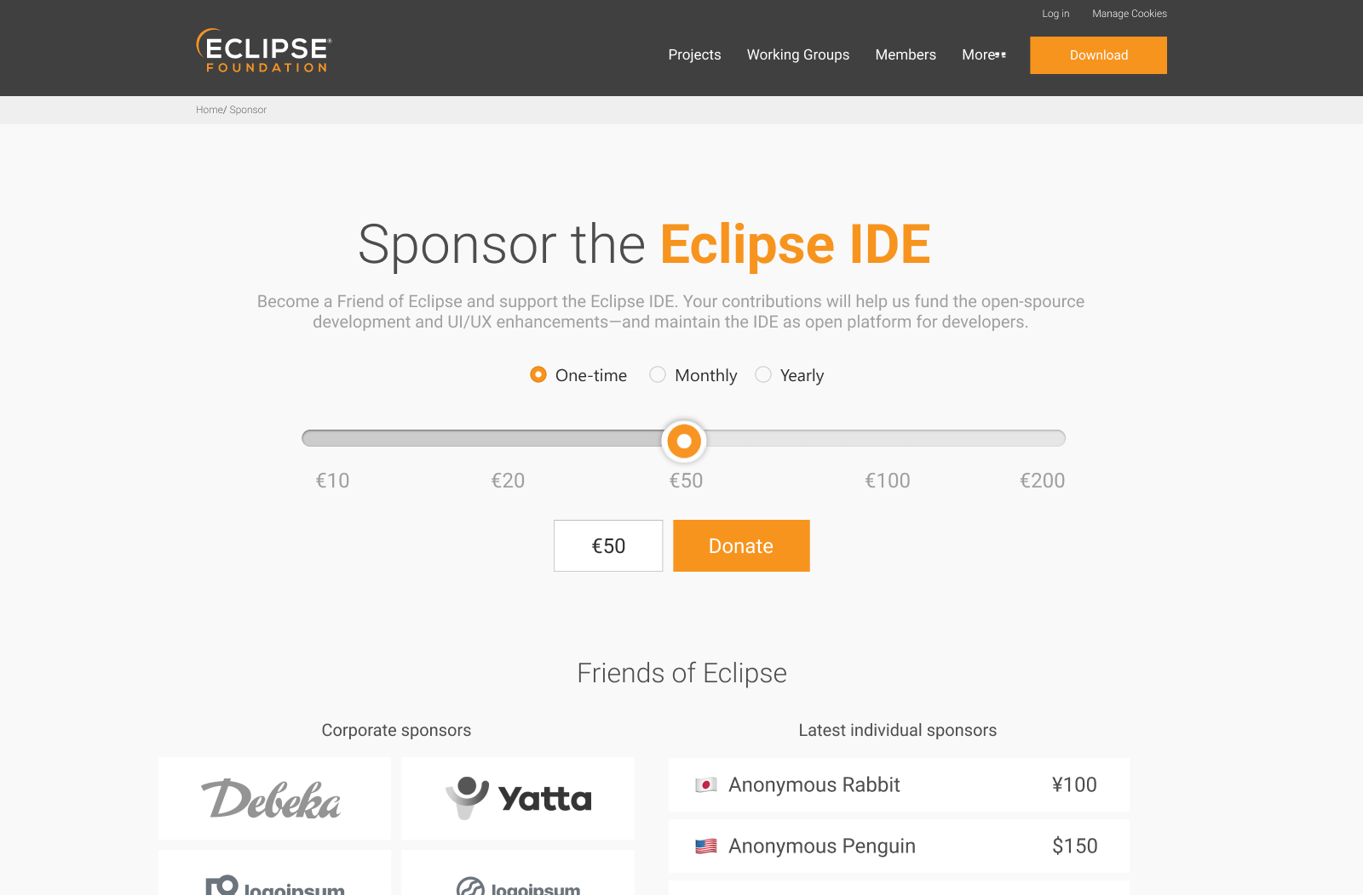
Eclipse
Website “Select sponsorship”
draft

Slide 7
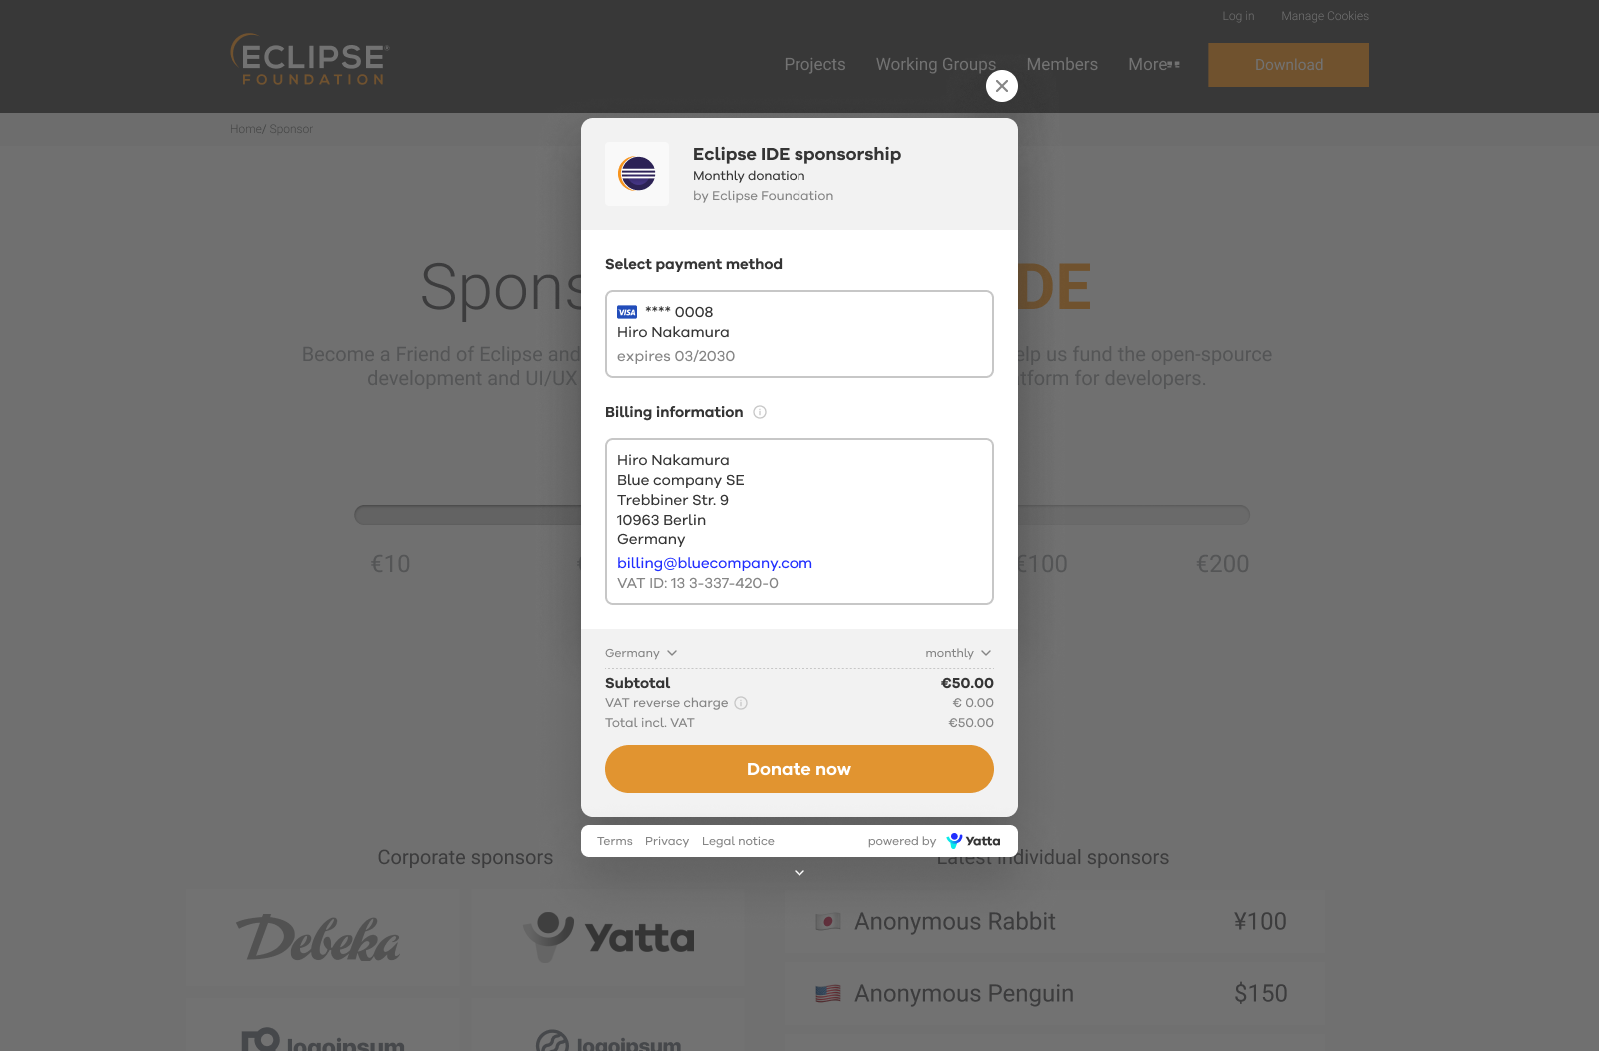
Website Checkout “Donate”
draft

Slide 8
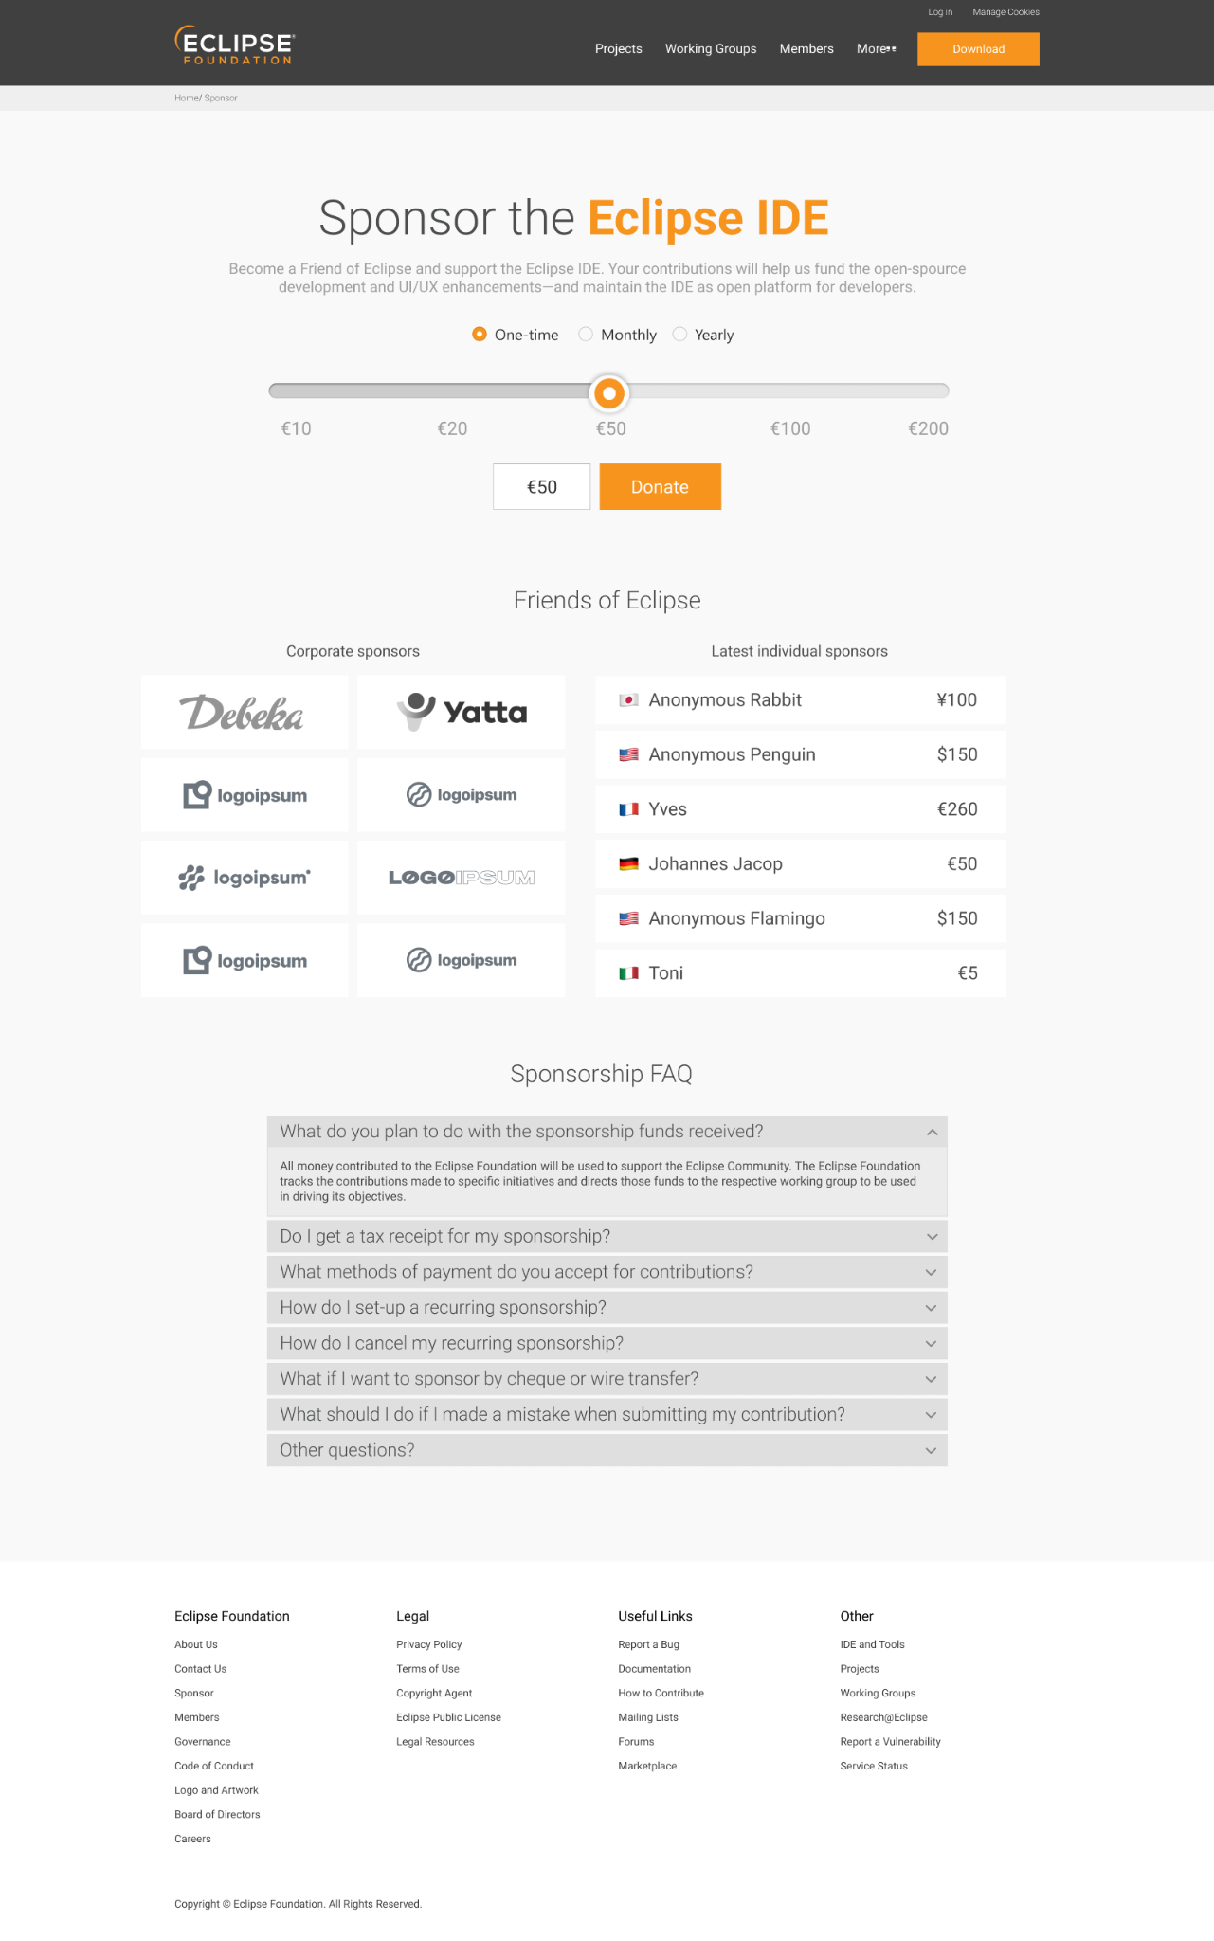
Overview
Eclipse Website
improvements
draft

Slide 9
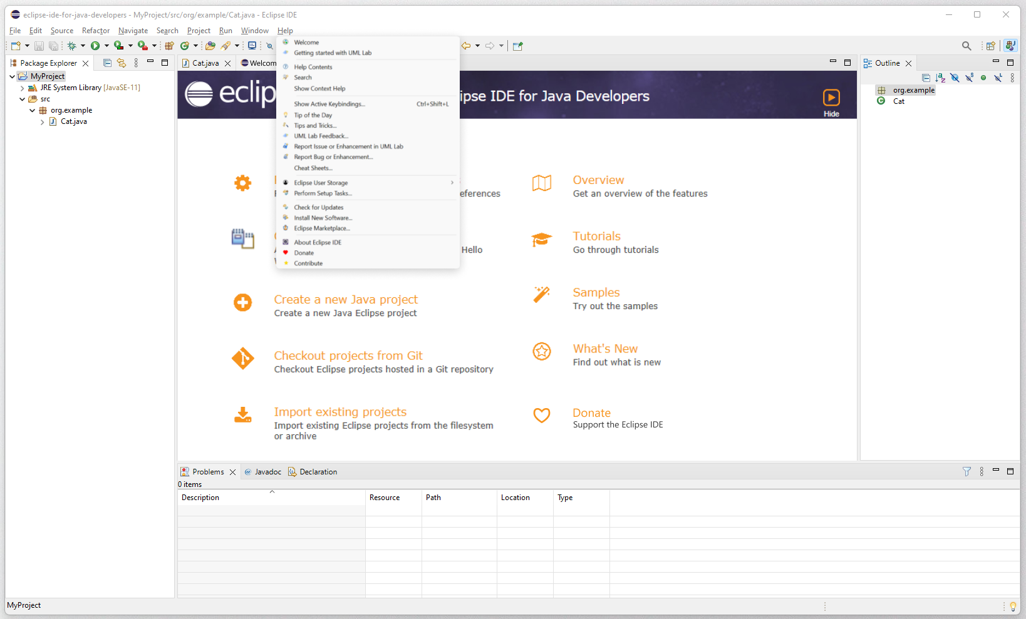
Eclipse IDE
in-app
“Welcome screen”
draft

Slide 10
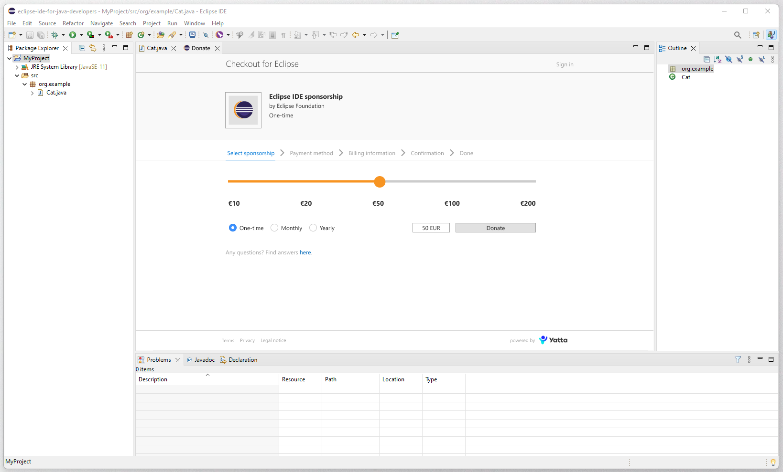
In-app
Checkout “Select sponsorship”
draft

Slide 11
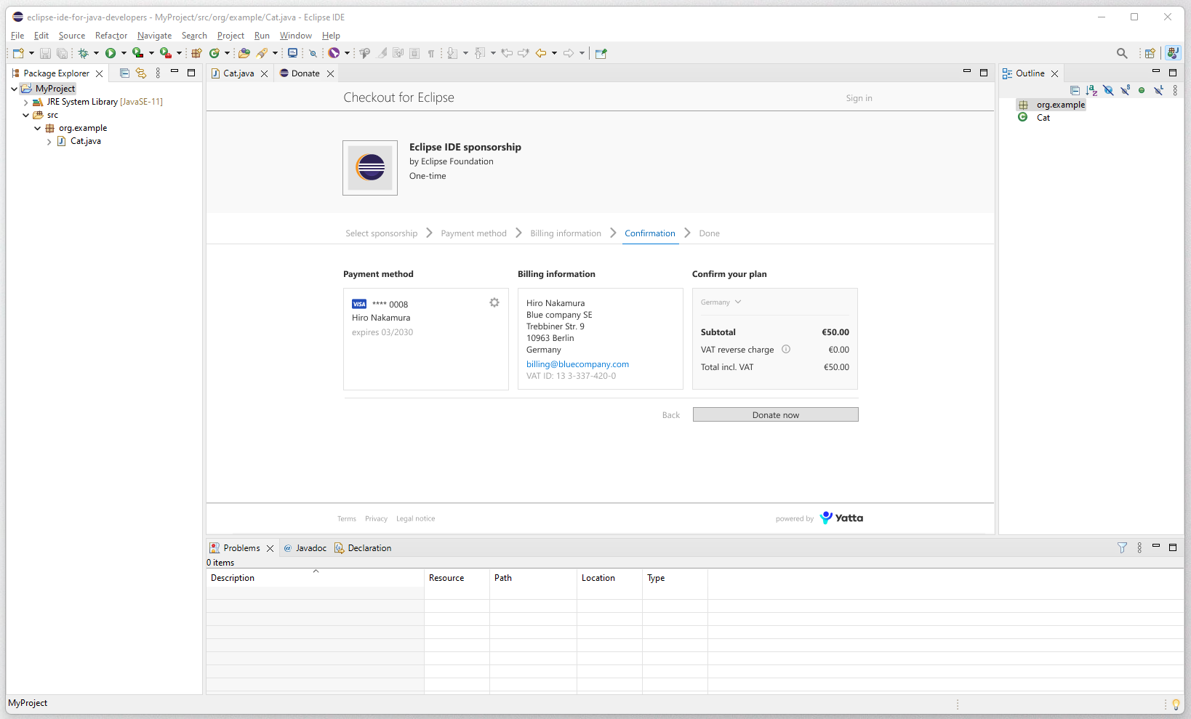
In-app Checkout “Donate now”
draft

Slide 12
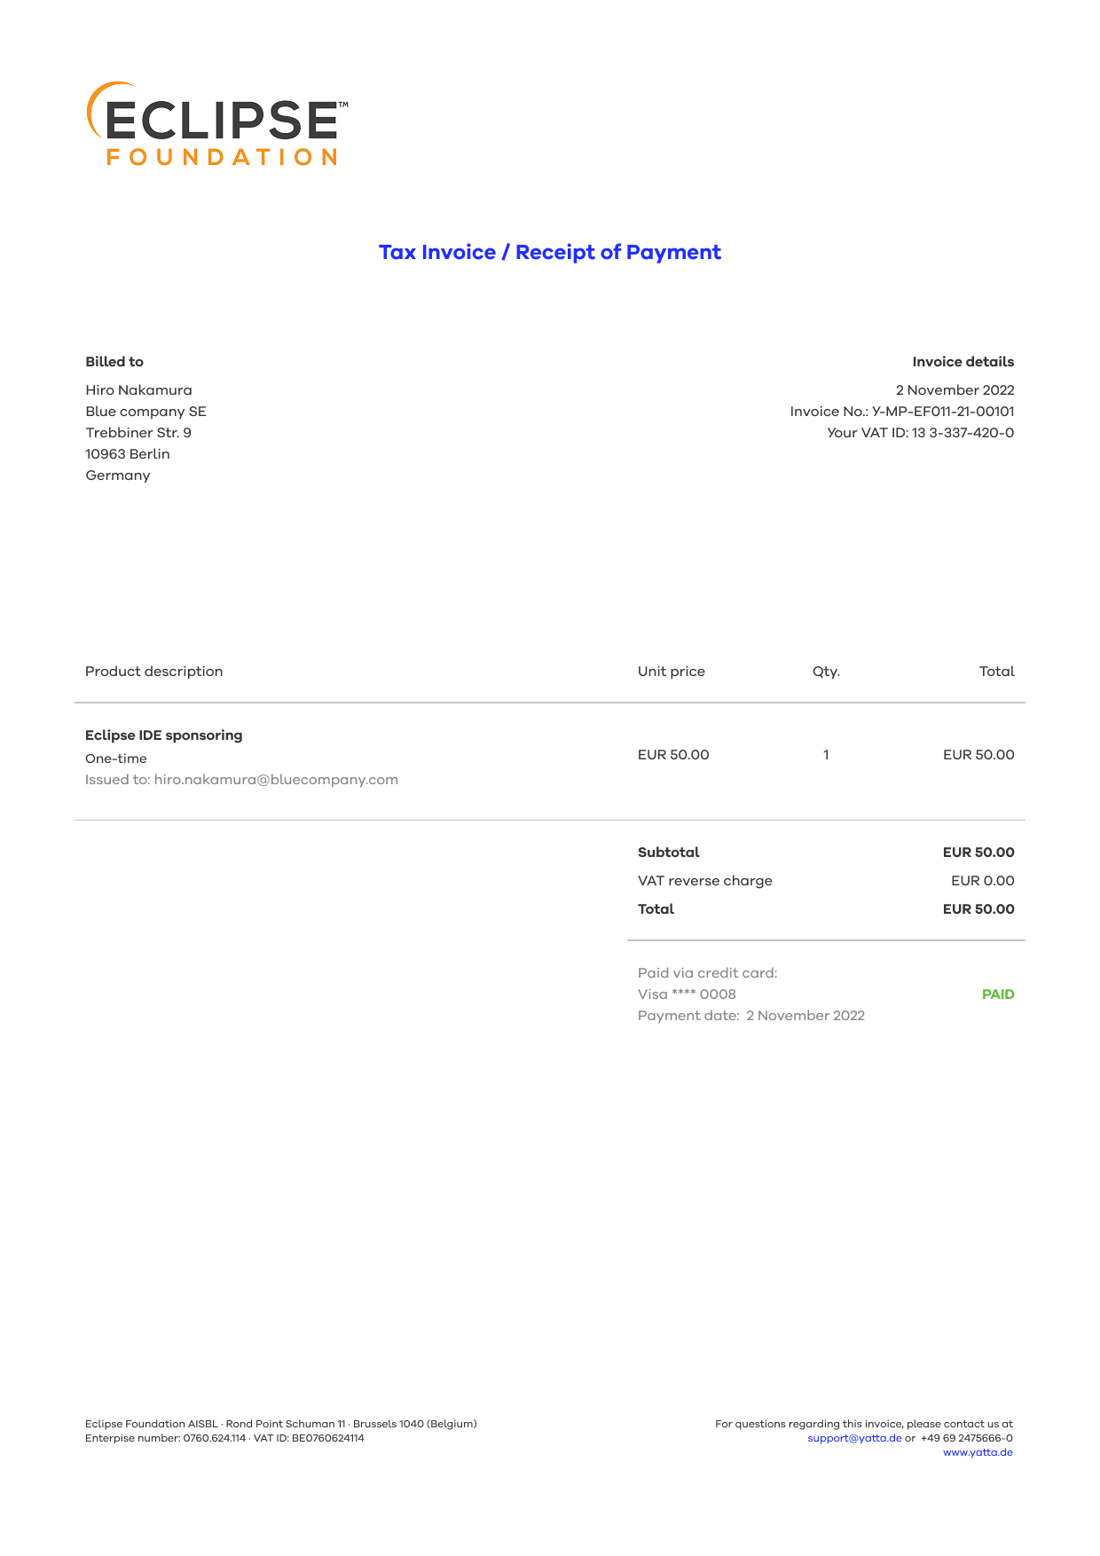
Automated invoicing
Sample invoice
draft

Slide 13
Yatta Checkout benefits
Increasing conversion rates from user to donor
Eclipse in-app donations achieve higher conversion rates than redirecting donors to the web
Major currencies for payments (including Euro, Yen, GBP and US$) allow a majority of users to choose their local currency
Donors can choose among additional payment methods—for one-time or recurring payments
Tapping additional sources of funding
Corporate Sponsorships (requiring tax invoices) are enabled—and processed fully automatically
Additional payment options and features for corporations will be added by Yatta without further costs for Eclipse
→ The goal is to at least double the amount of Eclipse Sponsorings within a year

Slide 14
ECLIPSE IDE Working Group
Members
‹#›

