Slide 1
COSMOS 1.1 Release Review
Draft – September 9, 2009
Eclipse Technology PMC

Slide 2
COSMOS 1.1 Features
Data Collection
  Framework for implementing CMDBf query and registration services
  Web service request interfaces and examples provided for building management data repositories (MDRs) for CMDBf support
Data Reporting/Visualization
  Presentation of reports to visualize systems management data
  Web-based viewer composed of Web 2.0 gadgets to thoroughly query and examine data from an MDR, using query builder driven by CMDBf metadata
  Extension points to create complementary visualizations in the form of Web 2.0 gadgets and BIRT reports
Resource Modeling
  Support for SML and SML-IF standards, version 1.1, including SML and SML-IF document validation, SML-IF editing, Import/Export of SML-IF documents
  A reconciliation taxonomy for mapping/describing federated data

Slide 3
COSMOS 1.1 Features
Management Enablement
  Support for SDD 1.0 standard (conformance level 1)
  SDD tools
    RPM and SDD readers
    Build time generator to create SDDs
    Aggregator to create composite SDDs
  SDD runtime
    Orchestrator
    Operation handlers
    Resource handlers
    Command line interface to gather user parameters
  Eclipse-integrated toolkit for creating data managers and MDRs

Slide 4
Non-code Aspects
User Documentation
  Web-based User Guide
  Web-based Installation Guide
  Integrated Help-in-Context
  Demo
Developer Documentation
  Web-based Developer Guide
Localization/Internationalization
  No widespread adoption by non-English countries; translation will be examined for future release although the code will be externalized

Slide 5
APIs
The following APIs are extended in V1.1 (or will be extended) by adopters:
  Subset of CMDBf, adopter:
The following APIs are provisional in V1.1:
  SML, adopter: IBM
  SDD, adopters: IBM, CA and SAS

Slide 6
Architectural Issues
There are future scalability changes that have been proposed.
The current framework has not been optimized for scalability.
The server cannot report the language and nationality of the client. The team has requested changes in the CMDBf specification.
The work in the SDD runtime needs to be reconciled and aligned with P2.

Slide 7
Tool Usability
COSMOS targets developers who want to merge their existing data store into the CMDBf ecosystem.
  Tools to build MDRs from scratch
  Eclipse-integrated toolkit for creating data managers and MDRs
  Framework to plug in your existing data store into the CMDBf ecosystem with minimal effort
  Tools to test MDRs for use in a CMDBf architecture
COSMOS enables developers who have merged their data store into the CMDBf ecosystem to share information:
  View and query MDR content via a web based UI
  Register a MDR with the COSMOS framework or a federatingCMDB using the COSMOS UI
  Present reports to visualize event and statistical data

Slide 8
Tool Usability
COSMOS targets deployment architects responsible for deployment and maintenance of software assets.
Tooling allows deployment architects to create SDDs from scratch or through generating SDDs from existing software assets such as RPM packages.
SDD runtime allows for processing of instructions defined in SDDs.
  Consists of a core orchestrator bundle and additional bundles for gathering user input, resource resolution and operation execution.

Slide 9
End-of-Life
Version 1.1 will be supported until September 2010, at which time adopters will be asked to move to a later version of COSMOS

Slide 10
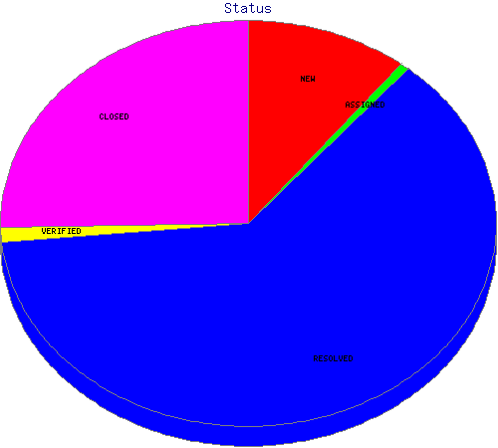
Bugzilla
Notes:
-- take the action to put the chart in here
This data was pulled from bugzilla on May 29, 2008. Of these bugzillas, 304 were or are enhancements.
NEW 254
ASSIGNED 24
REOPENED 3
RESOLVED 245
VERIFIED 70
CLOSED 449
Total 1045

Slide 11
Supported Standards
SML 1.1
CMDBf 1.0b
SDD 1.0

Slide 12
UI Usability
Accessibility
  No review for this release, but following accessibility guidelines
  http://www.eclipse.org/articles/Article-Accessibility/index.html
Follow the User Interface Guidelines
  Focus on consistent visual design, UI elements, icons
  http://wiki.eclipse.org/index.php/User_Interface_Guidelines

Slide 13
Schedule
Milestone | Date
M1 | April 17, 2009
V1.1 | September 23, 2009

Slide 14
Process
Open, transparent, permeable, and inclusive
  All discussions in Bugzilla, mailing list, newsgroup, and open developer conference calls
  Bugs resolved via committer work or patches from contributors
  Increased download activity for milestones

Slide 15
Process: Committers and Activities
9 active committers from 3 companies
  Committer elections and removals have followed charter principles
  Continuing to recruit additional contributors (organizations and individuals)
Open communications via COSMOS dev mailing list
  Not much newsgroup activity – looking to improve
  Plans available:
    i7: http://wiki.eclipse.org/COSMOS_1.1_Iteration7_Features
Meetings, meeting, meetings – numerous, open, and documented
  Weekly Community and Architecture meetings
  Architecture call minutes available on website: http://wiki.eclipse.org/COSMOS_Architecture_Meetings
Open and inclusive release planning and tracking processes
  Bugzilla used to request and track all defects and enhancements
  Additional reports (defect summaries, test stats, etc.) used to enhance planning / tracking
All contributions made directly to Eclipse CVS
  Nightly, weekly integration builds, and release builds available to the community
Coordination/cooperation with other Eclipse projects
  Equinox
Leveraging other open source technologies in the project

Slide 16
Process: Community
Moderate download activity for milestones and releases
Website content
  Download links, New & Noteworthy, mailing lists, presentation DB
  Tutorials, documentation, presentation summary,
  “people pages”
Evangelism and outreach in the market & broader community
  Multiple commercial implementations
  Planned attendance at EclipseCon 2010
  Engagement of other vendors and community customers
  COSMOS blog
  COSMOS newsgroup
Notes:
Put the blog and newsgroup links on this slide

Slide 17
Intellectual Property
IP log for COSMOS
  http://www.eclipse.org/projects/ip_log.php?projectid=technology.cosmos

