Slide 1
Che Knowledge Transfer:
Namespaces operations

Slide 2
Che Namespace Operations
Che Knowledge Transfer - Namespaces provisioning
Provisioning of Che workspaces consists of the following operations:
Getting the list of the available namespaces to provision Che workspace into it (optional)
First stage of provision done by Che server
Second stage of provision done by Che operator

Slide 3
Getting available Namespaces list
Che Knowledge Transfer - Namespaces provisioning
Available namespaces list endpoint is GET on /api/kubernetes/namespace
Getting the list of the available namespaces depends on the user's data and the Che server's configuration, which will be described below.
At first, server tries to find all namespaces which are satisfy both conditions:
1) Labeled by specific label(s), configured as CHE_INFRA_KUBERNETES_NAMESPACE_LABELS property value as a comma-separated list of labels.
2) Containing an annotation which value is a resolved value of the template, which is stored under CHE_INFRA_KUBERNETES_NAMESPACE_ANNOTATIONS property value. This template can contain two placeholders to hold either User name (<username> placeholder) or User Id (<userid> placeholder)
If there is matched namespaces, they’re returned back to the requester, who is, typically, Che Dashboard. Otherwise,

Slide 4
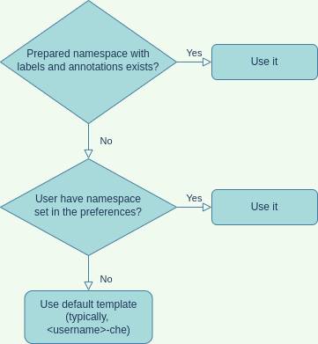
Getting available Namespaces list
Che Knowledge Transfer - Namespaces provisioning
if there are no properly labeled namespaces, we’re fallback to the default evaluation - trying at first to look for the namespace name in the user preferences. That’s made to ensure that existing user’s workspaces would be available even after configuration changes. Finally, if there is also none, we’re going to construct namespace name from the default naming template, which is stored under CHE_INFRA_KUBERNETES_NAMESPACE_DEFAULT property value, and can contain the same <username> and <userid> placeholders. That namespace may or may not exist at this moment, so we’re just returning it’s simple representation in the latter case, and add mark that is is the default namespace, and it will be created at workspace startup time.

Slide 5
First stage of provision by Che server
Che Knowledge Transfer - Namespaces provisioning
When the actual namespace provisioning process begins, its first part does namespace identification - and it is almost exact copy of the namespace finding process described above. After the correct namespace name is evaluated, a check of existence of the given namespace is performed. If namespace does not exist, it can be created, but only if such creation is allowed by CHE_INFRA_KUBERNETES_NAMESPACE_CREATION__ALLOWED property.
In case the namespace does not exists and that property disallows it’s creation, error will be thrown.
Let’s assume that namespace is exists or was allowed to create, after that it should be properly labeled and annotated. The boolean properties, which controls permissions to label and annotate the newly created namespaces are CHE_INFRA_KUBERNETES_NAMESPACE_LABEL and CHE_INFRA_KUBERNETES_NAMESPACE_ANNOTATE. The values to set are read from their respective pairs CHE_INFRA_KUBERNETES_NAMESPACE_LABELS and
CHE_INFRA_KUBERNETES_NAMESPACE_ANNOTATIONS.

Slide 6
First stage of provision by Che server
Che Knowledge Transfer - Namespaces provisioning
The final step of the provisioning process is a namespace configurators. There is a common interface NamespaceConfigurator and some good number of common and infrastructure-specific implementations of it. They configure service account, SSH keys, permission, preferences etc. So all registered instances are executed one-by-one there.

Slide 7
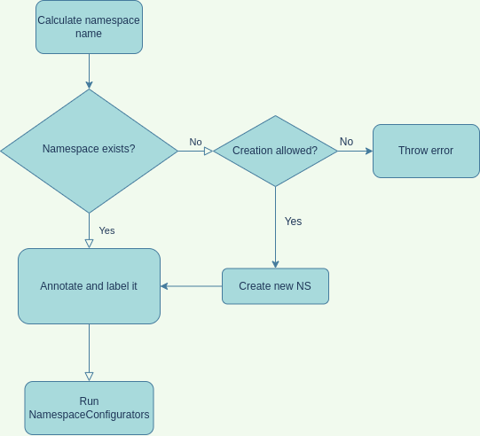
First stage of provision by Che server
Che Knowledge Transfer - Namespaces provisioning
Provisioning
process diagram

Slide 8
Second stage of provision by Che operator
Che Knowledge Transfer - Namespaces provisioning
Che operator performs the following steps for namespace provisioning:
Provision of self-signed and trusted certificates;
Provision of proxy settings;
Provision of Git TLS certificate;
Setting up node selector and tolerations;
Provision of self-signed and trusted certificates is basically a process of copying certificate data from the "self-signed-certificate" and "che-tls" secrets in the Che cluster namespace ( ) into the secret in user namespace with corresponding annotations and labels. Target secrets are named "che-server-cert" and "che-trusted-ca-certs", respectively. Their values will be mount after workspace startup as a files at the specified paths.
Provision of proxy settings consists of reading them either from Cluster-wide proxy settings (on Openshift 4) or from CheCluster CR instance configuration. Settings are typically put into ConfigMap named "che-proxy-settings" with the HTTP_PROXY, HTTPS_PROXY and NO_PROXY fields set if they’re present in the source.

Slide 9
Second stage of provision by Che operator
Che Knowledge Transfer - Namespaces provisioning
Git certificates are provisioned by copying them from the "che-git-self-signed-cert" ConfigMap in the Che cluster namespace into a "che-git-tls-certs" ConfigMap user namespace with adding corresponding labels and some key names remap: “githost” field mapped into “host” as well as “ca.crt” field is mapped into “certificate”.
Finally, node selector and tolerations provisioning is a process of copying the values from CheCluster instance configuration into specific annotations of the user namespace.

Slide 10
The end
Author: Max Shaposhnyk (mshaposh@redhat.com)

