Slide 1
Home
About
Getting Started
Demos
Documentation
Community

Slide 2
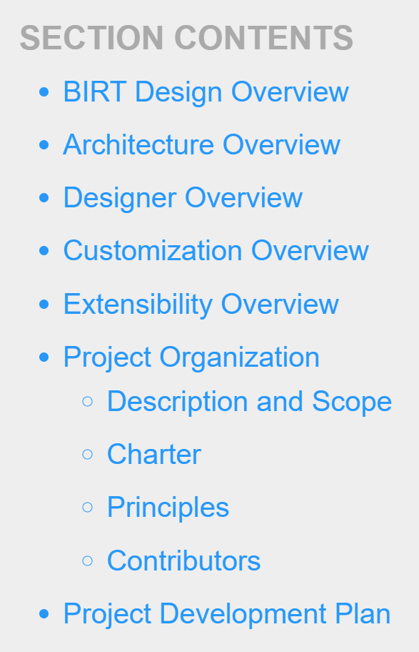
Home
About
Getting Started
Demos
Documentation
Community

Slide 3
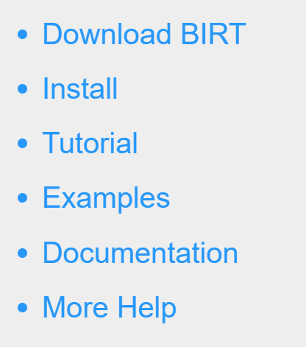
Home
About
Getting Started
Demos
Documentation
Community

Slide 4
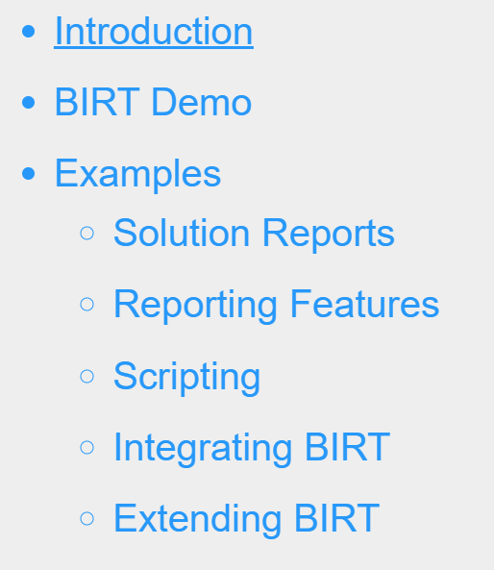
Home
About
Getting Started
Demos
Documentation
Community

Slide 5
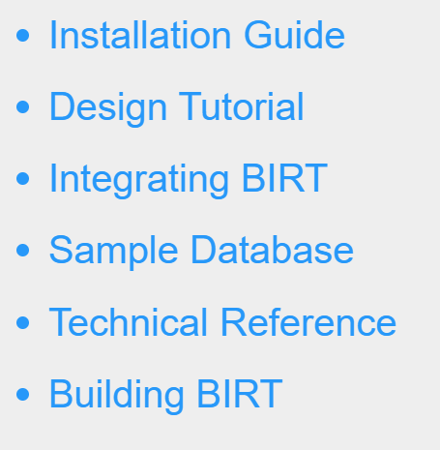
Home
About
Getting Started
Demos
Documentation
Community

Slide 6
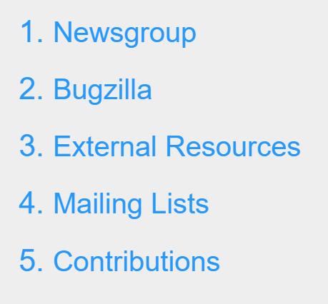
Home
About
Getting Started
Demos
Documentation
Community

